Slide 1
CS2911
Week 6, Class 1
Today
  Map (dict) objects in Python
  Email Protocols
Notes:
17q1 6-1 1,3,5,6,7,11-16
18q1 6-1 1-4,6-11,13-14

Slide 2
Email
[Sending email example]
Notes:
Example of sending email
Overview of protocols
Lab 8 (SMTP) topic – SMTP

Slide 3
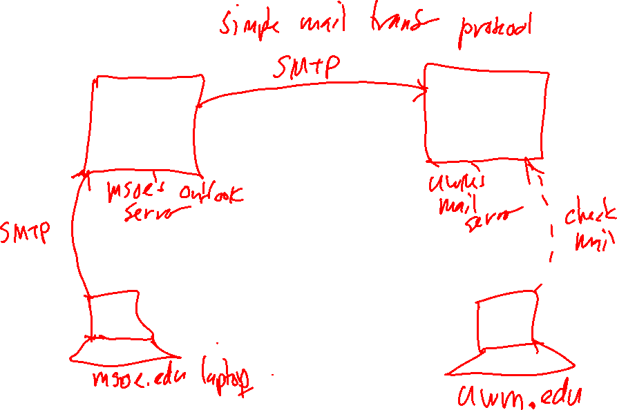
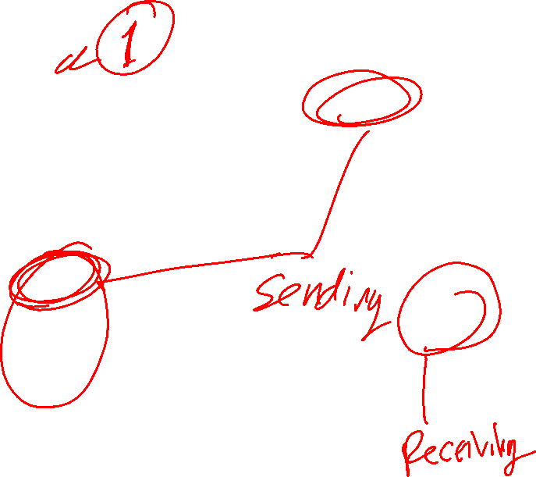
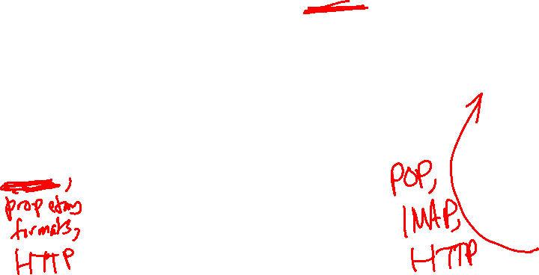

Slide 4
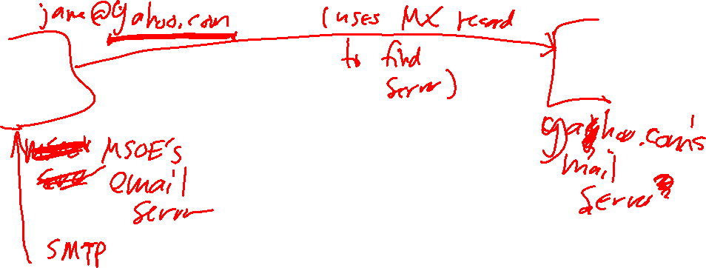
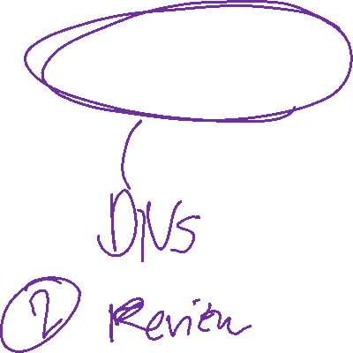

Slide 5
Why SMTP?
https://en.wikipedia.org/wiki/Simple_Mail_Transfer_Protocol
“Proprietary systems such as Microsoft Exchange and IBM Notes and webmail systems such as Outlook.com, Gmail and Yahoo! Mail may use non-standard protocols internally, but all use SMTP when sending to or receiving email from outside their own systems.” retrieved 18 Oct 2019
Notes:
Also, it is an example of a different application-layer conversation style

Slide 6
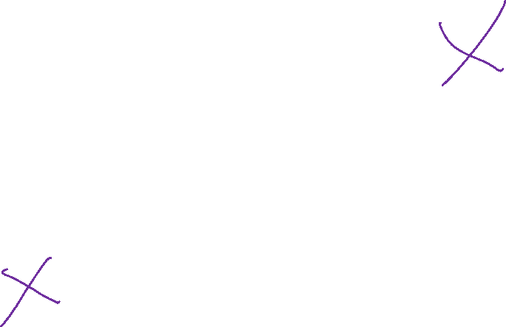
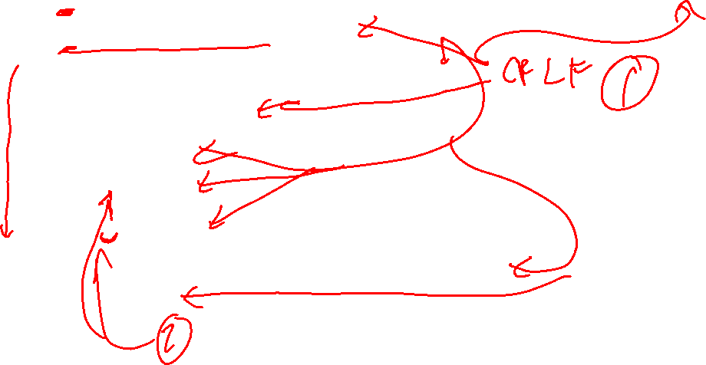
Unencrypted SMTP without Authentication
S: 220 aol.com Simple Mail Transfer Service Ready
C: EHLO msoe.edu
S: 250-aol.com greets msoe.edu
S: 250-8BITMIME
S: 250-SIZE
S: 250-DSN
S: 250 HELP
C: MAIL FROM: <smith@msoe.edu>
S: 250 OK
Notes:
S:<space> and C:<space> not actually sent

Slide 7
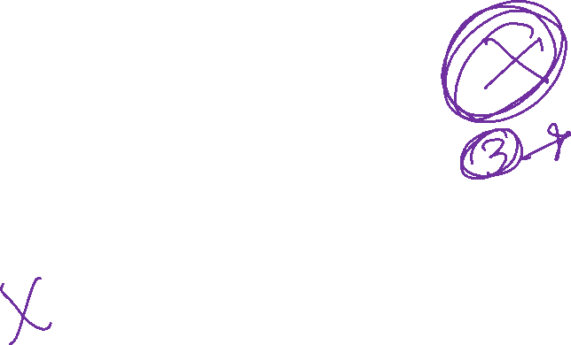
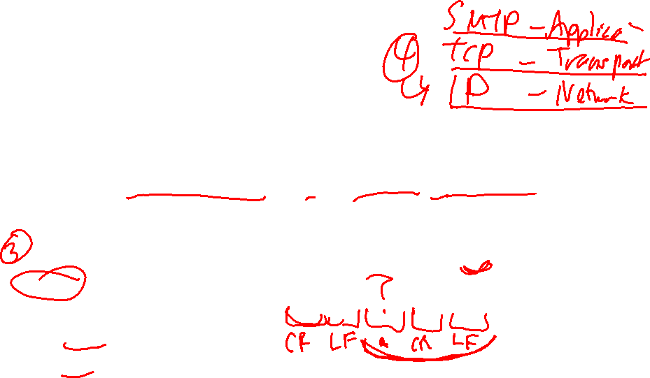
Unencrypted SMTP without Authentication (cont.)
C: RCPT TO: <jones@aol.com>
S: 250 OK
C: RCPT TO: <frank@aol.com>
S: 550 No such user here
C: DATA
S: 354 Start email input; end with <CRLF>.<CRLF>
C: Here's my message
C: It's a long one
C: Now I'm done. But does the server know it?
C: .
S: 250 OK
C: QUIT
S: 221 aol.com Service closing transmission channel

Slide 8
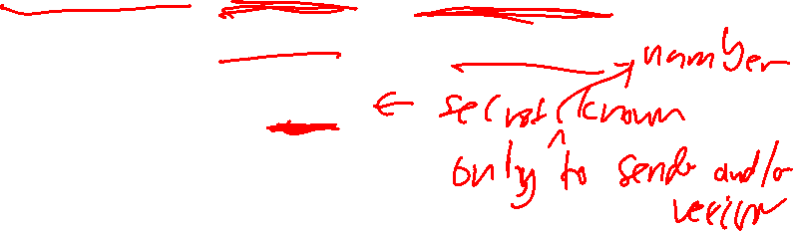
Looking Forward
Cryptography Videos: (From Week 7)
  Cryptography in network protocols
  Public key cryptography
  Modular arithmetic
  RSA encryption
Encryption: Plaintext -> Ciphertext
Decryption: Ciphertext -> Plaintext
Both require a "key"

Slide 9

SMTP with STARTTLS and AUTH LOGIN (1)
S: 220 aol.com ESMTP MAIL Service ready …
C: EHLO msoe.edu
S: 250-aol.com Hello [10.10.10.10]
S: 250-PIPELINING
S: 250-DSN
S: 250-ENHANCEDSTATUSCODES
S: 250-STARTTLS
S: 250-8BITMIME
S: 250 CHUNKING

Slide 10

SMTP with STARTTLS and AUTH LOGIN (2)
(continued from previous slide)
C: STARTTLS
S: 220 2.0.0 SMTP server ready
---- Everything beyond this point is sent encrypted ----
C: EHLO msoe.edu
S: 250-aol.com Hello [10.10.10.10]
S: 250-PIPELINING
S: 250-DSN
S: 250-ENHANCEDSTATUSCODES
S: 250-AUTH LOGIN
S: 250-8BITMIME
S: 250 CHUNKING
Notes:
(continued from previous slide)
added during demo time 18q1

Slide 11
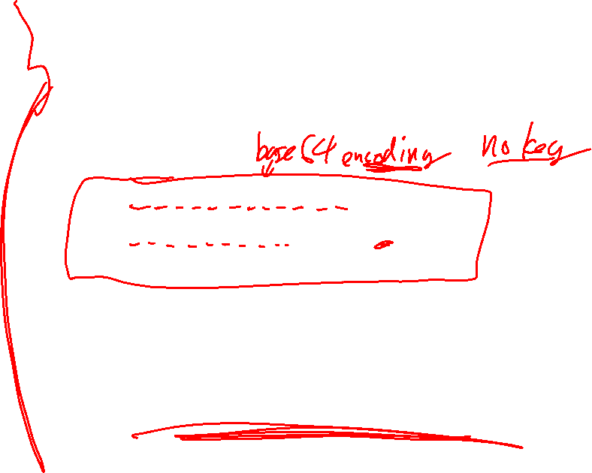
SMTP with STARTTLS with AUTH LOGIN (3)
"Username:"
(continued from previous slide)
C: AUTH LOGIN
S: 334 VXN1cm5hbWU6
C: c3R1ZGVudEBtc291LmVkdQ==
S: 334 UGFzc3dvcmQ6
C: bW9ua2V5
S: 235 2.7.0 Authentication successful
C: MAIL FROM: <student@msoe.edu>
… (The rest is the same as unencrypted)
"student@msoe.edu"
"Password:"
"monkey"
Notes:
(continued from previous slide)
added during demo time 18q1

Slide 12
Base64 encoding
https://tools.ietf.org/html/rfc4648#section-4
Use the base64 package, already imported in the lab template.
Use RFC 4648 base-64 encoding, as specified in the latest AUTH LOGIN RFC, RFC 4954.
Notes:
This is the same as the base-64 encoding defined in RFC 3548, the earlier version of RFC 4648.

Slide 13
Sending/Receiving
Encrypted Data in Python
context = ssl.create_default_context()
wrapped_socket =
context.wrap_socket(old_socket,
server_hostname=SMTP_SERVER)

Slide 14
Sending/Receiving
Encrypted Data in Python
Some errors if you accidentally receive/send raw/encrypted text when you should send the other:
ssl.SSLZeroReturnError: TLS/SSL connection has been closed (EOF) (_ssl.c:590)
ssl.SSLError: [SSL: UNKNOWN_PROTOCOL] unknown protocol (_ssl.c:590)
ssl.SSLError: [SSL: WRONG_VERSION_NUMBER] wrong version number (_ssl.c:590)

Slide 15
Sending/Receiving
Encrypted Data in Python
Some errors if you use the wrong protocol (which is hard to do with our sample code)
ssl.SSLZeroReturnError: TLS/SSL connection has been closed (EOF) (_ssl.c:590)
ssl.SSLEOFError: EOF occurred in violation of protocol (_ssl.c:590)

Slide 16
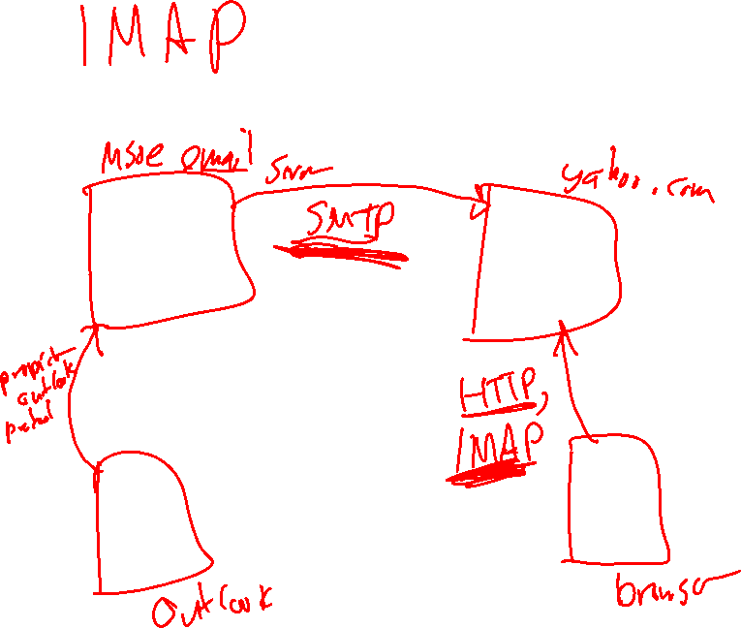

Slide 17
Outcomes
Describe the operation of the IMAP protocol at a high level
Describe the basic format of Internet Messages (email)
Describe how character sets are encoded in in internet messages
Program an email interface in Python

Slide 18
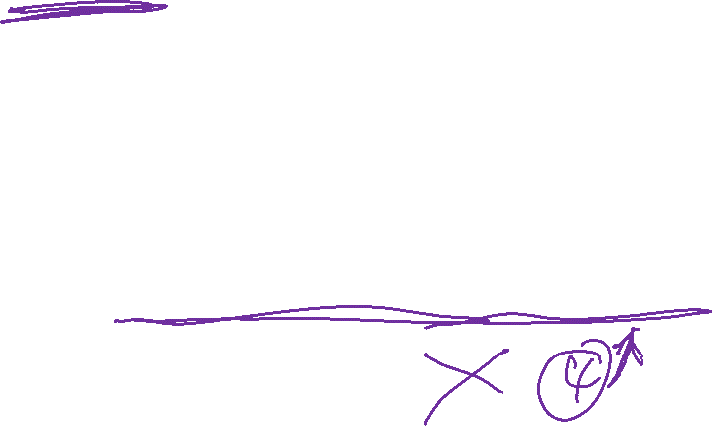
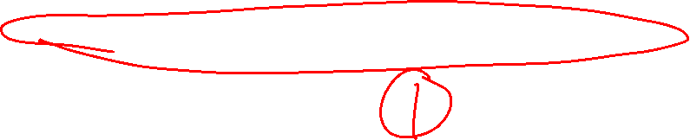
IMAP
Hierarchy of folders
Selective listing, fetching, and searching
  Even selective download of part of a message
Uploading, copying, and deleting messages
Simultaneous access by multiple clients
But not …

Slide 19
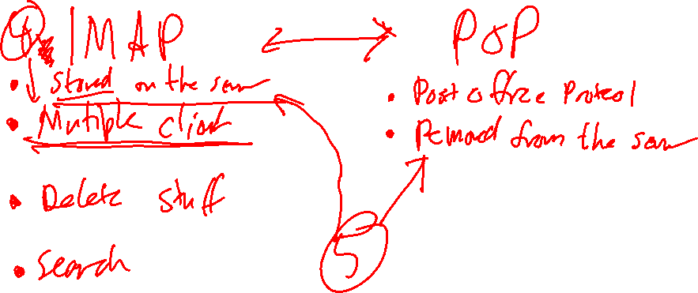


Slide 20
Some warranty laws suggest that mail stored more than (e.g.) 60 or 90 days can be searched without a warrant, assuming it has been opened.

Slide 21
IMAP
Client may make
  multiple requests
  additional requests while waiting for a response
Server may
  reply in a different order than client requested
  interleave two responses
  send unsolicited data

Slide 22
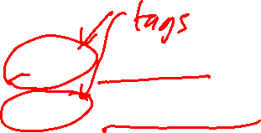
IMAP message format
C: A341 CLOSE
S: A341 OK CLOSE completed

Slide 23

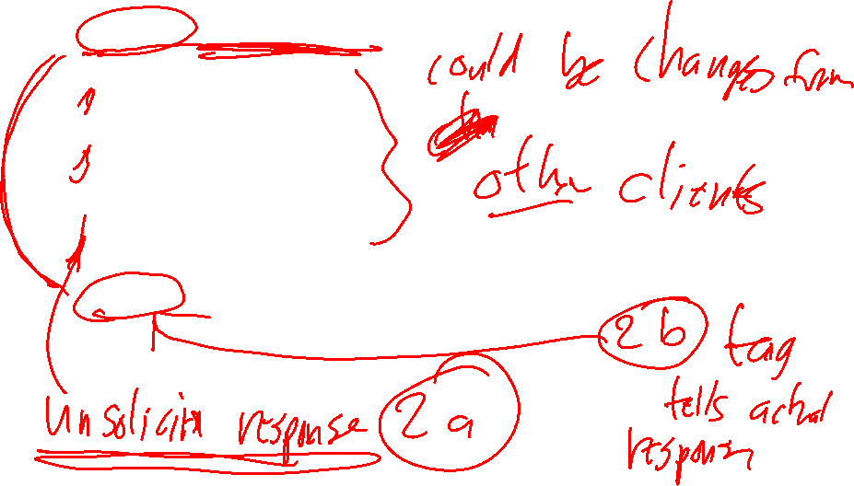
IMAP message format
C: A202 EXPUNGE
S: * 3 EXPUNGE
S: * 3 EXPUNGE
S: * 5 EXPUNGE
S: * 8 EXPUNGE
S: A202 OK EXPUNGE completed

Slide 24

IMAP message format
C: A003 APPEND saved-messages (\Seen) {310}
S: + Ready for literal data
C: Date: Mon, 7 Feb 1994 21:52:25 -0800 (PST)
C: From: Fred Foobar <foobar@Blurdybloop.COM>
C: Subject: afternoon meeting
C: To: mooch@owatagu.siam.edu
C: Message-Id: <B27397-0100000@Blurdybloop.COM>
C: MIME-Version: 1.0
C: Content-Type: TEXT/PLAIN; CHARSET=US-ASCII
C:
C: Hello Joe, do you think we can meet at 3:30 tomorrow?
C:
S: A003 OK APPEND completed

Slide 25
SMTP Security
 | SMTP STARTTLS | SMTP over SSL/TLS
RFC | 3207 | (no standard needed)
Port | 587 | 465
Security | Plain-text IMAP port with ability to switch to TLS | Dedicated port for SMTP wrapped in TLS
More info: https://www.fastmail.com/help/technical/ssltlsstarttls.html
Notes:
17q1 corrected after class

Slide 26
IMAP Security
 | IMAP over SSL/TLS | IMAP STARTTLS
RFC | (no standard needed) | RFC 2595, RFC 4616
Port | 993 | 143
Security | Dedicated port for IMAP wrapped in TLS | Plain-text IMAP port with ability to switch to TLS

Slide 27
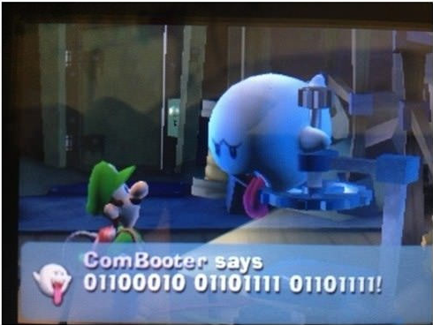
Student-provided
Question and Humor
Fall 2016 6-3
What text is sent in base-64? What text is sent encrypted? | Lab 7
"Silly Nintendo"

Slide 28
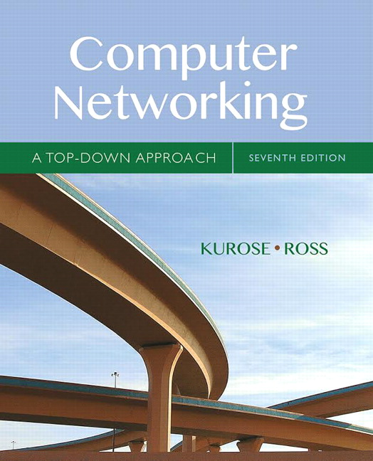
Acknowledgement
This course is based on the text
Computer Networking: A Top Down Approach
7th edition
Jim Kurose, Keith Ross
Addison-Wesley

