Slide 1
CS2911 – Network Protocols
Converting Decimal to Binary
Dr. Yoder
Binary Numbers

Slide 2
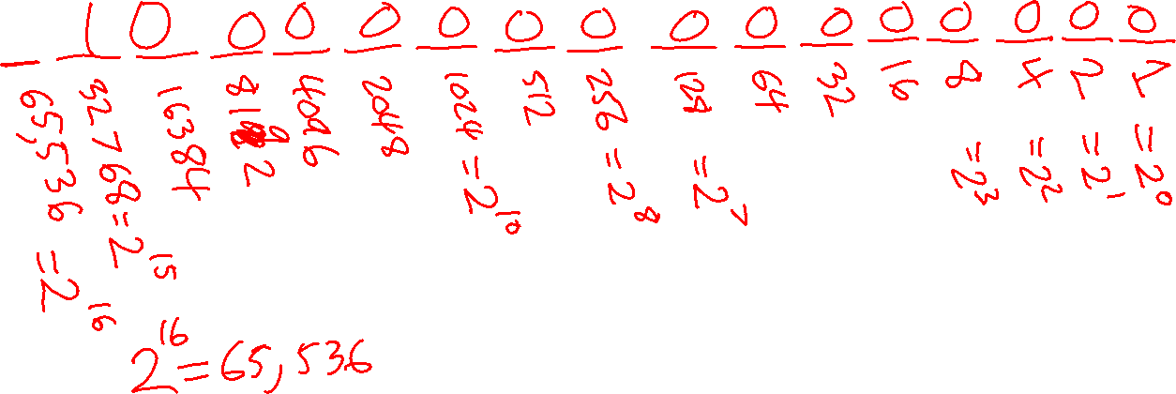
Binary –> Decimal Conversion

Slide 3
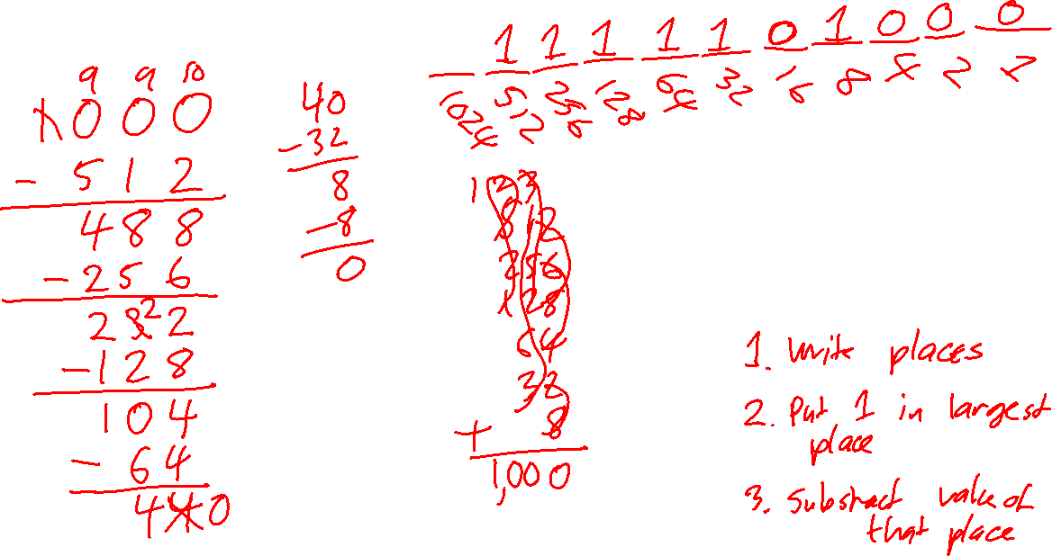
Decimal -> Binary
Conversion

