Slide 1
CS2911 Cryptography Tips
Exclusive-Or and High Powers of Two
Dr. Josiah Yoder
Milwaukee School of Engineering

Slide 2
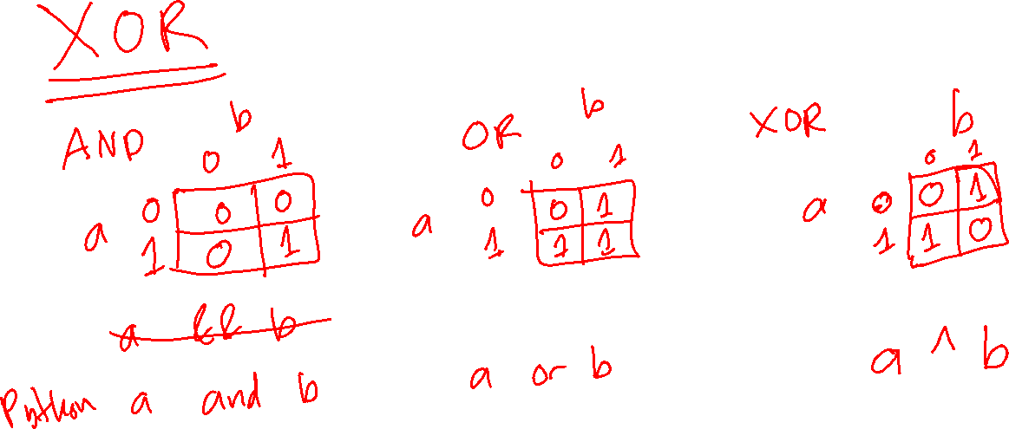

Slide 3
