Slide 1
CS2911
TCP Implementation
Today
  TCP
  Credit: Many slides in this deck by Dr. Rothe and the authors of our textbook
Notes:
18q1
19q1: 1-4,7-8,10,11,12-13,16,19

Slide 2
Outcomes
Be familiar with the layout of the TCP header
Describe the purpose of the following TCP header fields:
  Source Port, Dest Port,
  Sequence number, Acknowledgement number
  Receive window
  Checksum
Calculate sequence and acknowledgement numbers
Describe the behavior of the 3-way handshake

Slide 3
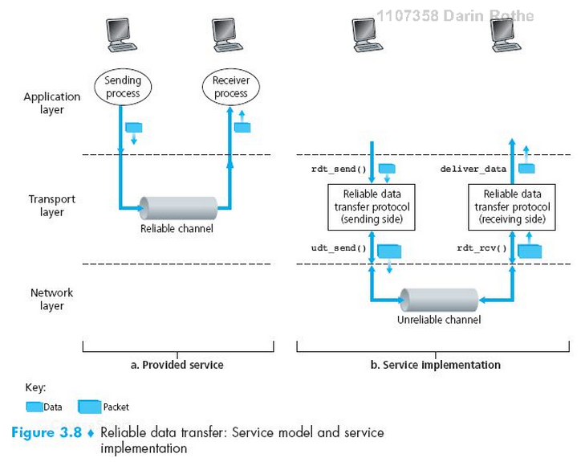
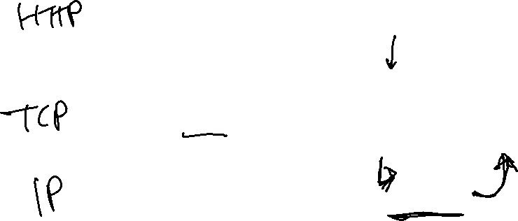
TCP as a Reliable Transport

Slide 4
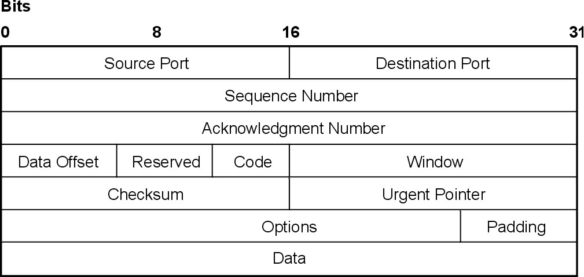
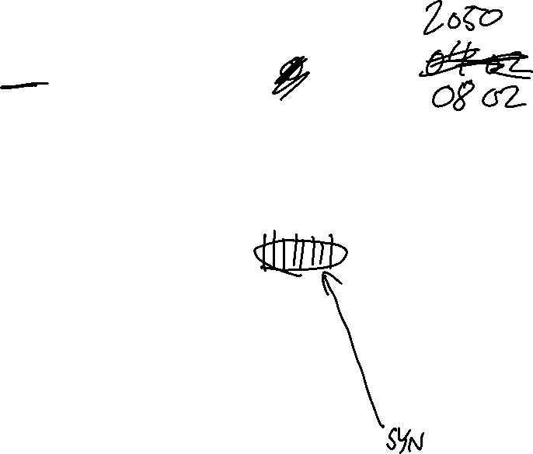
TCP Header format
http://ps-2.kev009.com/wisclibrary/aix51/usr/share/man/info/en_US/a_doc_lib/aixbman/commadmn/tcp_protocols.htm

Slide 5
Formatting of Field Values
Like UDP, all fields are stored in raw binary in a big-endian order (most significant byte first)

Slide 6
How things can go wrong…
Corrupted packets
Lost packets
Reordered packets
…Malicious packets…
Notes:
In these slides, we do not consider security issues – only the basics to overcome unintentional network errors

Slide 7
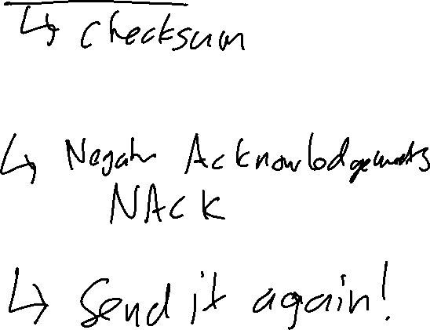
Strategies for Reliability
Error Detection
Receiver Feedback
Retransmission

Slide 8

Strategies for Reliability
Error Detection
  Checksum
Receiver Feedback
  ACK – acknowledgment
  NAK – negative acknowledgment
    (Missing ACK)
Retransmission
  Sender resends the segment requested in the NAK or which had the ACK missing

Slide 9
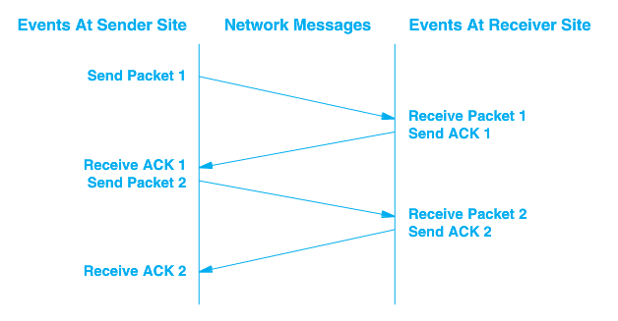
Stop and Wait
RTT –
Round
Trip
Time

Slide 10
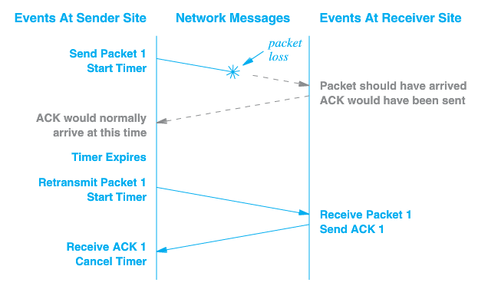
Packet Loss
Notes:
No way to send a NAK in this case

Slide 11
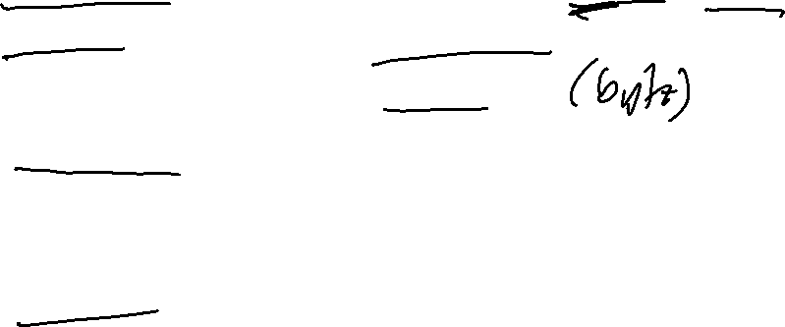
TCP Data Transfer Specifics
Data transferred as a stream of octets (bytes)
Data is transferred in segments, but acknowledged at the octet level
Full duplex – data can be transferred in either direction, or both
Both endpoints of connection must maintain buffers/windows for both sending and receiving

Slide 12
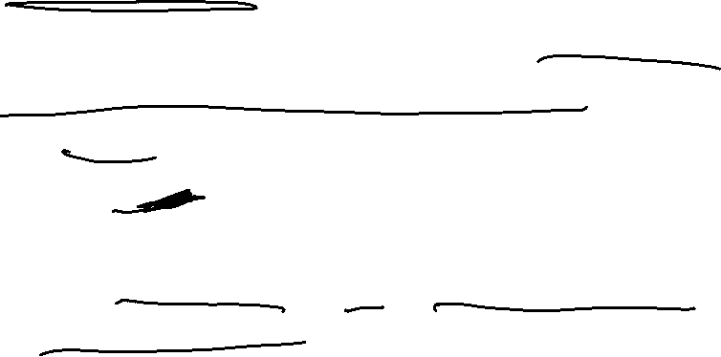
TCP sequence & acknowlegement numbers
TCP sequence numbers actually start at a random number
To establish the number, the sender sends the random first sequence number.
The receiver replies with the sequence number + 1
After this, the current sequence number is always first number + 1 + total number of bytes sent/received

Slide 13

Starting a TCP sequence
Client
Server
SYN, SEQ = 368
ACK, ACK = 369
SEQ = 369, 10 bytes data
ACK, ACK = 379
SEQ = 379, 10 bytes data
ACK = 389

Slide 14
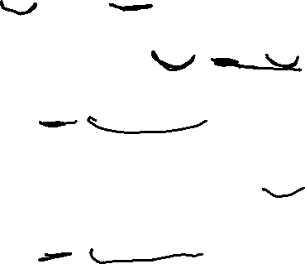
Server also can send data
Client
Server
SYN, SEQ = 824
ACK, ACK = 825
SEQ = 825, 30 bytes data
ACK, ACK = 855
SEQ = 855, 20 bytes data

Slide 15
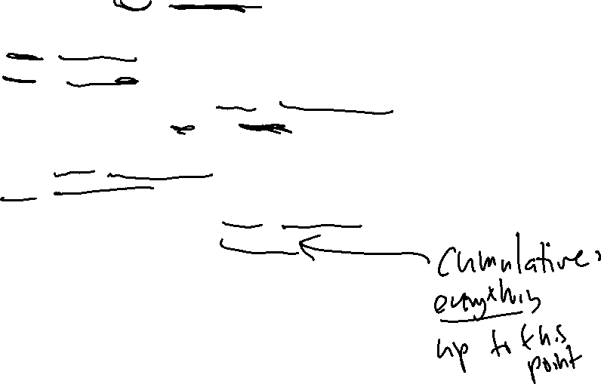
All together now…
Client
Server
SYN, SEQ = 368
ACK, ACK = 369
Three-way Handshake
SYN, SEQ = 824
SEQ = 369, 10 bytes data
ACK, ACK = 825
SEQ = 825, 30 bytes data
ACK, ACK = 379
SEQ = 379, 10 bytes data
ACK, ACK = 855
SEQ = 855, 20 bytes data
ACK = 389

Slide 16

Closing a TCP connection
Client
Server
FIN SEQ = 835
ACK = 836
FIN SEQ = 529
ACK = 530
Notes:
17q1: example sequence and acknowledgement numbers added after morning class
Note that the ACK to the FIN also counts as 1 "virtual byte"

Slide 17

Closing a TCP connection
Client
Server
FIN, SEQ = 835
ACK, ACK = 529
SEQ = 529
ACK, ACK = 836
FIN, SEQ = 529
ACK, ACK = 836
SEQ = 836
ACK, ACK = 530
Notes:
17q1: example sequence and acknowledgement numbers added after morning class
Note that the ACK to the FIN also counts as 1 "virtual byte"

Slide 18
Retransmission after timeout
Client
SYN, SEQ = 368
ACK, ACK = 369
SEQ = 369, 10 bytes data
SEQ = 369, 10 bytes data
ACK, ACK = 379

Slide 19
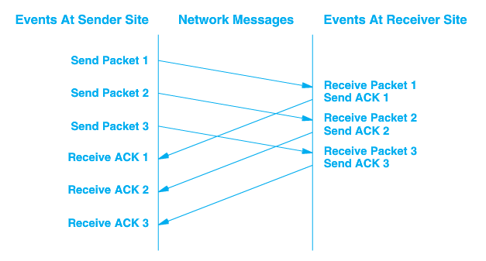
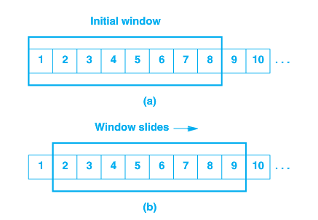
Sliding Window - Pipelined
Notes:
Just like stop and wait, the sliding window requires a buffer on either end.
But now the sender can send as many messages as will fill the buffer. This is the window.

Slide 20
Acknowledgements are cumulative
Acknowledgement of any octet implies receipt of all previous octets
Simple
Lost acknowledgements will not necessarily result in retransmission
Notes:
Skipped slide 12 (transfer specifics) and ended with this slide 18q1-wk9-2-011

Slide 21
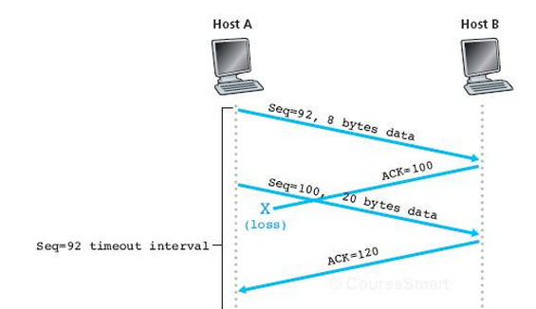
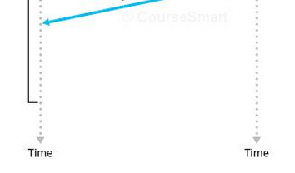
Acknowledgements are cumulative
Acknowledgement of any octet implies receipt of all previous octets

Slide 22

Acknowledgements are cumulative
Acknowledgement of any octet implies receipt of all previous octets
What if timeout ended here?

Slide 23
Sliding Window - Pipelined
Notes:
Just like stop and wait, the sliding window requires a buffer on either end.
But now the sender can send as many messages as will fill the buffer. This is the window.

Slide 24
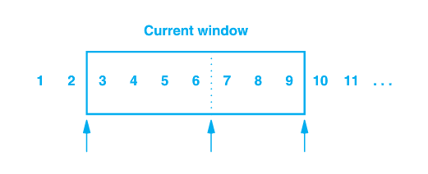

Sender’s Window
1, 2 have been sent and acknowledged
3 – 6 sent but not acknowledged
7 – 9 have not been sent but can be without delay
10 and higher will not be sent until window moves

Slide 25
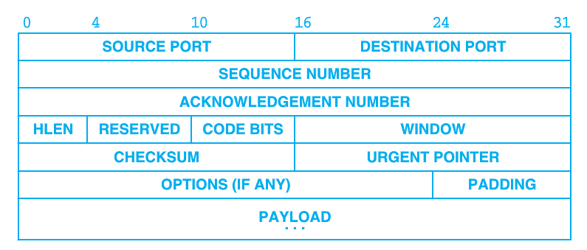

Window Advertisement
Window size can vary over time
Receiver sends a windows size with acknowledgement that indicates how many octets it is willing to accept
Allows flow control
An advertisement of 0 will halt transfer
Notes:
Receive is willing to accept as many bytes as will fit in its buffer

Slide 26
Sliding Window - Pipelined
Requires buffering on each end
Remaining space on receiver in last acknowledgement

Slide 27
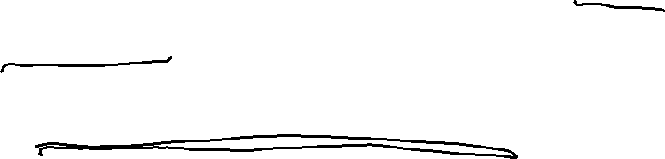
Sliding Window supports Flow Control
Won't over-fill receiver's buffer
Waits for receiving application to be ready
This is one reason to call recv even before we have gotten the whole message
Notes:
So the purpose of the flow control window is to make sure we don’t send more packets than the receiver can handle.
In your experience, do different servers operate at different speeds, or is the bottleneck somewhere else? (If somewhere else, where?)

Slide 28
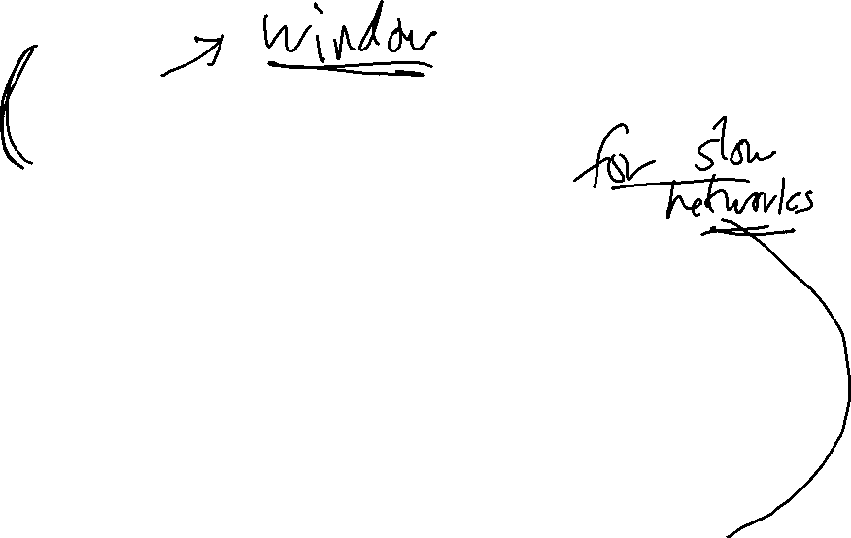
Flow vs. Congestion
Control
Flow control is a function of the receiver and its ability to accept data
Congestion control is a function of the network and its ability to carry messages
Congestion control avoids sending more data than the network can handle, resulting in collapse of the network
Notes:
Last slide for 18q1-011

Slide 29


Acknowledgement
The content of this video is based in part on lecture slides from a very good textbook, and used with the author’s permission:
Computer Networking: A Top-Down Approach, 7th edition, by Jim Kurose and Keith Ross
Publisher: Pearson, 2017

