Slide 1
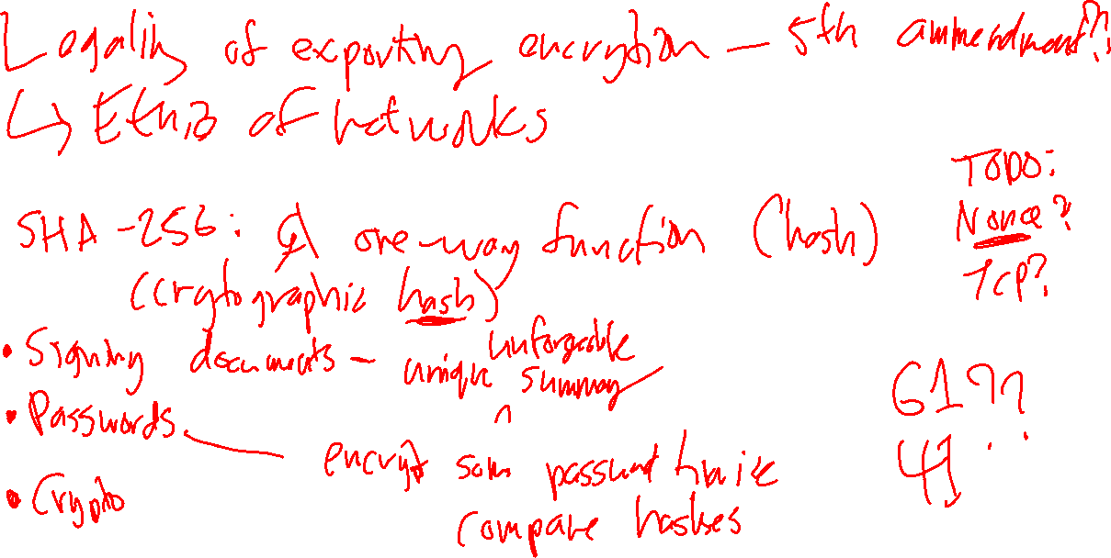
Aleph (א) Group

Slide 2
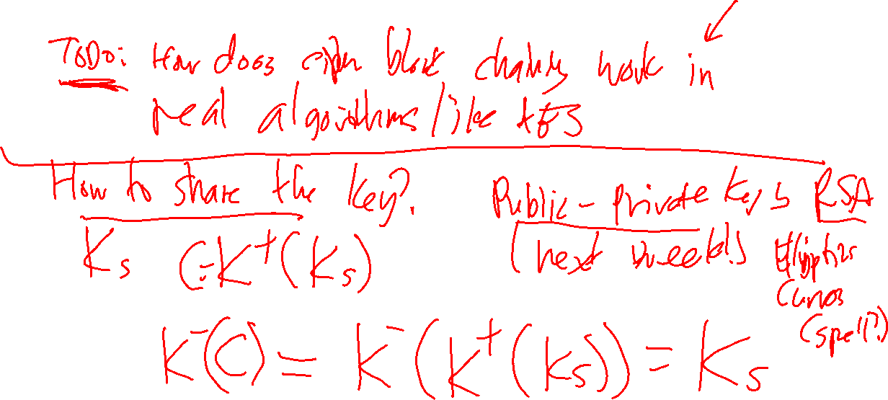
Beth (ב) Group

Slide 3
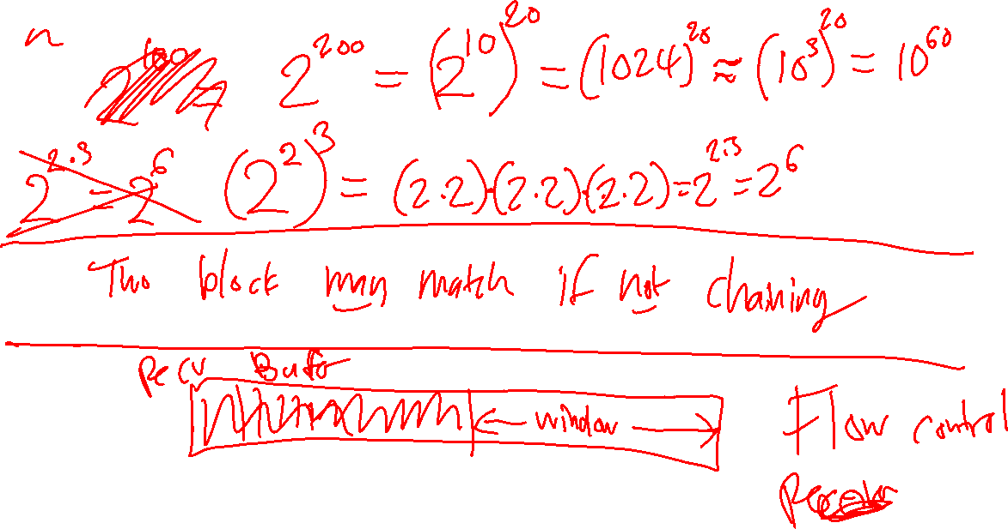
Gimel (ג) Group

Slide 4
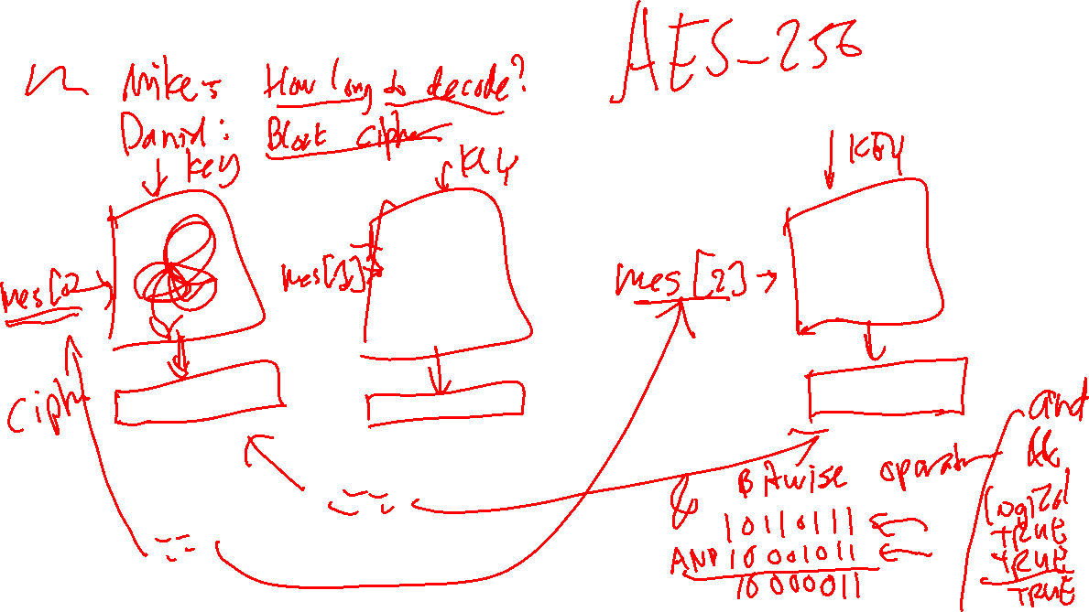
Dalet (ד) Group

