Slide 1
CS2911
Week 9, Class 3
Today
  Eavesdropping
  Man-in-the-middle attacks
Another Day
  Signing messages
  Certificates
Notes:
17q1 7-1 1-7,9-24
19q1, 20q1: AZAzazzz

Slide 2



Packet Sniffer (e.g. Wireshark)
Alice
Bob
Trudy
Notes:
This is the problem we've been considering so far.
This is a review of how we've solved it.

Slide 3


How to achieve confidentiality?
Approach 1: Symmetric keys
Alice wants to send confidential message, m, to Bob.
K_{S}
.
K_{S}(m )
.
K_{S}(m )
K_{S}( )
m
m
K_{S}( )
Internet
K_{S}
Bob
Alice
Problem: How to get K_{s}
to Bob without Trudy
intercepting?
Trudy
Alice:
encrypts message with K_{S} (for efficiency)
sends K_{S}(m) to Bob
Modified from the slides accompanying Kurose and Ross, 7th Ed.
Bob:
uses K_{S} to decrypt K_{S}(m) to recover m

Slide 4
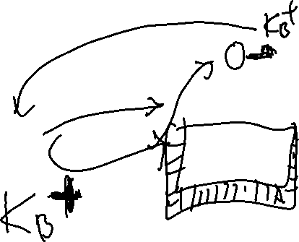
How to achieve confidentiality?
Approach 2: Public/private keys
Alice wants to send confidential message, m, to Bob.
+
K_{B}
Internet
.
+
m
K_{B}( )
+
C=K_{B}(m)
.
+
-
Bob
Alice
K_{B}
C
K_{B}( )
m
-
K_{B}
Trudy
Bob:
Send public key K_{B} to Alice
+
Alice:
encrypts message with Bob's public key K_{B}
sends C=K_{B}(m) to Bob
Modified from the slides accompanying Kurose and Ross, 7th Ed.
+
+

Slide 5
How to achieve confidentiality?
Approach 2: Public/private keys
Alice wants to send confidential message, m, to Bob.
+
K_{B}
Internet
.
+
m
K_{B}( )
+
C=K_{B}(m)
.
+
-
Bob
Alice
K_{B}
C
K_{B}( )
m
-
K_{B}
Trudy
Bob (final step):
Use private key K_{B} to decrypt C=K_{B}(m)
(because K_{B}(K_{B}(m)) = m)
-
+
-
+
Modified from the slides accompanying Kurose and Ross, 7th Ed.
Problems: Inefficient for large messages
and suffers from same problems as non-chained
cipher-blocks
Notes:
Inefficient because AES is faster.
If message

Slide 6
Apple

Slide 7

How to achieve confidentiality?
Approach 3: Use both!
K_{S}
.
K_{S}(m )
K_{S}(m )
.
m
K_{S}( )
K_{S}( )
m
Internet
+
-
K_{S}
.
.
+
-
Bob
K_{S}
K_{B}( )
+
+
K_{B}( )
Alice
K_{B}(K_{S} )
K_{B}(K_{S} )
+
-
K_{B}
K_{B}
Trudy
Bob:
uses his private key to decrypt and recover K_{S}
uses K_{S} to decrypt K_{S}(m) to recover m
Modified from the slides accompanying Kurose and Ross, 7th Ed.
Since the symmetric key K_{s} is designed for
cipher-block chaining, it works well on a large
amount of data

Slide 8
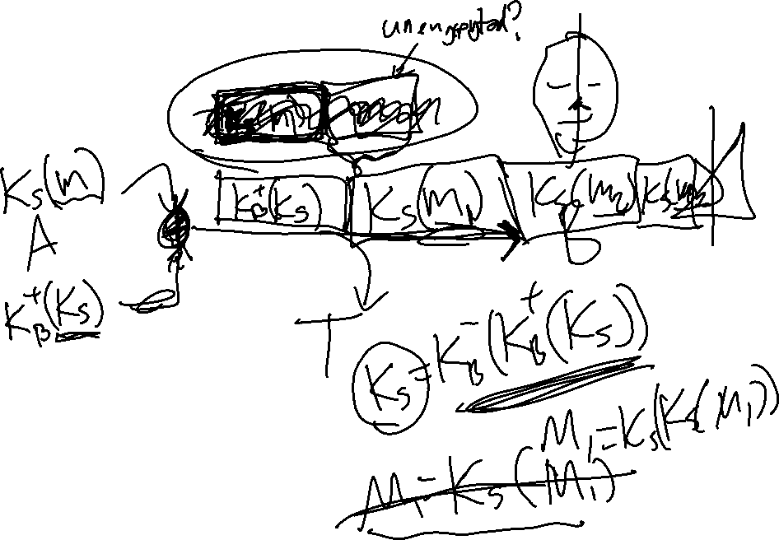
Apple

Slide 9
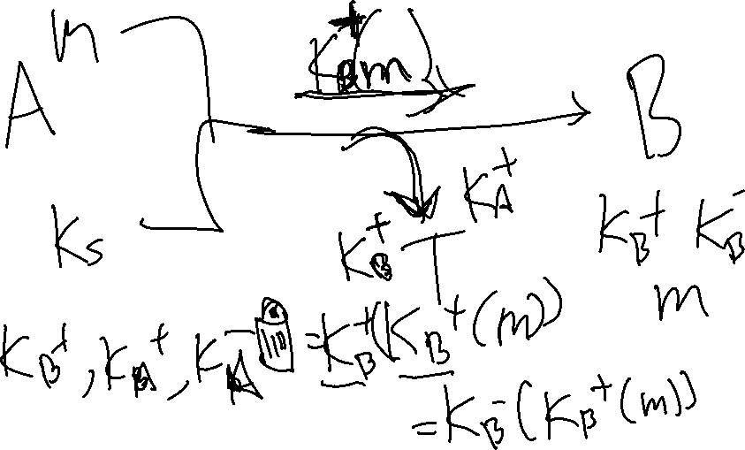
Banana

Slide 10
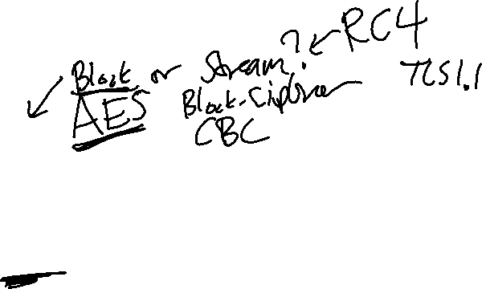
How to achieve confidentiality?
Approach 3: Use both!
K_{S}
.
K_{S}(m )
K_{S}(m )
.
m
K_{S}( )
K_{S}( )
m
Internet
+
-
K_{S}
.
.
+
-
Bob
K_{S}
K_{B}( )
+
+
K_{B}( )
Alice
K_{B}(K_{S} )
K_{B}(K_{S} )
+
-
K_{B}
K_{B}
Trudy
Alice:
generates random symmetric private key, K_{S}
encrypts message with K_{S} (for efficiency)
also encrypts K_{S} with Bob’s public key
sends both K_{S}(m) and K_{B}(K_{S}) to Bob
Modified from the slides accompanying Kurose and Ross, 7th Ed.
+

Slide 11
Carrot

Slide 12
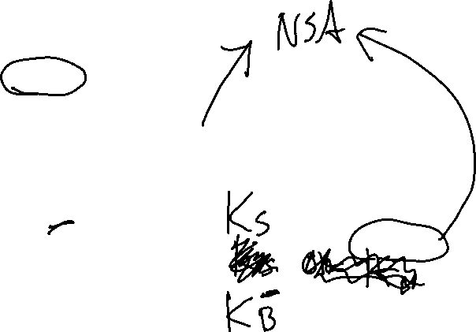
How to achieve confidentiality?
Approach 3: Use both!
K_{S}
.
K_{S}(m )
K_{S}(m )
.
m
K_{S}( )
K_{S}( )
m
Internet
+
-
K_{S}
.
.
+
-
Bob
K_{S}
K_{B}( )
+
+
K_{B}( )
Alice
K_{B}(K_{S} )
K_{B}(K_{S} )
+
-
K_{B}
K_{B}
Trudy
Alice:
generates random symmetric private key, K_{S}
encrypts message with K_{S} (for efficiency)
also encrypts K_{S} with Bob’s public key
sends both K_{S}(m) and K_{B}(K_{S}) to Bob
Modified from the slides accompanying Kurose and Ross, 7th Ed.
+

Slide 13
Donut

Slide 14
041

Slide 15
Aleph

Slide 16
How to achieve confidentiality?
Approach 3: Use both!
K_{S}
.
K_{S}(m )
K_{S}(m )
.
m
K_{S}( )
K_{S}( )
m
Internet
+
-
K_{S}
.
.
+
-
Bob
K_{S}
K_{B}( )
+
+
K_{B}( )
Alice
K_{B}(K_{S} )
K_{B}(K_{S} )
+
-
K_{B}
K_{B}
Trudy
Bob:
uses his private key to decrypt and recover K_{S}
uses K_{S} to decrypt K_{S}(m) to recover m
Modified from the slides accompanying Kurose and Ross, 7th Ed.
Since the symmetric key K_{s} is designed for
cipher-block chaining, it works well on a large
amount of data

Slide 18
Beth

Slide 19
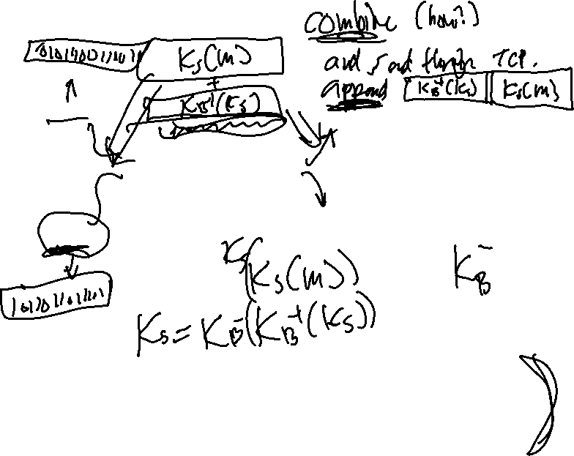
How to achieve confidentiality?
Approach 3: Use both!
K_{S}
.
K_{S}(m )
K_{S}(m )
.
m
K_{S}( )
K_{S}( )
m
Internet
+
-
K_{S}
.
.
+
-
Bob
K_{S}
K_{B}( )
+
+
K_{B}( )
Alice
K_{B}(K_{S} )
K_{B}(K_{S} )
+
-
K_{B}
K_{B}
Trudy
Bob:
uses his private key to decrypt and recover K_{S}
uses K_{S} to decrypt K_{S}(m) to recover m
Modified from the slides accompanying Kurose and Ross, 7th Ed.
Since the symmetric key K_{s} is designed for
cipher-block chaining, it works well on a large
amount of data

Slide 20
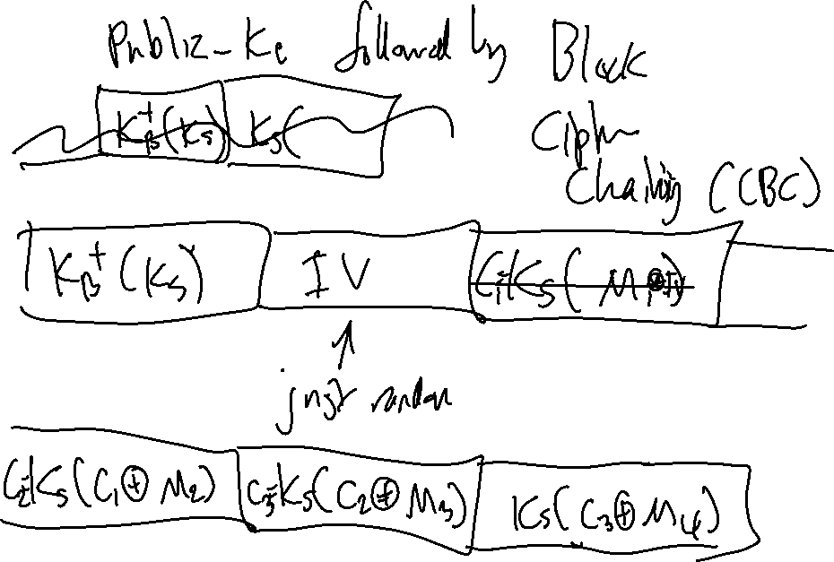

Slide 21
Gimel

Slide 22
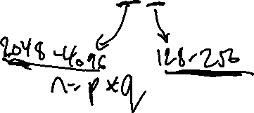
How to achieve confidentiality?
Approach 3: Use both!
K_{S}
.
K_{S}(m )
K_{S}(m )
.
m
K_{S}( )
K_{S}( )
m
Internet
+
-
K_{S}
.
.
+
-
Bob
K_{S}
K_{B}( )
+
+
K_{B}( )
Alice
K_{B}(K_{S} )
K_{B}(K_{S} )
+
-
K_{B}
K_{B}
Trudy
Bob:
uses his private key to decrypt and recover K_{S}
uses K_{S} to decrypt K_{S}(m) to recover m
Modified from the slides accompanying Kurose and Ross, 7th Ed.
Since the symmetric key K_{s} is designed for
cipher-block chaining, it works well on a large
amount of data

Slide 23
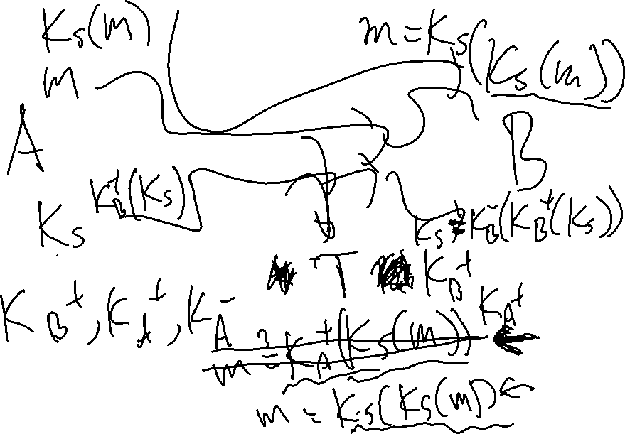

Slide 24
Dalet

Slide 25
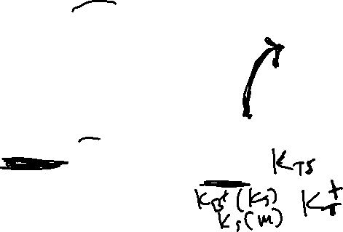
How to achieve confidentiality?
Approach 3: Use both!
K_{S}
.
K_{S}(m )
K_{S}(m )
.
m
K_{S}( )
K_{S}( )
m
Internet
+
-
K_{S}
.
.
+
-
Bob
K_{S}
K_{B}( )
+
+
K_{B}( )
Alice
K_{B}(K_{S} )
K_{B}(K_{S} )
+
-
K_{B}
K_{B}
Trudy
Bob:
uses his private key to decrypt and recover K_{S}
uses K_{S} to decrypt K_{S}(m) to recover m
Modified from the slides accompanying Kurose and Ross, 7th Ed.
Since the symmetric key K_{s} is designed for
cipher-block chaining, it works well on a large
amount of data

Slide 27
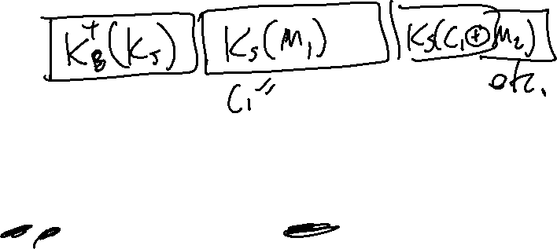
How to achieve confidentiality?
Approach 3: Use both!
K_{S}
.
K_{S}(m )
K_{S}(m )
.
m
K_{S}( )
K_{S}( )
m
Internet
+
-
K_{S}
.
.
+
-
Bob
K_{S}
K_{B}( )
+
+
K_{B}( )
Alice
K_{B}(K_{S} )
K_{B}(K_{S} )
+
-
K_{B}
K_{B}
Trudy
Alice:
generates random symmetric private key, K_{S}
encrypts message with K_{S} (for efficiency)
also encrypts K_{S} with Bob’s public key
sends both K_{S}(m) and K_{B}(K_{S}) to Bob
Modified from the slides accompanying Kurose and Ross, 7th Ed.
+

Slide 28
CS2911
Week 10, Class 1
Today
  Man-in-the-middle attacks
  Signing messages
  Certificates
Notes:
17q1 7-1 1-7,9-24

Slide 29
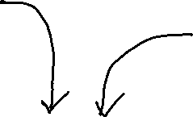
Man-in-the-middle attack
Alice
Bob
Trudy
Notes:
Here comes Trudy again!

Slide 30
Man-in-the-middle attack
Alice
Bob
Trudy

Slide 31

Trudy can edit ALL the packets
Not just application payload
Even TCP headers
Even IP headers
Even DNS packets
Even encrypted packets!
Every packet Alice sends
Every packet Bob sends

Slide 32
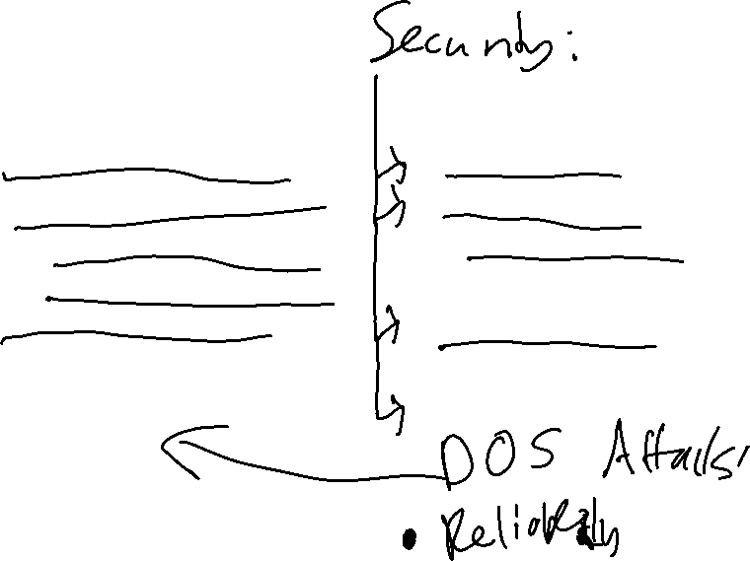
Trudy can…
Alice and Bob want…
See what Alice sends
Change what Alice sends
  Repeat what Alice sends
  Reorder what Alice sends
Pretend to be Alice
  Ask for Bob's password
…
Confidentiality
Data integrity
  Avoid replay attacks
  Session integrity (??)
Authentication
  Avoid phishing attacks
…
Notes:
Types of attacks / types of security
Try to get Bob's keys - Avoid chosen-plaintext attack
Take down Alice's server - Avoid denial of service attacks

Slide 33



Example Man-in-the-middle attack
Alice
Trudy
Bob
34.35.100.100
189.34.107.99
where is
alice.com?
at 189.34.107.99
My credit card:
123981284
Order complete!

Slide 34
OK, so Bob will probably be using encryption…
that will slow Trudy down…
… or will it?

Slide 35
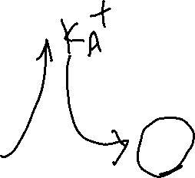
Example Man-in-the-middle attack (1)
Alice
Trudy
Bob
Please share your public key
Please share your public key
+
Looks good
to me!
K_{A}
+
K_{T}
Notes:
This time Trudy really does give Bob Alice’s IP address.

Slide 36
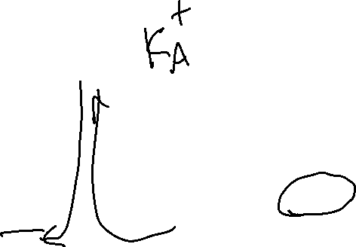
Example Man-in-the-middle attack (2)
Alice
Trudy
Bob
Here is the session key,
just for you, Alice! K_{T} (K_{S})
Here is the session key,
just for you, Alice! K_{A} (K_{S})
+
+
Notes:
This time Trudy really does give Bob Alice’s IP address.

Slide 37


Example Man-in-the-middle attack (3)
Alice
Trudy
Bob
K_{S} (Are you Alice?)
K_{S} (Are you Alice?)
K_{S} (Yes I am!)
K_{S} (Yes I am!)
K_{S} (GET /perfume.html HTTP/1.1)
K_{S} (GET /perfume.html HTTP/1.1)
K_{S} (Buy )
K_{S} (Buy )
Notes:
https://openclipart.org/detail/234632/scent-bottle

Slide 38
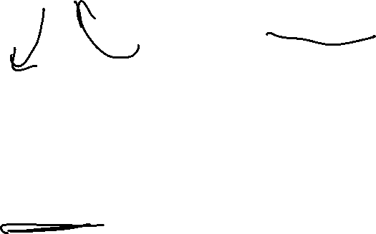
Example Man-in-the-middle attack (4)
Alice
Trudy
Bob
34.35.100.100
189.34.107.99
K_{S} (Credit card #: 123981284)
K_{S} (Credit card #: 123981284)
K_{S} (order complete)
K_{S} (order complete)
Thanks for the credit
card info, Bob!

Slide 39

When Bob lost authentication, he lost data integrity and confidentiality as well.
Notes:
(even though he was using encryption!)

Slide 40

Authentication
How can Bob know it is really Alice that sent him a message?
Alice needs to sign the message
Public-key cryptography can be used for this

Slide 41
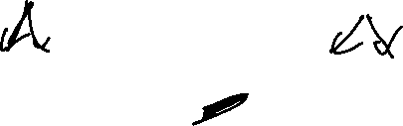

RSA: an important property
The following property will be very useful:
-
+
+
-
K (K (m)) = m
=
K (K (m))
B
B
B
B
use public key first, followed by private key
use private key first, followed by public key
result is the same!
Modified from the slides accompanying Kurose and Ross, 7th Ed.
8-41

Slide 42
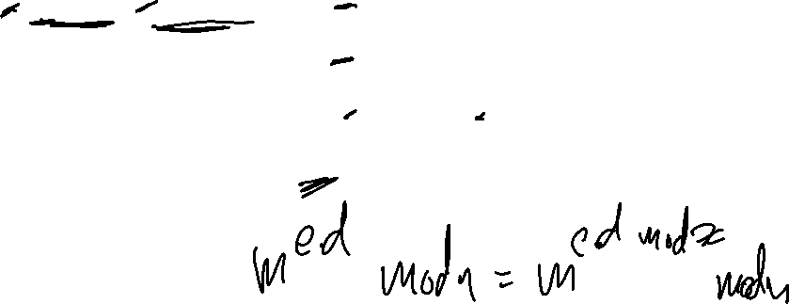

Why
-
+
+
-
K (K (m)) = m
?
=
K (K (m))
B
B
B
B
follows directly from modular arithmetic:
(m^{e} mod n)^{d} mod n = m^{ed} mod n
= m^{de} mod n
= (m^{d} mod n)^{e} mod n
= m (as shown in RSA video)
Modified from the slides accompanying Kurose and Ross, 7th Ed.
8-42

Slide 43
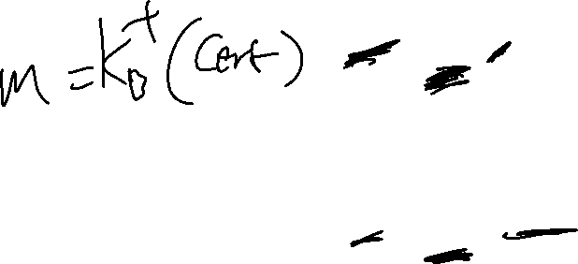
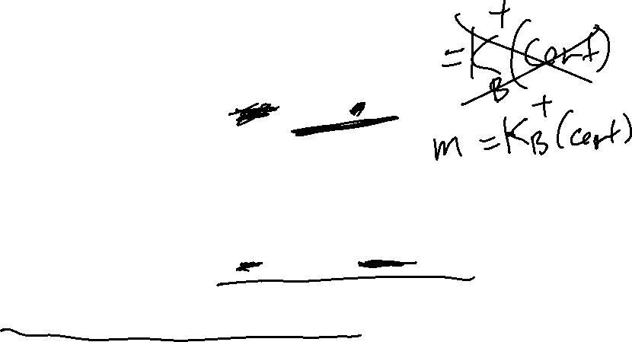
Key point
Forging a certificate
is just as hard as decrypting a message
Both require the private key! (Which only Bob has)
-
cert =
K (m)
B
-
m =
K (cipher)
B

Slide 44
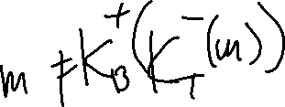
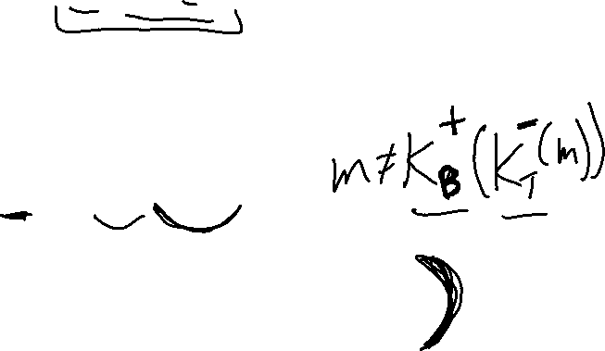
Anyone can check a certificate
Usually, the unencrypted message is included:
I can check the certificate by checking that:
Usually a cryptographic hash is signed instead of the entire message.
-
(m, K (m))
B
+
-
?
m
=
K (K (m))
B
B
Notes:
Another way to think about it: Going from m -> cert is like going from ciphertext -> m. You have to apply the inverse of the public key to do it.

Slide 45

Suppose, for a moment, that Bob and Alice have each other’s public keys already… and they know they didn’t come from Trudy!
Notes:
Now we have a technique for signing messages. How can this be used to protect communications?
We will again start with a weak assumption: That both parties already have each other’s public keys.

Slide 46
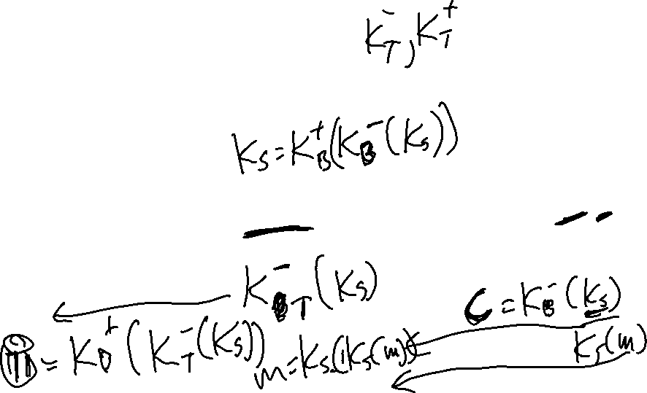
Signing a message
Alice
Trudy
Bob
+
-
+
+
+
-
K_{B}
K_{A}
K_{A}
K_{B}
K_{A}
K_{B}
Here is the session key,
It’s really from me, Alice! K_{B} (K_{S})
Here is the session key,
It’s really from me, Alice! K_{B} (K_{S})
-
-
Notes:
Can Trudy create the message K_{B}⁻(K_{S})?
However, Trudy can do something! What?

Slide 47
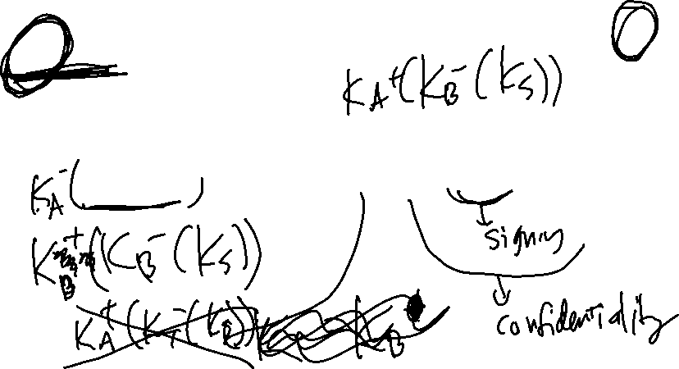
Signing and encrypting a message
Alice
Trudy
Bob
+
-
+
+
+
-
K_{B}
K_{A}
K_{A}
K_{B}
K_{A}
K_{B}
Here is the session key,
It’s really from me, Alice!
K_{A}( K_{B} (K_{S}))
Here is the session key,
It’s really from me, Alice!
K_{A}( K_{B} (K_{S}))
+
-
+
-
Notes:
Can Trudy create the message K_{A}⁺(K_{B}⁻(K_{S}))?
Can Trudy recover the primary key?
Have we achieved authentication? Have we achieved data integrity? Have we achieved confidentiality?

Slide 48
How can Alice get her key to Bob without Trudy changing it?
+
+
K_{A}
K_{T}
Alice
Bob
-
K_{A}
K_{T}
-
Trudy

Slide 49


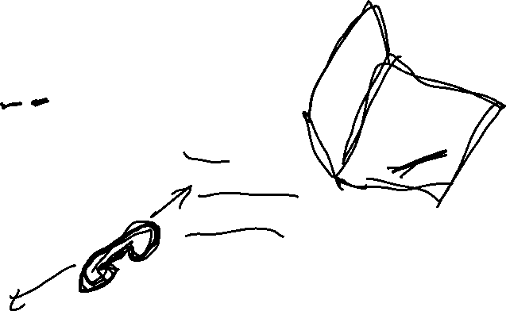
Public Key Certificate
-
+
K_{C} (K_{A})
+
Carol
K_{C}
+
(Certificate
authority)
K_{A}
Alice
Bob
49
Notes:
Suppose Alice sends Bob a message signed by Carol with Alice's public key saying it really is hers.
Suppose Bob trusts Carol
Suppose Bob already has Carol's public key
Then Bob can trust that Alice's public key is real!

Slide 50


A signed certificate
+
K_{A}
alice.com
-
+
K_{C} (K_{A},alice.com)
Notes:
Reminder: In practice, a cryptographic hash of the entire certificate is signed rather than the certificate data itself.

Slide 51

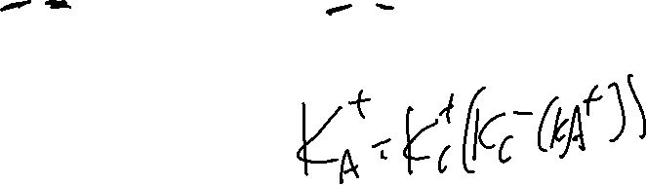
Public Key Certificate
-
+
K_{C} (K_{A})
+
Carol
K_{C}
+
K_{A}
-
+
-
+
K_{C} (K_{A})
K_{C} (K_{A})
Alice
Bob
Trudy
51
Notes:
Can look at certificates with MMC (search “mmc” from start menu), then File->Add/Remove Snap-in. Add “Certificates” for computer account, then browse to certificates->trusted root certificate authorities->certificates. Can see all root CAs trusted by OS here.
Suppose Alice sends Bob a message signed by Carol with Alice's public key saying it really is hers.
Suppose Bob trusts Carol
Suppose Bob already has Carol's public key
Then Bob can trust that Alice's public key is real!

Slide 52
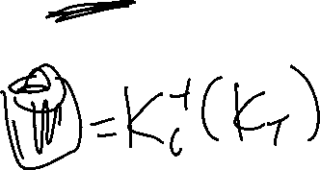
Public Key Certificate
-
+
K_{C} (K_{A})
+
Carol
K_{C}
+
K_{A}
-
+
+
K_{C} (K_{A})
K_{T}
Alice
Bob
Trudy
52
Notes:
How can Bob tell that this key is fake?

Slide 53
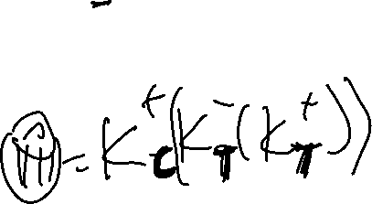
Public Key Certificate
-
+
K_{C} (K_{A})
+
Carol
K_{C}
+
K_{A}
-
+
-
+
K_{C} (K_{A})
K_{T} (K_{T})
Alice
Bob
Trudy
53
Notes:
How can Bob tell that this key is fake?
(This is called a self-signed key.)

Slide 54

Public Key Certificate
-
+
K_{C} (K_{A})
+
Carol
K_{C}
+
K_{A}
-
+
-
+
K_{C} (K_{A})
K_{C} (K_{T})
Alice
Bob
Trudy
54
Notes:
How can Bob tell that this key is fake?
(This is called a self-signed key.)

Slide 55


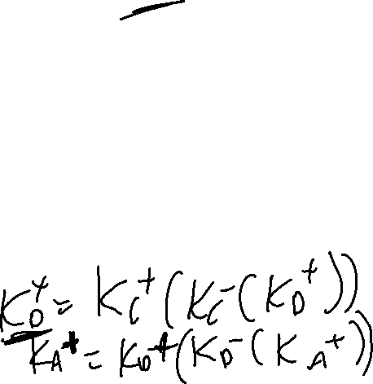
Public Key Certificate Chain
+
-
+
K_{C}
K_{C} (K_{D})
Carol
+
K_{D}
-
+
-
+
K_{D} (K_{A})
K_{C} (K_{D})
Dan
-
+
K_{D} (K_{A})
+
K_{A}
Bob
Alice
Notes:
Suppose Alice sends Bob a message signed by Carol with Dan' public key saying it really is his
Suppose Bob trusts Carol
Suppose Alice sends Bob a message signed by Dan with Alice's public key saying it really is hers.
Suppose Bob trusts Dan
Suppose Bob has Carol’s public key already
Then Bob can trust that Alice's public key is real!

Slide 56


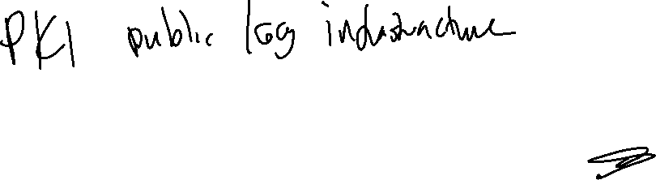
Public Key Certificate Chain
-
+
K_{C} (K_{D})
Carol
+
-
+
K_{C}
K_{D} (K_{E})
+
K_{D}
Dan
+
-
+
-
+
K_{E}
K_{C} (K_{D})
K_{E} (K_{A})
Esther
-
+
K_{D} (K_{E})
+
-
+
K_{A}
K_{E} (K_{A})
Bob
Alice
Notes:
Suppose Alice sends Bob a message signed by Carol with Dan' public key saying it really is his
Suppose Bob trusts Carol
Suppose Alice sends Bob a message signed by Dan with Esther's public key saying it really is hers.
Suppose Bob trusts Dan
Suppose Alice sends Bob a message signed by Esther with Alice’s public key saying it really is his
Suppose Bob trusts Esther
Suppose Bob has Carol’s public key already
Then Bob can trust that Alice's public key is real!

Slide 57
Bob still needs to have SOMEONE's public key to start with!
This "someone“ (Carol) is called a root certificate authority (CA)
Everyone else in the chain is a certificate authority (CA)
The root CA's key is stored on Bob's computer by the manufacturer (or by Bob's institution)

Slide 58
Confirming a certificate chain
Suppose Bob goes to alice.com, a perfume outlet
alice.com sends Bob
  Her key, signed by CA1
  CA1's key, signed by CA2
  CA2's key, signed by the root CA
Bob checks that all keys are properly signed.
Bob checks that the root CA is one he trusts
Now Bob knows Alice's key is real. He will use it to start a secure exchange with Alice
Notes:
(Example from our textbook)

Slide 59
What if someone is able to actually steal Alice's private key?
She would like to "revoke" her key – tell everyone that it is no longer valid
Certificate Revocation Lists (CRLs) are the classic way to do this.
  Each CA offers lists of all keys it has signed, but also revoked
New ways are OCSP and OCSP stapling
  User goes back to CA to ask if certificate is valid
Neither one is used 100%... compromised keys are still really bad

Slide 60
Example Man-in-the-middle attack (1)
Alice
Trudy
Bob
Please share your public key
Please share your public key
+
-
+
+
-
+
(K_{A},K_{C}(K_{A}))
(K_{A},K_{C}(K_{A}))
Bob checks it
Against Carol’s
public key
Looks good
t me!
Notes:
This time Trudy really does give Bob Alice’s IP address.

Slide 61
Example Man-in-the-middle attack (2)
Alice
Trudy
Bob
Here is the session key,
just for you, Alice! K_{A} (K_{S})
Here is the session key,
just for you, Alice! K_{A} (K_{S})
+
+
Notes:
This time Trudy really does give Bob Alice’s IP address.

Slide 62
Example Man-in-the-middle attack (3)
Alice
Trudy
Bob
K_{S} (Are you Alice?)
K_{S} (Are you Alice?)
K_{S} (Yes I am!)
K_{S} (Yes I am!)
K_{S} (GET /perfume.html HTTP/1.1)
K_{S} (GET /perfume.html HTTP/1.1)
K_{S} (Buy )
K_{S} (Buy )
Notes:
https://openclipart.org/detail/234632/scent-bottle

Slide 63
Example Man-in-the-middle attack (4)
Alice
Trudy
Bob
34.35.100.100
189.34.107.99
K_{S} (Credit card #: 123981284)
K_{S} (Credit card #: 123981284)
K_{S} (order complete)
K_{S} (order complete)
I wonder what
he is saying…?

Slide 64
Big-picture review
Public-private key and symmetric key together make for efficient way to confidentially exchange data
Man-in-the middle attack makes key distribution difficult
Public-key infrastructure and trusted root CA keys pre-installed make communication with new sites possible, even with man-in-middle attack
Lots of trust on CA hierarchy!

Slide 65
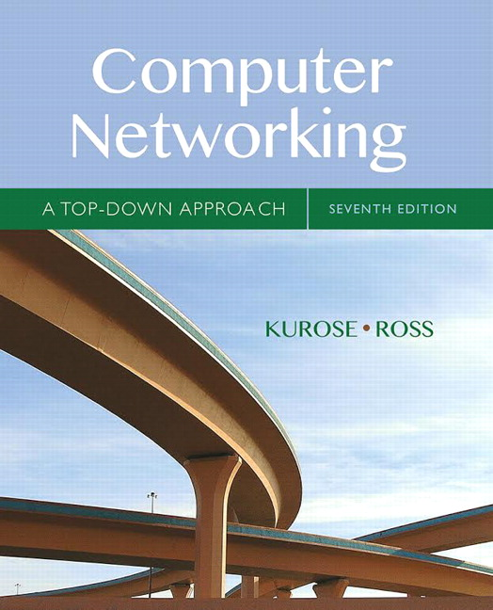
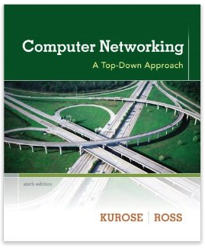
Acknowledgement
The content of this video is based in part on lecture slides from a very good textbook, and used with the author’s permission:
Computer Networking: A Top-Down Approach, 7th edition, by Jim Kurose and Keith Ross
Publisher: Pearson, 2017

