Slide 1
CS2911 – Network Protocols
Hexadecimal
Dr. Yoder
Binary Numbers

Slide 2
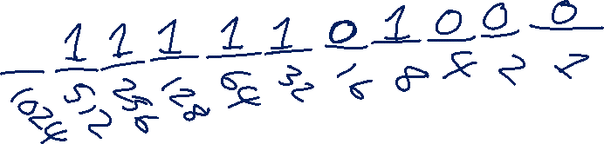

Decimal -> Binary
Conversion

Slide 3
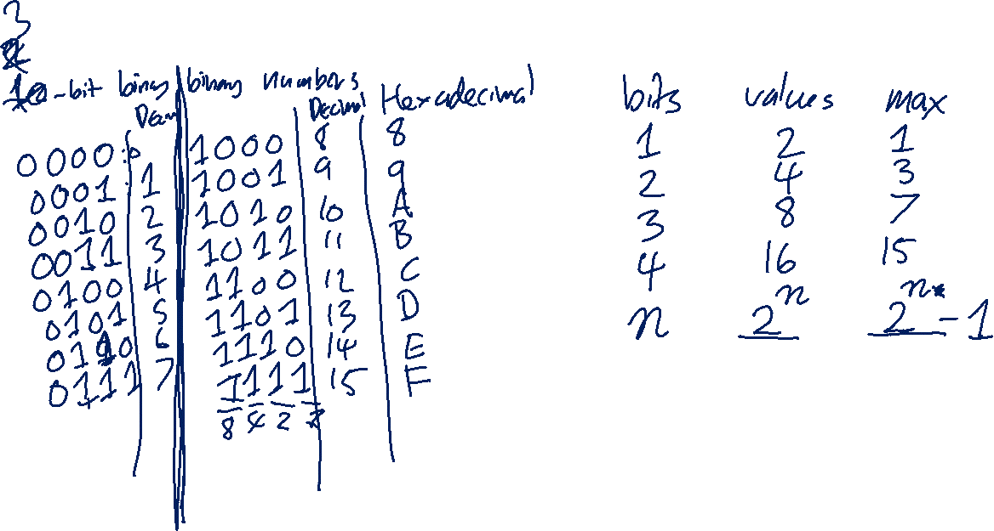
All n-bit numbers

Slide 4
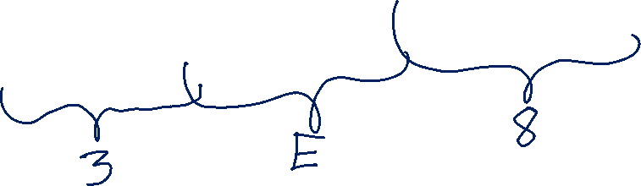
Decimal -> Binary
Conversion

Slide 5
Exercise
Convert to hexadecimal
48 121 9 5 25 142 237 93

