Slide 1
CS2911 – Network Protocols
Bytes
Dr. Yoder
Binary Numbers

Slide 2
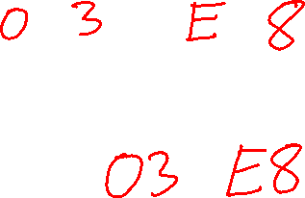
What's a byte?
A byte is 8 bits.
So 1000₁₀ can be written with two bytes:
0000 0011 1110 1000
How do you write this in hexadecimal?

Slide 3
Representing characters with bytes
‘A’
ASCII characters:
0100 0001 ‘A’
0100 0010 ‘B’
0110 0001 ‘a’
0011 0000 ‘0’
0011 0001 ‘1’
0000 1101 ‘\r’ CR (Carriage return)
0000 1010 ‘\n’ LF (Line feed, New line)
0010 0000 ‘ ’ (Space)
0100 0001
Byte
nibble

Slide 4

Required
ASCII characters
Hex code | Char |  | Hex code | Char |  | Hex code | Char |  | Hex code | Char
0d | '\r' CR |  | 30 | '0' |  | 41 | 'A' |  | 61 | 'a'
 |  |  | 31 | '1' |  | 42 | 'B' |  | 62 | 'b'
0a | '\n' LF |  | … | … |  | 43 | 'C' |  | 63 | 'c'
 |  |  | 38 | '8' |  | 44 | 'D' |  | 64 | 'd'
20 | ' ' SP |  | 39 | '9' |  | 45 | 'E' |  | 65 | 'e'
Notes:
17q1 added after class, "Hex code" added day of Lab 3

Slide 5
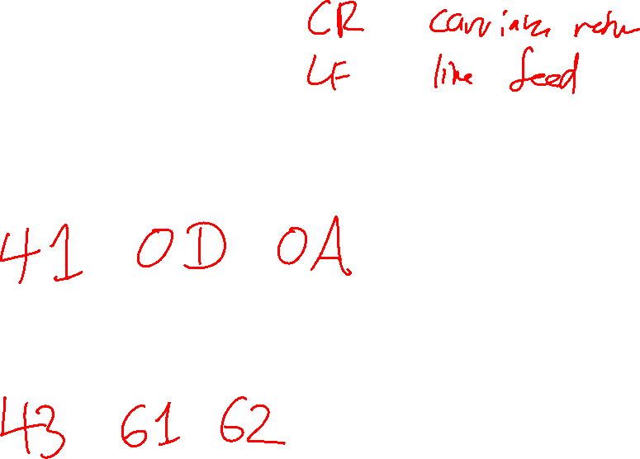
Exercise: Suppose the ASCII characters ‘A’, CR, and LF are stored in a bytes object. Write the hexadecimal shorthand for the contents of the bytes object.
Exercise: How do you write the ASCII string "Cab" in hexadecimal shorthand?

Slide 6
UDP Header
 | Byte | 0 |  |  |  |  |  |  |  | 1 |  |  |  |  |  |  |  | 2 |  |  |  |  |  |  |  | 3
Byte | Bit | 0 | 1 | 2 | 3 | 4 | 5 | 6 | 7 | 8 | 9 | 10 | 11 | 12 | 13 | 14 | 15 | 16 | 17 | 18 | 19 | 20 | 21 | 22 | 23 | 24 | 25 | 26 | 27 | 28 | 29 | 30 | 31
0 | 0 | Source port |  |  |  |  |  |  |  |  |  |  |  |  |  |  |  | Destination port
4 | 32 | Length |  |  |  |  |  |  |  |  |  |  |  |  |  |  |  | Checksum
Wikipedia: User Datagram Protocol

Slide 7
You are now ready to finish Lab 2!
Overview Lab 2 – see website

