Slide 1
CS2911 – Network Protocols
Octal and Endianness
Dr. Yoder
Binary Numbers
Notes:
https://www.bl.uk/britishlibrary/~/media/bl/global/dl%20restoration%20and%2018th%20century/banners/gullivers-travels-crop.jpg

Slide 2

Binary | Octal
000 | 0
001 | 1
010 | 2
011 | 3
100 | 4
101 | 5
110 | 6
111 | 7
Binary | Octal | Decimal
1000 | 10 | 8
1001 | 11 | 9
1010 | 12 | 10
1011 | 13 | 11
1100 | 14 | 12
1101 | 15 | 13
1110 | 16 | 14
1111 | 17 | 15

Slide 3
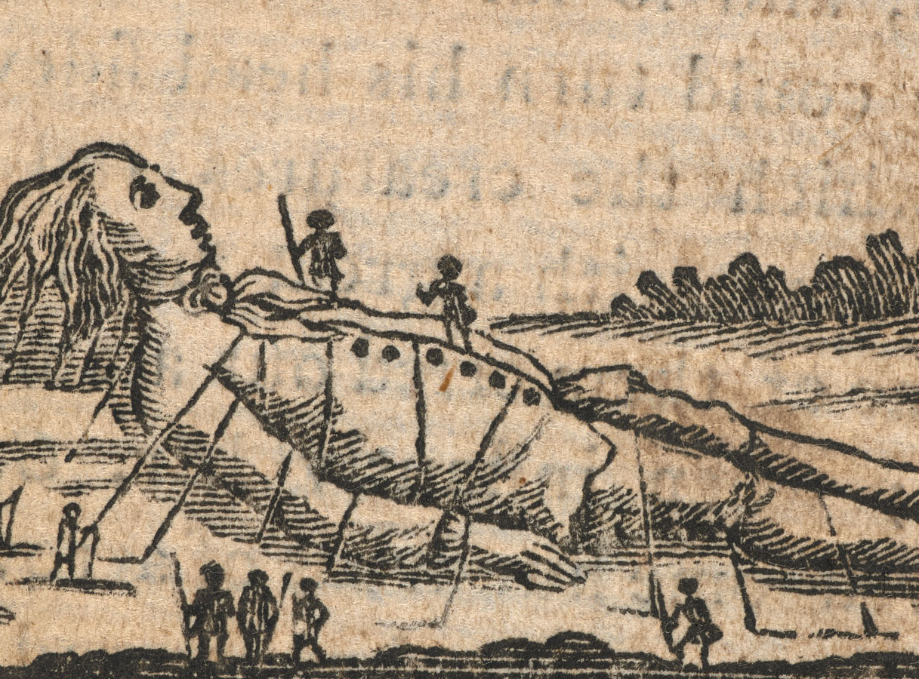
Gulliver’s Travels
Notes:
The tiny people that Gulliver attacked were at war with the others over which end of the egg to break

Slide 4
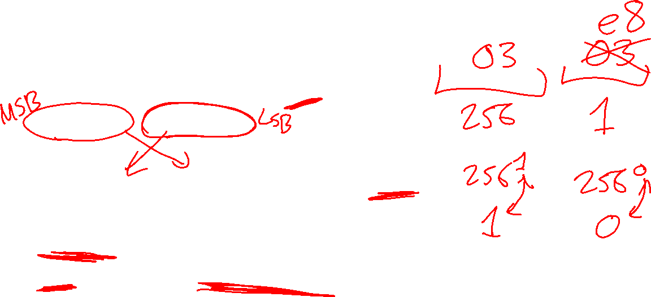
Big endian / little endian
1000₁₀ can be written with the bytes
big endian: most significant byte first
0000 0011 1110 1000 (03 e8)
little endian: least significant byte first
1110 1000 0000 0011 (e8 03)
Network order is BIG ENDIAN (whew!)
Intel machines are LITTLE ENDIAN

