Slide 1

Python hex escapes
CS2911
Dr. Josiah Yoder

Slide 2

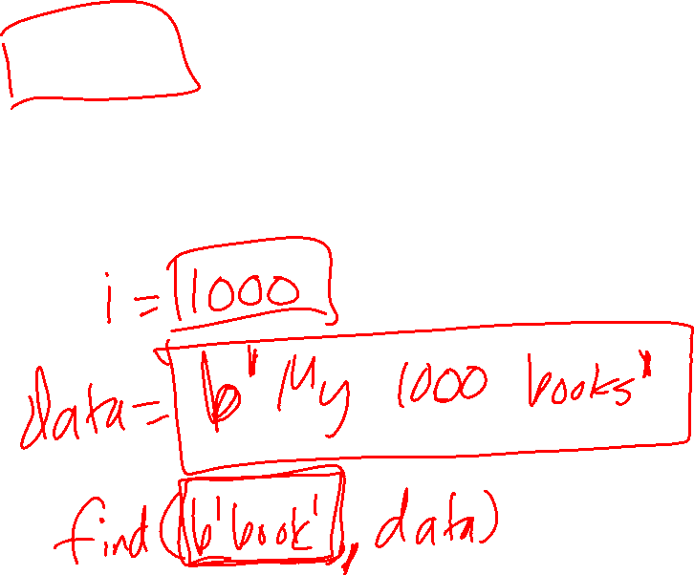
Literal
The value for an object written directly into a program’s code

Slide 3
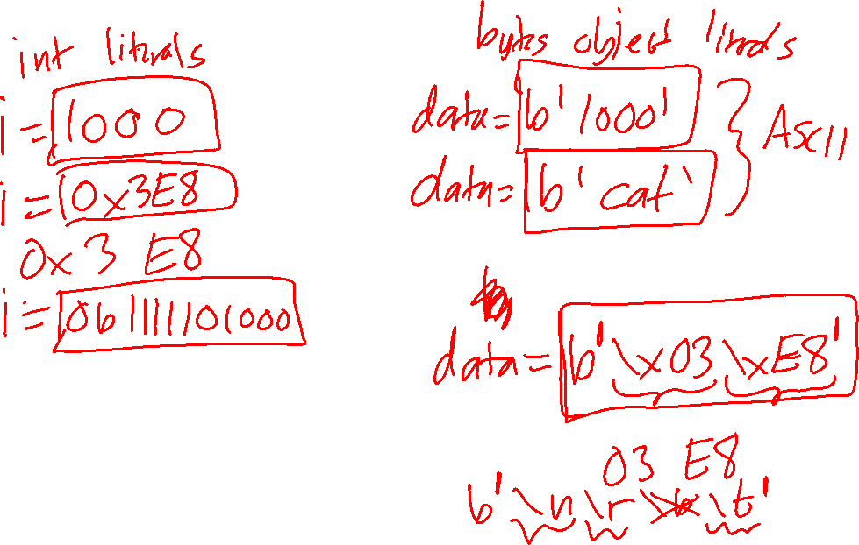
Python hex escapes

Slide 4
For more videos, visit
https://faculty-web.msoe.edu/yoder/cs2911/Videos

