Slide 1

Python Encoding Conversion
CS2911
Dr. Josiah Yoder

Slide 2
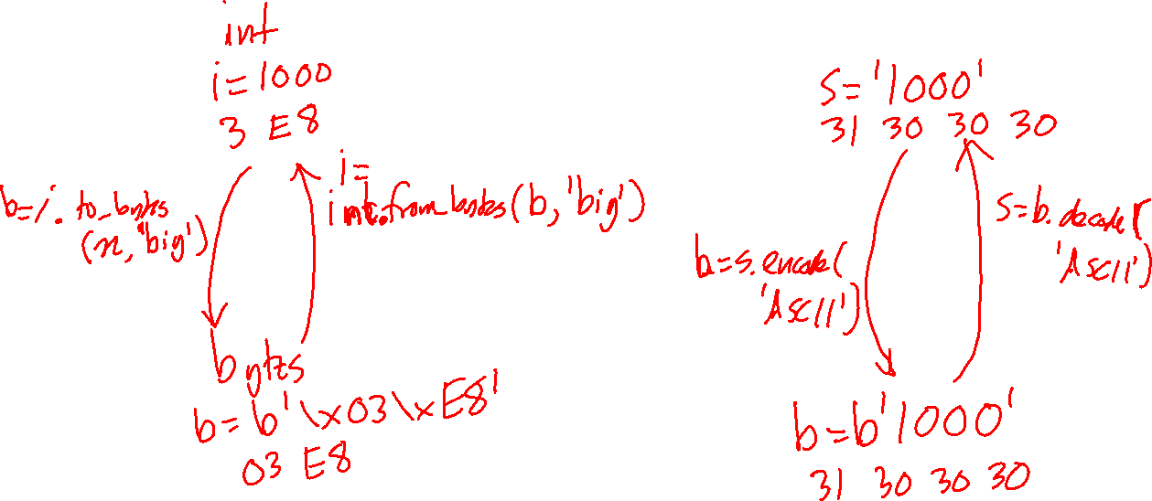
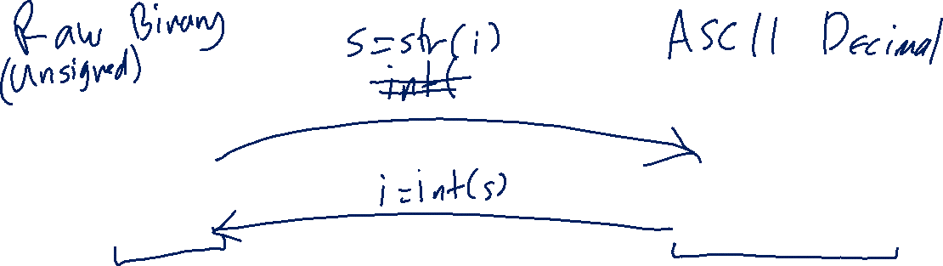

Slide 3
For more videos, visit
https://faculty-web.msoe.edu/yoder/cs2911/Videos

