Slide 1

Python Encoding Conversion
CS2911
Dr. Josiah Yoder

Slide 2
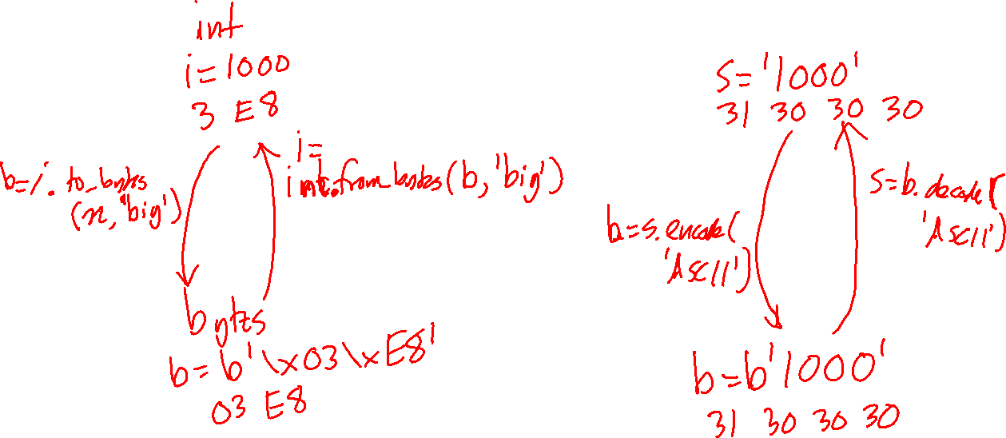

Slide 3
Python Encoding Conversion PyCharm Examples
CS2911
Dr. Josiah Yoder

Slide 4
For more videos, visit
https://faculty-web.msoe.edu/yoder/cs2911/Videos

