Slide 1
Announcement
Dear CEs,
It’s my pleasure to begin this invitation by welcoming our new CE freshmen! I look forwarding to seeing you and all our returning students in the coming weeks.
Please mark your calendar for our next CE student social and networking event at 5 PM on Monday, September 29 (week 4) in the Todd Wehr Auditorium. FedEx is our event sponsor. Each student and faculty who signs up and attends will receive a CE dress shirt; all faculty and CE student attendees will receive dinner.
Students and faculty must complete this form by Monday, September 8 to receive a shirt (late responders are unlikely to receive a shirt, but we’ll try our best): https://docs.google.com/forms/d/1s2iPM6HrVrxCiNtQDKccAxmWcUGJUS7S0HcT5RXwYgc/viewform
The event is a great chance to...
meet CEs from your year and other years;
hear a short talk and ask questions of our guest speaker, Mr. Jason Esch, Director, IT, FedEx Services; learn about senior design projects; meet CE alumni; win cool door prizes; and chat with faculty.
The six CE IAC student representatives (https://faculty-web.msoe.edu/durant/ceiac/members.shtml) are working to make this an event that you won’t want to miss.
-- Dr. Durant

Slide 2
SE-1011 Intro to Software Engineering I
Week 1, Class 1
Introductions
Safety
Syllabus
Our first program
What’s in a Computer?
Notes:
For Later:
http://www.qmatica.com/DataStructures/Trees/AVL/AVLTree.html
Perhaps Later
- Using generics
- Casting Thing<Circle> to Thing<Shape> or vice-versa
For future HW / in-class exercises
- Draw detailed memory-map diagrams of linked-lists and ArrayLists

Slide 3
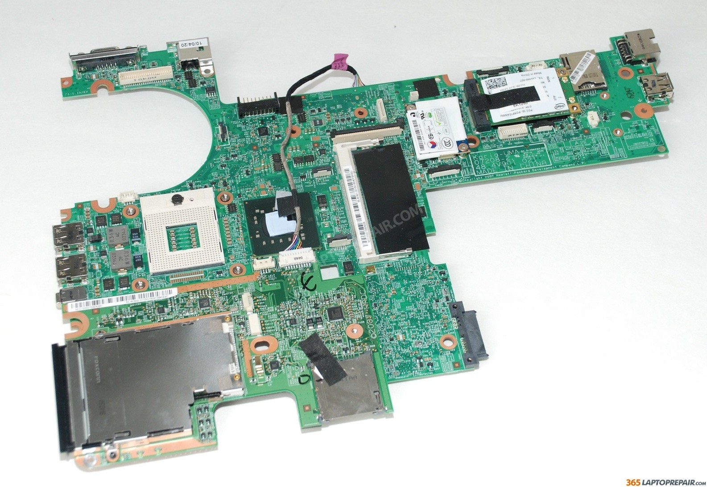
My Computer’s Motherboard
http://www.365laptoprepair.com/EbayGallery/HP-EliteBook-6930p-Intel-Motherboard-486301-001-TESTED

Slide 4
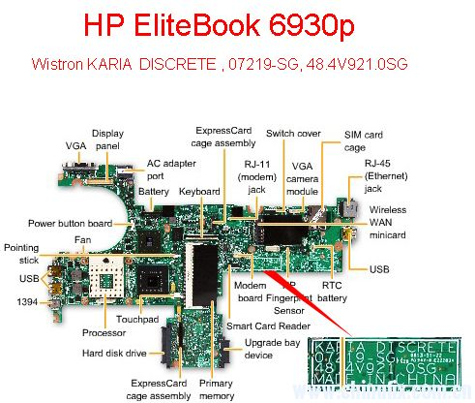
http://www.laptopschematic.com/hp-elitebook-6930p-schematic-karia-discrete/
http://www.laptopschematic.com/wp-content/uploads/2011/06/EliteBook-6930p-PCB.jpg

