Slide 1
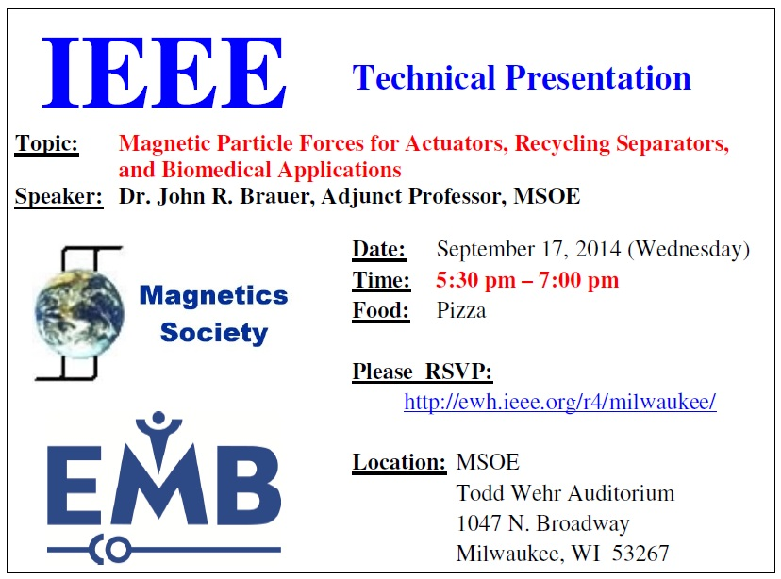

Slide 2
SE-1011
Intro to Software Engineering I
Week 1, Class 3
  Introductions, continued (perhaps)
  Software Development Process
  Algorithms and Programs
  Example: Computing the Volume
  of the Great Pyramid
Notes:
For Later:
http://www.qmatica.com/DataStructures/Trees/AVL/AVLTree.html
Perhaps Later
- Using generics
- Casting Thing<Circle> to Thing<Shape> or vice-versa
For future HW / in-class exercises
- Draw detailed memory-map diagrams of linked-lists and ArrayLists

