Slide 1
GUI design considerations
Dr. Riley
(with some edits by Dr. Yoder)

Slide 2
Design is Difficult!
In modern software, the user interface code can constitute the majority of the program
Creating a good UI is often harder than writing the software
Often, the user interface is the key to the success or failure of a program
Apple did not invent the mouse…

Slide 3
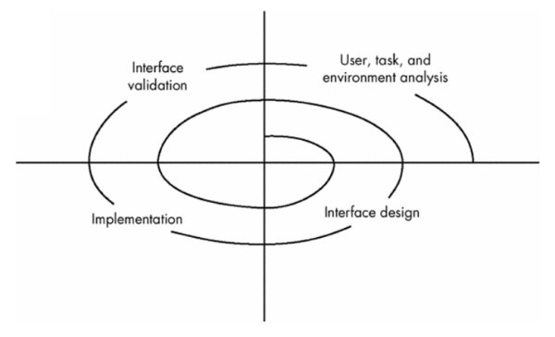
A Spiral Process
User interface development follows a spiral process
Interface analysis (user, task, and environment analysis)
Interface design
Defines a set of interface objects and actions
Interface implementation
Begins with a prototype
Interface validation (testing)
The degree to which the interface is easy to use and easy to learn

Slide 4
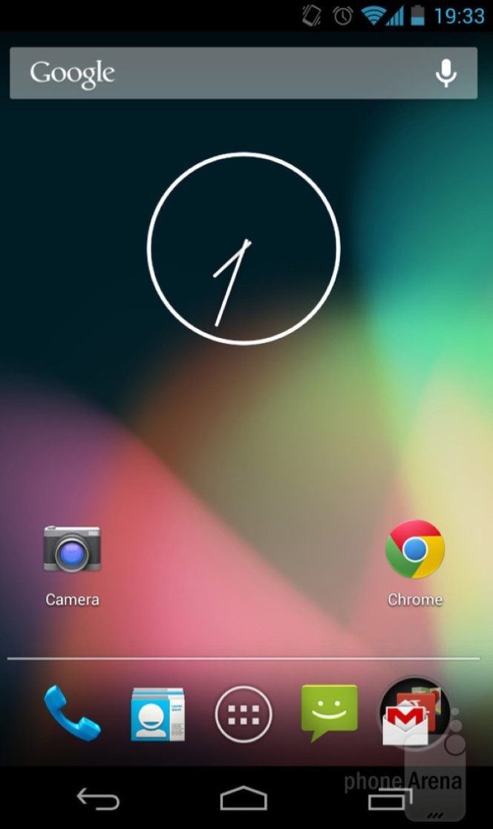
Layout Principles
Gestalt
Proximity
Similarity
Closure
Other
Visibility
Constraints
Mapping

Slide 5
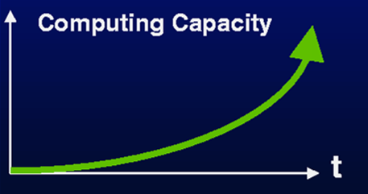
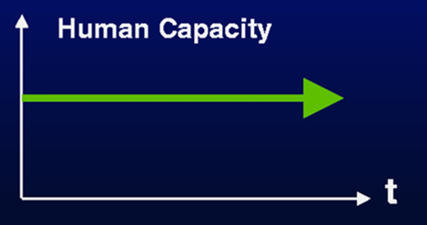
Design is Difficult!
In modern software, the user interface code can constitute the majority of the program
Creating a good UI is often harder than writing the software
Often, the user interface is the key to the success or failure of a program
Apple did not invent the mouse…
Computer speed increases by Moore’s law, humans do not

Slide 6
Complexity of the Human Brain
https://www.extremetech.com/computing/190946-stop-obsessing-over-transistor-counts-theyre-a-terrible-way-of-comparing-chips
86 Billion Neurons
The i7 has about 1.7 Billion Transistors
Each neuron is a cell and has additional working parts internally.
Neurons communicate not only electrically, but chemically as well
Think what drugs do to brains
8 Billion people, each different
(Even more computers – 10 billion manufactured in one year alone)

Slide 7
Rules about Developing for Users
Rule #1: All users are not like you.
Rule #2: All users are not alike.
Consider:
Physical & cognitive abilities & special needs
Personality & culture
Knowledge & skills
Motivation

Slide 8
Competing for customers
About 1 in 7 Americans has a disability
About 1 in 3 Americans has a family member or coworker with a disability
Notes:
Title: Competing for customers
Text only: About 1 in 7 Americans has a disability
About 1 in 3 Americans has a family member or coworker with a disability

Slide 9
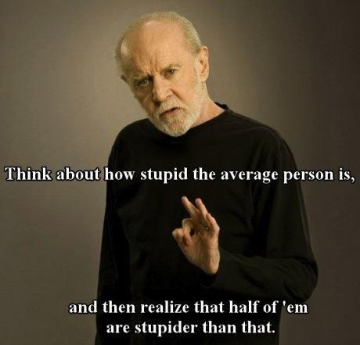
Designing for “average” users
Some of us are just a little more average than others
Age, disabilities, and situations make each of us unique…
-George Carlin
Notes:
Title: Designing for “average” users…Some of us are just a little more average than others… Age, disabilities, and situations make each of us unique…
Image: photo of male pedestrian and female jogger in shorts and t-shirts waiting at a street crossing. The man is very overweight, while the woman is very thin.

Slide 10
Affordances: to give a clue
Refers to an attribute of an object that allows people to know how to use it
a mouse button invites pushing
a door handle affords pulling
Norman (1988) used the term to discuss the design of everyday objects
Since then has been popularized in interaction design to discuss how to design interface objects
E.g. scrollbars to afford moving up and down, icons to afford clicking on
Is the Apple “swipe” on an iPad an affordance?

Slide 11
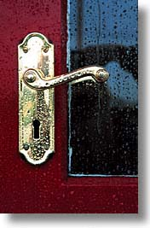
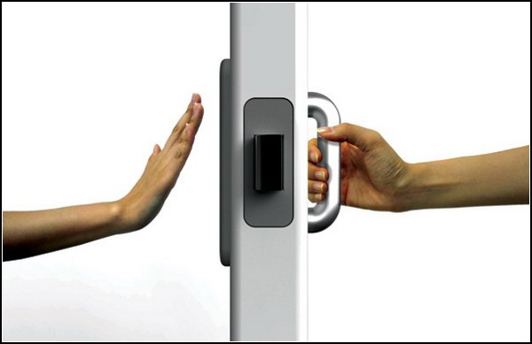
Activity
Physical affordances:
How do the following physical objects afford? Are they obvious?
Are they universally designed?

Slide 12
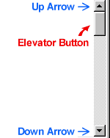
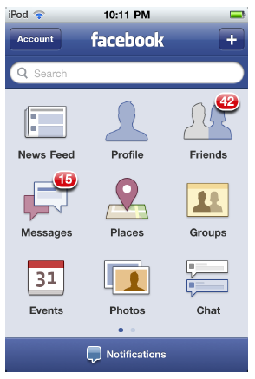
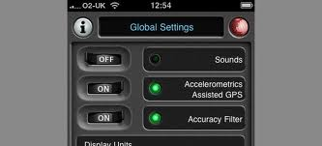
Activity
Virtual affordances
How do the following screen objects afford?
What if you were a novice user?
Would you know what to do with them?

Slide 13
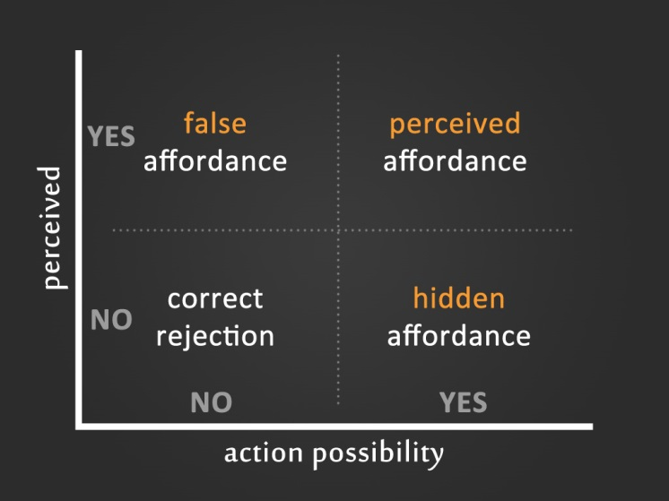
Activity: Physical and Perceived Affordances
Consider a “smart” phone
In a small group
Identify any physical affordances the device has
Identify any perceived or visual affordances the software user interface has
Write these down, to be shared

Slide 14
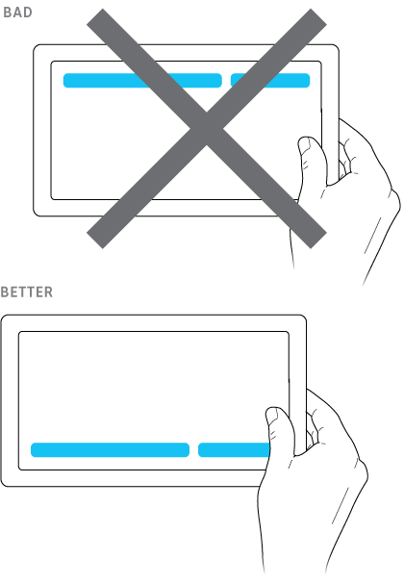
Fitts’ Law (Paul Fitts 1954)
The law predicts that the time to point at an object using a device is a function
Relating the distance from the target object & the object’s size.
Time = a + b log (Dist/Width + 1)
a and b are constants
Dist is the distance the finger needs to move
Width is across the tap target
The further away & the smaller the object
the longer the time to locate it and point

Slide 15
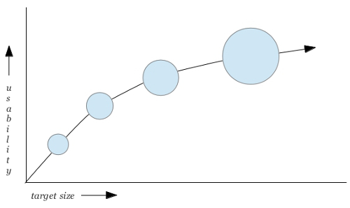
Fitts Law Limitations
Bigger doesn’t always mean faster
It can just mean fewer buttons can be displayed
http://www.particletree.com/features/visualizing-fittss-law/

Slide 16
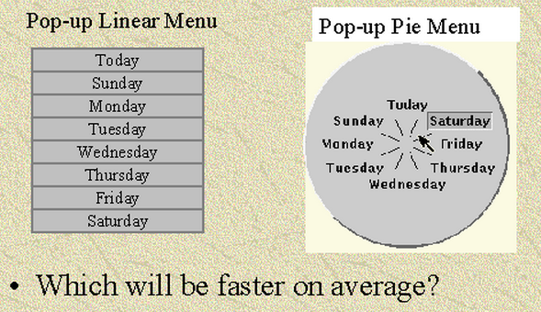
Which is faster?

Slide 17
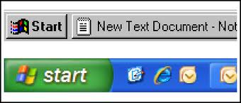
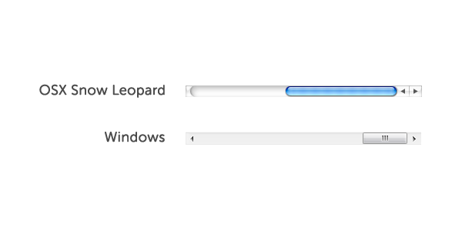
Why oh why?
What’s wrong with Windows’ start button?
Relate it to “Fitts’ Law”
What about slider bars?

Slide 18
Understand Fitts’ Law?
Is there a benefit to having a label under the icon on the Windows desktop?
If you have an auto-hidden Taskbar on Windows, how can this be irritating?
Does this confirm something about Fitts’ Law?
How would Fitts’ law impact your layout of buttons, fields, etc. in a dialog box?

Slide 19
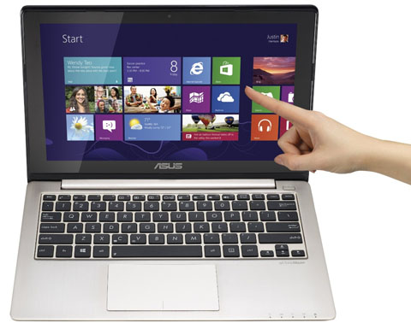
Example, Windows
How have they improved the layout in Windows 10 to adhere more closely to Fitts’ Law?

Slide 20
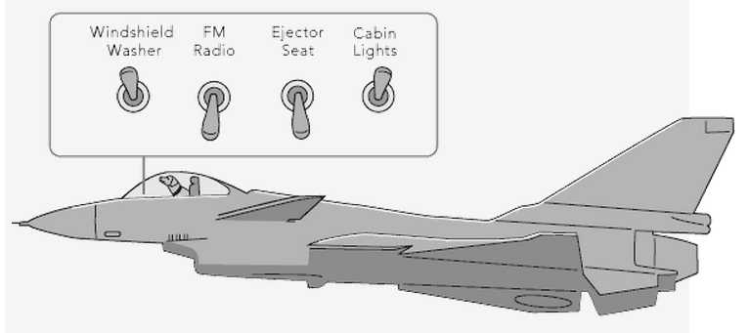
Application of Fitts’ Law
What implications do the button placements have?
On the image above
Consider Fitts’ Law
How could this be redesigned?

Slide 21
Case Study
A new UI for cars…
http://www.youtube.com/watch?v=XVbuk3jizGM&feature=youtu.be

Slide 22
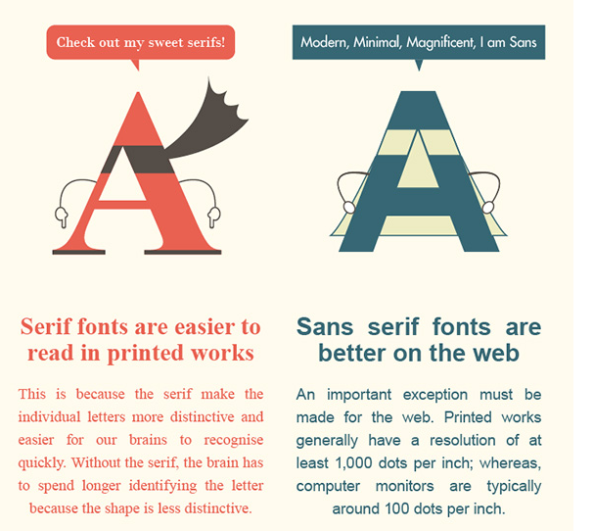
Using Text Well
Goal: legibility
Font is typeface + size
Factors to consider
Sans serif better than serif on screen
Not too big, not too small
10 or 12 point is smallest
Extended chunks of bold or italic harder to read
Spacing between lines
Too much and lines don’t group in user’s mind

Slide 23
Using Text Well
Underlining: a web-link or emphasis?
Consistency
Common issue on web-pages
Background / font-color combinations
Black on white
Lighter on darker (e.g. presentations in large rooms)
Some you should avoid?
Can you read this easily?
Can you read this easily?
Can you read this easily?

Slide 24
General Guidelines: Text
Keep text to a minimum
50% of what you had in printed form
Lists not paragraphs
Help users scan for information
Good headings and subheadings
Highlight important things
Good organization
Divide long blocks into sections or pages

