Slide 1
State Machines
State diagrams

Slide 2
The State Diagram can be a powerful aid in helping you to define the operation of a Controller
State Diagrams illustrate the dynamic behavior of a system (i.e.
how a Controller functions) where events (perhaps from the UI)
trigger one or more actions and cause the system (Controller)
to change its state.

Slide 3
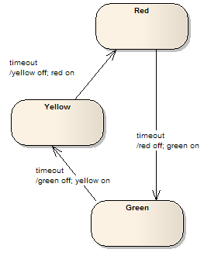
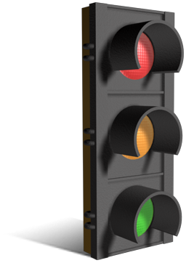
A traffic light controller changes states based on events from a timer that fires at regular intervals

Slide 4
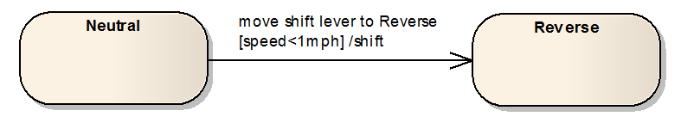
A guard may be used to illustrate a condition that must be satisfied before a state transition can occur.
The guard appears in brackets: [<guard>]

Slide 5
A State Diagram for a light bulb controlled with a toggle switch
The event flip switch to ‘1’ triggers the action current flows
and the transition to the on state.
The event flip switch to ‘0’ triggers the action current stops flowing
and the transition to the off state.

Slide 6
A State Diagram for a light bulb controlled with a pushbutton switch
The same event (button pressed) triggers different actions
depending upon its current state.

Slide 7
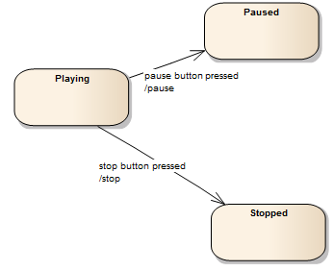
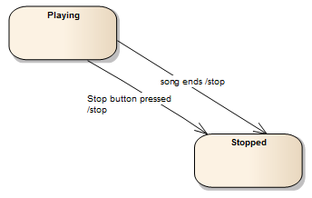
Different events may also cause transitions to the same state
Different events may cause transitions to different states
However, state transitions must be deterministic; that is, the same event
cannot cause a transition from one given state to more than one subsequent state.

Slide 8
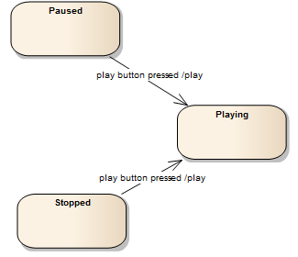
The same event can cause different states to transition to the same state
These state transitions are still deterministic since the same event
does not cause a transition from one given state to more than one subsequent state.

Slide 9
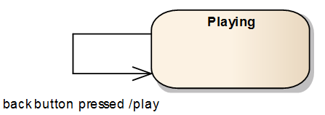
It is common for an event to result in an action, but no state transition

Slide 10
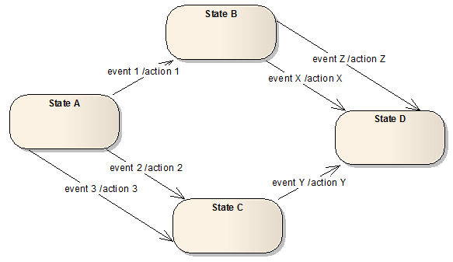
In a complex system, different events may cause transitions to different states or to the same state

Slide 11
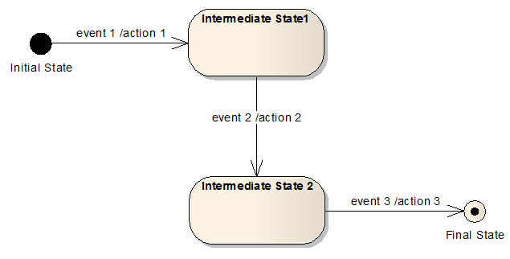
Initial and Final states may be indicated as follows
Initial and Final states are special in that once a system leaves an Initial state, it cannot
return to that state, and once a system achieves a Final state, it stays in that state.

