Slide 1
SE-2030
Software Engineering
Tools and Practices
Instructor: Dr. Yoder
Slide Credits: Drs. Hornick and Riley
(Applies all quarter)

Slide 2
Essential Info
Instructor: Dr. Josiah Yoder
email: yoder@msoe.edu
Office: L341
See the syllabus for Office Hours
  Lets look at it together…

Slide 3
Grading
Lab assignment submission details will be posted on my faculty-web page.
(http://faculty-web.msoe.edu/yoder)
Labs will be due on the first class of the week
Quizzes (~1 per week) will be on Thursday
Final exam is cumulative

Slide 4
Grading policy
This is a course about teamwork
  All team members must contribute
    Contributions are documented through Git
    My primary role is to mentor you as leaders
    Team members could receive different grades
  All work must be submitted on time to count
    Unless extenuating circumstances exist

Slide 5
Grading policy
Discussing homework and code with your fellow students is encouraged
  Sharing code (even by showing it on your screen) is a violation of course policy
  You should copy the URL into your code before copying even a single method call from stack overflow
You must have a passing grade on the exams to pass the class.

Slide 6
Icebreaker
Presenter
  Stand (and stay standing until the end)
  Say
    Name (first and last)
    Major
    A fun fact about yourself
Everyone else
  If you have the fun fact in common, stand
  First person to stand becomes next presenter
  Everyone else sits down

Slide 7

What are Software tools?
Describe the tools have you used to develop software in SE 1011, 1021, and 2852.
What about these tools improves your ability to develop software?
What does it mean to develop good software?

Slide 8

What is a “process” for building software?
A software process typically defines phases
What phases can you think of?

Slide 9
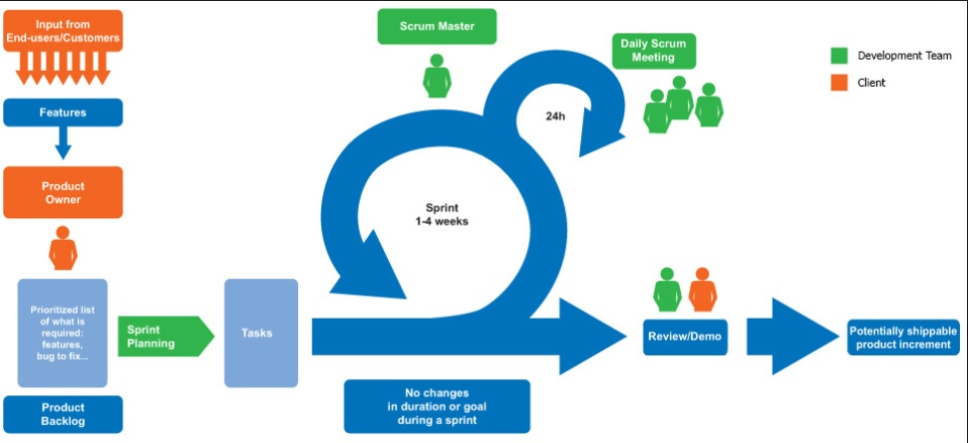
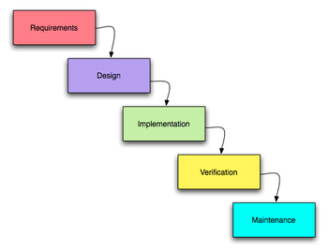
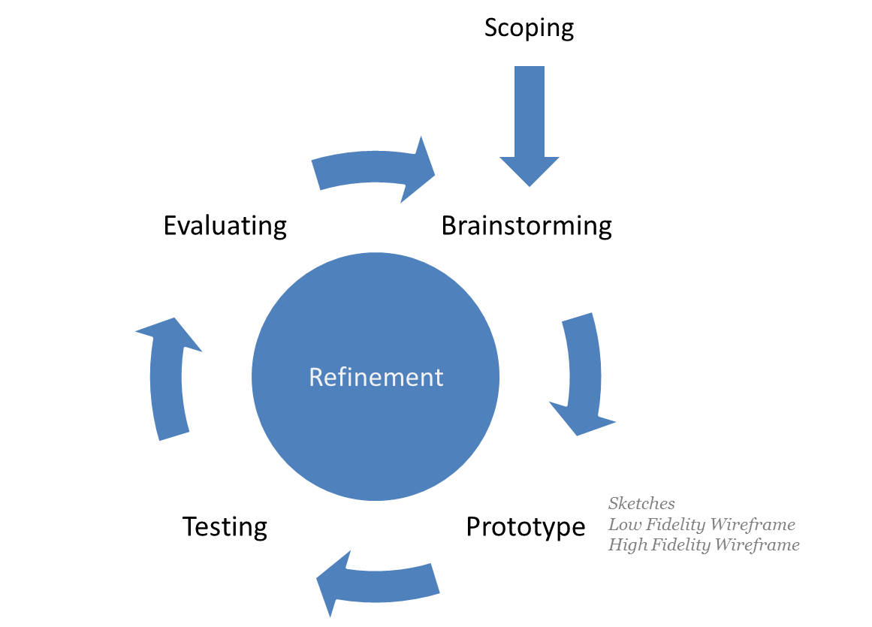
Example Software Processes

Slide 10

Why do we use processes?
Large software is hard to build as a team
  Examples?
Practices are activities that implement the process

Slide 11
A Requirement is a specific thing your system must satisfy in order to work correctly
A Requirement is usually a single thing that can be tested
  to make sure you’ve actually satisfied it
  When all Requirements are met, your application is complete!
    In theory…
Example requirements???
  For Uber’s mobile app (for riders)
  Are your requirements testable?

Slide 12
What is meant by Requirements?
Statements that qualify what the program does…
  Or should do
Sometimes requirements specify what a program must not or cannot do
  Or should not do
  These are sometimes called inverse requirements

