Slide 1
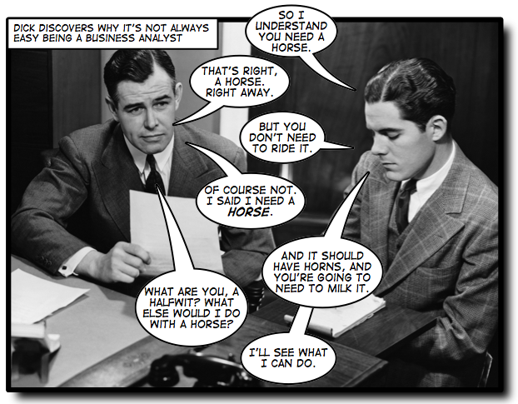
Use Cases and User Stories
An Engineer

Slide 2
Terminology
User Story
  Short description (formulaic sentence)
  Text only
Use Case
  Description of a set of interactions
  Text or UML representation
“A user story is to a use case as a gazelle is to a gazebo”
  Alistair Cockburn

Slide 3
User Stories are a common way of expressing a Requirement
  User Story format: “As a <specific type of user>, I would like to <achieve some goal> in order to <justification>”
  As a Student, I would like to view open courses in order to create a schedule
  As a Faculty, I would like to view the students registered for the course sections I am teaching in order to take attendance.
  As the Registrar, I would like to create courses and course sections in order to set up the upcoming schedule
A complete set of User Stories
describe everything an system can do.

Slide 4
Use Cases narrate
Use Cases explain what actually happens when someone uses the system to (try to) achieve a goal
To help us understand how it should work in detail
Use Cases were introduced by Ivar Jacobson in the 1980’s

Slide 5
Each Use Case explains one or more Scenarios that describe how the system should interact with an Actor to achieve a specific Goal
A Scenario is a narrative that describes what happens within a specific Use Case
An Actor is an external agent that interacts with the system
A Goal is the specific thing accomplished as a result of executing a Use Case.

Slide 6
A Use Case can contain more than a single Scenario
  Every Use Case contains a basic Scenario that describes what happens in the “normal” case
    This is called the Main Path, Normal Flow, Basic Flow, or “Sunny Day” Scenario
    The Goal is always achieved in the basic Scenario
Additional Reading: How to Write a Use Case:
http://www.bridging-the-gap.com/what-is-a-use-case/

Slide 7
An Actor is a external agent that interacts with the system
The Actors for some systems are just the conventional “users”
  The Blackboard system incorporates the concept of different types of Actor/users
    What are they?
An Actor does not have to be a person
  Some systems interact with other (external) systems
  Examples?

Slide 8
Actor Differences- Blackboard
As a Student, you can
  View the courses you are enrolled in
  Submit your assignments
  Retrieve your grades
As a Faculty, I can
  View the courses I am teaching
  View the students in each course
  Create assignments
  Grade assignments
The Registrar can
  Create courses
  Assign me to a course as the Faculty
  Assign you to a course as a Student
Each of these is a Goal, and each distinct Goal is the end result of a separate Use Case

Slide 9

A Goal is a specific thing accomplished as a result of executing a Use Case
Achieving the Goal is the reason for the User Story
  it has some value
A system may be capable of achieving multiple Goals
  Such as?
How many Goals does Blackboard achieve?

Slide 10

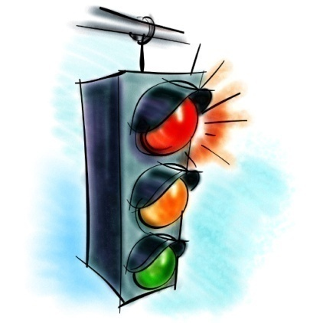
Use Cases have clear boundaries
Every Use Case must have a definite Starting and Stopping point
  Every Use Case is started off by an external initiator (an Actor)
  Every Scenario must have a condition that indicates that is complete
    goal achieved or not

Slide 11
Often, one Use Case must first be satisfied before another Use Case can proceed
This is called a Precondition
  What Precondition(s) must exist before a Customer can withdraw cash from an ATM?

Slide 12
Achieving a Goal may result in the creation of artifacts
These are called Postconditions
  The system may have changed state
  Data may have changed
  Files may have been created or destroyed
  Other output may have been generated

Slide 13
Meeting Goals of User Stories and their associated Use Cases
To verify that a Goal has been achieved, we usually talk about Acceptance Criteria
These take the form of:
  Evidence of tests passing
  Approval of observed functionality

Slide 14
Expectations for software reliability are increasing
A good solution goes beyond the obvious things a customer tells you
-Makes sure your system works even in unusual or unexpected circumstances
Plan for things to go wrong!
”Thinking and writing about failure handling
saves the design team a lot of money
over the course of the project.”
from Use cases, ten years later – Alistair Cockburn

Slide 15
Alternate Scenarios of a Use Case describe atypical or exceptional situations (“Rainy day scenarios”)
Alternate Scenarios can have
Different steps from those of the Main Path
Additional steps added to the Main Path
  recovery steps to get back on the Main Path
All Scenarios in a Use Case target a common Goal, although
in some Alternate Scenarios the Use Case may terminate abnormally
(without achieving the intended Goal)

Slide 16
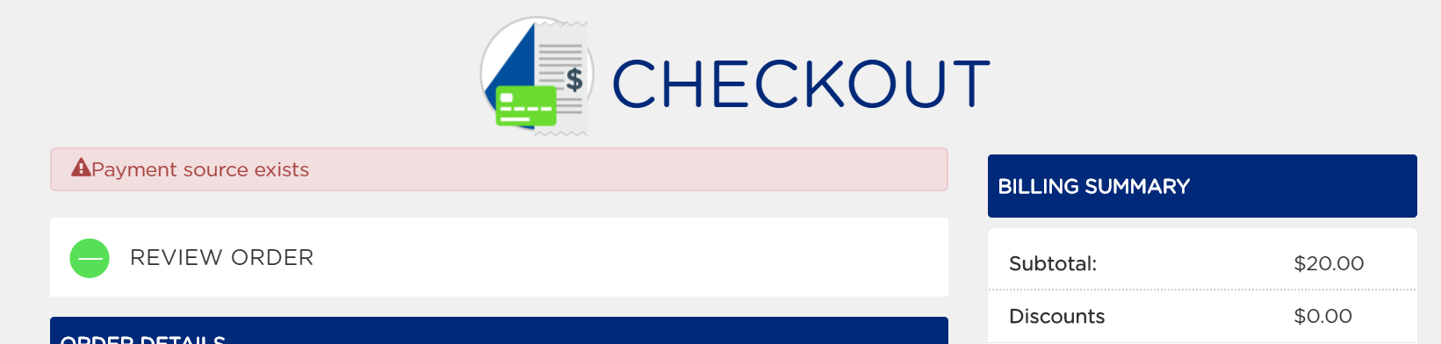
Example rainy-day scenario
User enters credit card info, hits submit, then…
What do you think went wrong?
How could the problem be better handled?
Notes:
At tracfone.com

Slide 17


Writing Use Cases is usually an iterative process
In reviewing Use Cases, you nearly always uncover requirements that the Customer expects
  …but didn’t think about on their own
  …sometimes you need to think beyond
  what the Customer asks for in order to determine the complete Requirements (more User Stories may need to be written)

Slide 18
Use Case Templates are used to provide a degree of standardization to related Use Cases
Use Case Title or User Story
Brief Description including Goal
Identification of Actor(s)
Pre-conditions
Scenarios
  Basic/Normal Flow
  Alternate Flows
Post-conditions/Acceptance Criteria
Additional Notes

Slide 19
Exercise: ATM
User Story Requirement #x: As a Customer, I would like to login to my Checking Account at an ATM so that I can withdraw money.
  Identify preconditions
  Individually write down the steps in the Main Path required to achieve the Goal
    Think sequence diagram!
  Each step should be described as an action/response
    i.e. an action initiated by an Actor and the subsequent response by the system
  Each step should be numbered
  Identify postconditions
The customer steps up to the ATM and swipes her card

Slide 20
Use case modeling
Use cases were developed originally to support requirements elicitation
  Now incorporated into UML
Each use case represents a discrete task that involves external interaction with a system
Actors in a use case may be people or other systems
Represented diagramatically to provide an overview of the use case and in a more detailed textual form

Slide 21
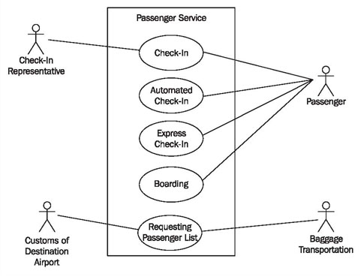
Use Case Diagrams
Building blocks
  Actors
  Use cases
  Boundaries (optional)
Relationships
  Include
  Extend
  Generalizations
  Associations
Notes:
We are only using associations this quarter, but you can also include “Is-a” and “Has-a” relationships between use-cases.

Slide 22
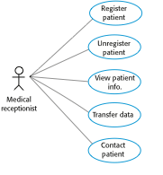
Use cases involving the role ‘Medical Receptionist’

Slide 23
