Slide 1
Design and UML
Sequence Diagrams
“There are two ways of constructing a software design. One way is to make it so simple that there are obviously no deficiencies. And the other way is to make it so complicated that there are no obvious deficiencies.”
-- Tony Hoare

Slide 2
Creating a Design
How did you design your software in other projects?
What is the limitation of those approaches as software gets bigger/more complex?

Slide 3

Textual Analysis of Use Case scenarios / User Stories is used to create high-level designs
Precondition: Source material should be complete, so that all capabilities of the system are described
Textual Analysis is a quick and easy way to make a “first guess” at the classes that will comprise the system

Slide 4

Textual Analysis: looking for the nouns and verbs
-in your Use Cases/User Stories
Nouns in the Use Cases are candidates for the classes you need to write
  Grammar 101: nouns are things
Verbs in the Use Cases are usually the methods that the classes implement
  Verbs are actions

Slide 5
Approach: Read through each Use Case, picking out the nouns appearing in the scenario descriptions
You’re actually discovering objects, which are instances of classes that abstract the problem domain entities
As a student I would like to see my grades in Blackboard in order to know how I am
doing in a class.
As a bank customer I would like to deposit checks using my phone in order to
avoid going to the bank.

Slide 6
After identifying nouns, eliminate redundancies
“list of names”
“name collection”
“array of names”
“Welcome message”
“Welcome dialog”
“Welcome screen”
“Names”
“Welcome Screen”
Note: Do not identify individual Buttons,
Checkboxes, Menus, etc as individual nouns;
these would all be part of a parent screen.

Slide 7
Some Nouns can be excluded
The following nouns are not candidates for classes:
“user retrieves cash from ATM”
“user inserts envelope into ATM”
Experience and common sense help here.

Slide 8
Write the objects and methods for the following User Stories...
As a Facebook user, I would like to be able to read my messages when I get a notification so I can respond appropriately.
As a Facebook user, I would like to respond to messages in the same window as I read the message so I can respond appropriately.
As a Facebook user, I would like to see when someone else has read my sent messages so I can know whether I should keep monitoring them.

Slide 9
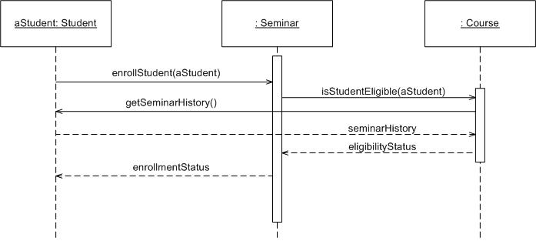
UML Sequence Diagrams
A sequence diagram is an interaction diagram that emphasizes the time ordering of messages
It shows a set of objects and the messages sent and received by those objects
Objects are arranged along the X axis
Messages are ordered in increasing time along the Y axis

Slide 10
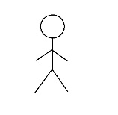
Sequence Diagram
Account
Box: Object/Entity
  With a dashed line descending from it
  The line is called the object lifeline
Actor:
  Treated the same as a box
  Different icon

Slide 11
Sequence Diagram
ATM
Account
checkBalance()
Messages are horizontal arrows being
  Passed from object to object
  Typically methods/functions
Time advances down the object lifelines
return

Slide 12
Sequence diagrams illustrate high-level interactions (method calls)
  A given Sequence Diagram shows just one interaction for a specific circumstance
    e.g. startup, shutdown, processing a single button click,…
    Classes and objects can interact with one another in many different ways
    Generally the interaction shown is interesting or important for some reason
ATM
checking : Account
savings : Account
main();
status = withdraw(100);
status = deposit(100);

Slide 13
Startup Sequence Diagram
public class ATM {
private static Account checking = new Account(); private static Account savings = new Account(); private ATM() {
}
public static void main(String[] args) {
// perform some initial transactions
boolean status = checking.withdraw(100); status = savings.deposit(100);
}
} //end ATM
ATM
checking : Account
savings : Account
main();
status = withdraw(100);
status = deposit(100);

Slide 14
Notation & representation
The name of the class appears at the top of a Sequence Diagram rectangle
  Which can also (optionally) include the name of the object representing a particular instance of that class:
  [<object_name> ]: <class_name>
chkAcct : Account
chkAcct is the name of the reference to an instance of an Account

Slide 15
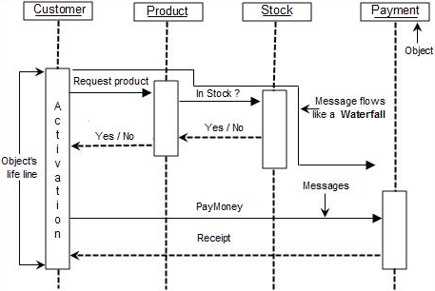
Example
Critiques?

Slide 16
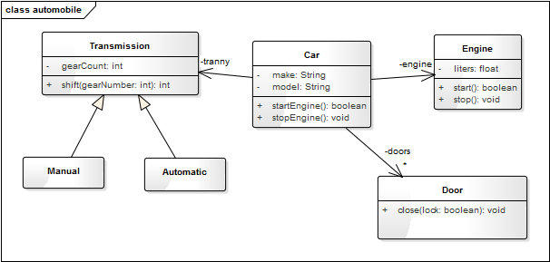
Lets try an example
Lets create a sequence diagram for starting a Car
Critiques?
Lets create a sequence diagram for opening and closing a door

Slide 17
Another Example
Create a sequence diagram
Based on the user stories analyzed previously
  Shows the process of a mobile app user
    Opening the Facebook app
    Checking messages
    Replying to a message
    Closing the app

Slide 18



Further refinement: Object classification
Boundary Objects
  Model the system boundary
  User Interface elements (entire screens,
  but not individual ui elements)
    Interfaces to external actors (e.g. databases)
Control Objects
      Represents an entity or manager that makes decisions (e.g. figures out what to do when a button is pressed)
      In simple systems, this is usually the application itself, and there is typically only a single Control Object (thread)
Entity Objects
      A data store or persistence element that captures or represents information (often multiple objects)
The precise/permanent classification of objects is not always
possible upon first review – iteration is often necessary!

Slide 19
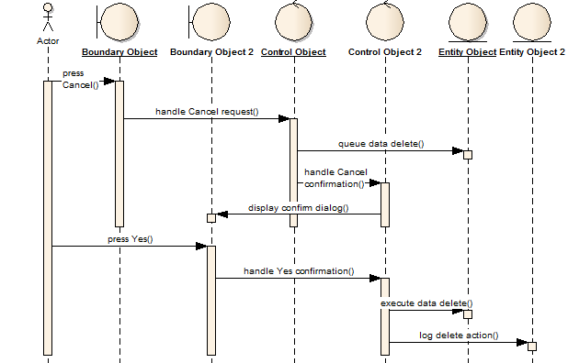
Elements must obey the following relationships
Actors can only talk to boundary objects.
Boundary objects can usually only talk to controllers and actors.
Entity objects can usually only talk to controllers.
Controllers can talk to boundary objects and entity objects, and to other controllers, but not to actors
There should only be one controller unless you are designing a multithreaded application.

Slide 20
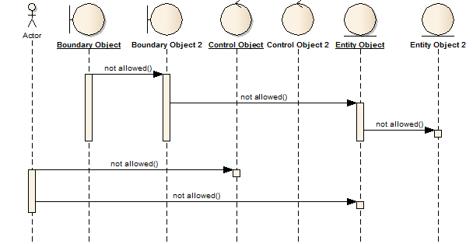
The following relationships are generally restricted or not permitted
Actors can only talk to boundary objects.
Entity objects can communicate with an another Entity that it “owns” (e.g. an Collection owns Items in the Collection)
Boundary objects can talk to only very specific Entity objects (UI gets Items from a Collection to display), and other Boundary objects it “owns” (e.g. a popup dialog).
Controllers can talk to boundary objects and entity objects, and to other controllers, but not to actors
Allowed with
reservations
Allowed with reservations
Allowed with
reservations

Slide 21
Demo!
http://www.sparxsystems.com.au/resources/demos/sequence/Sequence_diagram.htm
Now create a sequence diagram for a simple ATM scenario…

Slide 22
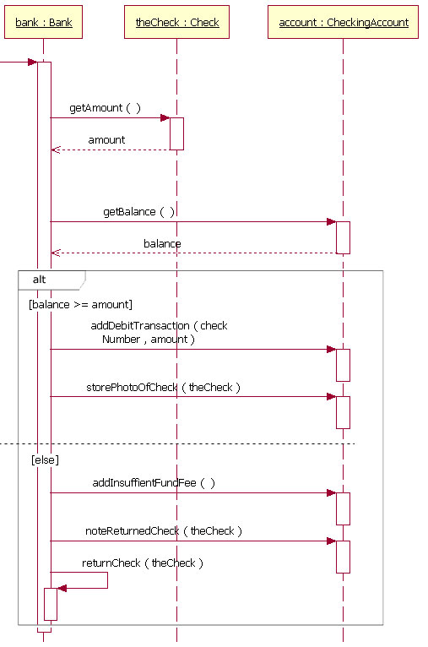
Sometimes, you may want to show conditional logic (selection) in a Sequence Diagram
Critiques?

Slide 23
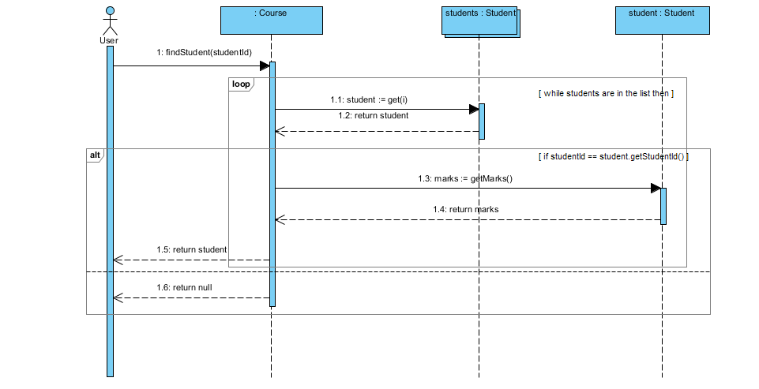
Similarly, you can illustrate iteration

