Slide 1
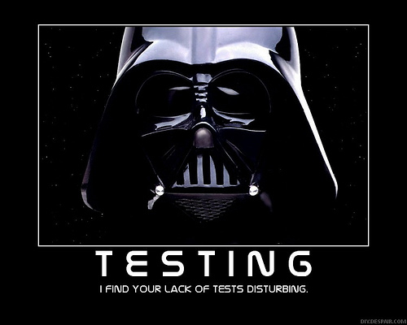
Introduction to Testing

Slide 2
Motivation
How have you tested your software in previous classes?
Is this adequate?
What if your software was used on the next mission to Mars?

Slide 3
Testing
Testing is intended to show that a program does what it is intended to do and to discover program defects
  before it is put into use
You check the results of the test run for errors, anomalies or information about the program’s non-functional attributes
Can reveal the presence of errors NOT their absence
Testing is part of a more general verification and validation process
Wait, why are we talking about testing now???

Slide 4
Test-Driven Development (TDD)
It’s generally better to write the tests before writing the code you want to test
This seems backward, but it really does work better:
  When tests are written first, you have a clearer idea what to do when you write the methods
  Because the tests are written first, the methods are necessarily written to be testable
  Writing tests first encourages you to write simpler, single-purpose methods
  Because the methods will be called from more than one environment (the “real” one, plus your test class), they tend to be more independent of the environment

Slide 5
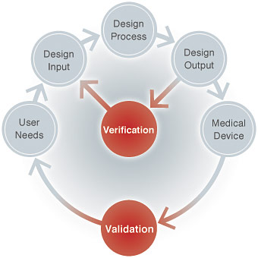
V&V
Validation
Verification
Evaluating the product to see if meets the requirements
  Specified by the customer
Was the right software built?
Does it match what the customer wants?
  Specification
Evaluating the product to see if it meets the design
  Specified by the architect
Was the software built “right”?
Does it match the design?
Both must be performed!
Notes:
https://www.asme.org/engineering-topics/articles/manufacturing-design/validation-verification-for-medical-devices
https://cdn.asme.org/getmedia/18e4cd2e-361e-4330-99c0-224685d42207/Validation-and-Verification-for-Medical-Devices_01.jpg.aspx?width=340
Added image after presenting this 19q3.

Slide 6
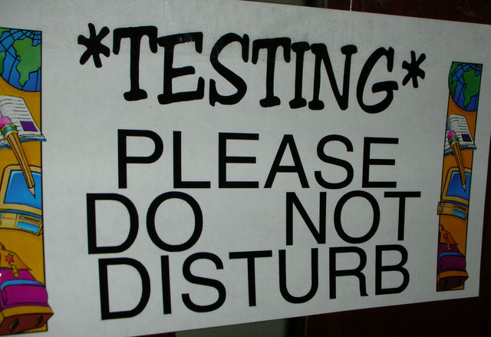
Testing Scope
Unit testing
  Test individual components in isolation
  Units: Classes, methods, etc
  Usually done by the developer
Module testing
  Test a group of components that interact with each other (Logically related)
  Interfaces between the components must also be tested
Functional tests -- Integrated testing
  Test systems and subsystems
Acceptance testing – functional tests with user present

Slide 7
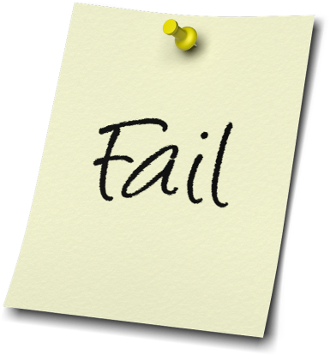
How can you test your code?
Run the app with inputs that should produce a known output, and verify the actual output
  Problems???
Write a separate “test” program that is designed to exercise the classes and methods of the “production” app
A problem with this might be gathering the results of the exercises and determining whether each one passed or failed.

Slide 8
Acceptance Testing
“Final” criteria that the owner uses to accept a product as “done”
  Examples?
User Acceptance Testing
  User-focused
Business Acceptance Testing
  What is necessary to get paid ($)

Slide 9
Acceptance Testing Objectives
Three major objectives of acceptance testing:
Confirm that the system meets the agreed upon criteria
Identify and resolve discrepancies
  If there are any
Determine the readiness of the system for cut-over to live operations

Slide 10
Acceptance Test Plan
All acceptance tests should be established BEFORE a design is implemented
  Why?
Test cases must be written
  Test title, objective
  Test preconditions
  Test procedure
  Expected results
How many???
Lets write some test cases
Library Room Reservation App

Slide 11
Criteria to consider
  Functional Correctness and Completeness
  Accuracy
  Data Integrity
  Data Conversion
  Backup and Recovery
  Competitive Edge
  Usability
  Performance
  Start-up Time
  Stress
  Reliability and Availability
  Maintainability and Serviceability
  Robustness
  Timeliness
  Confidentiality and Availability
  Compliance
  Installability and Upgradability
  Scalability
  Documentation

Slide 12
Testing Activity
In teams
  Identify testable acceptance criteria for an ATM application
  Write one test for your acceptance criteria
    Name/Objective
    Preconditions
    Procedure
    Expected result
  These will be presented

Slide 13
Acceptance Test Execution
Two subgroups
  Basic/fundamental
  Complex/nuanced
If the basic tests pass, then move onto the complex tests
Usually with the customer/user
Test status should be documented
  Defects should be documented for future repair

Slide 14
Quotable quotes
If you don't unit test then you aren't a software engineer, you are a typist who understands a programming language.
--Moses Jones
1. Never underestimate the power of one little test.
2. There is no such thing as a dumb test.
3. Your tests can often find problems where you're not expecting them.
4. Test that everything you say happens actually does happen.
5. If it's worth documenting, it's worth testing.
--Andy Lester

