Slide 1
UML Review – class diagrams

Slide 2
Remember UML Class Diagrams from SE1021 and CS2852?
What does a Class
diagram illustrate?

Slide 3
UML Review:
Class diagrams
A UML Class Diagram represents classes and their relationships to one another
  UML is not specific to any language
  The name of the class always appears at the top of a Class Diagram rectangle
public class Account {
}
Account

Slide 4
Class diagrams:
Attributes
A Class Diagram can also show class attributes or fields
  Syntax: [visibility] <attr_name> [ : <type> [=default_value] ]
  Note: The static specification may be illustrated with an underscore
public class Account {
private double balance;
public static double rate = 2.5;
}
Account
?????
What goes here?

Slide 5
Class diagrams:
Attributes
A Class Diagram can also show class attributes or fields
  Syntax: [visibility] <attr_name> [ : <type> [=default_value] ]
  Note: The static specification may be illustrated with an underscore
public class Account {
private double balance;
public static double rate = 2.5;
}
Account
balance: double
+ rate: double = 2.5

Slide 6
Class diagrams:
Operations
A Class Diagram can also show class methods or operations
  Syntax: [visibility] <name>([ [in|out] param:type]*]) [:<return_type>]
public class Account {
private double balance;
public static double rate = 2.5;
public void deposit (double amount) {
balance += amount;
}
protected double getBalance() {
return balance;
}
public static void setRate(double intRate ) {
rate = intRate;
}
}
Account
balance: double
+ rate: double = 2.5
?????
What goes here?

Slide 7
Class diagrams:
Operations
A Class Diagram can also show class methods or operations
  Syntax: [visibility] <name>([ [in|out] param:type]*] [:<return_type>]
public class Account {
private double balance;
public static double rate = 2.5;
public void deposit (double amount) {
balance += amount;
}
protected double getBalance() {
return balance;
}
public static void setRate( double intRate ) {
rate = intRate;
}
}
Account
balance: double
+ rate: double= 2.5
+ deposit(amount : double) : void
# getBalance() : double
+ setRate(intRate: double) : void

Slide 8
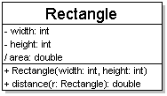
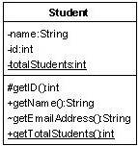
Class attributes
attributes (fields, instance variables)
  visibility name : type [count] = default_value
  visibility: + public
  # protected
  - private
  ~ package (default)
  / derived
  underline static attributes
  derived attribute: not stored, but can
  be computed from other attribute values
  attribute example:
  - balance : double = 0.00

Slide 9
Class operations / methods
operations / methods
  visibility name (parameters) : return_type
  visibility: + public
  # protected
  - private
  ~ package (default)
  underline static methods
  parameter types listed as (name: type)
  omit return_type on constructors and
  when return type is void
  method example:
  + distance(p1: Point, p2: Point): double

Slide 10
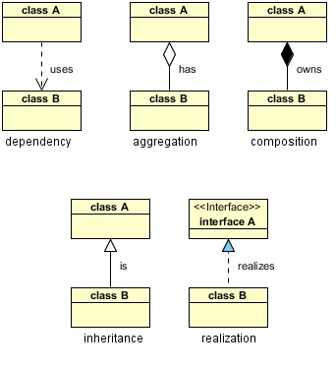
UML Class Diagrams usually illustrate a relationship between classes
The easiest to master are those that illustrate a permanent (that is, static) relationship between classes
There are two basic categories of static relationships:
  Inheritance
  Dependency

Slide 11
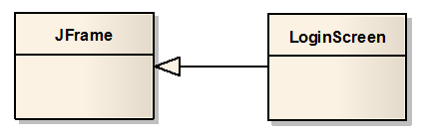
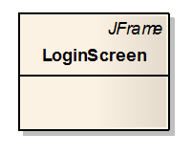
Generalization is a form of Inheritance
Generalization indicates that a class (statically) inherits behavior
defined and implemented in another class
Here, the UML Generalization connector originates from the LoginScreen class inheriting the behavior (and attributes) of the JFrame class. The connector is a solid line pointing to the class whose behavior is being inherited with a triangle (not an arrow!)
Generalization can be illustrated in the alternate notation shown if the parent class is not present in the class diagram

Slide 12
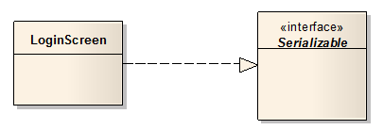

Realization is a form of Inheritance
Realization indicates that a class implements the behavior defined in an interface
Here, the Realization connector originates from the LoginScreen class implementing the behavior of the Serializable class. The connector is a dashed line pointing to the class whose behavior is being implemented with a triangle (not an arrow!)
Realization can also be illustrated in the alternate notation shown if the parent class is not present in the class diagram

Slide 13

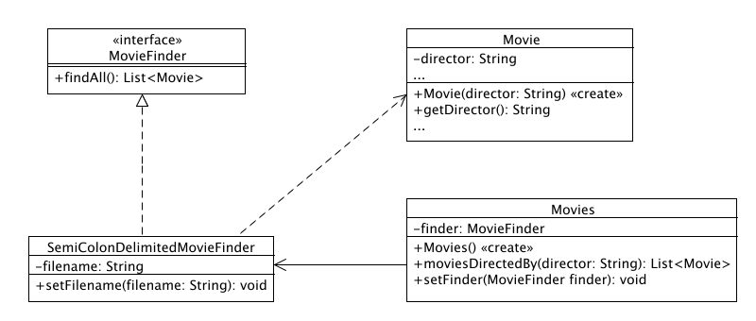
Class diagrams sometimes explicitly illustrate Dependency relationships
(of classes on other classes or packages)
Dependency is indicated by a dashed-line connector, with the line originating from the dependent class and pointing (with an arrow) at the other class it depends upon.
The arrow may also point at a package, implying a dependency on many of the classes within that package.

Slide 14
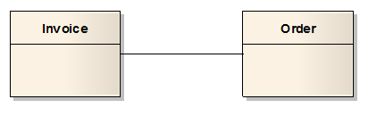
The Association connector is used to indicate a run-time (dynamic) interaction between instances of classes
The single-line connector doesn’t indicate anything specific – that
is, it’s an unspecified association.
About all we can say is that objects of these classes somehow interact when the application executes – perhaps an Invoice somehow accesses an Order (or vice versa).
In fact, the Invoice can create the Order at runtime (and later delete it); or the Order can create the Invoice at runtime – thus these relationships are dynamic.
We may not know enough to be more specific when we’re designing our application – it may have to wait until we get into implementation

Slide 15
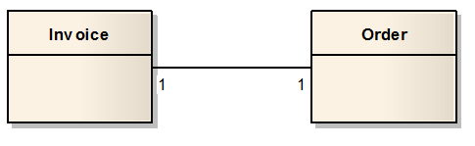
An Association can indicate multiplicity – that is, how many objects of one class interact with objects of the other
This Association indicates that there is a one-to-one correspondence between Invoice instances and Order instances; that is, for every Invoice object, there is one corresponding Order object, and vice versa.
If the numbers are absent, you can assume that there is a one-to-one correspondence.

Slide 16
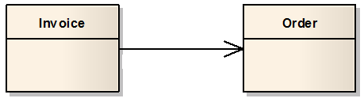
Associations can indicate navigability – that is, whether an object holds a reference to the other
This one-way directed association indicates that an Invoice object holds a reference to a single Order object, but the Order does not hold a reference to an Invoice.
Note that we’ve omitted the multiplicity
here, so it’s assumed to be one-to one

Slide 17
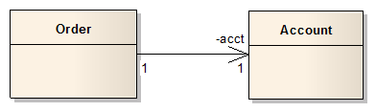
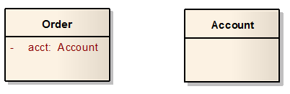
End Roles indicate that an association is maintained via a specific attribute defined within a class
This one-to-one, one-way association with end role acct indicates that an Order object holds a reference to a single Account object via a private Account attribute named acct.
Note that we’ve included the multiplicity
here, but we could have omitted them since
the correspondence is one-to-one
Here is another way of showing the same relationship.
Is this more or less illustrative?

Slide 18
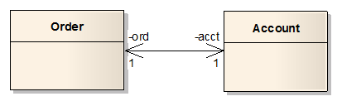
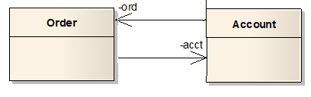
Bi-directional navigability
This bi-directional association indicates that an Order object holds a reference to a single Account object via a private Account attribute named acct, and that an Account object holds a reference to a single Order object via a private Order attribute named ord.
However, it is always best to avoid bi-directional associations, and instead to use two uni-directional arrows to illustrate this relationship.
Note that we’ve omitted the multiplicity
here, so it’s assumed to be one-to one.
It also reduces clutter.

Slide 19

An Association can be labeled to indicate the nature of the relationship
This diagram can be read as follows: “A Person lives in a House, which the Person refers to as home”.
Again, we’ve omitted the multiplicity here, so it’s assumed to be one-to one.
It also reduces clutter.

Slide 20
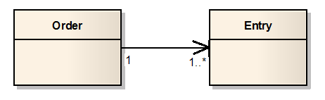
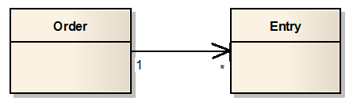
Associations can indicate various degrees of multiplicity
This Association indicates that for every Order object, there is at least one corresponding Entry object.
Here, any number (including zero) of Entry objects correspond to each Order object
We can omit the 1 next to the Order class to reduce clutter

Slide 21
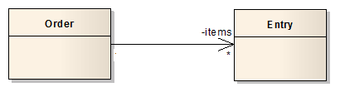
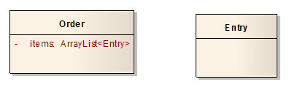
Associations with multiplicity >1 implies that a reference is a collection of objects
This one-way association indicates that an Order object holds a reference to a collection of zero or more Entry objects via a private attribute named items.
However, the type of collection is not specified here.
The same association, where the collection is explicit. However, this approach is not preferred.

Slide 22
Good UML Class Diagram practices
Consider the following code:
Public class Student {
private String firstname;
private String lastname;
private Date birthdate;
private String major;
private int id;
private double gpa;
private List<Course> courses;
}
What does the UML class diagram look like?
Which class(es) should be explicitly shown? Why?
Which class(es) should appear as attributes? Why?

Slide 23
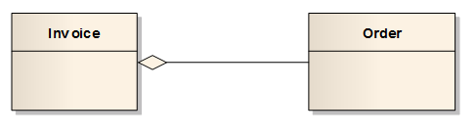
Advanced Associations:
Containment (aka Shared Aggregation) is a form of an association that indicates a whole-part relationship.
Containment indicates that an Invoice is logically comprised of an Order part (one, in this case). It does not make sense for Invoice object to exist independently of the Order object, because an Invoice always must contain an Order.
However, the Order can exist without the Invoice. That is, if the Invoice object is deleted, the Order can still exist (maybe it can be fulfilled free of charge).
Some believe that it is not necessary to indicate Containment/Shared Aggregation, and that more general directed Association is sufficient.

Slide 24
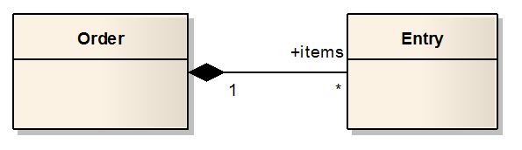
Another Advanced Association:
Composition (or Composite Aggregation) is a stronger form of aggregation that implies a whole-part relationship and lifetime of the parts
Composition implies that an Order is comprised of Entry parts (an Order logically does not exist without any Entry objects), and that the Entry objects cannot exist independently of the Order object; that is, the Order exclusively owns the Entry objects.
The lifetime of the Entry objects is controlled by the Order object. If the Order is deleted, all the Entries are deleted as well.
Again, some believe that it is not necessary to indicate Compostion/Composite Aggregation, and that more general directed Association is sufficient.

Slide 25
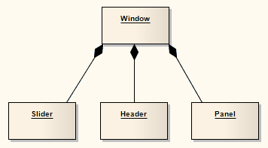
If a Composition is deleted, all of its parts are deleted with it
A component (part instance) can be included in a maximum of one Composition at a time.
A part can be individually removed from a Composition without having to delete the entire Composition.

Slide 26
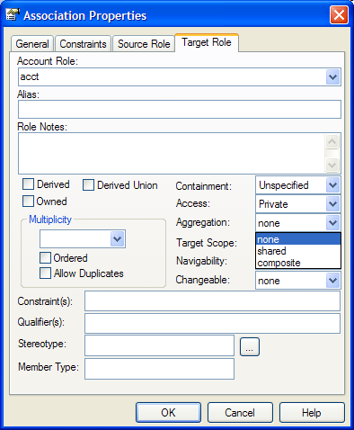
Inconsistent terminology between strict UML and EA
UML Containment
  A is composed of B; B can exist without A
  EA refers to this as Shared Aggregation
UML Composition
  A is composed of B; B cannot exist without A
  EA refers to this as Composite Aggregation

Slide 27
How to see parameter names and types in EA13
Right click on the model
Select Properties
Select Features
Show Parameter Detail
  Full details
Hit OK

