Slide 1
Design Patterns

Slide 2

Design patterns
A design pattern is a way of reusing abstract knowledge about a problem and its solution
  A pattern is a recurring solution to a standard problem, in a context
Pattern descriptions usually make use of object-oriented characteristics
  such as inheritance and polymorphism
What commonly-used patterns can you think of?
  Not necessarily software…

Slide 3
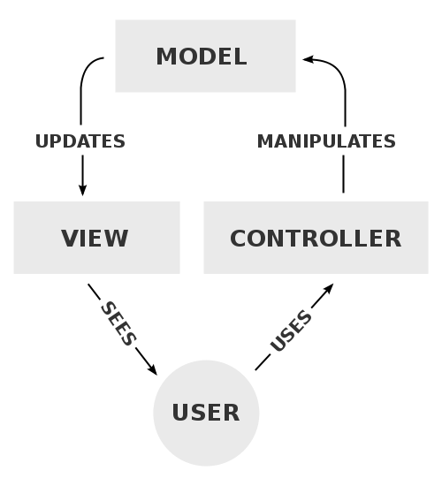
Model, View, Controller
The model represents data and the rules that govern access and updates of this data.
The view renders the contents of a model. It specifies exactly how the model data should be presented.
The controller translates the user's interactions with the view into actions that the model will perform.
Model
M
Update
V
View
Controller
User
C
To decide how to implement a pattern, we need to understand how
components interact with each other…

Slide 4
Patterns
What other software patterns can you think of?
What common solutions exist???

Slide 5
Observer Pattern - Example
a
b
c
b
Observers
x
60
30
10
a
c
y
50
30
20
z
80
10
10
a b c
a = 50%
b = 30%
c = 20%
Subject
requests, modifications
change notification

Slide 6
Subject & Observer
Subject
  the object which will frequently change its state and upon which other objects depend
Observer
  the object which depends on a subject and updates according to its subject's state.
Examples???

Slide 7
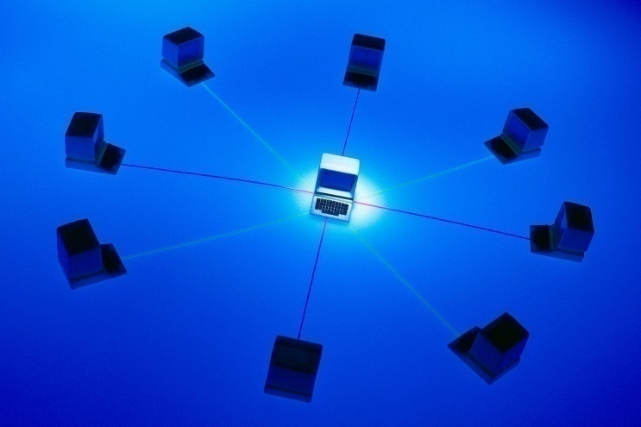
Observer Pattern Context
A system contains objects exhibiting:
  One-to-many dependency between objects
  One object changes state
  All dependents are notified and updated automatically

Slide 8
What are we trying to achieve with the Observer Pattern ?
Separation of software subsystems
  Separation between GUI & Domain objects
Loosely-coupled classes
  Because tightly-coupled classes reduce reusability & understanding
A generic/elegant way for the classes to communicate

Slide 9
Key components in the Observer Pattern
Subject
  Subject has dependent observers.
Observer(s)
  When the state of the subject changes, each dependent observer is notified.

Slide 10
Generic Subject class
class SubjectClass implements Subject {
public SubjectClass();
public void attach(Observer obs);
public void detach(Observer obs);
public void notifyObservers();
private ArrayList <Observer> observers;
}
Note: Some implementations define a notify() instead of notifyObservers() method.
-However, Java’s Object class already has a notify() method, which we don’t want to override.
Notes:
Subject::attach(Observer* pObserver)
{
m_hObservers.push_back(pObserver);
}
Subject::detach(Observer* pObserver)
{
m_hObservers.remove(pObserver);
}
Subject::notify()
{
Vector<Observer*>::iterator m_ppObserver;
for (m_ppObserver = m_hObservers.begin();m_ppObserver = m_hObservers.end(); ++m_ppObserver)
(*m_ppObserver)->update();
}

Slide 11
Generic Observer
class ObserverClass implements Observer {
public ObserverClass();
public void update(???);
}
What is/are the appropriate parameter(s) for the update() method?

Slide 12
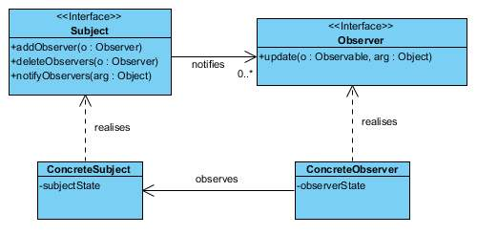
Basic class relationships

Slide 13
Collaborations between objects in the Observer pattern
s:ConcreteSubject
o1:ConcreteObserver1
o2:ConcreteObserver2
addObserver(this)
addObserver(this)
notifyObservers()
update(?)
Push vs. Pull
getContextSpecificInfo()
update(?)
getContextSpecificInfo()
Table service vs.
takeout

Slide 14
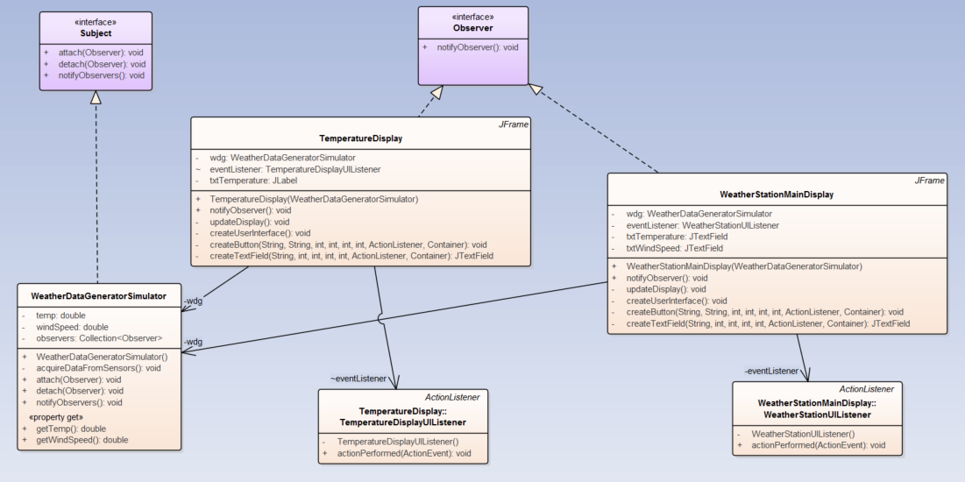
UML for a Weather Station

Slide 15
Consequences (positive)
Coupling between Subject and Observers:
  Subject knows it has a list of Observers, but not specific classes
  Each Observer conforms to the simple interface of the abstract Observer Interface.
  Hence, coupling is
    Abstract
    Minimal

Slide 16
Consequences (negative)
Broadcast communication
  Notification is broadcast to all interested objects.
  Observers can be added/removed at any time.
  Observer decides when it needs to be notified.
Unexpected updates
  Observers have no knowledge
    Of each other’s presence
    About the cost of “state change of subject”
  Cascade of updates can happen
    Prioritization is not built in

Slide 17
Design Principles by Alan Davis
A design process should not have tunnel vision.
  It should consider all possible solutions and make use of all available resources
A design specification should have mechanisms to trace back to requirements.
  It should be easy to identify mistakes later on and is also easy to add more features to the software product
A design process should not reinvent the wheel.
  It should try to make use of previous design patterns, resources and experiences as much as possible
A design specification should be structured to accommodate changes.
  It should be easier if it follows some standards such as IEEE, ANSI, ISO, etc.

