Slide 1
Bug Tracking

Slide 2
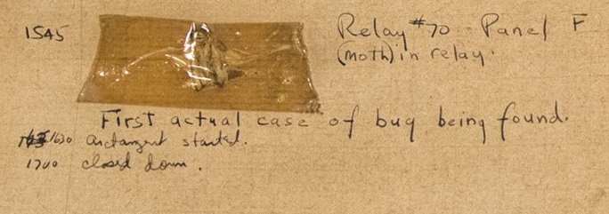
Bugs
What is a bug?
The original software “bug” was supposedly a moth that flew into a relay and shorted out a connection in a Mark II computer
  1946
Why call it a defect?
  The implication of a bug is that it accidently incorporated itself
    Is this ever the case?
  Defect is a better term
How do you discover defects in your code?

Slide 3
Defect Tracking
Keeping track of all the defects that have been discovered
Keeping track of all the steps required to validate, correct, and take preventative action for a defect
Necessary
  to not lose any reported defects
  to co-ordinate defect resolution
  to ensure coders don’t work on non-defects
    Features masquerading as defects
    Wasting time fixing something that isn’t broken
    Wasting time chasing down a badly reported defect
  to control defect correction activity
    ensure the right defects are being worked on
In practice:
  A database of defect records
  A workflow driven by the state and owner fields.
Notes:
The 80% includes mortgages: http://www.pewtrusts.org/~/media/assets/2015/07/reach-of-debt-report_artfinal.pdf

Slide 4
Defect Information
Where Found
  product, release, version, hardware, os, drivers, general area
Who Found It
  customer, internal, when
Description of the Defect
  summary, description, how to reproduce, associated data
  links to related defects or features
Triage
  severity, likelihood → priority
Audit Trail
  all changes to the defect data, by whom, when
State
  state, owner

Slide 5
Priority Matrix
 |  | Likelihood
 | Priority | Low | Medium | High
Severity | Crash, bad data | 2 | 1 | 1
 | Work around | 5 | 3 | 2
 | Cosmetic | 5 | 4 | 3
Submitter of defect chooses severity and likelihood
  May later correct if determined to be an exaggeration or in error
System assigns a priority according to the priority matrix
Humans may change the priority using their judgment
  No need to stick to “the matrix”, which is after all too simple to account for every contingency

Slide 6
Defect Workflow
WIP
Valid
Fixed
New
Closed
Disputed
issue
customer
QA

Slide 7
Management Controls
One of main purposes is to provide defect visibility to enable management to ensure defects are appropriately prioritized.
Management must:
  overview all active defect records
  ensure priorities are good
  if languishing too long in a given state, act
  ensure coders are working on defects of appropriate priority at any given time
System Support
  Most systems can be configured to
    send e-mail and/or re-assign to manager when certain conditional action thresholds are reached
      E.g., prio 1 defect with state unchanged for 24 hrs.
    Post daily reports of overdue defects

Slide 8
Metrics
Another purpose for defect tracking is to enable gathering of good, clean defect arrival/departure data.
Gives insight into productivity of
  coders fixing defects
  testers finding defects
Arrivals:
  defects per day entering into Valid
Departures:
  defects per day going from Fixed to Closed
Total:
  sum of defects in states Valid, WIP, and Fixed.
Clean data is essential
  e.g., if no way to validate defects
    lots of arrivals may be due to bad code or to bad defect triage
    may expend a lot of effort on coding initiatives and numbers will go the wrong way!
  Must quickly get defects out of New and Fixed.

Slide 9
Metrics Example
100
80
60
total
arrivals
defects
40
departures
net
20
0
1
3
5
7
9
11
13
15
17
19
21
23
25
-20
days
Notes:
The terms arrivals and departures are defined on the previous slide. As for “Net” and “Total”: “net” is simply the difference arrivals-departures. “Total” is the integral of net: That is the total number of bug reports that are currently between “Valid” (inclusive) and “Closed” (exclusive).

Slide 10
Defect Attribution
Attempting to understand root causes of defects
Should record time taken to deal with it, or at least a “difficulty” field (high, medium, low)
Attribute to:
  where in the source code
    can identify modules whose re-design will add most bang-for-the-buck
  which developer introduced it
    organizationally tricky but very useful
  during what phase
    requirements, design, implementation, etc

Slide 11
Customer Issue Tracking (IT)
Customers have many issues:
  how to use software
  installation issues
  perceived problems
  problems that have already been resolved in a previous patch
  known issues
  ship me a manual, please
  …
Some of these issues will result in new defect awareness, some may not
Requirements of issue tracking systems will include:
  customer relationship management tie-in
  searchable knowledge bases
  customer tracking of issue progress
  …

Slide 12
Shipping Known Defects
0-defects is not possible in non-trivial software
  how many defects are acceptable?
  how many are you shipping?
Defect seeding
  inject defects, see how many are found, use the ratio
  hard to work this in practice
Must measure customer satisfaction with perceived level of defects and correlate to known defects at ship. e.g.,
  If we release with 50 known defects measure the issue tracking rate
  If we ship with 10 and customers say “best release ever” super stable, then it’s good.
    Might want to use 10 as the shipping threshold, and then gradually lower that over time

Slide 13
Testing/Coding Effort Changes
Can only compare across releases if have a consistent testing effort
  same number of testers, same productivity, same time, same general size of the release
If increase size of testing team relative to coding team,
  ratio of known to unknown defects decreases
Assume ratio is 50%
  ship with 50 known, actually shipping 100 defects
Add testers, raising ratio to 75%
  ship with 75 known, actually shipping 100 defects
    good to know. If increasing testing effort without increasing coding efforts, will be hard-pressed to meet the old thresholds
Add coders, lowering ratio to 25%
  ship with 25 known, actually shipping 100 defects
Add coders and testers
  ratios stay the same
  but will reach the thresholds faster for the same sized effort

Slide 14
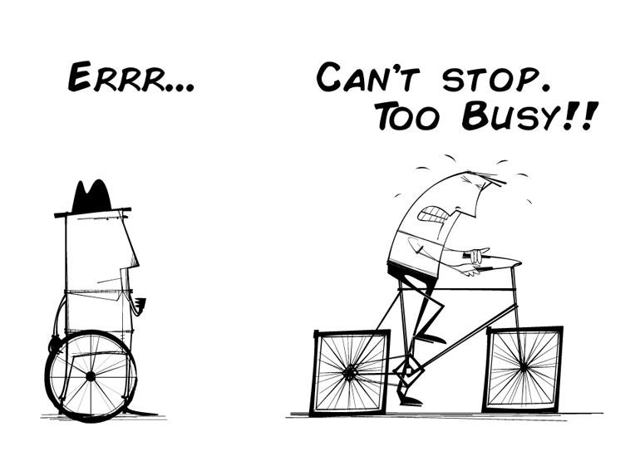
Technical Debt
80% of Americans carry financial debt,
100% of technical projects have technical debt
Notes:
The 80% includes mortgages: http://www.pewtrusts.org/~/media/assets/2015/07/reach-of-debt-report_artfinal.pdf

Slide 15
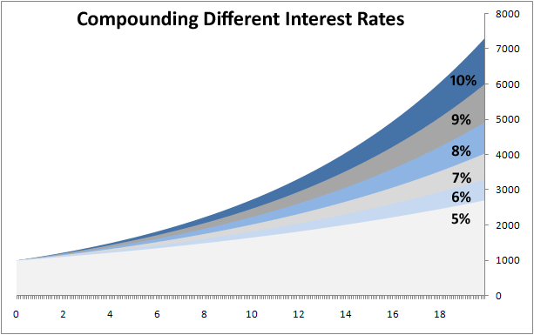
Technical Debt
  What is debt (in a financial sense)?
    Principal, interest, payments, compounding
  What’s the basic idea of “technical debt”?
    Additional effort required to “fix” poor designs
      Refactoring time
  Kicking the can down the road…

Slide 16

Technical Debt Metaphor
What would technical debt look like in a building project?
  When a new commercial building is built?
    What are the phases of the project?
    How could debt be accumulated?
    How is debt paid back?
    How does accumulated debt affect the project?

Slide 17
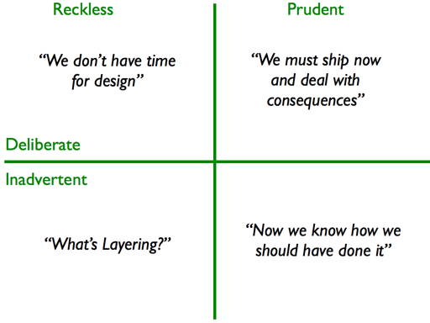
Kinds of Technical Debt
  Unfit (bad) design
  Defects
  Insufficient test coverage
  Excessive manual testing
  Poor integration and release management
  Lack of platform experience
  Other kinds?

Slide 18
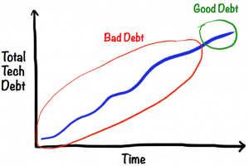
Technical Debt Age
  Is old or new debt “better” to carry?
    Why?
  “A fresh mess is easier to clean”

Slide 19
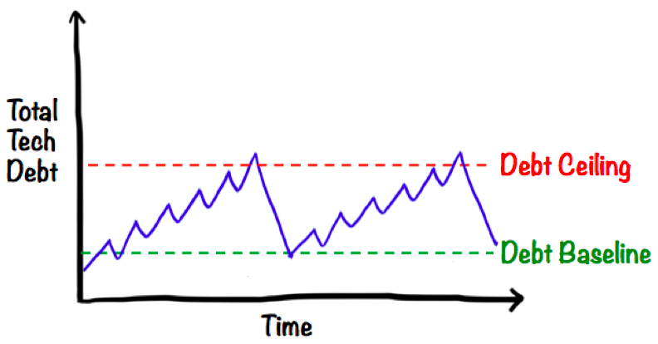
Types of T. Debt
How do the following types differ?
  Naive technical debt
  Unavoidable technical debt
  Strategic technical debt

Slide 20
Tracking tools
Issue tracking is built into Github
Demo!

