Slide 1
Legal Aspects of Software Engineering

Slide 2
Case Studies:
Full Screen Mario!
http://www.fullscreenmario.com/
UW-Madison
  http://www.jsonline.com/business/warf-wins-in-patent-suit-against-apple-b99596325z1-332581992.html
Plagiarism
  http://www.npr.org/2014/10/26/358903514/did-led-zeppelin-plagiarize-stairway-a-penn-judge-will-decide

Slide 3
Legal Environment
Software is developed in a complex legal and
economic framework.
Every software developer needs to be aware of some parts of the framework.
A senior manager or consultant will frequently work with lawyers.
You need a lawyer for anything other than the most basic legal issues.

Slide 4
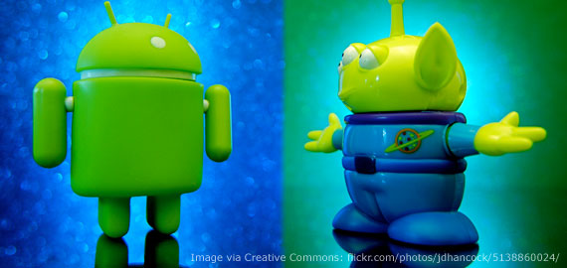
Legal Topics in Software
• Jurisdiction (international, federal, state laws)
• Intellectual property (copyright, patent, trademark, trade secrets)
• Contracts and licenses
• Privacy
• Free speech and its limitations (government secrets, obscenity)
• Commerce (ISPs, e-commerce)
• Employment (personnel, your next job, etc.)

Slide 5
Statues and Precedents
The United States follows Common Law.
The law is a combination of:
• Statutes (bills) passed by Congress and the 50 states.
Examples?
• Regulations issued by the government
Examples?
• Precedents (Common Law)
(judgments) made by courts.
Examples?
HIPAA
What ISPs can/cannot do
IP (what is copyright infringement)

Slide 6
Intellectual Property (IP)
Copyright
Patent
Trade secret
Trademark
Why do we have IP laws?

Slide 7
Intellectual Property
Intangible creative works (the expression of ideas)
  Books
  Songs
  Art
  Movies
  Software
  Inventions
  Brands
IP has value
  IP laws allow a creator to profit from their creation
  Can be bought and sold
Each country has their own laws regarding IP
  Enforcement is up to the “owner(s)” of the work
Public domain
  Once legal protection runs out a work enters the public domain
  Examples?

Slide 8


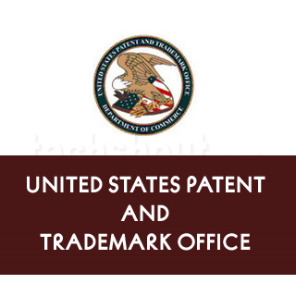
IP types
Copyright
  Protects creative work (1 of a kind)
  Protection is inherent when the work is created
  Last for a limited time (lifetime +70 yrs)
  Facts, ideas, concepts, processes, and methods of operation are not copyrightable
Patent
  Legally protects inventions of devices or processes
  Apply through the patent office
  Provides the holder a monopoly
  Last for a limited time (~20 years)

Slide 9
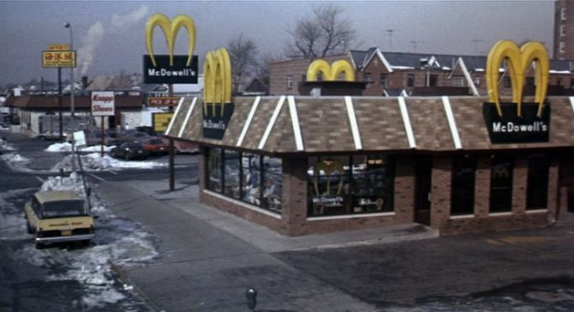
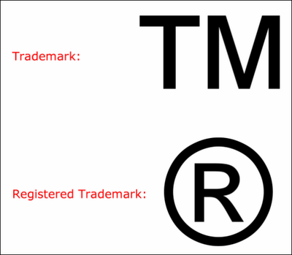
Other IP
Trademark
  Symbol that identifies a product or company
  Must be registered and approved to be internationally recognized
  Must be “active” in the last 5 years
Others
  Trade secrets
  Industrial design rights
Fullscreen Mario, where does it fall???

Slide 10
Intellectual Property Law: Copyright
Copyright is Federal law, which applies to literary works.
Originally applied to textual materials, but gradually extended to cover text, music, photographs, designs, software, ...
Copyright applies to the expression of ideas (e.g., the words used), not to the ideas themselves, nor to physical items.
Software
Copyright applies to the program instructions, but not to
the concepts behind the instructions, nor to the files on disk
or on paper where the programs instructions are stored.
Similar to book protections

Slide 11
Copyright
In the USA, copyright gives the owner exclusive right to:
• reproduce or copy
• distribute
• perform or execute
• display
• license others to reproduce, distribute, perform, or display
Duration (Individual): Lifetime+70 years
Duration (Corporation): 90 years
Special exceptions
• First sale. The owner of an object, e.g., a book, can sell the object without permission of the copyright owner.
• Fair use. Limited use is permitted without permission of the copyright owner, e.g., in a review or short quotation.

Slide 12
Ownership of Copyright (USA)
At creation
• Copyright is automatically owned by the creator.
You don’t even need to register it! (although you can)
• Except works for hire, where the employer owns the copyright.
Transfer of copyright
• In the USA, copyright is property that can be sold or licensed.
The agreement is written as a contract.

Slide 13
Ownership of Software
• If you are employed, copyright for the code that you write belongs to your employer
• If you work free lance, have a contract with the organization that you are working for that is explicit about who owns the copyright in work that you do.
• If you do not own the copyright, you need a license to copy, or use the software, even if you wrote the code
(e.g., you cannot make a copy for your personal use).

Slide 14
Copyright: Derivative Software
When software is derived from other software:
• Copyright in new code only is owned by new developer
• Conditions that apply to old code apply to derived work
If you write S, which includes code derived from A and B, you cannot copy, use, distribute or license S unless the copyright owners of both A and B give permission.
When creating a software product, you should have documented rights to use everything from which it is derived.
Example: Python distribution

Slide 15
Copyrights - Fair Use
Permission of the copyright holder is not always required
  To use or distribute a work
Fair Use Criteria
  Purpose
    Commercial or for the general public’s enhancement
  Nature
    Creative or factual
  Amount
    Large or small
  Effect
    Reduce the value of the original work?
Vanilla Ice vs. David Bowie (http://www.youtube.com/watch?v=kk6NhjD3Dbg)
Is the fair use doctrine adequate for defining ethics of IP?

Slide 16
A Fair(y) Use Tale
Video
http://www.youtube.com/watch?v=CJn_jC4FNDo

Slide 17
Fair Use Cases- Fair or not?
Videotaping TV broadcasts at home (or DVR)
Google displays thumbnail images of photos from a subscription-only website
Funky Drummer (Clyde Stubbelfield)
  https://www.youtube.com/watch?v=8L4gITE3nUc
  https://www.youtube.com/watch?v=HqByU0WCr3I
  https://www.youtube.com/watch?v=X3hu0dhiBxg
  https://www.youtube.com/watch?v=UoKr_pc5gvQ
  https://www.youtube.com/watch?v=t_vSGkS3tCQ
  https://www.youtube.com/watch?v=0xMJZHrG_94
  http://www.the-breaks.com/search.php?term=Funky+Drummer&type=4
How does this relate to CS?
  What software can you “sample”?

Slide 18
Intellectual Property: Patents
Copyright covers CODE ITSELF,
not the idea. But NDAs DO
protect more than the code
Patents apply to inventions
• Should be: non-obvious, novel, useful
• Requires a complex process of patent application
• 17 years from award (20 years from application)
Copyright applies to the expression of ideas, patents to the ideas themselves.
EX: http://en.wikipedia.org/wiki/List_of_software_patents
Patents make the idea public during the registration process
What if you don’t want your idea made public?
approval can take 5+ yrs
https://www.youtube.com/watch?v=3bxcc3SM_KA&index=9&list=WL
Obvious is better-defined than you would think --- because of many court-cases that have refined it. But some of the best ideas FEEL obvious even though they are not.
Must also be new (novel)
Must be useful … but super-easy to fulfill. “entertaintment” “fetish”
Both “patent pending” and “TM” don’t mean much – just that you “intend to imply” or have submitted an initial application.

Slide 19
Patents
Examples
  Online shopping checkout (Amazon.com)
  Creating a single file from multiple source files
  Automatic answering of email
  Sending messages to players in an online game
  Image/audio formats (tiff, mp3, gif, etc)
  http://patft.uspto.gov/netacgi/nph-Parser?Sect1=PTO1&Sect2=HITOFF&d=PALL&p=1&u=%2Fnetahtml%2FPTO%2Fsrchnum.htm&r=1&f=G&l=50&s1=7,640,233.PN.&OS=PN/7,640,233&RS=PN/7,640,233
  http://sdt.bz/content/article.aspx?ArticleID=65268&page=1
Technically “algorithms” are not patentable
  Most companies circumvent this by using the terminology “system and method”
Microsoft
  17,000 patents
  Own patents that legally prevent other companies from using the Linux kernel unless they pay Microsoft
Google
  17,000 patents
  2,835 patents in 2016
IBM
  40,000 active patents
  8,088 patents in 2016 alone
    2700 AI patents alone in 2016!
Every Tuesday the USPTO releases 3000+ new patents
http://en.wikipedia.org/wiki/List_of_top_United_States_patent_recipients
Non-disclosure and non-compete agreements can (AND SOMETIME SHOULD) be negotiated. You may benefit from some negotiations that have gone on before.

Slide 20
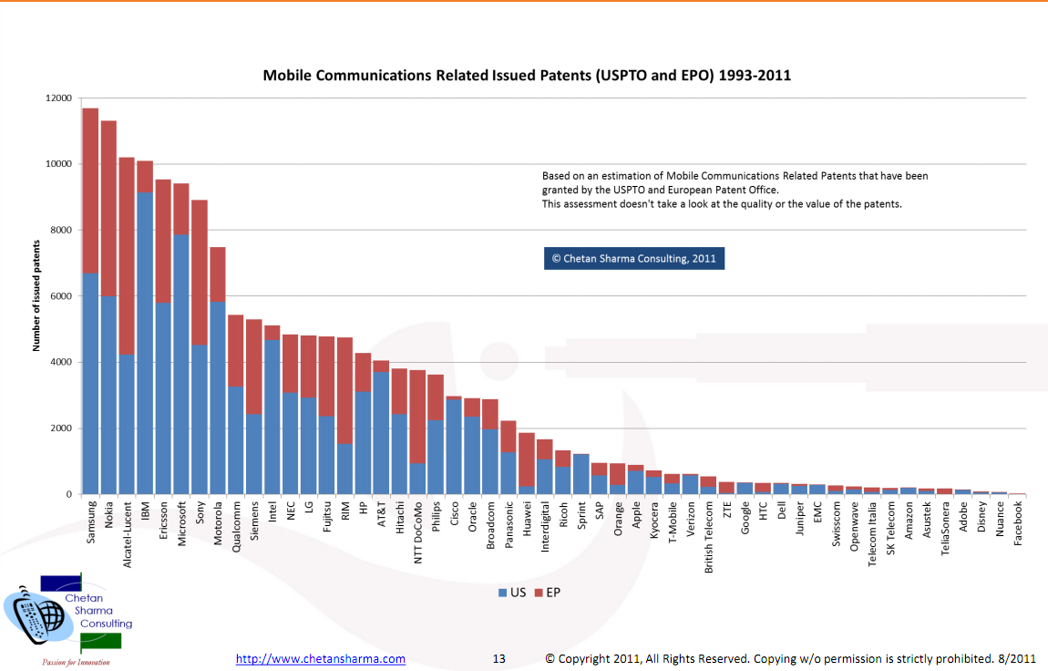

Slide 21
EFF Stupid Patents
https://www.eff.org/deeplinks/2015/08/stupid-patent-month-drink-mixer-attacks-internet-things

Slide 22
Software IP
Licenses are combined with copyright.
Copyright
  Creative, 1 of a kind work
  Long protection
Patent
  Invention
  Short protection
Where should software fall?
  Invention vs. writing
  Expression of ideas or an algorithm?
  Patents are not supposed to be granted for “obvious” or in common use when patent is filed
    How can this be determined with software patents?

Slide 23
Licensing your software
You will need to choose what license you will associate with your software
Closed source
  You own the IP rights
Open source
  You allow anyone else to modify and use the software
  Any users of it cannot make it closed source*
How can money be made from open source software?
But we diverge…

Slide 24
Example licenses
/*************************************************************************
* ADOBE CONFIDENTIAL
*
* Copyright [2002] - [2007] Adobe Systems Incorporated
* All Rights Reserved.
*
* NOTICE: All information contained herein is, and remains
* the property of Adobe Systems Incorporated and its suppliers,
* if any. The intellectual and technical concepts contained
* herein are proprietary to Adobe Systems Incorporated
* and its suppliers and may be covered by U.S. and Foreign Patents,
* patents in process, and are protected by trade secret or copyright law.
* Dissemination of this information or reproduction of this material
* is strictly forbidden unless prior written permission is obtained
* from Adobe Systems Incorporated. */

Slide 25
Example licenses
/*************************************************************************
* This program is free software: you can redistribute it and/or modify it under the terms
* of the GNU General Public License as published by the Free Software Foundation,
* either version 3 of the License, or (at your option) any later version. This program is
* distributed in the hope that it will be useful, but WITHOUT ANY WARRANTY; without
* even the implied warranty of MERCHANTABILITY or FITNESS FOR A PARTICULAR PURPOSE.
* See the GNU General Public License for more details. You should have received a copy
* of the GNU General Public License along with this program. If not, see
* <http://www.gnu.org/licenses/>.*/
The waiver of LIABILITY is IMPORTANT

Slide 26
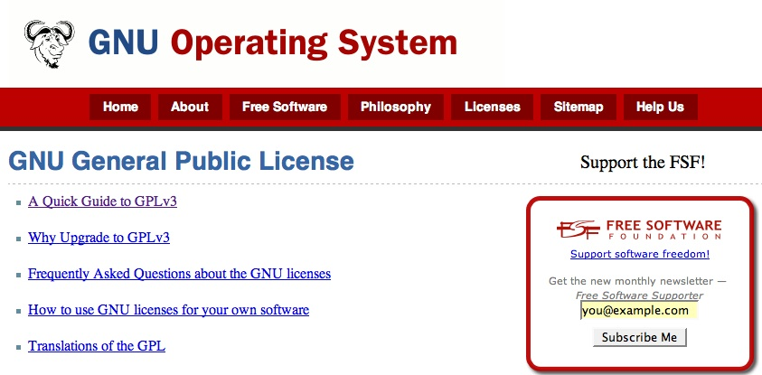
GNU Public License
Open sources software is an important part of modern computing that does not fit well into traditional contract law.

Slide 27
Open Source Software – Main Features
Non-proprietary software which may or may not be used commercially;
Typically licensed under an Open Source license (not given away)
  License terms differ from proprietary software license terms
Source code is generally made available
  Legal restriction on reverse engineering (under the DMCA) do not apply.

Slide 28
Open Source Software License - Licensees
Original software owner or developer chooses to limit the rights that he asserts over licensees
Licensees, subject to license terms, can:
  make and distribute copies of software;
  build upon software to create modifications or other works.

Slide 29
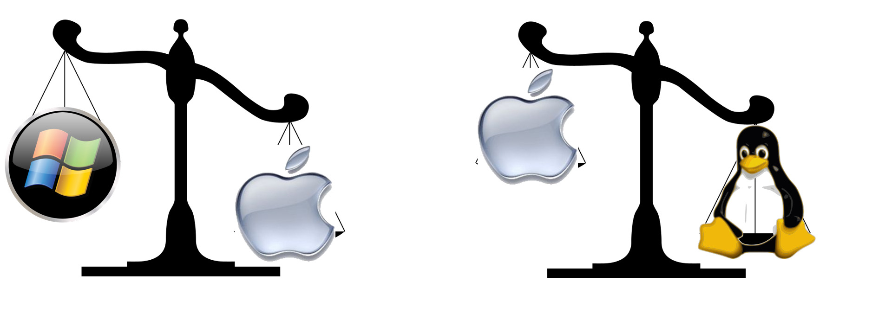

Is Mac OSX Open Source?
Major components of Mac OS X, including the UNIX core, are made available under Apple’s Open Source license. But not the whole operating system.
The Android operating system is open source. Except for version 3.0. The Apps such as Gmail, the Market, and Google Maps are not open source.
What about me?

Slide 30
Open Source Software Licenses - Source Code
Source code to original product always provided;
Licensee can modify or enhance source code
  create “derivative works”
Licensee can include source code with other license types
  create “larger works”
Licensee may be required to share modifications with the world (in source and/or binary form)
  but not necessarily
Licensee may be prohibited from charging royalties for derivative and larger works
  but not necessarily

Slide 31
Open Source Software License – Warranties and Support
Generally, software provided “AS-IS” with no warranties, warranties excluded;
No indemnification;
  User cannot sue creator for liability reasons
No maintenance or support.

Slide 32
The GNU “General Public License” (GPL)
No standard open source license, but GPL most widely used
  Roughly 85% of open source software
Terms include:
  User freedom to distribute and/or modify;
  Requirement that original and modified source code be always made available to the world under the terms of the original license;
  Must retain copyright notices and warranty disclaimers;
  Does not include grant of patent licenses;
  Extremely viral license.
Sometimes called “copyleft”
http://www.gnu.org/copyleft/gpl.html

Slide 33
The Apache Software License
Governs the Apache web-server software.
Terms include:
  User freedom to distribute and/or modify;
  No requirement for source code to be made available to the world in downstream distribution;
  Must retain all copyright notices and warranty disclaimers;
  Not a viral license.
http://www.apache.org/licenses/LICENSE-2.0.html

Slide 34
Summary: Existing open source licenses
Terms will always include preservation of copyright notices and warranty disclaimers;
Some licenses will be extremely viral: thus prohibiting any other type of downstream licensing apart from under the terms of the original license;
Some with permit inclusion of code within proprietized programs;
In some instances, provision of additional warranties and support will trigger indemnification provisions to the original developer.

Slide 35
Online resources
For a comprehensive chart describing and comparing open source licenses see http://en.wikipedia.org/wiki/Comparison_of_free_software_licenses
For full open source license texts see http://opensource.org/licenses

Slide 36
Advantages: Proprietary Software
Indemnification;
Maintenance and support;
Licensee doesn’t have to have open source savvy staff;
Licensees’ rights if:
  media is defective;
  software contains viruses, backdoors, etc.;
  product fails to meet written technical/business specifications.

Slide 37
Disadvantages: Proprietary Software
COST!
  License fee
  Product bundling—example: Microsoft office.
Licensee cannot modify or enhance the code;
Often not built to open standards, leading to interoperability problems;
Shut off from continuing development and information sharing in open source community;
Some proprietary code is not as good as its open source counterparts.

Slide 38
Advantages: Open Source License
PRICE: Generally no or low license fees;
Availability of source code coupled with permission to make modifications;
Access open source development community, which may be very active with respect to code used. Continuing improvement; outstanding development;
More likely to be built to open standards, so interoperable with other open standards systems.

Slide 39
Disadvantages: Open Source Licensing
No indemnification; if a third party claims that licensee is using code that the third party developed, the licensee has no one to pay his legal fees and damage award
No maintenance and support (unless purchased separately);
No warranties regarding media, viruses, and performance;
Staff must be open source savvy;
License terms are NOT standard: thus important to pay close attention to terms.

Slide 40
New Slides Follow
100-200 registered copyright
200-300 registered trademark

Slide 41
Additional Open Source license
https://opensource.org/licenses/MIT
  Permission is hereby granted, free of charge, to any person obtaining a copy of this software and associated documentation files (the "Software"), to deal in the Software without restriction, including without limitation the rights to use, copy, modify, merge, publish, distribute, sublicense, and/or sell copies of the Software, and to permit persons to whom the Software is furnished to do so, subject to the following conditions:
  The above copyright notice and this permission notice shall be included in all copies or substantial portions of the Software.
  Plus “AS IS” disclaimer
NOTE DIFFERENCES FROM PUBLIC DOMAIN:
* Requirement to include the license. * AS IS disclaimer

Slide 42
Software Patents – recent cases
Section 101 of title 35, United States Code, provides:
  Whoever invents or discovers any new and useful process, machine, manufacture, or composition of matter, or any new and useful improvement thereof, may obtain a patent therefor, subject to the conditions and requirements of this title.
https://en.wikipedia.org/wiki/Software_patents_under_United_States_patent_law#Alice_case
  More difficult to get a software patent after Alice case (which is a type of “business process/method patent”)
  "Without additional limitations, a process that employs mathematical algorithms to manipulate existing information to generate additional information is not patent eligible.“

Slide 43
The IBM Public License
Terms include:
  User freedom to distribute and/or modify;
  No requirement for source code availability in downstream distribution;
  The program can be distributed in executable form thus allowing downstream users to develop, sell, and install customized software packages without having to make all customizations available to the world;
  Must retain all copyright notices and warranty disclaimers;
  Includes grant of patent licenses.
http://www.ibm.com/developerworks/library/os-i18n2/os-ipl.html

Slide 44
Freeware
Freeware is free software, software that the licensee can use without paying a license fee.
Free software may be proprietary software for which source code is not provided
  Adobe Acrobat
  Linux
  Note: Not all open source software is free; not all
  proprietary software is licensed for a fee.

