Slide 1
1. Where to start
SE2811 Software Component Design
Dr. Josiah Yoder
(Throughout this course, many slides originally by Dr. Hasker, Dr. Hornick, and Dr. Urbain)
Notes:
Acknowledgement

Slide 2
SE 2811: Software Component Design
Algorithms CS 2852
Requirements
SE 3821
Design?
Systems
Opportunities for reuse
Classic reuse models: requirements, algorithms
Notes:
SE3821: Fall of Junior year in 3.3 curriculum.
You can reuse full sets of requirements; it’s only effective when the problems are very similar. For example, the basic requirements for car door locks are independent of whether you have a key fob or enter a pin on the door. (Ask students for features that are common.)

Slide 3
SE 2811: Software Component Design
Algorithms CS 2852
Requirements
SE 3821
Design: SE 2811
Systems
Opportunities for reuse
Classic reuse models: requirements, algorithms
2811: reusing designs
Notes:
Print

Slide 4
Administrative Break
Safety Review
Review Syllabus

Slide 5
Personal Note
"Enter through the narrow gate. For wide is the gate and broad is the road that leads to destruction, and many enter through it. But small is the gate and narrow the road that leads to life, and only a few find it." - Jesus

Slide 6
Personal Note
He does not delight
in the strength of the horse;
He takes no pleasure
in the legs of a man.
The LORD takes pleasure
in those who fear Him,
In those who hope in His mercy.
- Psalm 147
Notes:
https://www.blueletterbible.org/nkjv/psa/147/10/s_625011

Slide 7
SE 2811: Software Component Design
Algorithms CS 2852
Requirements
SE 3821
Design: SE 2811
Systems
Opportunities for reuse
Classic reuse models: requirements, algorithms
2811: reusing designs
Notes:
Print

Slide 8
SE 2811: Software Component Design
Algorithms CS 2852
Requirements
SE 3821
Design: SE 2811
Systems
Opportunities for reuse
Classic reuse models: requirements, algorithms
2811: reusing designs
1994: Gang of 4
Gamma, Helm, Johnson, Vlissides
Notes:
Print

Slide 9
SE 2811: Software Component Design
Algorithms CS 2852
Requirements
SE 3821
Design: SE 2811
Systems
Opportunities for reuse
Classic reuse models: requirements, algorithms
2811: reusing designs
1994: Gang of 4
Gamma, Helm, Johnson, Vlissides
Design pattern: general, reusable solution to a commonly occurring problem in software design
Notes:
Print

Slide 10
A real-life example
How to get from Milwaukee to Chicago?
Identify at least four methods
What are common elements?
What can differ?
How do we compare them?
Are these algorithms?
Algorithm: sequence of steps to be followed to calculate a result

Slide 11
Example #2
Problem:
Workplace, home traffic pattern: travel to frequently accessed objects
If objects scattered, flow of life is awkward
Items forgotten, misplaced

Slide 12
Example #2
Problem:
Workplace, home traffic pattern: travel to frequently accessed objects
If objects scattered, flow of life is awkward
Items forgotten, misplaced
Solution:
Waist-high shelves around at least part of main rooms in which people live & work
They should be long, 22-40 cm deep
Shelves or cupboard underneath
Interrupt shelf for seats, windows, doors

Slide 13
Example #2
Note features:
Shelf color, material not important to the structure
Not an algorithm/not blueprints
Architectural design pattern
Are there times when the pattern is a poor choice?
Each pattern:
Solves a recurring problem
Tradeoffs: advantages, disadvantages to applying

Slide 14
Software example
public class StereoController {
private Volume volume;
private Equalizer equalizer;
public StereoController(Volume volume,
Equalizer equalizer) {
this.volume = volume;
this.equalizer = equalizer;
}
public changeVolume(int ticks) {
volume.adjust(ticks);
}
public changeChannel(int channel,
int ticks) {
if ( equalizer != null )
equalizer.getChannel(channel).adjust(ticks);
}
}

Slide 15
Software example
Models core elements of stereo: volume control, equalizer
public class StereoController {
private Volume volume;
private Equalizer equalizer;
public StereoController(Volume volume,
Equalizer equalizer) {
this.volume = volume;
this.equalizer = equalizer;
}
public changeVolume(int ticks) {
volume.adjust(ticks);
}
public changeChannel(int channel,
int ticks) {
if ( equalizer != null )
equalizer.getChannel(channel).adjust(ticks);
}
}

Slide 16
Software example
Models core elements of stereo: volume control, equalizer
If statement: allows stereo without equalizer
Problem: will need to check every use
Violates an OO principle: don’t repeat yourself
Why is repetition a problem?
How can we remove it?
public class StereoController {
private Volume volume;
private Equalizer equalizer;
public StereoController(Volume volume,
Equalizer equalizer) {
this.volume = volume;
this.equalizer = equalizer;
}
public changeVolume(int ticks) {
volume.adjust(ticks);
}
public changeChannel(int channel,
int ticks) {
if ( equalizer != null )
equalizer.getChannel(channel).adjust(ticks);
}
}

Slide 17
Solution: create “do nothing” classes
public class Equalizer {
public final int MAX_CHANNEL = 6;
private Level[] channels =
new Level[MAX_CHANNEL];
public Equalizer() { }
public Level getChannel(int i) {
return channels[i];
}
}
public class NullEqualizerObject {
private NullLevelObject nullLevel =
new NullLevelObject();
public Level getChannel(int i) {
return nullLevel;
}
}
public class NullLevelObject {
public adjust(int value) { }
}
NullEqualizerObject: returned channel does nothing on adjust

Slide 18
Removing the `if’
public class StereoController {
private Volume volume;
private Equalizer equalizer;
public StereoController(Volume volume,
Equalizer equalizer) {
this.volume = volume;
this.equalizer = equalizer;
}
public changeVolume(int ticks) {
volume.adjust(ticks);
}
public changeChannel(int channel,
int ticks) {
equalizer.getChannel(channel).adjust(ticks);
}
}
new StereoController(new Volume(),
new NullEqualizerObject());
Stereo without equalizer:

Slide 19
Null Object Pattern
Create a class that mirrors another
Each operation “does nothing”
Value returning operations: return something reasonable
Use this class wherever might have a check for null
Advantage: avoid lots of “if ( x != null )…”
Disadvantage: more classes to write
Clearly a bad idea in this case!
Possibly useful for full Stereo
Also: may delay raising an error: fail fast!
Notes:
A significant part of the course: identify problems and solve those problems using (design) patterns

Slide 20
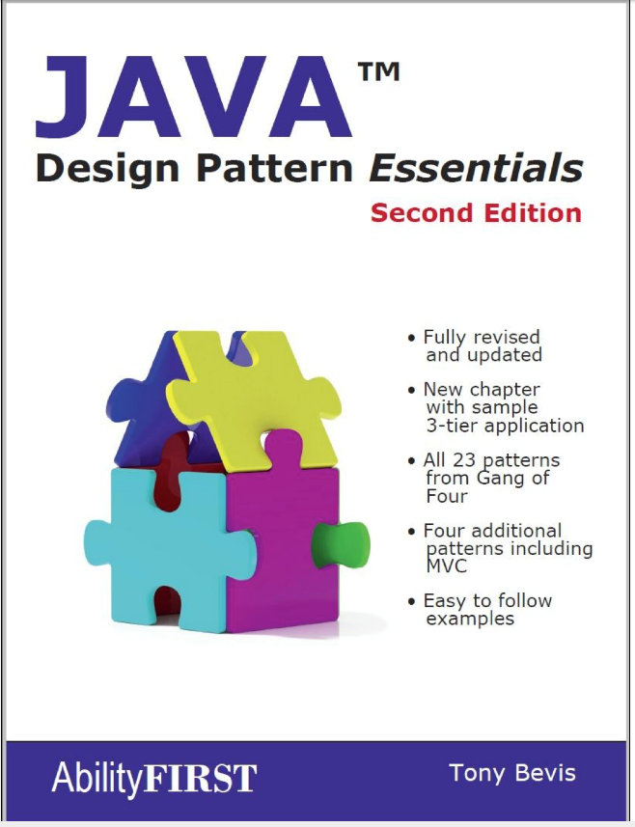
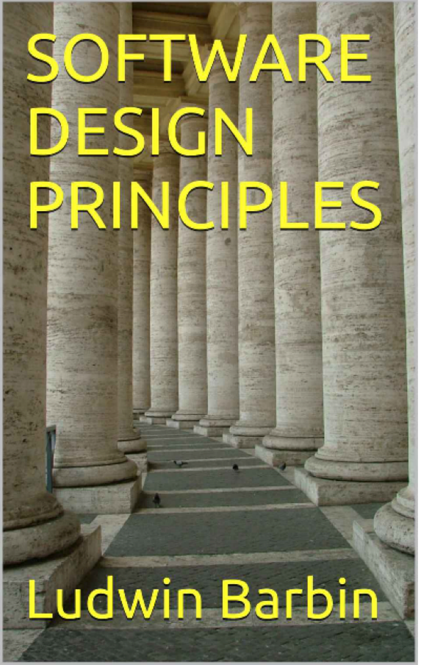
SE-2811 Software Component Design
See syllabus at https://faculty-web.msoe.edu/hasker/se2811
Required:
Optional:
Notes:
Print

Slide 21
Review
Design patterns: capturing frequent design solutions
Reusing designs in addition to requirements, algorithms
Null Object Pattern: avoiding
if ( x == null )…
through “do nothing” classes
Next: Adapter Pattern

