Slide 1
3. Object-oriented Design
SE2811 Software Component Design
Dr. Yoder
Notes:
Acknowledgement: Slides originally by Dr. Hasker

Slide 2
How to design object-oriented systems?
Null Object Pattern, Adapter Pattern: solving problems in existing systems
Open question: how to write systems in the first place?
Imagine that you have just discovered an idea for a new web application with an enormous market share
What qualities would you want your software to have in ten years?
How do we achieve these goals?
What were the steps in SE 2030?
Notes:
Steps in SE 2030: write use cases, develop classes from those – some students will know about noun identification

Slide 3
How to identify classes?
Meal Wheel
As a hungry student, I want my phone to randomly select from different restaurants so I know where to eat.
As a picky student, I want my phone to suggest close restaurants that serve sashimi so I can choose a place to eat within 10 minutes walk.
As a restaurant owner, I want to distribute menus to potential customers.
As a restaurant owner, I want potential customers to know of dietary restrictions that I support so I can attract customers who do not eat particular foods.
What classes should be in this system? Why?

Slide 4
Domain classes
Solution 1: solution space
Classes that are in a particular solution
Possible classes: table of restaurants to GPS coordinates, table of restaurants to menus, table of dietary restrictions to menu items
Solution 2: domain classes
Classes that are part of the problem space
Why prefer domain classes?
Solution independent – less likely to change to support new features
How would each solution change if we track popularity and wait times?
Natural: these are the entities that form the problem to solve
The best designs can have both
Notes:
Why prefer domain classes?

Slide 5
How to identify domain classes?
Solution 1: just sit there and think them up
Solution 2: mine the stories/scenarios/requirements
Objects: lead to classes
Verbs: actions

Slide 6
Finding classes:
Meal Wheel
As a hungry student, I want my phone to randomly select from different restaurants so I know where to eat.
As a picky student, I want my phone to suggest close restaurants that serve sashimi so I can choose a place to eat within 10 minutes walk.
As a restaurant owner, I want to distribute menus to potential customers.
As a restaurant owner, I want potential customers to know of dietary restrictions that I support so I can attract customers who do not eat particular foods.

Slide 7
Finding classes:
Meal Wheel
As a hungry student, I want my phone to randomly select from different restaurants so I know where to eat.
As a picky student, I want my phone to suggest close restaurants that serve sashimi so I can choose a place to eat within 10 minutes walk.
As a restaurant owner, I want to distribute menus to potential customers.
As a restaurant owner, I want potential customers to know of dietary restrictions that I support so I can attract customers who do not eat particular foods.

Slide 8
Other sources of classes
Active objects
Objects which consume, produce others; objects which control actions
Passive objects
Data storage, inputs, basic output
Example: light switch, sensors, printers
Real-world items – domain classes discussed earlier
Physical devices – things with internal state to capture
Transactions – sales receipt, todo item
Persistent information: configuration
User interface elements – menus, dialogs

Slide 9
Sound designs
Start with domain classes
These persist across problem changes
Capture things clients, users will recognize
Capture requirements that go with those items
Explore interactions through sequence and state diagrams
Add containers, architectural elements
Decisions about time/space/complexity tradeoffs
Databases, network communications, GUI elements
Introduce design patterns, refine
These generally reduce coupling, increase flexibility
May REMOVE classes from previous steps
Be careful about removing domain classes!
Notes:
Might remove a domain class, but document why, especially where it’s responsibilities have moved

Slide 10
Common mistakes
“doit” class: does everything
Generally surrounded by lots of passive objects
VERY low cohesion
System class – no need to document main()!
Often becomes a doit class
Classes for actions
“parser”, “artificial intelligence”, “list maintainer”
Roll these into domain objects!
Patterns excepted!
Poor inheritance
If A extends B, then anywhere a B can appear, so can an A
Liskov Substitution Principle – see Ch. 5 of Software Design Principles
Never violate contracts

Slide 11
How to design object-oriented systems?
Null Object Pattern, Adapter Pattern: solving problems in existing systems
Open question: how to write systems in the first place?
What were the steps in SE 2030?
More questions to consider:
What makes a system object-oriented?
Why are object-oriented designs preferred?
What is the alternative to OO?
Are some OO systems better than others?
Starting point: defining what it means to be “object-oriented”
Notes:
Steps in SE 2030: write use cases, develop classes from those – some students will know about noun identification

Slide 12
What’s an object?
What does it mean to say Java is object-oriented?
1st year: oo programming; 2811: object-oriented design
So what’s an object?
An instance of a class, but what makes a class?
A class has state
Captures information, provide it on request, record events
Student: name, id, classes taking, GPA
A class has behavior
Operations that do things
Student: compute GPA for term, add a class to schedule
A class has responsibility
What the object provides to the rest of the system
Student: record classes taking, progress
Notes:
Ensure discuss: ways

Slide 13
What’s an object?
What are the responsibilities of…
A house?
A roof? door? window?
Bank account?
Student record in registration system?
How many responsibilities should a class have?
Could say “just one,” but…
What would happen if Student had just one responsibility?
Responsibilities: clear, limited, but complete!
When would it make sense to have just one responsibility?

Slide 14
Responsibilities are the key to understanding classes, but…
What is the responsibility of a PostalAddress object?
Address objects have state, behavior, and responsibilities, but…
They are not ”real” objects
We need another condition
Notes:
With my Unix mindset, I might count milliseconds since Jan. 1, 1970. You might count milliseconds since (or before) your birth.

Slide 15
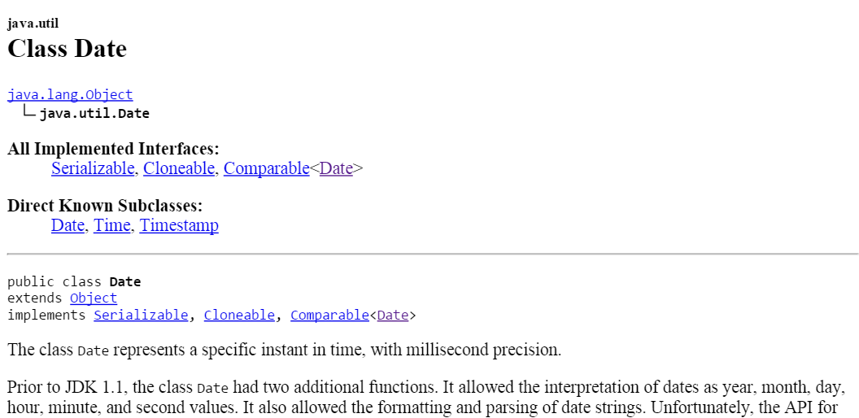
Responsibilities are the key to understanding classes, but…
What is the responsibility of java.util.Date?
See first line of Java API
Milliseconds from when?
If time is a construct, this represents a concept, not a thing
Date objects have state, behavior, and responsibilities, but…
They are not ”real” objects
We need another condition
Notes:
With my Unix mindset, I might count milliseconds since Jan. 1, 1970. You might count milliseconds since (or before) your birth.

Slide 16
What’s an object, continued…
An object has identity
Something you can point at
An address: just text
A building: there is a specific building at a specific location
Helps distinguish between pieces of information about something (color, name, identification number, temperature) and the things that have that information (people, hurricanes, cars, boats)
Objects without identity: attributes
Examples: colors, names, addresses, numbers
“Red” can appear in multiple places
There had better be just one instance of each student in a system

Slide 17
What characterizes an object
An object is something with
Responsibility
Identity
Behavior
State

Slide 18
What characterizes an object
An object is something with
Responsibility
Identity
Behavior
State
Helps to distinguish objects from attributes

Slide 19
Exercise: construct diagram
Meal Wheel
As a hungry student, I want my phone to randomly select from different restaurants so I know where to eat.
As a picky student, I want my phone to suggest close restaurants that serve sashimi so I can choose a place to eat within 10 minutes walk.
As a restaurant owner, I want to distribute menus to potential customers.
As a restaurant owner, I want potential customers to know of dietary restrictions that I support so I can attract customers who do not eat particular foods.

Slide 20
Finding classes:
Meal Wheel
As a hungry student, I want my phone to randomly select from different restaurants so I know where to eat.
As a picky student, I want my phone to suggest close restaurants that serve sashimi so I can choose a place to eat within 10 minutes walk.
As a restaurant owner, I want to distribute menus to potential customers.
As a restaurant owner, I want potential customers to know of dietary restrictions that I support so I can attract customers who do not eat particular foods.
Noun identification method
Classes: groups of objects w/ RIBS
Attributes: simple data
Methods: actions on objects

Slide 21
Review
Noun identification method
Other sources for classes
Doit, passive classes and their dangers
Liskov Substitution Principle

