Slide 1
5: Object-oriented Analysis & Design
SE2811 Software Component Design
Dr. Rob Hasker

Slide 2
Building an OO system
What is the process we have so far for building a system?
Interview customers, collect stories/scenarios
Identify nouns, verbs
Use RIBS to identify items that are not classes
Result: identified domain classes with attributes, operations
High level/domain level class diagram:
Meal wheel – see next page

Slide 3
Domain
Meal Wheel
As a hungry student, I want my phone to randomly select from different restaurants so I know where to eat.
As a picky student, I want my phone to suggest close restaurants that serve sashimi so I can choose a place to eat within 10 minutes walk.
As a restaurant owner, I want to distribute menus to potential customers.
As a restaurant owner, I want potential customers to know of dietary restrictions that I support so I can attract customers who do not eat particular foods.
Student: same as customer
Sashimi => menu item
Place: restaurant
10 minutes walk => distance: no identity
Dietary restriction: also no identity
Menu item: same as food
Know: publish (dietary restriction)

Slide 4
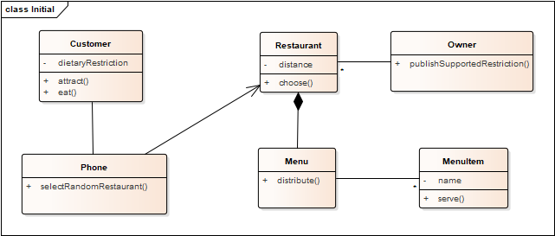
As a hungry student, I want my phone to randomly select from different restaurants so I know where to eat.
As a picky student, I want my phone to suggest close restaurants that serve sashimi so I can choose a place to eat within 10 minutes walk.
As a restaurant owner, I want to distribute menus to potential customers.
As a restaurant owner, I want potential customers to know of dietary restrictions that I support so I can attract customers who do not eat particular foods.

Slide 5
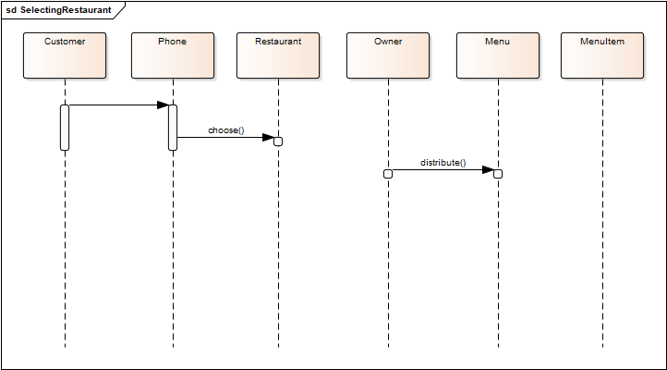
Selecting a restaurant
Notes:
Customer does something with phone, chooses a restaurant. Owner distributes menu. None of this makes sense

Slide 6
Refinements
eating: out of scope
menus may be distributed, but not by a direct act of the owner
serving menu items is out of scope
MealWheel knows about the customer; user just runs the app
How they run it is an Android/iOS issue, out of scope for MealWheel

Slide 7
Selecting a restaurant
Sequence has no scenario; what is a realistic
one for selecting a restaurant?
Identify restaurant items satisfying restrictions
Present list
Select restaurant

Slide 8
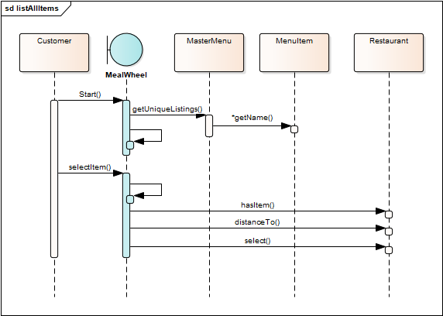
Add MealWheel App
System is not a domain object, but useful
MasterMenu: list all items
Restaurant: does it have an item? How far away?
But why notify the restaurant?
No state change with operation

Slide 9
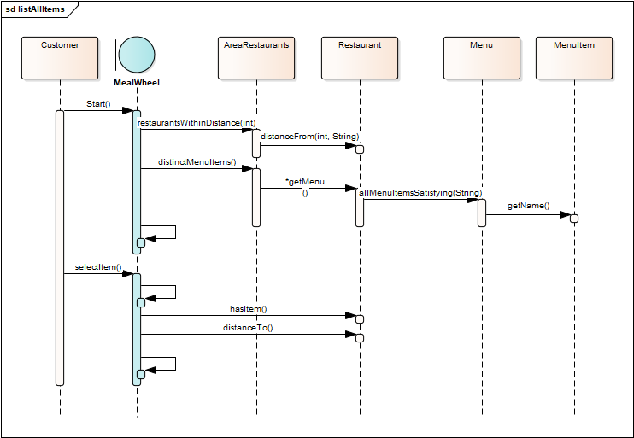
displayMenuItems
displayRestaurantsWithItem
Note many new operations
AreaRestaraunts class: opportunity to restrict list by “close” restaurants
displayRestaurantLocation

Slide 10
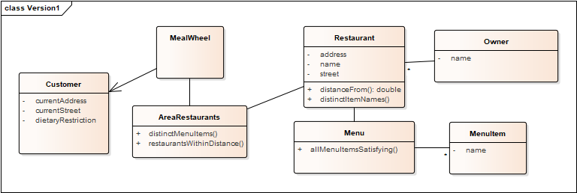
Notes:
Note added restaurantsWithinDistance, etc.; didn’t list operations on MealWheel, though could have.
Note that each operation is in the TARGET class

Slide 11
General notes
No static relationships - capture things that don’t change during run
Dynamic relationships rarely change interfaces
Minimal directionality, few attribute/operation types; only where known
No association labels – these clutter diagram and add little value beyond “x has y”
Capture multiplicities!
generally 1 or *
1..* usually not true at start, and 1..n (or i..n) is generally unnecessary detail.
Don’t list getters, they are assumed, but probably should list setters
Don’t list constructors; they can also be assumed at this point
Type returned by distinctMenuItems is a bit vague; ok at this point

Slide 12
Next steps
Refine, refine
Important aspect of UML: can carry diagrams through whole project
Questions to answer
What are the responsibilities for each class?
Containers to use?
Do any objects have complex states? If so, capture these!
Capture additional scenarios as sequence diagrams
Menu updates
Setting dietary restriction; likely to discover need to support > 1
Are there opportunities for patterns?
What maintenance problems can we anticipate?
Are there classes with too many associations or operations?

Slide 13
Additional refinements
Capture all getters, setters, return, attributes, parameter types
Generally: do not list private methods – those are particular to a developer’s implementation
If specify enough detail, can auto-generate all code
UML has sophisticated notation; can capture things like “object A is associated with only one of B or C”
This can be more work than just writing the code…
The win: can maintain the diagram, clients can provide more help

Slide 14
Review
Process:
Collect user stories, requirements, identify nouns and verbs
Create initial class diagram
Collect scenarios for use cases
Draw high level sequence diagrams
Construct domain-level class diagram(s)
Refine class diagram, capturing containers and state diagrams
Identify maintenance issues, apply patterns
Create detailed diagram (“implementation level”) with all types, etc.
Key in UML: can carry diagram through full process:
analysis to design to implementation
OOA&D:
Object-oriented Analysis and Design
Notes:
I often don’t draw the detailed diagram – I can see this in the class diagram

Slide 15
Next
What are the criteria for maintenance issues?
How do we know what designs are fragile?

Slide 16
Optional Exercise
Campus door lock system with phone interface
Can use app to provide user id information
Alternatively: unlock with domain username, password
Need mechanism to give/remove access for sections of students, individuals
Auto lock, unlock at specified times of the day

