Slide 1
11. MVC
SE2811 Software Component Design
Dr. Rob Hasker (based on slides by Dr. Josiah Yoder)

Slide 2
Model-View-Controller
Model-View-Controller
Why? What? How?
Example: Barnyard Simon for the Web
Question: Where should we use the command pattern?
Notes:
Full agenda:
Return Exam
Questions about lab due tomorrow in class?
Threads: Locking on null object
Threads: invokeLater
Threads: The squares example
Decorator Class Diagram
More on Java IO
Class diagrams
Design Principles
in the patterns we’ve seen so far
Compare with alternatives
Decorator vs. array approach suggested in class
Non-decorator array – decorator can be added on without modifying the original hierarchy
Decorator has “before-after” and possibly other combinatorial control that would be hard-coded in array
[Show “screenshot” of discussion from class? Or just re-type?]
Strategy vs. Decorator class diagrams side-by-side
Structural difference (inheritance optional in Strategy pattern?)
Decorator vs. “Strategy” array
Perhaps next:
Coding Starbuzz coffee (?)
Add real patterns
ArrayList – null-checking
Java I/O: Students do coding examples
http://stackoverflow.com/questions/9358821/should-i-extend-arraylist-to-add-attributes-that-isnt-null

Slide 3
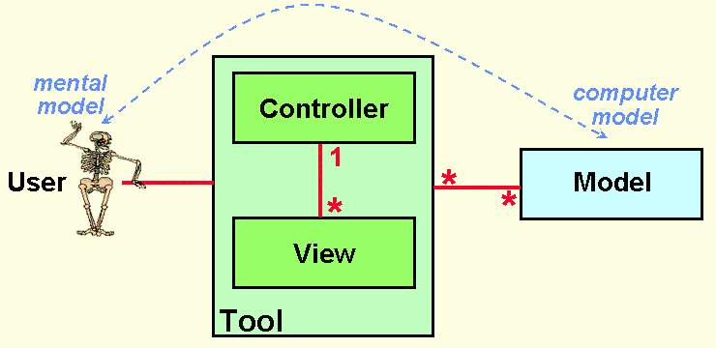
Why MVC?
To support the user’s mental model
http://heim.ifi.uio.no/~trygver/themes/mvc/mvc-index.html
Notes:
Image by a creator/discoverer of MVC

Slide 4
What is MVC?
click, drag, type
display
User
Controller
View
manipulate
update
Model
Notes:
Architectural pattern popular for user interface design

Slide 5
What is MVC (2)
User
display
click, drag, type
forward events
update
View
Controller
manipulate
update
Model

Slide 6
What is MVC? (3)
user clicked, etc.
change . . display
View
update
update
state, . please
Controller
change state
Model
Notes:
Model – The data and “business logic” – how it works
View – What the user sees
Controller – Strategy for handling events / interface between Model and View

Slide 7
MVC and Design Patterns
From the “Gang of Four” …
“MVC decouples views and models by establishing a subscribe/notify protocol between them [and[ lets you attach multiple views to a model”
What design pattern is this?

Slide 8
MVC and Design Patterns
From the “Gang of Four” …
“MVC also lets you change the way a view responds to user input without changing its visual presentation. You might want to change the way it responds to the keyboard, for example, or have it use a pop-up menu instead of command keys. MVC encapsulates the response mechanism in a Controller object.”
What design pattern is this?

Slide 9
MVC and Design Patterns
From the “Gang of Four” …
“MVC decouples views and models by establishing a subscribe/notify protocol between them [and[ lets you attach multiple views to a model”
What design pattern is this?

Slide 10
MVC and Design Patterns
From the “Gang of Four” …
“Another feature of MVC is that views can be nested.”
What design pattern is this?

Slide 11
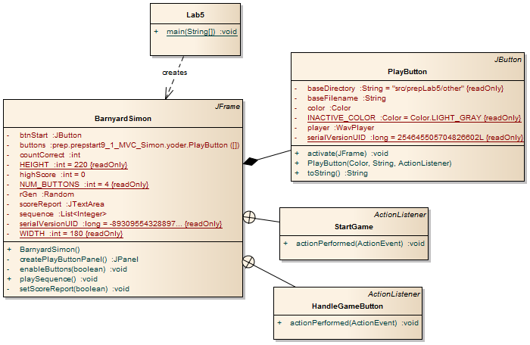
Simon without MVC

Slide 12
Goal: Make web version of Barnyard Simon
RESTful programming – Representational State Transfer
SOAP – Simple Object Access Protocol
HTTP/2 – HTTP for an interactive web

Slide 13
What will go where?
Model
View
Control
Button responses
Store Sequence
Determine next correct answer
Store Current position
Store Scores
Display scores
Play sounds
GUI stuff
Respond to user selecting an option

