Slide 1
1. Where to start
SE2811 Software Component Design
Dr. Josiah Yoder
(Throughout this course, many slides originally by Dr. Hasker, Dr. Hornick, and Dr. Urbain)
Notes:
Acknowledgement

Slide 2
SE 2811: Software Component Design
Design Patterns
Domain-level Object-Oriented Design (OOD)
Notes:
SE3821: Fall of Junior year in 3.3 curriculum.
You can reuse full sets of requirements; it’s only effective when the problems are very similar. For example, the basic requirements for car door locks are independent of whether you have a key fob or enter a pin on the door. (Ask students for features that are common.)

Slide 3
SE 2811: Software Component Design
Algorithms CS 2852
Requirements
SE 3821
Design?
Systems
Opportunities for reuse
Classic reuse models: requirements, algorithms
Notes:
SE3821: Fall of Junior year in 3.3 curriculum.
You can reuse full sets of requirements; it’s only effective when the problems are very similar. For example, the basic requirements for car door locks are independent of whether you have a key fob or enter a pin on the door. (Ask students for features that are common.)

Slide 4
SE 2811: Software Component Design
Algorithms CS 2852
Requirements
SE 3821
Design: SE 2811
Systems
Opportunities for reuse
Classic reuse models: requirements, algorithms
2811: reusing designs
Notes:
Print

Slide 5
Domain-Level Design
There are many ways to solve a problem
Solutions change over time
But the core problems don’t change
Having classes that describe the core problem makes them more reuasable, too.

Slide 6
Administrative Break
Safety Review
Review Syllabus

Slide 7
SE 2811: Software Component Design
Algorithms CS 2852
Requirements
SE 3821
Design: SE 2811
Systems
Opportunities for reuse
Classic reuse models: requirements, algorithms
2811: reusing designs
Notes:
Print

Slide 8
SE 2811: Software Component Design
Algorithms CS 2852
Requirements
SE 3821
Design: SE 2811
Systems
Opportunities for reuse
Classic reuse models: requirements, algorithms
2811: reusing designs
1994: Gang of 4
Gamma, Helm, Johnson, Vlissides
Notes:
Print

Slide 9
SE 2811: Software Component Design
Algorithms CS 2852
Requirements
SE 3821
Design: SE 2811
Systems
Opportunities for reuse
Classic reuse models: requirements, algorithms
2811: reusing designs
1994: Gang of 4
Gamma, Helm, Johnson, Vlissides
Design pattern: general, reusable solution to a commonly occurring problem in software design
Notes:
Print

Slide 10
A real-life example (#1)
How to get from Milwaukee to Chicago?
Identify at least four methods
What are common elements?
What can differ?
How do we compare them?
Are these algorithms?
Algorithm: sequence of steps to be followed to calculate a result

Slide 11
Example #2
Problem:
Workplace, home traffic pattern: travel to frequently accessed objects
If objects scattered, flow of life is awkward
Items forgotten, misplaced

Slide 12
Example #2
Problem:
Workplace, home traffic pattern: travel to frequently accessed objects
If objects scattered, flow of life is awkward
Items forgotten, misplaced
Solution:
Waist-high shelves around at least part of main rooms in which people live & work
They should be long, 22-40 cm deep
Shelves or cupboard underneath
Interrupt shelf for seats, windows, doors

Slide 13
Example #2
Note features:
Shelf color, material not important to the structure
Not an algorithm/not blueprints
Architectural design pattern
Are there times when the pattern is a poor choice?
Each pattern:
Solves a recurring problem
Tradeoffs: advantages, disadvantages to applying

Slide 14
Software example
public class StereoController {
private Volume volume;
private Equalizer equalizer;
public StereoController(Volume volume,
Equalizer equalizer) {
this.volume = volume;
this.equalizer = equalizer;
}
public changeVolume(int ticks) {
volume.adjust(ticks);
}
public changeChannel(int channel,
int ticks) {
if ( equalizer != null )
equalizer.getChannel(channel).adjust(ticks);
}
}

Slide 15
Software example
Models core elements of stereo: volume control, equalizer
public class StereoController {
private Volume volume;
private Equalizer equalizer;
public StereoController(Volume volume,
Equalizer equalizer) {
this.volume = volume;
this.equalizer = equalizer;
}
public changeVolume(int ticks) {
volume.adjust(ticks);
}
public changeChannel(int channel,
int ticks) {
if ( equalizer != null )
equalizer.getChannel(channel).adjust(ticks);
}
}

Slide 16
Software example
Models core elements of stereo: volume control, equalizer
If statement: allows stereo without equalizer
Problem: will need to check every use
Violates an OO principle: don’t repeat yourself
Why is repetition a problem?
How can we remove it?
public class StereoController {
private Volume volume;
private Equalizer equalizer;
public StereoController(Volume volume,
Equalizer equalizer) {
this.volume = volume;
this.equalizer = equalizer;
}
public changeVolume(int ticks) {
volume.adjust(ticks);
}
public changeChannel(int channel,
int ticks) {
if ( equalizer != null )
equalizer.getChannel(channel).adjust(ticks);
}
}

Slide 17
Solution: create “do nothing” classes
public class Equalizer {
public final int MAX_CHANNEL = 6;
private Level[] channels =
new Level[MAX_CHANNEL];
public Equalizer() { }
public Level getChannel(int i) {
return channels[i];
}
}
public class NullEqualizerObject {
private NullLevelObject nullLevel =
new NullLevelObject();
public Level getChannel(int i) {
return nullLevel;
}
}
public class NullLevelObject {
public adjust(int value) { }
}
NullEqualizerObject: returned channel does nothing on adjust

Slide 18
Removing the `if’
public class StereoController {
private Volume volume;
private Equalizer equalizer;
public StereoController(Volume volume,
Equalizer equalizer) {
this.volume = volume;
this.equalizer = equalizer;
}
public changeVolume(int ticks) {
volume.adjust(ticks);
}
public changeChannel(int channel,
int ticks) {
equalizer.getChannel(channel).adjust(ticks);
}
}
new StereoController(new Volume(),
new NullEqualizerObject());
Stereo without equalizer:

Slide 19
Null Object Pattern
Create a class that mirrors another
Each operation “does nothing”
Value returning operations: return something reasonable
Use this class wherever might have a check for null
Advantage: avoid lots of “if ( x != null )…”
Disadvantage: more classes to write
Clearly a bad idea in this case!
Possibly useful for full Stereo
Also: may delay raising an error: fail fast!
Notes:
A significant part of the course: identify problems and solve those problems using (design) patterns

Slide 20
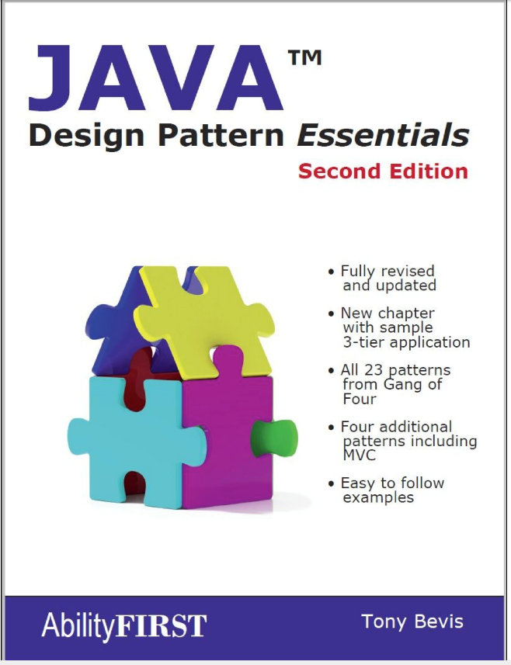
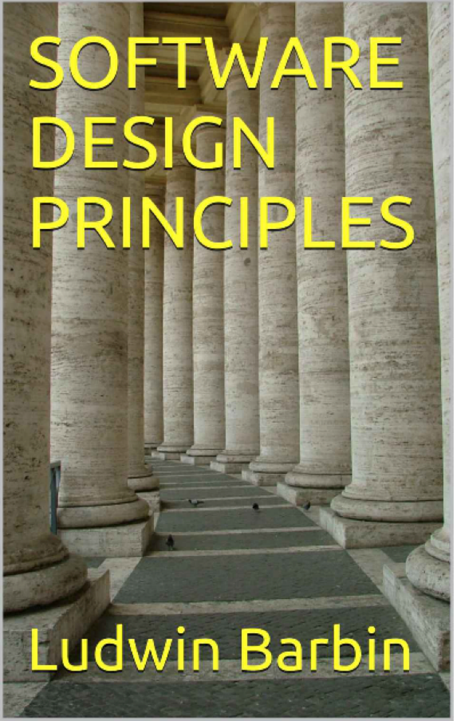
SE-2811 Software Component Design
See syllabus at https://faculty-web.msoe.edu/hasker/se2811
Required:
Optional:
Notes:
Print

Slide 21
Review
Design patterns: capturing frequent design solutions
Reusing designs in addition to requirements, algorithms
Null Object Pattern: avoiding
if ( x == null )…
through “do nothing” classes
Next: Adapter Pattern

