Slide 1
12. Command Pattern
SE2811 Software Component Design
Dr. Rob Hasker (based on slides by Dr. Mark Hornick)

Slide 2
Excise
Excise: actions not contributing to goal
Financial excise: taxes, insurance
Bicycle locks, repairing flats, oiling the chain
Software excise: configuration, manuals
Goal: eliminate excise so user more effective

Slide 3
Sources of excise
GUI excise
Must move/resize window before can do work
Command-line interface excise: learning commands
GUI helps beginner, intermediate; cmd for expert
Training wheels
allow dismissing support for beginners
Android power saver notification – why?
Notes:
Power saver notifier: displays message about turning off wireless/Bluetooth/etc at 30% - great idea, just do it; don’t need non-dismissible banner on my nofications page!

Slide 4
More excise
Computer excise
Frequent & expensive updates for security features that affect few users.
Visual excise
Work user does to decode visual information
Old software: special icons for beginners
printer icons, fax machines
help beginner, eat screen space for everyone else

Slide 5
Visual Clutter
Notes:
http://www.firemountaingems.com
http://www.harborfreight.com

Slide 6
Visual Clutter
Scrolling down several screens:
Notes:
http://www.firemountaingems.com
http://www.harborfreight.com

Slide 7
Undo
Another source of excise: “are you sure you want to do that?”
Annoying at best
Can be interpreted as saying: are you qualified to use this software?
Solution: Undo
Every action should be undoable
Goal of undo: permit exploration
Simple solution: save, restore state
Each action: save state of system before the action
Doesn’t scale: every video edit could require saving gigabytes of data…
Even if have that much memory, undo/redo will be very slow!

Slide 8
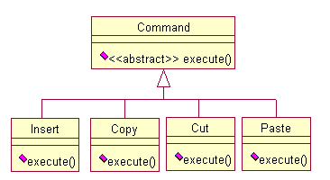
Command Pattern
Basic behind command pattern: store commands as objects
base class defines
abstract execute()
subclasses:
implement execute()
Uses
All menus, buttons, etc. can invoke same action
Stack commands for undo/redo
Share common bits of operations

Slide 9
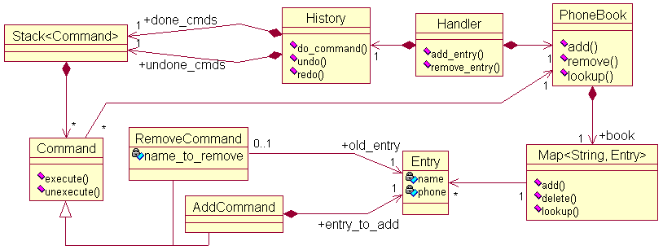
Command pattern applied
Applied to phonebook.java:
Remove, add: core commands
Two lists of commands; clear undone on new cmd

Slide 10
More phonebook details
Implements GUI/policy/data layers
History part of policy layer, encapsulates undo/redo
Handler doesn’t need to track this!
Phonebook: current contents; Map provides lookup
Add: points to entry so can redo the add
Remove: uses entry in undo

Slide 11
More phonebook details
Issues to decide
What data to store?
Have a few “intelligent” commands, or lots of small ones?
Provide way to group commands into a unit?
Need way to save commands without exposing internal details?

Slide 12
More phonebook details
Other ramifications:
Macro = sequence of commands
User might define own commands & assoc w/ menus
Can log commands to handle system crashes, accountability, etc.

Slide 13
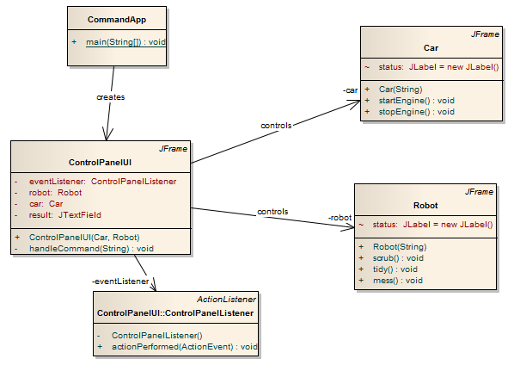
Another application
How to support operations like startEngine, scrub?
Should control panel team implement both?
UI should be independent of actions

Slide 14
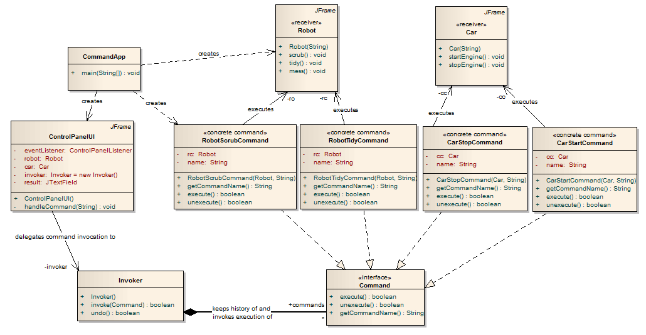
Using command pattern with this

