Slide 1
16. Visitors
SE2811 Software Component Design
Dr. Rob Hasker (based on slides by Dr. Mark Hornick)

Slide 2
Recall the Composite example: computer
Structure
Computer System as a collection of Components (Parts & Composites)
Operations
Compute total price
Compute power consumption
Compute total weight
computer
keyboard
monitor
System Unit
Fan
HDD
Cabinet
Chassis
CPU
Memory
GPU
Motherboard

Slide 3
Diagram, code…
class Composite {
…
public void priceInCents() {
int total = basePrice;
for(Component c : components)
total += c.priceInCents();
return total;
}
public double weight() {
double total = 0.0;
for(Component c : components)
total += c.weight();
return total;
}
public double amps() { /*similar*/ }
}
computer
keyboard
monitor
System Unit
Fan
HDD
Cabinet
Chassis
Duplicated code: loops, accumulator
Does not scale
CPU
Memory
GPU
Motherboard
Notes:
Scaling: suppose we add checks for hazardous materials, checks that no price/weight/amp is negative, no composite has empty component lists

Slide 4
Visitor pattern context
Problem
Different operations (algorithms) need to be performed on an object structure
the object structure may be a composite hierarchy but any structure is applicable
Solution
Define operations as separate classes without changing the classes on which the operations are carried out
That is, implement algorithms as classes – these classes are known as Visitors

Slide 5
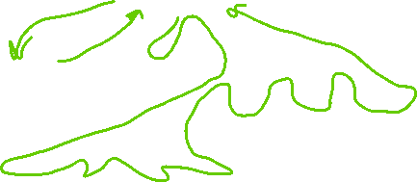
A problem and a solution
Violates DRY: Don’t repeat yourself!
Repeated code: traversing the structure
Solution:
Construct class to visit all the elements of the structure
Visitor: “walk through” the structure, recursively visiting sub-elements
computer
keyboard
monitor
System Unit
Fan
HDD
Cabinet
Chassis
CPU
Memory
GPU
Motherboard

Slide 6
A problem and a solution
Violates DRY: Don’t repeat yourself!
Repeated code: traversing the structure
Solution:
Construct class to visit all the elements of the structure
Visitor: “walk through” the structure, recursively visiting sub-elements
Another case of making an action into a class
Visitor: apply the action everywhere
computer
keyboard
monitor
System Unit
Fan
HDD
Cabinet
Chassis
CPU
Memory
GPU
Motherboard

Slide 7
The Visitor pattern in UML:

Slide 8
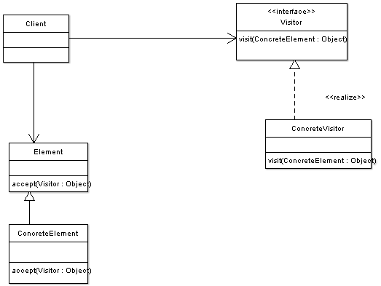
Simple visitor
Client creates visitor to acquire information
Apply visitor to each element
Call accept()
Pass element to accept
Simple case: single ConcreteElement
Element interface modified to allow visitor
ConcreteElement: provides public methods that can be invoked by visitor
Typically: visitor will have attributes used to keep a running tally of operations
Example: running total, count of items meeting a condition

Slide 9
The Visitor pattern in UML:
public abstract class ComponentVisitor {
public abstract void visit(Component c);
}
public class WeightVisitor {
private double totalGrams = 0.0;
public double getTotalGrams() {
return totalGrams;
}
public void visit(Component c) {
totalGrams += c.unitWeight();
}
}
Notes:
Code for the visitor, using WeightVisitor as an example; note how it has an accumulator. Power visitor would be similar.

Slide 10
The Visitor pattern in UML:
abstract class Component {
abstract void accept(ComponentVisitor);
}
public class Part extends Component {
public void accept(Visitor v) {
v.visit(this);
}
…
}
public class Composite {
public void accept(Visitor v) {
v.visit(this);
for(Component c : components)
c.accept(v);
}
…
}
Notes:
Visiting component: calls accept, and this processes current component and calls accept for any children

Slide 11
Museum Example: see demo folder

Slide 12
The Visitor pattern in UML:
public abstract class ComponentVisitor {
public abstract void visit(Component c);
}
public class WeightVisitor {
private double totalGrams = 0.0;
public double getTotalGrams() {
return totalGrams;
}
public void visit(Component c) {
totalGrams += c.unitWeight();
}
}
Notes:
Code for the visitor, using WeightVisitor as an example; note how it has an accumulator. Power visitor would be similar.

Slide 13
The Visitor pattern in UML:
abstract class Component {
abstract void accept(ComponentVisitor);
}
public class Part extends Component {
public void accept(Visitor v) {
v.visit(this);
}
…
}
public class Composite {
public void accept(Visitor v) {
v.visit(this);
for(Component c : components)
c.accept(v);
}
…
}
Notes:
Visiting component: calls accept, and this processes current component and calls accept for any children

Slide 14
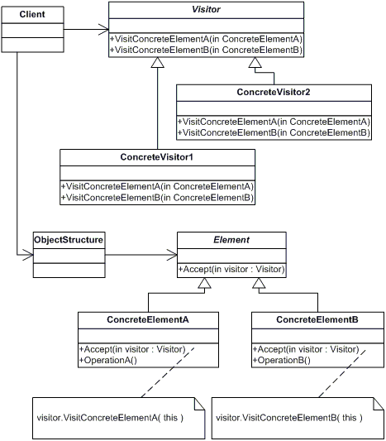
Visiting multiple types of objects
Each Visitor has specific methods that target each type of ConcreteElement to be visited.
Common: object hierarchy implements Composite
Not mandatory!
Client: capability to traverse the hierarchy
Client applies visitor to each element
Each ConcreteElement provides a specific public method that the Visitors invoke in order to perform their operation(s).

Slide 15
Collaborations
Client
ConcreteElementA
ConcreteElementB
aVisitor=new ConcreteVisitorA()
ConcreteVisitorA
accept(aVisitor)
visitConcreteElementA(this)
operationA()
getResultA()
accept(aVisitor)
visitConcreteElementB(aConcreteElementB)
operationB()
getResultB()

Slide 16
Advantages
Visitor makes adding new operations relatively easy
If a new operation over the object structure is needed, just create another type of ConcreteVisitor
Each Visitor gathers related operations and separates unrelated ones.
Unrelated behaviors are implemented in their own Visitors.

Slide 17
Disadvantages
A lot of code has to be written to prepare for the Visitor pattern:
The Visitor class/interface with one abstract “visit_xxx” method per ConcreteElement class to be visited must be defined.
An accept() method has to be added to each ConcreteElement class to be visited
Public methods must be provided on each ConcreteElement to provide Visitor access
Arguments and the return type of visit_xxx() methods have to be known in order to write abstract visitor
ConcreteElements must be modified to accommodate the pattern as well
Encapsulation is compromised – public methods must be provide sufficient access to ConcreteElement to let the Visitor perform its function; thereby exposing internal implementation
The code is more obscure

