Slide 1
6. Cohesion and Coupling
SE2811 Software Component Design
Dr. Rob Hasker
Notes:
Optional reading: Software Design Principles, Ch. 1 on cohesion, coupling, and others

Slide 2
Review
What are the two or three MAJOR topics that we have covered so far?
What is Cohesion? What is coupling?
Notes:
Idea: Point out that cohesion and coupling are closely related to both major topics:
Domain: Can think about these issues at both levels. For example, the task of finding collisions in the Bee lab is something you can figure out at the domain level to build a loosely-coupled expression into the “problem statement” itself.
Solution-space: Many patterns work to reduce coupling and improve cohesion, as we shall see in a little bit.
So today’s topic is closely related to BOTH major topics of the course.

Slide 3
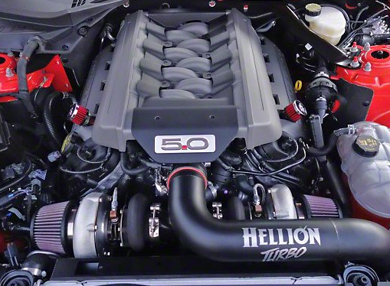

Which would you rather do?
What are the challenges of each?
Finding the parts to change
Knowing what happens when you change them
Knowing how to put them back together again
Knowing what the parts DO!
How they connect
Change a diaper?
Change a fuel filter?
Notes:
(Observation: many students would prefer to change diapers, even at MSOE…)
The point: can’t work on a system without knowing how they interface with other parts and what the individual parts do.
Coupling & cohesion: looking at each of these separately.

Slide 4
Cohesion & Coupling in Software
Design issue in software: each element can do lots of things, interact with a large number of other elements
But how many things are too much? What happens if we connect with everything?
  Both lead to “doit” classes/methods/subsystems
Need ways to measure interconnectivity, ”doing too much”
Cohesion: a measure of how much elements do
  Cohesive military unit: one goal, strong team
Coupling: a measure of how elements are connected
  Train cars are coupled nicely if they aren’t too lose and aren’t too tight

Slide 5
Software systems
Component: a collection of responsibilities
  Large numbers of responsibilities: difficult to understand
  Small number, closely related: much easier to understand
  Classes with a small number of closely related responsibilities: cohesive
  True for methods, packages, etc.: want closely related responsibilities
  General goal for each component: high cohesion
Understanding relationships between classes
  Interconnectivity between two classes: their coupling
  High coupling: a change in one class means changes in the other
  Goal: low coupling between components

Slide 6
Improving coupling, cohesion
How does the Adapter Pattern improve coupling, cohesion?
  Lower coupling, no impact to cohesion
How does the Strategy Pattern improve coupling, cohesion?
  Higher cohesion, but possibly higher coupling
What does the Singleton Pattern do to improve coupling, cohesion?
  Lower coupling; if alternative is no class, higher cohesion
Note:
  Adapter: structural pattern
  Strategy: behavioral pattern
  Singleton: creational pattern
Structural patterns are generally about reducing coupling
Notes:
Note: give students time to think about each of these questions, and have them describe how
Strategy: higher coupling if need pointer from strategy back to strategy ”container”
Generally: structural are based on lowering coupling; strategy patterns are based on improving cohesion

Slide 7
What are we measuring the coupling, cohesion of?
Classes: obvious components
Individual methods:
  Cohesion = what a method does
  Coupling: interactions though parameters, attributes, static data, etc.
Subsystem = any portion of the whole system
  Typically something developed by a team
  On smaller projects: developed by an individual
  Collection of classes, package, etc.
Measuring coupling, cohesion of modules – a system’s modularity
  Any portion of the system: methods, classes, subsystems
  Will start with focusing on classes

Slide 8
Coupling
Will look at coupling first
  Reminder: a measure of interconnection between modules
Goal: low coupling
  Simple connections between modules
Starting point: extremely coupled
  Any small change will result in changes to the rest of the system

Slide 9
Breaking Encapsulation 101
// a well-behaved class:
class Student {
private String firstName = "Sampath";
}
…
Student stu = new Student();
System.out.println(stu.firstName); // ERROR!
But is there a way to make this legal?
Notes:
We’re going t

Slide 10
import java.lang.reflect.Field;
class Student {
private String firstName = "Sampath";
}
public class TestReflection {
public static void main(String args[]) throws Exception {
Student someStudent = new Student();
Field fs = someStudent.getClass().getDeclaredField("firstName");
fs.setAccessible(true);
System.out.println("Value of " + fs.getName() + ": " + fs.get(someStudent));
fs.set(someStudent, "Trisha");
System.out.println("Value of " + fs.getName()
+ " after changing: " + fs.get(someStudent));
}
}
# output
Value of firstName: Sampath
Value of firstName after changing: Trisha
Makes field accessible by both get, set
Consequences?
Notes:
getClass: returns the object representing the class, Student
getDeclaredField: returns the field
Consequences: broken abstraction – nothing is safe!
Specifically: author of Student cannot assume you use public interface

Slide 11
Content Coupling
Content Coupling: using data, control encapsulated within the boundary of another module
  Bypassing protected, private: allows covert (hidden) communication
    Difficult to identify, reason about
  Other examples:
    Jumping into the middle of a subroutine in assembly to skip initialization code
    Modifying a constructor at runtime so future initialization is faster
  Key characteristic: inappropriate use of programming constructs
  Probably the worst form of coupling: nothing is safe…

Slide 12
Common Coupling
Closely related to content coupling
Leaving data unrestricted; can access anywhere
No real encapsulation – any code can change default, firstName
Very challenging to identify which code modifies either
Known as “global variables” in other languages
public class Student {
public static String defaultName;
public String firstName;
}

Slide 13
Another example of common coupling
public class Stack {
int size = 0; // package visibility!
String[] items = new String[100]; // package visibility!
public void push(String x) { items[size++] = x; }
public String pop() { --size; return items[size + 1]; }
}
Stack s = new Stack();
s.size = 100; // oops…
Notes:
This might be used to send a signal to some piece of code that should assume stack is full…

Slide 14
public class Shape {
void draw() { assert false; } // stub for draw method
void draw(int shape, int x1, int y1, int x2, int y2
int x3, int y3, int x4, int y4) {
switch ( shape ) {
case 1: ...draw line using (x1, y1), (x2, y2)...
case 2: ...draw triangle with (x3, y3) as well...
case 3: ...draw rectangle using all 4...
case 4: ...draw circle within enclosing rectangle...
}
}
}
public class EquilateralTriangle extends Shape {
private int top_x, top_y, height;
public void draw() {
super.draw(2, top_x, top_y, top_x – height/2, top_y – height,
top_x + hieght/2, top_y – height,
0, 0);
}
}
Passing control information
Note not used
control coupling: information in one module dictates logic in another
- often through a “flag”, a true/false variable used as a signal
Notes:
Unused parameters don’t always exist, but it’s a strong sign when they are there…

Slide 15
public class Shape {
void draw() { assert false; } // stub for draw method
void draw(int shape, int x1, int y1, int x2, int y2
int x3, int y3, int x4, int y4) {
switch ( shape ) {
case 1: ...draw line using (x1, y1), (x2, y2)...
case 2: ...draw triangle with (x3, y3) as well...
case 3: ...draw rectangle using all 4...
case 4: ...draw circle within enclosing rectangle...
}
}
}
public class EquilateralTriangle extends Shape {
private int top_x, top_y, height;
public void draw() {
super.draw(2, top_x, top_y, top_x – height/2, top_y – height,
top_x + hieght/2, top_y – height,
0, 0);
}
}
Why is this a problem?
The logic is hard to follow
Little encapsulation – caller must know how the branching works
No names to tell you what’s happening; just need to know extra meanings
Cannot reuse components by themselves
control coupling: information in one module dictates logic in another
Notes:
Unused parameters don’t always exist, but it’s a strong sign when they are there…

Slide 16
void handleErrors(int errorNumber) {
string[] messages = { "file not found",
"folder not found", "file already open",
"disk error" };
System.out.print(messages[errorNumber]);
if ( errorNumber == 1 || errorNumber == 2 )
System.exit(3);
else if ( errorNumber == 3 ) closeAllFiles();
else {
System.out.println("Cannot recover.");
System.exit(1);
}
}
Frequent form: handle all errors
Seems consistent
Difficult to use
Impossible to reuse
Any change to control: revisit all calls
Control Coupling:
Not as bad as content, common coupling, but avoid
Notes:
The point: at control coupling feels like maximizing consistency, but as project continues you find it just makes it impossible to change any piece of code, either the caller or the callee
That is, it’s consistent, but a REALLY bad idea

Slide 17
stamp coupling: passing large structure and using just a portion
classic example: swap(int[] numbers, int pos1, int pos2);
another:
issues:
  piece not as reusable as it could be
  piece could have undesired side-effects; could even result in security breaches
public class Image { … }
public class Buffer { Image a, b; … }
… void drawPartB(Buffer full) { … use just full.b
Notes:
swap: can’t avoid in Java, but can in other languages

Slide 18
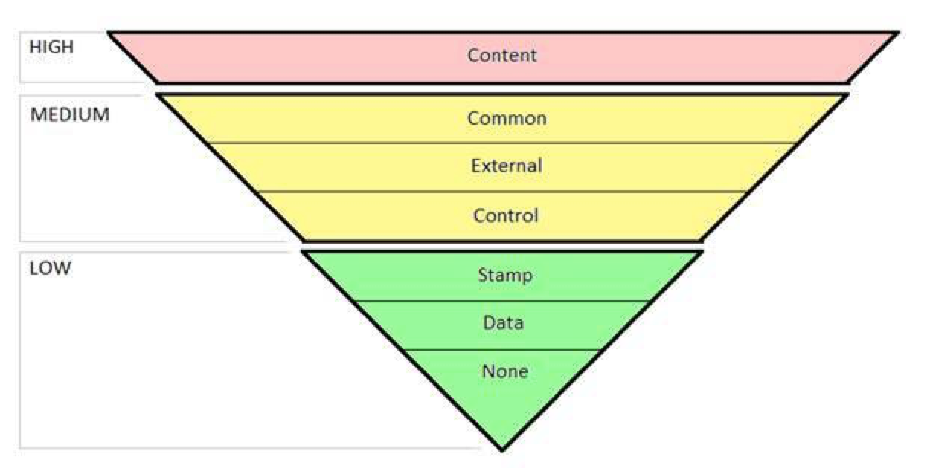
(best): data coupling
simple, easy-to-understand argument lists
simple communication path
Full list
External: not covered
  Just to make the course
  slightly easier
None: no dependency
Goal: green zone
Notes:
External: dependency on external data such as communication channels – this depends on the level of documentation

Slide 19
In-class exercise
Distribute first-year code (anonymized), have students identify examples of poor cohesion, poor coupling

Slide 20
Cohesion
Cohesive module: performs single task with minimal interaction with rest of system
Single responsibility!
  Or at least, a small number
  Example: grade book would record grades, compute statistics
Notes:
A grade book cannot be seen as having just one responsibility…

Slide 21
Levels of Cohesion
coincidental cohesion: loose relationship between responsibilities
  Example: putting all of your GUI code in a single form class
    This was easy to do in Java Swing
    The bee simulator sample code!
  Example: StudentFinancialsWithCoursesAndResidence
    Hmm… how about “StudentData”?
    All of the clauses, especially “and” show this has too many responsibilities
problems: hard to maintain, hard to reuse such pieces
Solution for Student: associations to specialized classes
  Student -- Schedule, Student -- Room -- ResidenceHall
  Student -- Account
Notes:
No arrows: Think

Slide 22
Coincidental cohesion: also happens at the method level
  example methods: PrintLineInReverseAndConvertToFloat, CloseFilesAndPrintAverageTemperatures
    Bad names can be an important clue, but only when they “cover” the method
    PrintData would also be a hint…
Causes:
  rigid rules about lengths, such as ”no methods longer than 10 lines”
    We have to impose such limits to force methods in the 1st year, but be cautious in industry…
  improper concerns about efficiency, such as avoiding 3-line functions because of function call overhead
    Extreme version: single function that does everything (just one big main)
  adding functionality during maintenance because “it just works there”
  randomly joining, splitting methods
Problem: hard to maintain, hard to reuse such pieces
Notes:
[The example is from a textbook by Schach]

Slide 23
More coincidental cohesion: False “functional cohesion”
The sub-operations perform similar computations, but they are independent at all levels:
Domain level: e.g., different files belong to different objects
Solution level: e.g., different files are handled at different times in conjunction with different objects
class examples:
  ErrorHandler, EventLogger, FileHandler
  occasionally: PartNumberOrName (implying can have one but not both)
public class EventLogger {
public void logDatabaseError() { /* */ }
public void logFileReadingError() { /* */ }
public void logUserInputError() { /* */ }
}
Notes:
* review issues after making point about how tempting it is to use this design strategy
Interesting application, but probably would take too much time to discuss: Therac-25 control system: poll keyboard to check for new character, poll hardware to see if ready to dose patient, poll clock to see if dose time up - some polling operations done more frequently, so have flag to determine if infrequent operations must be polled

Slide 24
logical cohesion: the result of control coupling
The sub-operations perform similar
but independent computations.
method: HandleAllErrors(int errno, const char *msg);
  OpenFiles(); (opening all files regardless of when needed)
generate all output regardless of type:
  void SendOutput(int dest, int type, String msg, int inum, float fnum); where
    dest: 0 means stdout, 1 means tape, 2 means printer
    type: 0 means print msg and inum, 1 means print msg and fnum, 2 means msg only, 3 means inum only, 4 means fnum only
issues:
  interface hard to understand
  intricate code due to module activating differently based on different parameters
  hard/impossible to maintain/reuse one piece
Watch out for this! This sort of organization is very tempting to engineers…
“handle all of the errors in one place,” etc.
Notes:
* review issues after making point about how tempting it is to use this design strategy
Interesting application, but probably would take too much time to discuss: Therac-25 control system: poll keyboard to check for new character, poll hardware to see if ready to dose patient, poll clock to see if dose time up - some polling operations done more frequently, so have flag to determine if infrequent operations must be polled

Slide 25
temporal cohesion: tasks that are related just by when they are done
Classic example: initializing all data structures/state variables
  public class Setup
  issue: separating initialization from use, so must maintain two places
In methods: Document.new()
  Prompt user to save current, clear document, reinitialize state, update recent document list, update title bar
  all this needs to be done, but with different (reusable) methods, probably in different classes
  note: issue is what's done directly vs. what's done in a method that's called by a more policy-oriented one

Slide 26
procedural cohesion: tasks designed based on being able to be invoked in a particular order
Generally an issue with methods, not classes
Often: no data being passed
example: ReadPartNumberFromDatabaseAndUpdateRepairRecord
still: low reusability

Slide 27
communicational cohesion: tasks which are together because they process the same data
Generally an issue with methods only
example: UpdateDatabaseRecordAndWriteToAuditTrail
example: ComputeAverageAndPrint which contains a loop to compute an average and then prints it at the end
again: low reusability
note "it" could have been in both names

Slide 28
functional cohesion: highest level - module does one task
Classes: Furnace, Student
  Almost any domain level class!
Method examples:
  Furnace.getTemperature
  Student.save
  SalesCommissision.compute
high reusability, maintainability

Slide 29
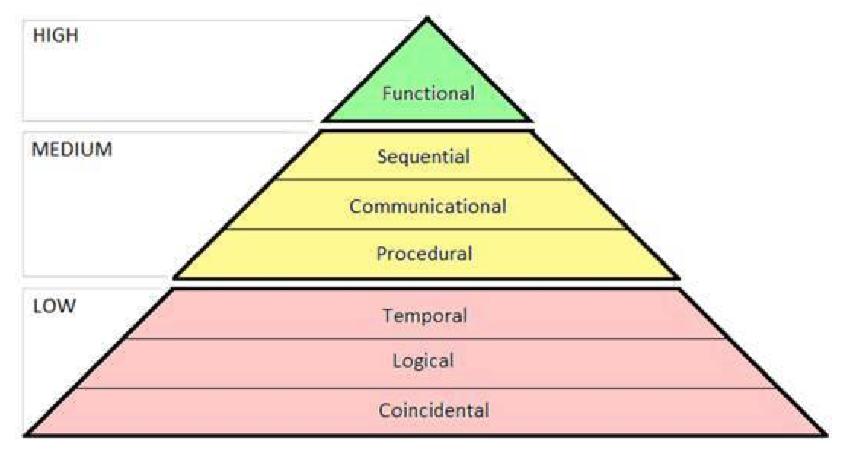
Coincidental, logical, temporal cohesion: avoid at all costs
Procedural, communicational cohesion: still not perfect, but much better than the first 3
Sequential: see book
Goal: functional cohesion

Slide 30
Review

Slide 31
In groups, write sample questions:
Write code segments that students are to classify where the answers are “common coupling” and “stamp coupling”.
Write a method with control coupling and have the student improve the coupling.
Have the student compare two coupling mechanisms and explain why one is better.
Write code to be classified by cohesion covering two forms of cohesion.
Have the student draw a UML diagram for a problem where the diagram illustrates a class with temporal cohesion.
Pick 3 types of cohesion and have the student explain how to identify each.

Slide 32
Design Heuristics
examine first-cut design; reduce coupling and improve cohesion
  combine, break apart modules as needed (without breaking abstractions)
minimize structures with very high fan-out, strive for fan-in at bottom levels
  poor structure: pancake: A uses B, C, D, E, F, G, H
  better: A uses B, C, D; B uses E, F, D uses F, G, H
keep scope of effect of a module within scope of control
  scope of effect: what modules are affected by a decision
  scope of control: sub-modules
  example of bad effect: B sets a flag that controls what happens in H
evaluate module interfaces: reduce complexity, redundancy; improve consistency
  inconsistencies: seemingly unrelated data being passed to a module (low cohesion)
make modules predictable
  should be able to view module as a "black box"
  avoid recording state info that's not necessary
don't introduce arbitrary restrictions to modules
  unnecessary restrictions on data size, sequences (arrays) will require maintenance to remove those restrictions
  most Unix loopholes can be attributed to fixed sized strings and other arrays!

