Slide 1
SE-3910
Real-time Systems
Week 5, Class 2
  Lab turn-in page is up!
  Use interrupts in a Linux/C environment
  Scheduling
  Watchdog follow-up
    Watchdog demo
Notes:
SE3910
Class 5-1
Yoder
PPT notes
Spring 2014
Print slide 15 for all students
Instructor: Print notes
Tentative Class Objectives:
Explain why writing a file causes a pin to “light”
Explain why reading a file reads a 3.3/0V value from a pin
Create programs using file I/O
Create new capabilities for the GPIO library
Create new kernel modules for the BeagleBone?
- Because it’s cool
- To give deeper hardware/software understanding
- To give familiarity with the whole beagle-bone process
Explore the Beaglebone OS source code
Explain key design decisions made by Beaglebone / Linux OS writers
Contrast these decisions with Classic Linux and Windows decisions
For HW:
Explain the concept of rise time and fall time.
Make sketch or figure: Using the oscilloscope, measure the time difference between two signals.
Classify events as either being synchronous or asynchronous, periodic, aperiodic, or sporadic
Explain the difference between an embedded and non-embedded system
Explain the difference between a real-time system and a non-real-time system
Identify the key components of the Beaglebone platform
Explain why the Beaglebone changes operating frequency under different power conditions
Identify the key hardware interfaces of the beaglebone
Explain the concept of a cape (daughterboard)
Calculate the software GPIO pin number from an expansion port header definition
Understand how to read a basic schematic
Explain the concept of a dropping resistor
Explain the concept of a pull up and a pull down resistor
Short the beaglebone’s output to ground
Connect the input directly to 5V
Connect the input through a resistor to 5V
Discuss peak voltage again
Potential Topics
Piazza
Link to Schilling’s PDF Slides
Future Quick-quizzes:
Labeling voltage, current etc.
Why frequency scale? What is the advantage of turning down frequency?
HW:
How to set frequency to minimize power consumption given full-speed CPU load?
(for after scheduling later)Suppose a program blocks X time, and runs Y time while waiting for data, per period. What is the CPU load?
Future potential objectives:
Discuss two kinds of interrupt systems:
Idle main
“background” main
etc.
Identify possible values for hyperperiod and frames in cyclic scheduling
Compare and constrast round-robin and cyclic scheduling

Slide 2
Quick Quiz! (1)
What is an advantage of a Watchdog Timer?
What is a disadvantage?
How can we avoid the disadvantages?

Slide 3
Quick Quiz! (2)
Name two non-essential OS components and describe why each is non-essential.

Slide 4
Quick Quiz (3)
What does this shell script print?
-------- script ------
echo “var1: $1”
echo ‘var2: $2’
echo “Number of Arguments: $#”
-----------------------
when run as
./script “John Doe” “Pete Stephens” “Nancy Drew”

Slide 5
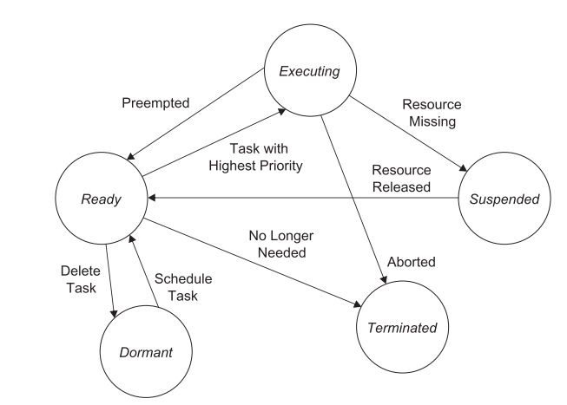
Task State Diagram

Slide 6
Scheduling Approaches
Pre-runtime
  Create a feasible schedule offline prior to execution
  Requires prediction of the worst case performance for the system
  Takes into account context switch overhead
  Tries to avoid resource conflicts
Runtime scheduling
  Priorities (fixed or dynamic) are assigned and resources are allocated
  Allows for tasks to be interrupted
  Allows for resources to be demanded periodically, aperiodically, or sporadically

Slide 7
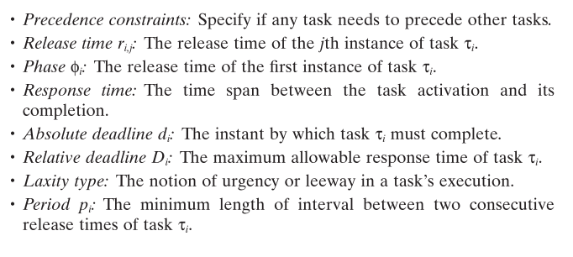
Scheduling Definitions
Notes:
Define d_i,j as well
Skip laxity if desired.

Slide 8
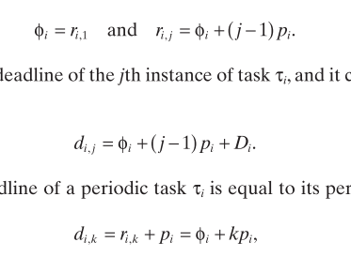
(cont.)
Notes:
Perhaps illustrate the definitions rather than using words.
Third line: Assuming deadline = period (assumption made on next slide)

Slide 9
Simplifying Assumptions
All tasks in the task set considered are strictly periodic.
The relative deadline of a task is equal to its period.
All tasks are independent; there are no precedence constraints.
No task has any nonpreemptible section, and the cost of preemption is negligible.
Only processing requirements are signiﬁcant; memory and I/O requirements are negligible.

Slide 10
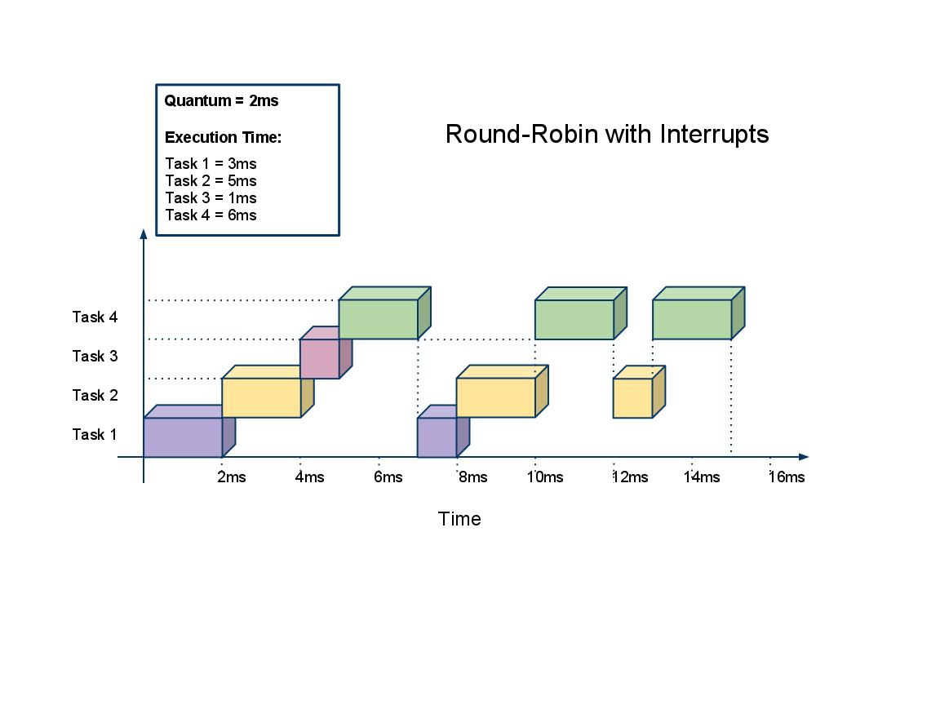
Round-Robin Scheduling

Slide 11
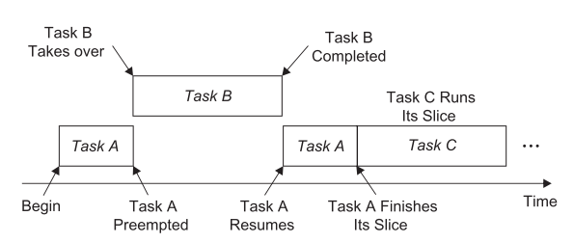
Round-Robin Scheduling with pre-emption

Slide 12
Cyclic Code Scheduling
Scheduling decisions are made periodically rather than arbitrarily
  Major cycle (hyperperiod)
    The minimum time required to execute tasks allocated to the CPU
    Equal to the least common multiple of the task periods
  Frames
    The locations where scheduling decisions are made
    No premption within frames
Notes:
p.100-101
Illustrate these definitions.

Slide 13
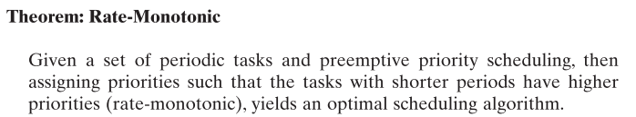
Optimal Cyclic Code Scheduling
– Rate Monotonic Scheduling
Notes:
Write out by hand
- use creative spacing to emphasize structure

Slide 14
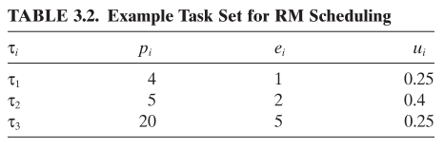
In-Class Exercise
Calculation: What is the processor utilization for this problem?
Based on RMA, what order will they execute and how will they execute?
Hints: Draw release times, break up processing into multiple frames if needed.
Notes:
Skip calculation if time short

Slide 15
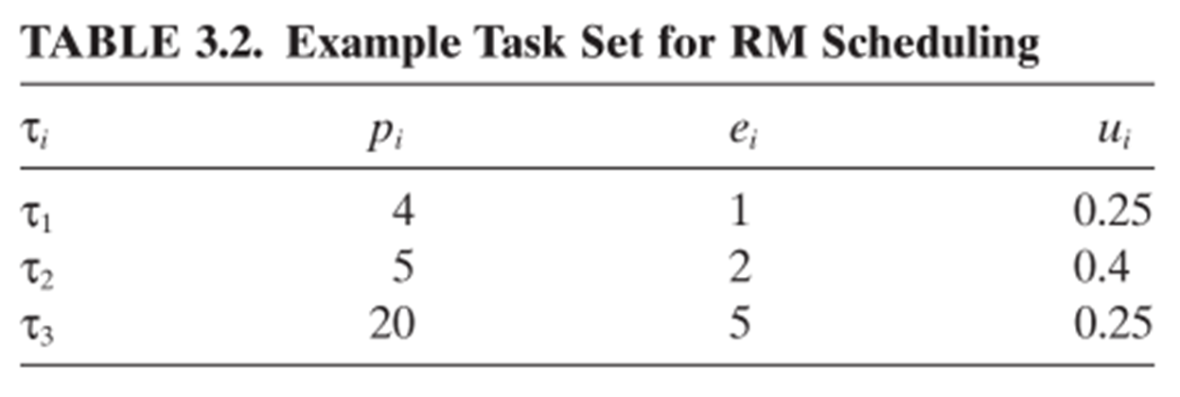
Rate-Monotonic Example
Notes:
See example soln. in text.

Slide 16
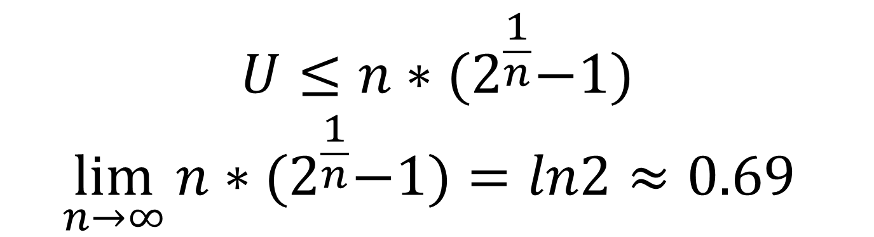
RMA Guarantee – Upper Bound for lower bound for range that will work
$$U≤n∗{(2}^{\frac{1}{n}}−1)$$
$$\lim_{n→∞}{n∗{(2}^{\frac{1}{n}}−1)=ln2≈0.69 }$$

Slide 17
Demo – Connecting to Beaglebone
[TODO] – Perhaps another time!
  I may eventually put instructions for setting up a DHCP server on your laptop using “connection sharing” on website under “Objectives”
  Ask me if you don’t find it when you need it
  You know my number.

Slide 18
Demo – Watchdog
One prompt
  for i in `seq 0 1000`; do
  echo $(($i*10));
  sleep 10; done;
Another
  cat > /dev/watchdog

