Slide 1
SE-3910
Real-time Systems
Week 7, Class 3
  Announcement
  Estimating rates
    Uncompressed Video Size
    Compression Ratio
    Frame rate – the Stroboscope effect (Aliasing)
    Channel capacity
      Fourier Transform
    Sampling error
Notes:
SE3910
Class 5-1
Yoder
PPT notes
Spring 2014
Print 1-5,11,13-21
Instructor: Print notes
Tentative Class Objectives:
Explain why writing a file causes a pin to “light”
Explain why reading a file reads a 3.3/0V value from a pin
Create programs using file I/O
Create new capabilities for the GPIO library
Create new kernel modules for the BeagleBone?
- Because it’s cool
- To give deeper hardware/software understanding
- To give familiarity with the whole beagle-bone process
Explore the Beaglebone OS source code
Explain key design decisions made by Beaglebone / Linux OS writers
Contrast these decisions with Classic Linux and Windows decisions
For HW:
Explain the concept of rise time and fall time.
Make sketch or figure: Using the oscilloscope, measure the time difference between two signals.
Classify events as either being synchronous or asynchronous, periodic, aperiodic, or sporadic
Explain the difference between an embedded and non-embedded system
Explain the difference between a real-time system and a non-real-time system
Identify the key components of the Beaglebone platform
Explain why the Beaglebone changes operating frequency under different power conditions
Identify the key hardware interfaces of the beaglebone
Explain the concept of a cape (daughterboard)
Calculate the software GPIO pin number from an expansion port header definition
Understand how to read a basic schematic
Explain the concept of a dropping resistor
Explain the concept of a pull up and a pull down resistor
Short the beaglebone’s output to ground
Connect the input directly to 5V
Connect the input through a resistor to 5V
Discuss peak voltage again
Potential Topics
Piazza
Link to Schilling’s PDF Slides
Future Quick-quizzes:
Labeling voltage, current etc.
Why frequency scale? What is the advantage of turning down frequency?
HW:
How to set frequency to minimize power consumption given full-speed CPU load?
(for after scheduling later)Suppose a program blocks X time, and runs Y time while waiting for data, per period. What is the CPU load?
Future potential objectives:
Discuss two kinds of interrupt systems:
Idle main
“background” main
etc.
Identify possible values for hyperperiod and frames in cyclic scheduling
Compare and constrast round-robin and cyclic scheduling

Slide 2
How is an image stored in memory?
Notes:
[Draw out example on board]

Slide 3
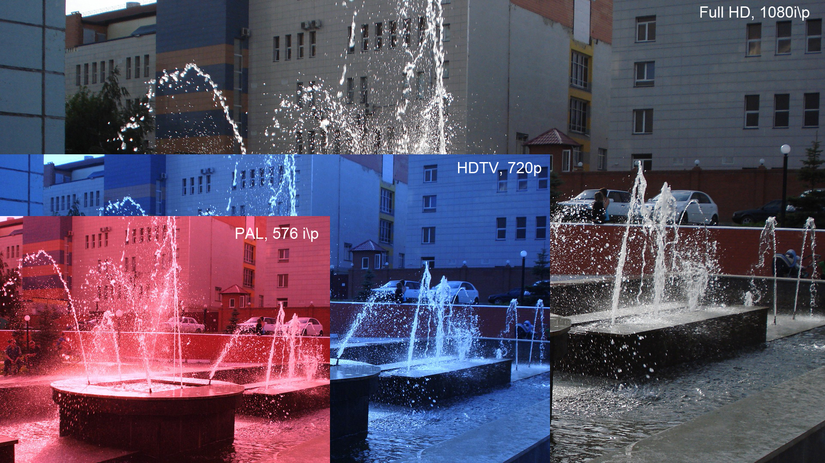
Full HD/1080p
Notes:
Explain that 1080p means the image has a resolution of 1920 by 1080
Image is sent at 60 frame per second
Each pixel has at least 24 bit color associated with it
i – interaced
p – progressive

Slide 4
How large is an uncompressed image?
1080p
  1920 x 1080
  3 channels (RGB), each 8 bits
How many bytes for one image?

Slide 5
What is the uncompressed data-rate?
1080p
  1920 x 1080
  3 channels (RGB), each 8 bits
  60 fps
What is the data rate, in Xbits per second?

Slide 6
H.262 Compression
H.262 compression has a target maximum data rate of 25 Mb/s. Supposing this means Mebibits/s (or Megabits/s), what is the desire compression ratio?
compression ratio = compressed /
uncompressed

Slide 7
The Stroboscopic Effect
Have you ever noticed something that is in motion seem to stop?

Slide 8
The Stroboscopic Effect
(Aliasing)
http://upload.wikimedia.org/wikipedia/commons/7/77/Propeller_strobe.ogv
http://upload.wikimedia.org/wikipedia/commons/e/ef/The_wagon-wheel_effect.ogv

Slide 9
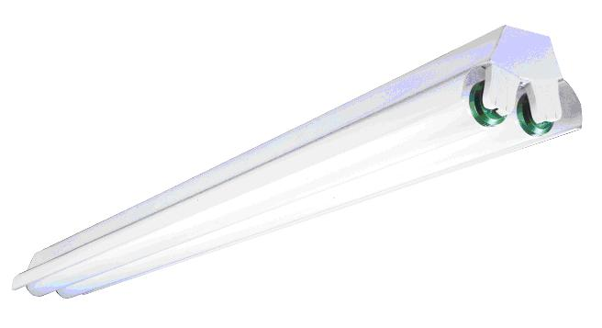
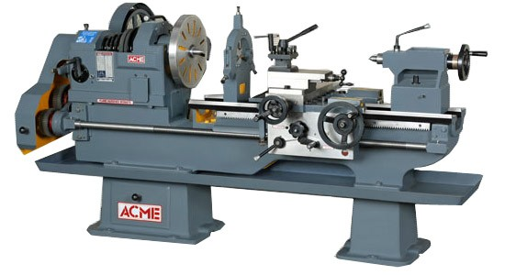
Safety
See, e.g. http://www.seasshops.ucla.edu/services/student-faculty-shop/machine-shop-rules

Slide 10
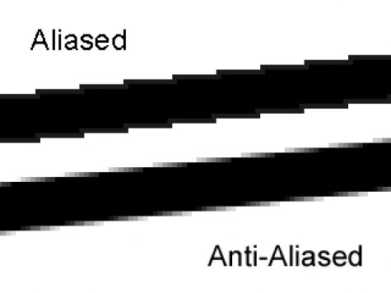
Aliasing
http://photo.stackexchange.com/questions/24512/what-is-aliasing-and-anti-aliasing

Slide 11
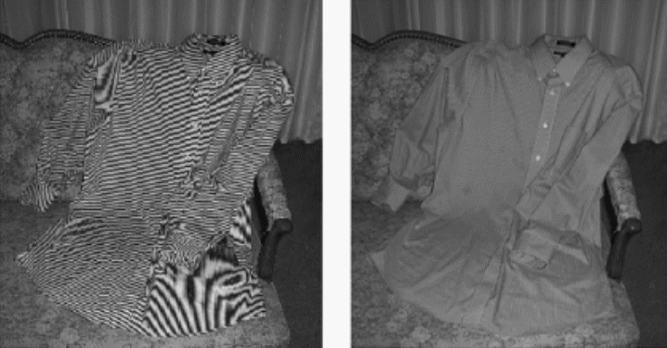
More aliasing
Single-Sensor Imaging: Methods and Applications for Digital Cameras, by Rastislav Lukac
http://www.openphotographyforums.com/forums/showthread.php?t=14988

Slide 12
Transmitting data
Physical Layer
  You didn’t talk too much about this in Network Protocols
  Can occur through many mediums
    Twisted Pair
    Coaxial Cable
    Fiber Optics
    Wireless

Slide 13
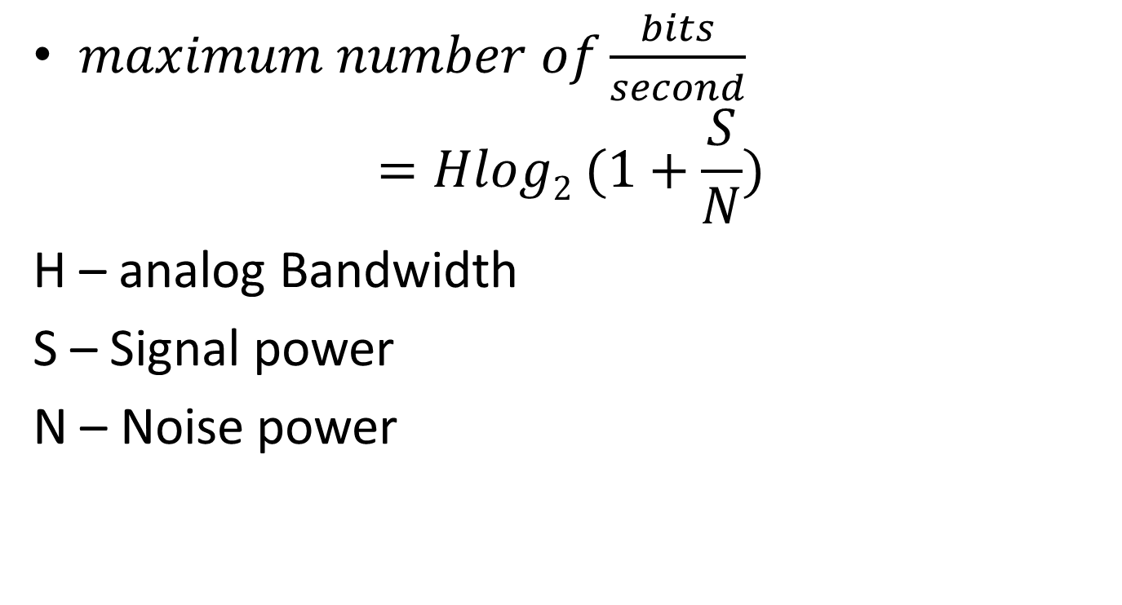
Claude Shannon
$maximum number of\frac{bits}{second}$
$$=Hlog2 (1+\frac{S}{N})$$
H – analog Bandwidth
S – Signal power
N – Noise power

Slide 14
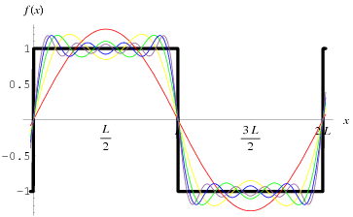
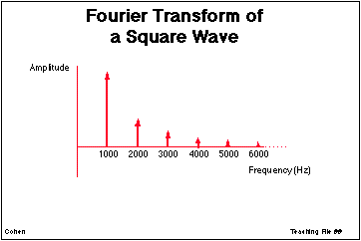
Signals as sums of sine-waves
http://ccn.ucla.edu/BMCweb/SharedCode/slides/SlideFiles.html
http://mathworld.wolfram.com/FourierSeriesSquareWave.html

Slide 15
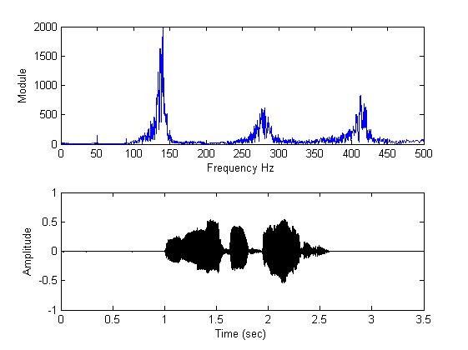
What is analog bandwidth?
Time
Freq.
http://www.mathworks.com/matlabcentral/fileexchange/22214-voice-audio-processing
Notes:
Can do this not only with audio, but also with radio waves
Indeed, both are squared:
http://en.wikipedia.org/wiki/Parseval's_theorem

Slide 16
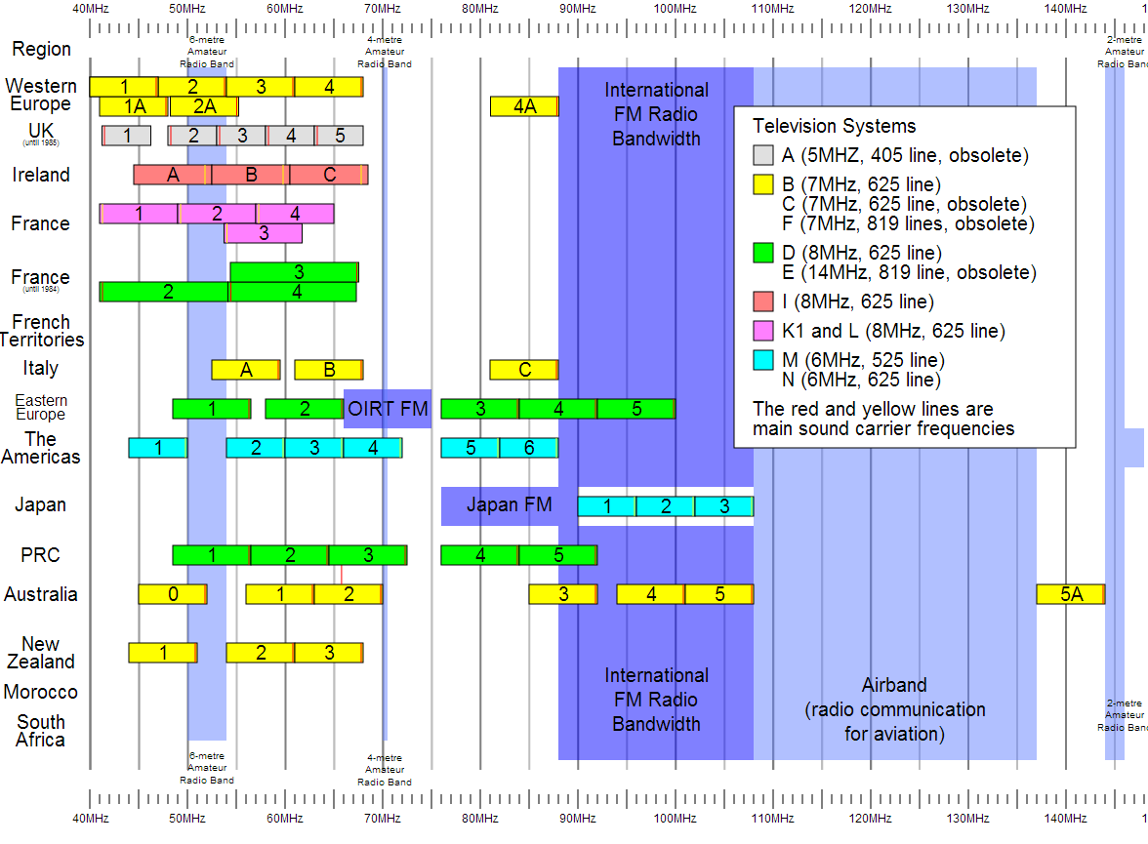
Notes:
For Digital TV:
http://transition.fcc.gov/mb/engineering/dtvmaps/
Full US allocations:
http://upload.wikimedia.org/wikipedia/commons/4/45/United_States_Frequency_Allocations_Chart_2003_-_The_Radio_Spectrum.jpg
VHF Usage (World wide)
http://upload.wikimedia.org/wikipedia/en/c/cc/VHF_Usage.svg

Slide 17

Channel capacity
$maximum number of\frac{bits}{second}$
$$=Hlog2 (1+\frac{S}{N})$$

Slide 18
In-class exercise
The old analog TV channels had a bandwidth of 6MHz
Supposing a SNR of 50 dB, what is the maximum possible bit-rate?
Notes:
For Spring 2015 (15q3):
Work through one, then give an in-class exercise for the following.

Slide 19
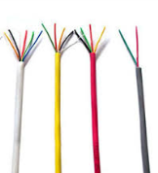
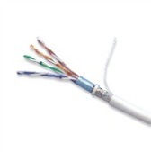

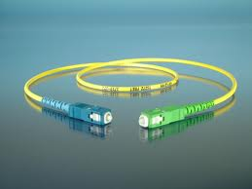
Rates
Wiring Type | Bandwidth
CAT 3 | 16MHz
CAT 5 | 100 MHz
Coaxial Cable (50 Ohm) | 1-2 GHz
Fiber Optic | 50000 GHz
Notes:
Compare result with this

Slide 20
In-Class Exercise: If this is 1 second, what is the output if we sample 3 times per second?
Notes:
Just barely finished this.

Slide 21
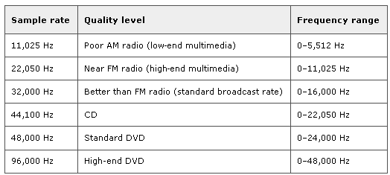
Sampling Theorem (again Nyquist)
f_{s} = 2B (B is bandwidth of signal)
Notes:
Did not get to this.

Slide 22
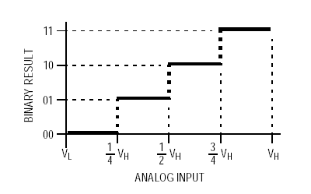
Discretization
Consider an analog signal that will vary between two values – say 0 and V_{H} volts
Discretization refers to the “levels” the ADC is able to resolve the analog signal to:
  a 2-bit converter can resolve 4 different discrete levels

Slide 23
Discretization Error
Difference between the actual analog value and quantized digital value due is called quantization error.
  Due either to rounding or truncation.

