Slide 1
SE-3910
Real-time Systems
Week 7, Class 3
  Announcement
  Estimating rates
    Uncompressed Video Size
    Compression Ratio
    Frame rate – the Stroboscope effect (Aliasing)
    Channel capacity
      Fourier Transform
    Sampling error
Notes:
SE3910
Class 5-1
Yoder
PPT notes
Spring 2014
Print 1-5,11,13-21
Instructor: Print notes
Tentative Class Objectives:
Explain why writing a file causes a pin to “light”
Explain why reading a file reads a 3.3/0V value from a pin
Create programs using file I/O
Create new capabilities for the GPIO library
Create new kernel modules for the BeagleBone?
- Because it’s cool
- To give deeper hardware/software understanding
- To give familiarity with the whole beagle-bone process
Explore the Beaglebone OS source code
Explain key design decisions made by Beaglebone / Linux OS writers
Contrast these decisions with Classic Linux and Windows decisions
For HW:
Explain the concept of rise time and fall time.
Make sketch or figure: Using the oscilloscope, measure the time difference between two signals.
Classify events as either being synchronous or asynchronous, periodic, aperiodic, or sporadic
Explain the difference between an embedded and non-embedded system
Explain the difference between a real-time system and a non-real-time system
Identify the key components of the Beaglebone platform
Explain why the Beaglebone changes operating frequency under different power conditions
Identify the key hardware interfaces of the beaglebone
Explain the concept of a cape (daughterboard)
Calculate the software GPIO pin number from an expansion port header definition
Understand how to read a basic schematic
Explain the concept of a dropping resistor
Explain the concept of a pull up and a pull down resistor
Short the beaglebone’s output to ground
Connect the input directly to 5V
Connect the input through a resistor to 5V
Discuss peak voltage again
Potential Topics
Piazza
Link to Schilling’s PDF Slides
Future Quick-quizzes:
Labeling voltage, current etc.
Why frequency scale? What is the advantage of turning down frequency?
HW:
How to set frequency to minimize power consumption given full-speed CPU load?
(for after scheduling later)Suppose a program blocks X time, and runs Y time while waiting for data, per period. What is the CPU load?
Future potential objectives:
Discuss two kinds of interrupt systems:
Idle main
“background” main
etc.
Identify possible values for hyperperiod and frames in cyclic scheduling
Compare and constrast round-robin and cyclic scheduling

Slide 2
Very Useful for Today’s Lecture
P = 1,000,0000,000,000,000
T = 1,000,000,000,000
G = 1,000,000,000
M = 1,000,000
K = 1,000
() = 1
m = 1/1,000
us = 1/1,000,000
ns = 1/1,000,000,000 (us = μs)

Slide 3
In-class Activity: What is the data rate of classic NTSC television?
Store color with special scheme so only two bytes required per pixel, on average
720x480
30/1.001 fps
Follow up:
If compressed to 25MiB/s (or 25MB/s) what is the compression ratio?
Notes:
[Draw out example on board]

Slide 4
Human eye
Recall
  As little as 13ms
Notice interruption
  As short as 16ms
Single-ms duration looks as long as
  100-400ms
10ms green followed by 10ms red
  May appear as single yellow stimulus

Slide 5
Quick Quiz:
Why might you want to sample at a higher frame-rate than the 30fps?
Be as professional as possible
  Avoid flame wars
  Have technical depth to back it
  Avoid sounding technical just to be cool

Slide 6
Quick Quiz:
What are two ways we can avoid the stroboscopic effect in a video game simulation of a rotating wheel?

Slide 7
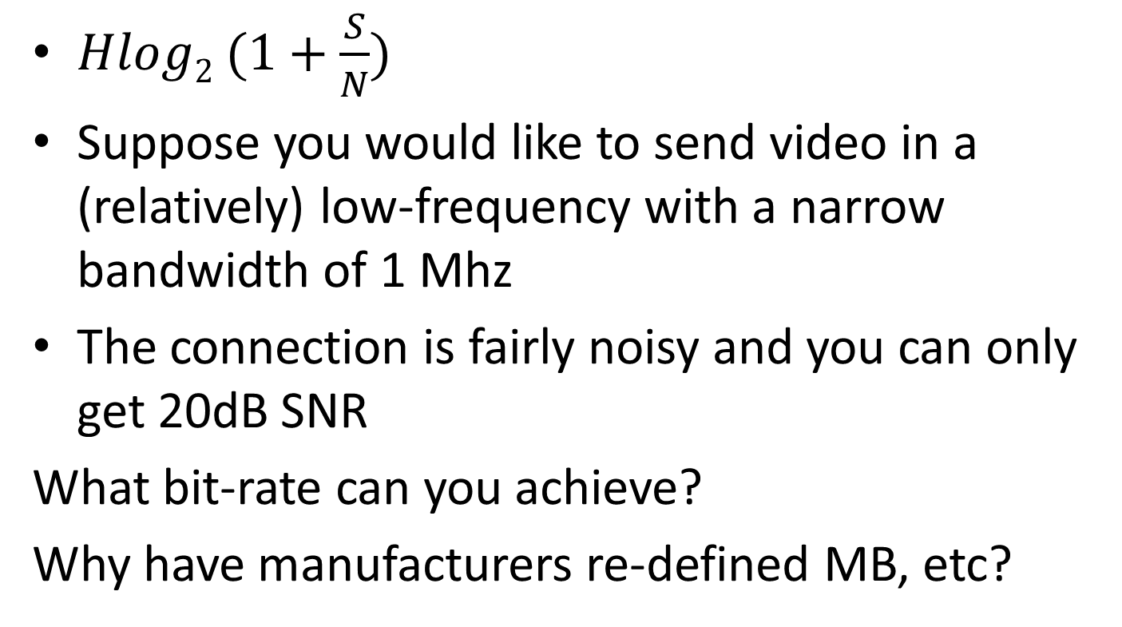
In-class Activity:
Analog to digital bandwidth
$Hlog2 (1+\frac{S}{N})$
Suppose you would like to send video in a (relatively) low-frequency with a narrow bandwidth of 1 Mhz
The connection is fairly noisy and you can only get 20dB SNR
What bit-rate can you achieve?
Why have manufacturers re-defined MB, etc?
Notes:
http://www.arrl.org/files/file/Regulatory/Recommended_Practices_Version_6_5.pdf
Earlier draft:
Modern Digital TV uses the same channels as analog TV, but dynamically maps them.
But each channel is now re-used by allocating virtual “sub-channels” within the main channel that use less of the bandwidth.
This is done digitally
[And as a result, the channel width is about the same]

Slide 8
In-class activity
Suppose I have a band centered at 100 Mhz which is 1Mhz wide.
What are the limits on this range?
What is the wavelength of the center 1 Mhz signal
speed of light = 299 792 458 m / s
speed in Cat-5 is 70% of this
wavelength = time of period * velocity
Notes:
http://www.eham.net/ehamforum/smf/index.php?topic=56160.0

Slide 9
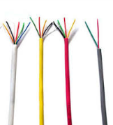
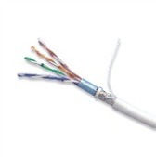
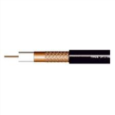
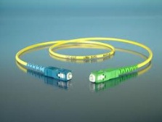
Rates (Review)
Wiring Type | Bandwidth
CAT 3 | 16MHz
CAT 5 | 100 MHz
Coaxial Cable (50 Ohm) | 1-2 GHz
Fiber Optic | 50000 GHz
Notes:
Compare result with this
We got this far – working examples either again or for the first time and discussing new material.

Slide 10
Fiber-optic Transmission
In fiber-optic transmission, signals are sent by transmitting various colors (or invisible) light down a fiber-optic channel
The colors are separated at the other end
Multiple fibers can be used
Supposing that the same bandwidth rule applies, what bandwidth can be carried by the visible spectrum? (700-400nm)
Use SNR of 4000
Hint: Convert wavelength to period/frequency
Notes:
http://physics.stackexchange.com/questions/56240/maximum-theoretical-bandwidth-of-fibre-optics
So, let's begin by exploring the best way to use our power. If we devote it to M symbols per second, each of our measurements comprise the detection of N=PMhν0 photons, thus our signal to noise ratio is SNR=NN√=PMhν0−−−−−√. By the Shannon-Hartley form of the Noisy channel coding theorem(see also here), we can therefore code our channel to get log2(1+PMhν0−−−−−√) bits of information per symbol, i.e. Mlog2(1+PMhν0−−−−−√) bits per second through our optical fibre. This is a monotonically rising function of M, so a limit on P by itself does not limit the capacity.
However, by a converse of the Nyquist-Shannon sampling theorem we can send a maximum of Bsymbols down the channel per second. This then is our greatest possible symbol rate. Hence, our overall expression for the fibre capacity in bits is:
C=Blog2(1+PBhν0−−−−−√) bits per second

Slide 11
In-Class Exercise: If this is 1 second, what is the output if we sample 3 times per second?
Notes:
Just barely finished this.

Slide 12
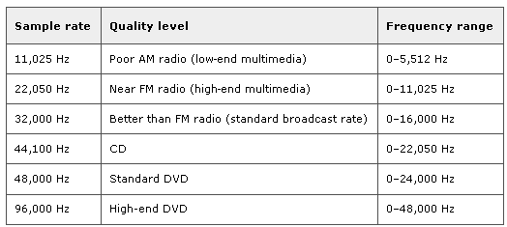
Sampling Theorem (again Nyquist)
f_{s} = 2B (B is bandwidth of signal)
Notes:
Did not get to this.

Slide 13
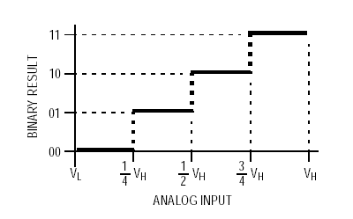
Discretization
Consider an analog signal that will vary between two values – say 0 and V_{H} volts
Discretization refers to the “levels” the ADC is able to resolve the analog signal to:
  a 2-bit converter can resolve 4 different discrete levels

Slide 14
Discretization Error
Difference between the actual analog value and quantized digital value due is called quantization error.
  Due either to rounding or truncation.
Notes:
SQNR – Signal to Quantization Noise Ratio

Slide 15
What is the discretization error of 8-bit audio?
Notes:
http://www.stanford.edu/~yxchen/publications/SampledCapacity_ICASSP.pdf

