Slide 1
SE-3910
Real-time Systems
Week 8, Class 3
  Announcement(s)
  Static Analysis
    What/Why
    Tools
    Examples
    Coding Standards vs Style Guides
    How to include SA in your development process
Notes:
SE3910
Class 5-1
Yoder
PPT notes
Spring 2014
Print 1-5,11,13-21
Instructor: Print notes
Tentative Class Objectives:
Explain why writing a file causes a pin to “light”
Explain why reading a file reads a 3.3/0V value from a pin
Create programs using file I/O
Create new capabilities for the GPIO library
Create new kernel modules for the BeagleBone?
- Because it’s cool
- To give deeper hardware/software understanding
- To give familiarity with the whole beagle-bone process
Explore the Beaglebone OS source code
Explain key design decisions made by Beaglebone / Linux OS writers
Contrast these decisions with Classic Linux and Windows decisions
For HW:
Explain the concept of rise time and fall time.
Make sketch or figure: Using the oscilloscope, measure the time difference between two signals.
Classify events as either being synchronous or asynchronous, periodic, aperiodic, or sporadic
Explain the difference between an embedded and non-embedded system
Explain the difference between a real-time system and a non-real-time system
Identify the key components of the Beaglebone platform
Explain why the Beaglebone changes operating frequency under different power conditions
Identify the key hardware interfaces of the beaglebone
Explain the concept of a cape (daughterboard)
Calculate the software GPIO pin number from an expansion port header definition
Understand how to read a basic schematic
Explain the concept of a dropping resistor
Explain the concept of a pull up and a pull down resistor
Short the beaglebone’s output to ground
Connect the input directly to 5V
Connect the input through a resistor to 5V
Discuss peak voltage again
Potential Topics
Piazza
Link to Schilling’s PDF Slides
Future Quick-quizzes:
Labeling voltage, current etc.
Why frequency scale? What is the advantage of turning down frequency?
HW:
How to set frequency to minimize power consumption given full-speed CPU load?
(for after scheduling later)Suppose a program blocks X time, and runs Y time while waiting for data, per period. What is the CPU load?
Future potential objectives:
Discuss two kinds of interrupt systems:
Idle main
“background” main
etc.
Identify possible values for hyperperiod and frames in cyclic scheduling
Compare and constrast round-robin and cyclic scheduling

Slide 2
What is/Why Static Analysis?
Static analysis is the process of evaluating a system or component based on its form, structure, content, or documentation [IEEE]
  Does not involve the execution of the program
  Software inspections are a form of static analysis
“even well tested code written by experts contains a surprising number of obvious bugs” [Hovermeyer/Pugh]
“Java has many language features and APIs which are prone to misuse.” [Hovermeyer/Pugh]
Static analysis tools “can serve an important role in raising the awareness of developers about subtle correctness issues. . . . prevent future bugs” [Hovermeyer/Pugh]
Notes:
[Draw out example on board]

Slide 3
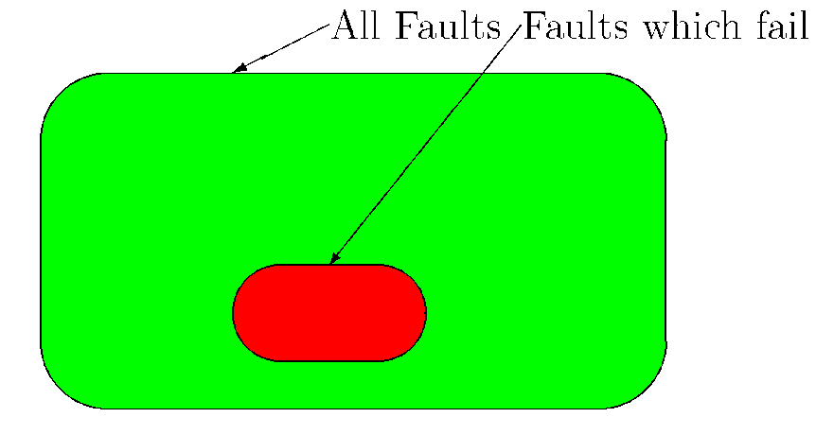
What is Static Analysis?
Similar to a spell checker or grammar checker.
Search through code to detect bug patterns
  error prone coding practices that arise from the use of erroneous design patterns, misunderstanding of language semantics, or simple and common mistakes.
Static Analysis tools detect faults
  Not all faults will fail
    90% of downtime comes from
    10% of the faults
Can detect many different
classifications of software faults
  Coding standards violations
  Buffer overflows (Viega et all)
  Security vulnerabilities (Livshits and Lam)
  Memory leaks (Rai)
  Timing anomalies (race conditions, deadlocks, and livelocks) (Artho)

Slide 4
Why Static Analysis? (1)
Required to claim compliance with MISRA C Standard
Between 40% and 60% of statically detectable faults will eventually manifest themselves in the field (QA Systems)
Has been shown to reduce software defects by a factor of six (Xiao and Pham)
Can remove upwards of 91% of errors (R. Glass)
Have been shown to have a 92% ROI _{time} (Schilling)
NEW: Required by the state of New York for contracted SW

Slide 5
Why Static Analysis? (2)
Impossible to prove a software program correct in the general case
  Manifestation of the Halting Problem.
    Halting Problem: Write a code-analysis program to determine if a program will ever stop running (i.e. will it halt?)
    Turing proved this is impossible
Most static analysis tools are unsound and incomplete.

Slide 6
Halting problem: Solution Sketch
Suppose willStop(File * file) is a method that will determine if the source code available at file will complete.
Run it on Gotcha.java:
public static void main() {
while(willStop(“Gotcha.java”)) {
// do nothing
}
}

Slide 7
A Static Analysis Classification
General Purpose Tools
  General purpose Static Analysis tools are those geared for general developmental usage
  Lint, QAC, Polyspace C, JLint, mlint, Findbugs
Security Tools
  Static Analysis tools targeting security issues within source code
  RATS (Rough Auditing Tool for Security), SPLint, Flawfinder
Style Checking Tools
  Audit software code from a stylistic standpoint ensuring consistant implementation style
  PMD, Checkstyle
Teaching Tools
  Developed to help students develop better software
  Safer C Toolkit, Gauntlet

Slide 8
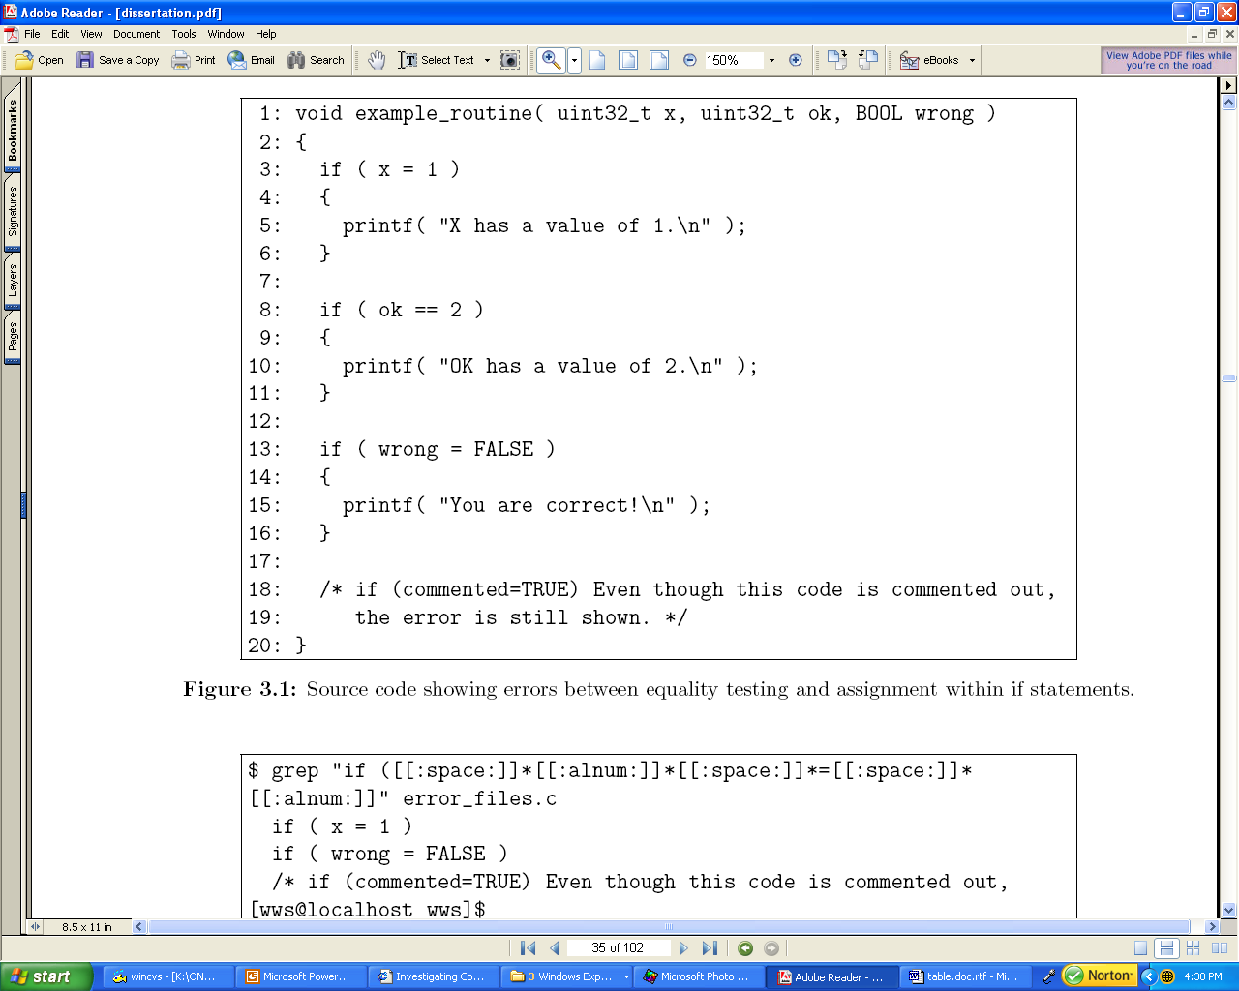
What’s wrong with this C code?

Slide 9
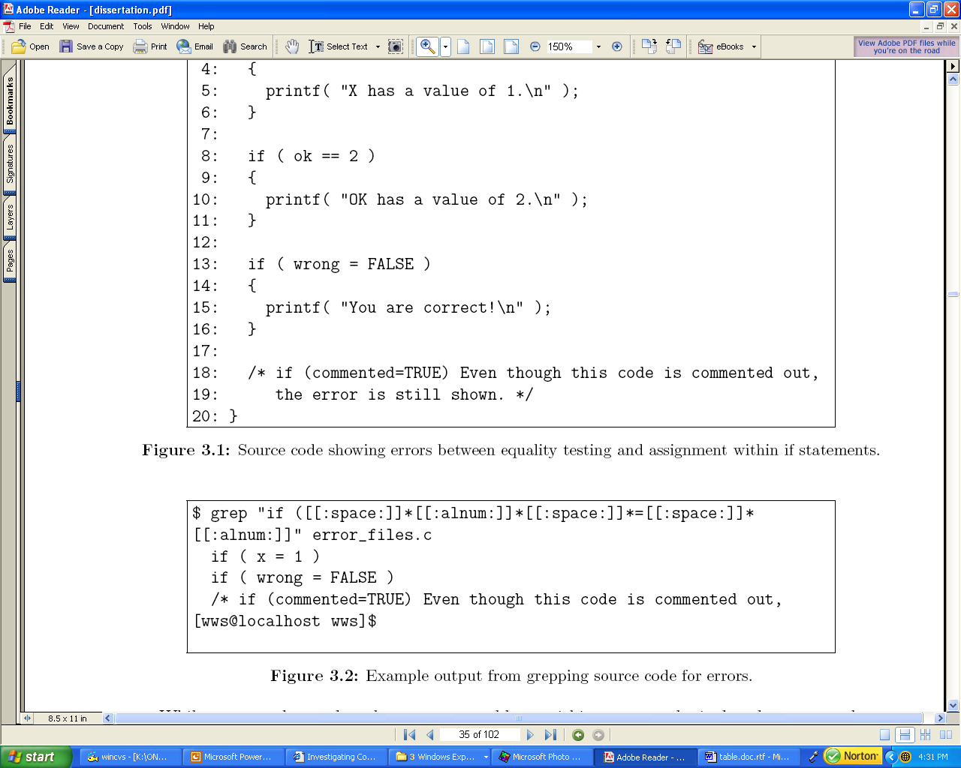
Simple search for this sort of error with GREP

Slide 10
Simple search for this sort of error with GREP

Slide 11
Lint
One of the oldest and readily available static analysis tools
  Developed initially by Bell Labs
    C Language
    UNIX development
    Now available for Dos, Windows, Linux, OS/2
  Commercial version available from Gimpel Software
    Supports value tracking, MISRA C standard compliance verification, and Effective C++ Standards
    Analyzes C and C++ code
    ALOA metrics tool is available to collect quality metrics from Lint tool.
    XML Output readily available

Slide 12
Buffer Overflow
1: typedef unsigned short uint16_t;
2: void update_average(uint16_t current_value);
3:
4: #define NUMBER_OF_VALUES_TO_AVERAGE (11u)
5:
6: static uint16_t data_values[NUMBER_OF_VALUES_TO_AVERAGE];
7: static uint16_t average = 0u;
8:
9: void update_average(uint16_t current_value)
10: {
11: static uint16_t array_offset = 0u;
12: static uint16_t data_sums = 0u;
13:
14: array_offset = ((array_offset++) % NUMBER_OF_VALUES_TO_AVERAGE);
15: data_sums -= data_values[array_offset];
16: data_sums += current_value;
17: average = (data_sums / NUMBER_OF_VALUES_TO_AVERAGE);
18: data_values[array_offset] = current_value;
19: }

Slide 13
Lint Output
--- Module: buffer_overflow.c
array_offset = ((array_offset++) % NUMBER_OF_VALUES_TO_AVERAGE);
_
"*** \index{LINT}LINT: buffer_overflow.c(14) Warning 564: variable ’array_offset’ depends on order of evaluation [\index{MISRA C}MISRA Rule 46]“
Fault manifesting itself as a failure depends upon the compiler’s handling of source code!
  Some compilers may handle code properly.
  Other compilers may cause failure to occur.
  Compiler options may affect behavior.
    Especially true of optimization flags

Slide 14
MISRA C/C++
Misra C/C++ (Motor Industry Software Reliability Association)
Rules first introduced in 1998
Revised in 2004: 141 rules for C
Revised to cover C++ in 2008 (mostly derived from JSF rules): 228 rules
Widely used in motor vehicle industry
Some support in popular embedded compilers
Closed standard

Slide 15
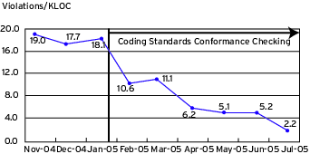
Impact of Static Analysis (SA)
Notes:
http://www.nxtbook.com/nxtbooks/cmp/ddj0806/index.php?startid=51
AND/OR
http://www.drdobbs.com/architecture-and-design/integrate-static-analysis-into-a-softwar/193500967

Slide 16
Style Guides
Provides stylistic guidance for developing source-code modules.
Items to define include:
  Copyright notices
  requisite commenting
  Indentation
  naming conventions
  Any other stylistic items
Can raise significant debate amongst software engineers
Can be automated by providing templates to automatically format code in conformance with the style guide
  Eclipse, JEdit, CodeWright all support style templates.

Slide 17
Coding Standard
Defines which coding constructs can and can not be used in a project.
  Should predominantly be enforceable through static analysis methods
  Should include general best practices as well as past experiences within the domain
Example rule:
  “All variables shall be assigned a value before being used in any operation“
  Statically detectable
  Can be easily understood by a programmer.
Defined deviation procedure
  With every coding standard, there will be a need for an occasional deviation.
  All deviations should be reviewed in a formal setting (peer review, formal review, walkthrough, etc.)
Standards Exist to use as a baseline
  MISRA C
  High Integrity C++

Slide 18
Adding SA to the Development Process
1. Develop a coding standard and style guides
  Style guide is not a necessity to use SA effectively
  There may be multiple style guides
2. Automate compliance checking with the standard
3. Add SA Compliance checking to review process

Slide 19
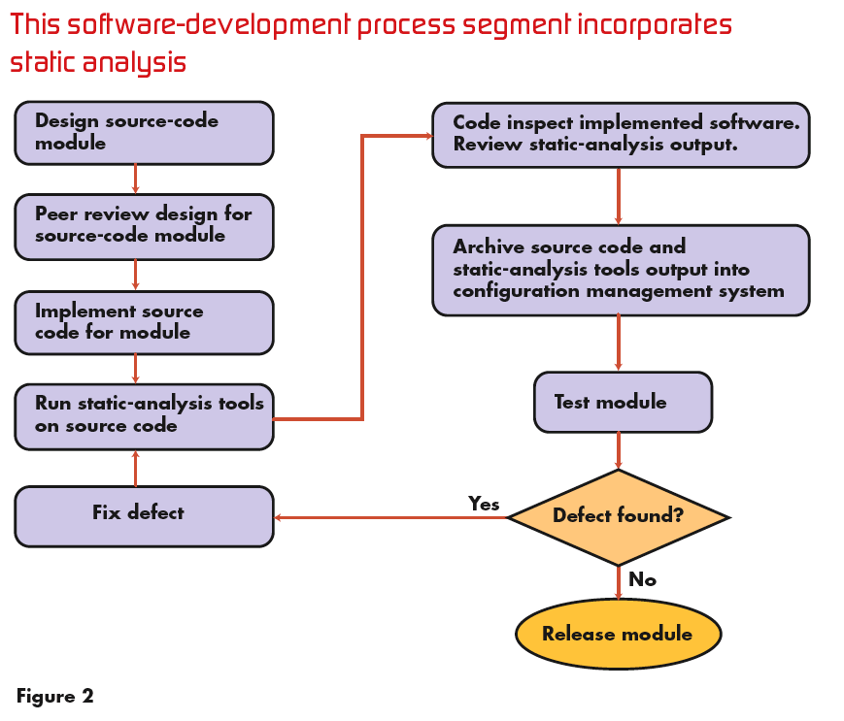
Adding SA to the Development Process (Example)

Slide 20
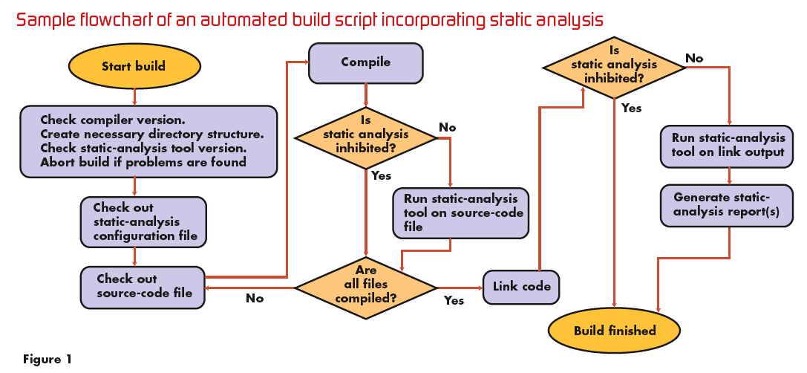
Automate Coding Standard Compliance with SA

Slide 21
SA for Legacy Code (1)
Applying to existing code base can be challenging
Success depends upon
  age of the code
  engineer's programming style
  paradigms used
  Diligence of engineers applying static analysis
Many projects have abandoned SA when the first run of the tool generates 100,000 or more warnings.
With legacy code, it's often not practical to remove all statically detectable faults.

Slide 22
SA for Legacy Code (2)
Treat each statically detectable fault as a bug fix.
  Each time a fault is removed, there's the possibility of injecting a more serious fault into the module.
  The worst thing would be to attempt to repair a false-positive that was statically detected as a fault and inject a failure.
  This must be done diligently, as each Statically Detectable fault could be a catastronphic failure in the making
    Ariane V
With legacy code, the most important information to track isn't necessarily the presence of statically detectable faults, but the change in the number of faults as revisions are made to that code.
Coding standard development follows the same behavior as that for traditional coding standard development.

Slide 23
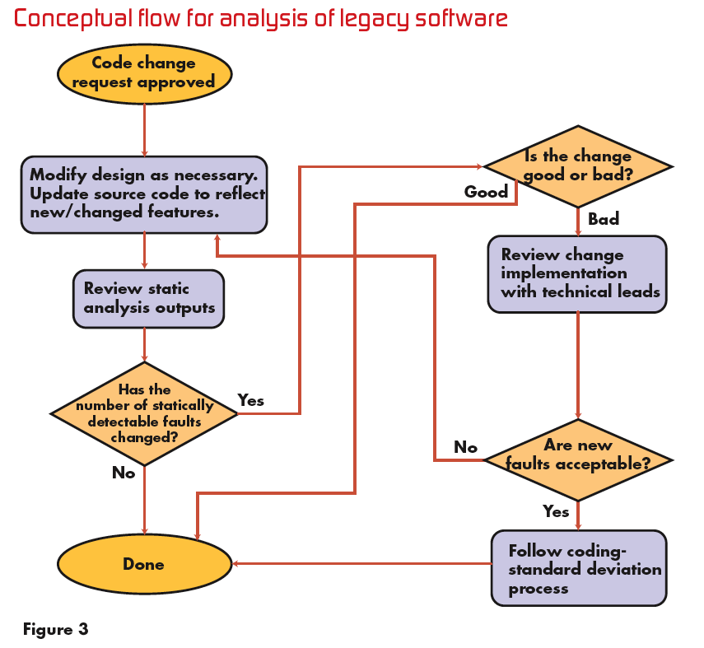
Legacy Code Flowchart

Slide 24
Resources
Integrate static analysis into a software development process
  http://www.embedded.com/shared/printableArticle.jhtml?articleID=193500830
NIST SAMATE - Software Assurance Metrics And Tool Evaluation Project
  http://samate.nist.gov/index.php/Main_Page
Static Source Code Analysis Tools for C
  http://www.spinroot.com/static/
Notes:
First link broken… perhaps this one?
http://www.drdobbs.com/architecture-and-design/integrate-static-analysis-into-a-softwar/193500967

