Slide 1
SE-3910
Real-time Systems
Week 9, Classes 1 and 2
  Announcement* (regexp style)
  Significance Testing
  Failure statistics
  Structured Analysis & Design
    SA/SD vs OOA/OOD
    Data flow diagrams
Notes:
SE3910
Class 5-1
Yoder
PPT notes
Spring 2014
Print 1-5,11,13-21
Instructor: Print notes
Tentative Class Objectives:
Explain why writing a file causes a pin to “light”
Explain why reading a file reads a 3.3/0V value from a pin
Create programs using file I/O
Create new capabilities for the GPIO library
Create new kernel modules for the BeagleBone?
- Because it’s cool
- To give deeper hardware/software understanding
- To give familiarity with the whole beagle-bone process
Explore the Beaglebone OS source code
Explain key design decisions made by Beaglebone / Linux OS writers
Contrast these decisions with Classic Linux and Windows decisions
For HW:
Explain the concept of rise time and fall time.
Make sketch or figure: Using the oscilloscope, measure the time difference between two signals.
Classify events as either being synchronous or asynchronous, periodic, aperiodic, or sporadic
Explain the difference between an embedded and non-embedded system
Explain the difference between a real-time system and a non-real-time system
Identify the key components of the Beaglebone platform
Explain why the Beaglebone changes operating frequency under different power conditions
Identify the key hardware interfaces of the beaglebone
Explain the concept of a cape (daughterboard)
Calculate the software GPIO pin number from an expansion port header definition
Understand how to read a basic schematic
Explain the concept of a dropping resistor
Explain the concept of a pull up and a pull down resistor
Short the beaglebone’s output to ground
Connect the input directly to 5V
Connect the input through a resistor to 5V
Discuss peak voltage again
Potential Topics
Piazza
Link to Schilling’s PDF Slides
Future Quick-quizzes:
Labeling voltage, current etc.
Why frequency scale? What is the advantage of turning down frequency?
HW:
How to set frequency to minimize power consumption given full-speed CPU load?
(for after scheduling later)Suppose a program blocks X time, and runs Y time while waiting for data, per period. What is the CPU load?
Future potential objectives:
Discuss two kinds of interrupt systems:
Idle main
“background” main
etc.
Identify possible values for hyperperiod and frames in cyclic scheduling
Compare and constrast round-robin and cyclic scheduling

Slide 2
Example
An airplane software system has a failure probability of 10⁻⁹ per hour. Supposing this failure will cause the plane to crash. What is the chance that the plane will crash within the year if it flies 2400 hours a year?
Compute assuming both independent and dependent.

Slide 3
Structured Analysis & Design
Structured design is a process for breaking large systems into smaller systems consisting of
  Processes
  Data flow
This is in contrast to Objet Oriented Design where a large program is broken into
  Objects
  Methods for operating on objects

Slide 4
Data flow diagrams
(Key design tool for structured design)
Entity
  An entity is the source or destination of data.
  The source in a DFD represents these entities that are outside the context of the system.
  Entities either provide data to the system (referred to as a source) or receive data from it (referred to as a sink).
Process
  The process is the manipulation or work that transforms data, performing computations, making decisions (logic flow), or directing data flows based on business rules. Data Store
Data Store
  A data store is where a process stores data between processes for later usage by the same process or another process.
Data Flow
  Data flow is the movement of data between the entity, the process, and the data store. Data flow portrays the interface between the components of the DFD.

Slide 5
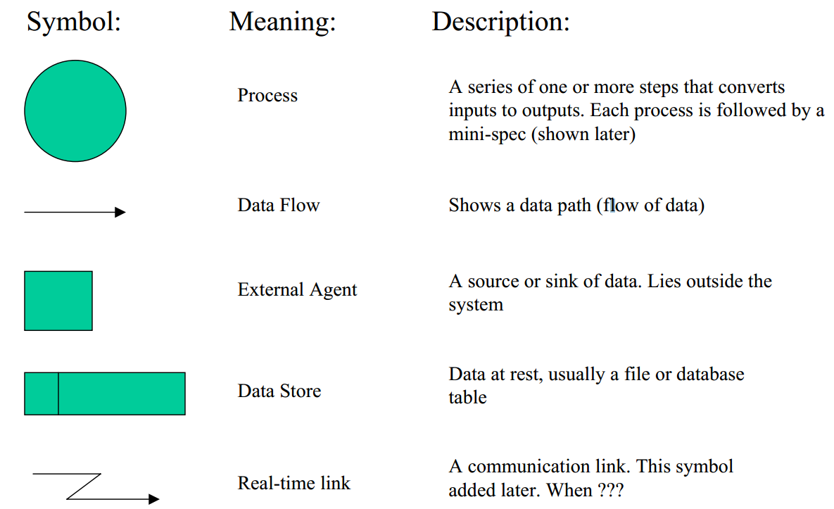
Data Flow Diagram Symbols

Slide 6
Case study: Traffic Control
We are going to walk through the design of a Traffic Control System
  Starting with the needs of the system.
  We want to talk about how data flows through the system.

Slide 7
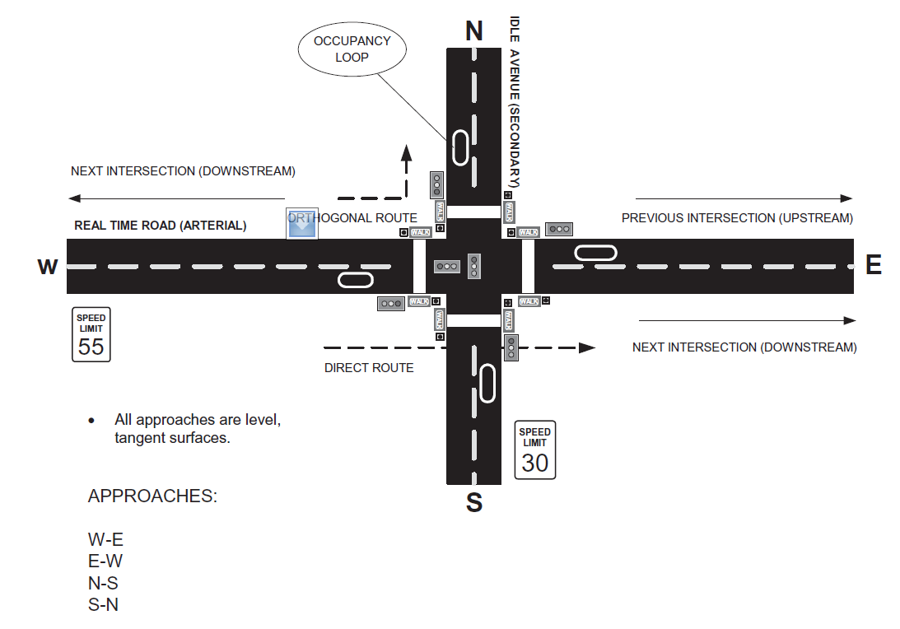
An Intersection System

Slide 8
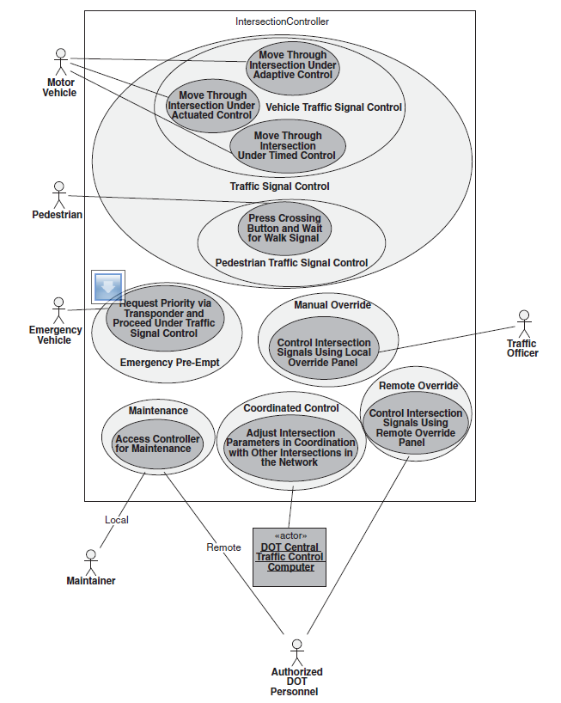
Intersection Control Diagram

Slide 9
Dataflow diagram

Slide 10
Data Dictionary
An essential aspect of a structured design
  Includes entries for data flows, control flows, data stores, buffers, etc.

Slide 11
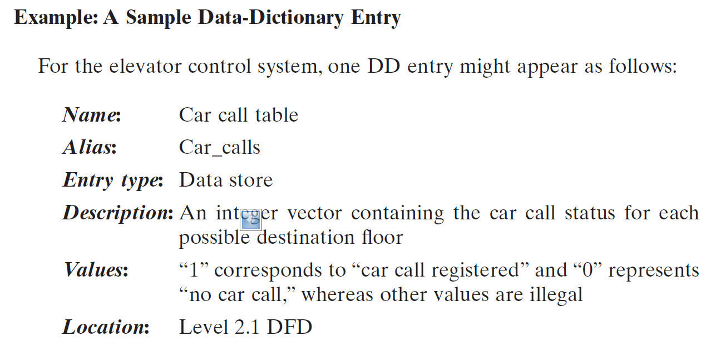
Data Dictionary Example

Slide 12
Discussion: Which software failure(s) we have talked about (throughout the curriculum) should have been caught using this approach?
Notes:
Skipped this 14q3.

Slide 13
DFD – Practical Example
Launched Dec. 11, 1998, the Climate Orbiter plunged too steeply into the Martian atmosphere Sept. 23, 1999, and either burned up or crashed. In an initial failure report released Oct. 15, 2000 the review board blamed the navigation error on a communications foul-up between NASA's Jet Propulsion Laboratory and prime contractor Lockheed Martin.

Slide 14
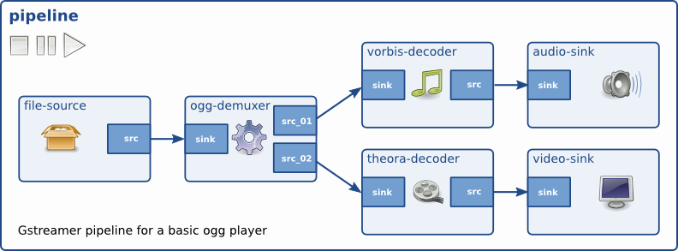
DFD – Second Practical Example

Slide 15
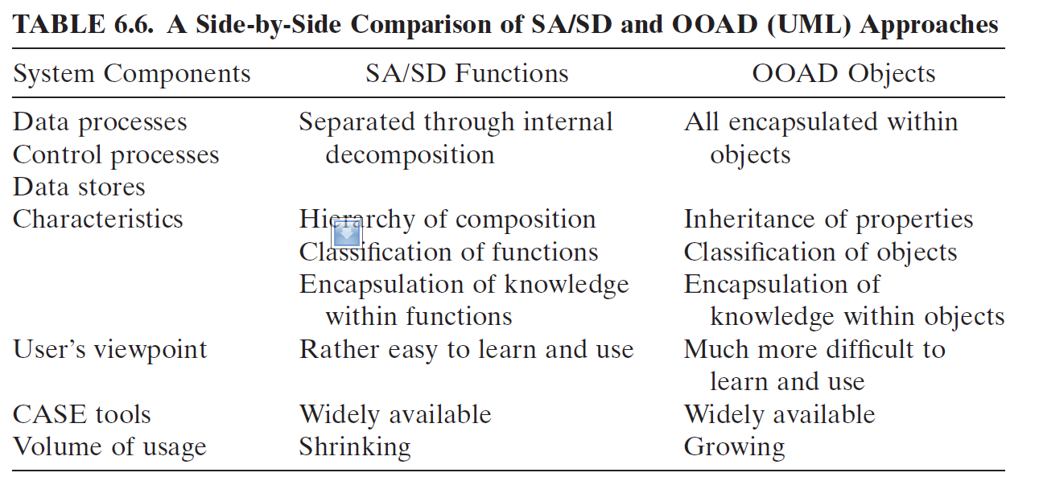
Structured vs OO Design (1)

Slide 16
Structured vs OO Design (2)
Three key “views” of a program
  Data
  Events
    Stimuli
    Control signals
  Actions
    Procedures
    “Precise rules”
    E.g. “compensate” or “calibrate”

Slide 17
Structured vs OO Design (2)
Choosing SA or OO for an object-oriented design
Notes:
Draw table
Data
Events
Actions
Vs
Real time needs it?
OO
SA

