Slide 1
SE3910
Week 10, Class 2 (Last class)
Today
  Return Quiz
  Class Climate Survey
  Review

Slide 2
Final Exam
SE 3910 021 Yoder
Wednesday 2:00 PM - 4:00 PM S210
[2015]
Source: http://www.msoe.edu/docs/DOC-5403

Slide 3
Review
Overview of course
Muddiest Point of the quarter
Practice Exercises from quarter
TBA?: Graphical Overview of course
TBA?: Review material for multithreading based on my review of your final projects

Slide 4
What is/was SE3910 about?
Embedded Systems
  Terminology
  Electronics and Interfacing
  Low-level I/O (simple digital input and output)
Real-Time Systems
  Terminology
  Meeting deadlines
  Predicting and measuring latency
  Predicting bandwidth, both analog and digital
  Scheduling, especially RMA
  Multithreading

Slide 5

Notes:
Poll Title: What was the muddiest point of the quarter?
https://www.polleverywhere.com/free_text_polls/NudT706GZ8kvjJR

Slide 6
Notes:
Poll Title: Which sized SD card did you buy?
https://www.polleverywhere.com/multiple_choice_polls/kYwv1PEHU0kh7eM

Slide 7
Real-time Systems
It’s got to be fast… or does it?

Slide 8
Exercise
Select all that are real-time systems
  Video Game
  Aircraft Autopilot
  Refinery Process Control
  Cash Register
  Smartphone
Notes:
Discussion:
Why do we pick these options?
Are there any proceses that are not real-time?
Why does the book re-define real-time systems?
What are the practical implications?

Slide 9
Exercise
Select all that are embedded systems
  Video Game
  Aircraft Autopilot
  Refinery Process Control
  Cash Register
  Smartphone
Notes:
Discussion:
What is the key difference between an embedded system and a non-embedded system?
Does this clarify our answers?

Slide 10
Circuits
What fun to wire and smoke…

Slide 11
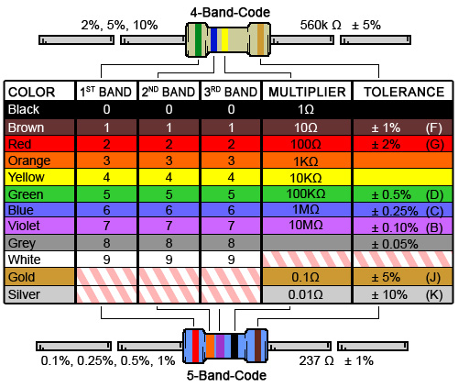
Ex: What is the resistance of this resistor?
Notes:
And what is the tolerance?

Slide 12
Ex: What is the resistance of this resistor?
Notes:
And what is the tolerance?

Slide 13
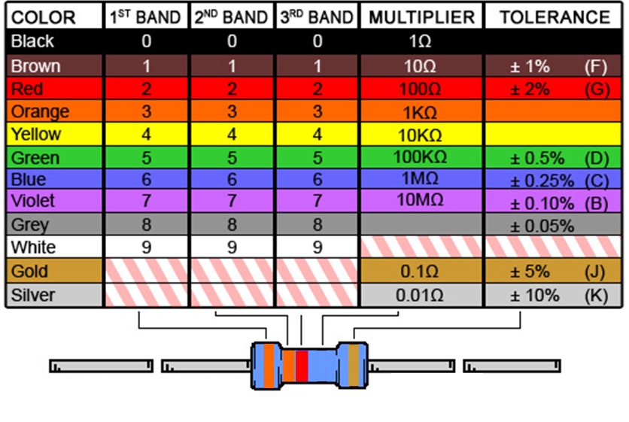
Ex: What is the resistance of this resistor?
Notes:
And what is the tolerance?

Slide 14
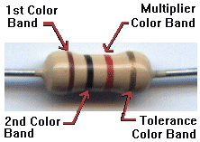
Ex: What is the resistance of this resistor?
Notes:
And what is the tolerance?

Slide 15
Ex: What is the resistance of this resistor?
Notes:
And what is the tolerance?

Slide 16
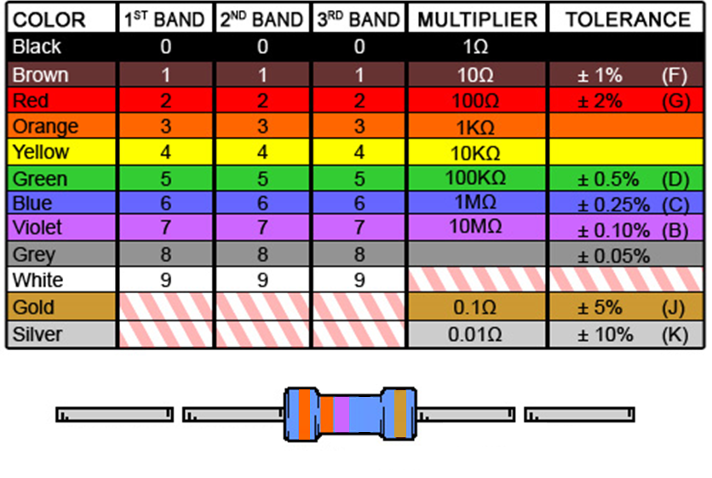
Ex: What is the resistance of this resistor?
ORANGE ORANGE VIOLET GOLD
Notes:
And what is the tolerance?

Slide 17
Ex: GPIO safety
Considering any one of the resistors on the previous slides, is it large enough to not damage a GPIO pin configured as output, if the resistor ties the output to ground?
Sourcing limit: 4mA
Sinking limit: 8mA
Voltage: 3.3 V

Slide 18
Ex: GPIO safety
Considering any one of the resistors on the previous slides, is it large enough to not damage a GPIO pin configured as output, if the resistor ties the output to 3.3V?
Sourcing limit: 4mA
Sinking limit: 8mA
Voltage: 3.3 V

Slide 19
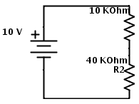
Ex:
What is the voltage across R2?

Slide 20
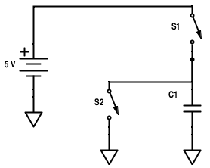
Ex: Compute voltage across C1
If S1 is closed, and S2 is opened, what is the voltage across C1?
If S2 is closed, and S1 is opened?
If both are opened?
If both are closed?

Slide 21
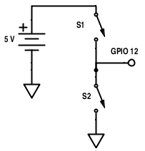
Ex: Compute voltage into GPIO
If S1 is open and S2 is closed, compute the voltage from GPIO 12 to ground.
(Assume GPIO 12 is not connected to anything)

Slide 22
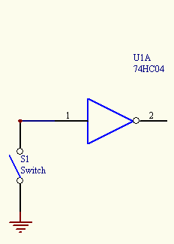
Ex: What’s wrong with this simple circuit’s input?
Notes:
15q3 – 3-1
Work through making this input better

Slide 23
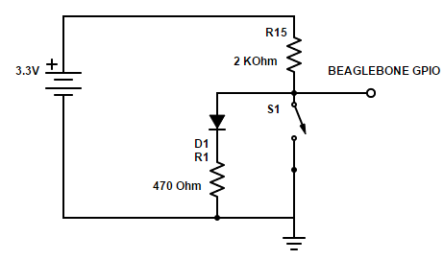
Ex: What’s wrong with this circuit? (The worst thing)

Slide 24
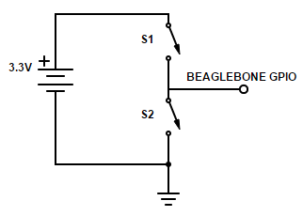
Exercise: Find all of:
Voltage from GPIO to ground if
  S1 is closed
  S2 is closed
  Both are open
Current from source if both are closed

Slide 25
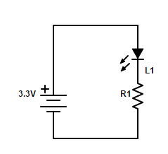
Selecting an LED resistance value
Suppose L1 is a diode with V_{d} = 1.8 V
Ex: Write a formula relating the current through L1 to R1.
Ex: Solve for R1 if we want the (max) current to be 10 mA.

Slide 26
C language
It’s like Java, only with pointers…

Slide 27
(Extra Exercise)
Why does this
6 unsigned short *pt;
7 pt = myArray[0];
Produce this?
myLib.c:7: error: data definition has no type or storage class
myLib.c:7: error: type defaults to 'int' in declaration of 'pt'
myLib.c:7: error: conflicting types for 'pt'
myLib.c:6: note: previous declaration of 'pt' was here
myLib.c:7: error: initialization makes integer from pointer without a cast
How should it be written?
Are these compile or link errors?
http://stackoverflow.com/questions/6639256/pointer-to-first-element-in-array-c

Slide 28
Exercise: Which of the following is correct?
void foo(struct bar2* b);
…
struct bar b;
And then….
foo((struct bar2*) b*)
foo((bar2*) *b)
foo((bar2*) b&)
foo((struct bar2*) &b)
Notes:
15q3 – 3-1
This problem AGAIN has an error. b is a pointer, and yet we don’t need to de-reference it. It should just be passed straight through:
foo((struct bar2*) b)

Slide 29
Exercise
How do you get a reference (pointer) to the first element in an array?
int x[5] = {1,2,3,4,5}
boolean foo(int *ip);
foo(&x);
foo(&x[0]);
foo(x);
foo(x[0]);

Slide 30
Exercise
How do you get a reference (pointer) to the second element in an array?
int x[5] = {1,2,3,4,5}
boolean foo(int *ip);
foo(&x+1);
foo(&x[0]);
foo(x+1);
foo(x[0]);
foo(&(x+1));

Slide 31
Ex: C/C++ (Review)
Why do we have both .h and .cpp file extensions for C++? Why not just have .cpp (like .java for Java classes)?
Answer these questions:
What should you put into a class’s .h file?
What should you put into a class’s .cpp file?
[Note: On next lab, use .hpp and .cpp instead of .h and .cpp]

Slide 32
Ex: C/C++
Circle the link-time errors. Box the compile-time
  cannot find -lasound [NEW!!! (As of Quiz 5)]
  syntax error
  warning: implicit declaration of function `...'
  point.m:40: error: ‘mypoint’ undeclared (first use in this function)
  parse error before `...‘
  collect2: ld returned 1 exit status
  undefined reference to `filterText'
  /usr/lib/crt1.o(.text+0x18): undefined reference to `main '

Slide 33
Quiz Practice: C/C++
Circle the link-time errors. Box the compile-time
  syntax error
  point.m:40: error: ‘mypoint’ undeclared (first use in this function)
  collect2: ld returned 1 exit status
  /usr/lib/crt1.o(.text+0x18): undefined reference to `main '
  parse error before `...‘
  undefined reference to `filterText'
  warning: implicit declaration of function `...'

Slide 34
Signals
Wiggly and squiggly…

Slide 35
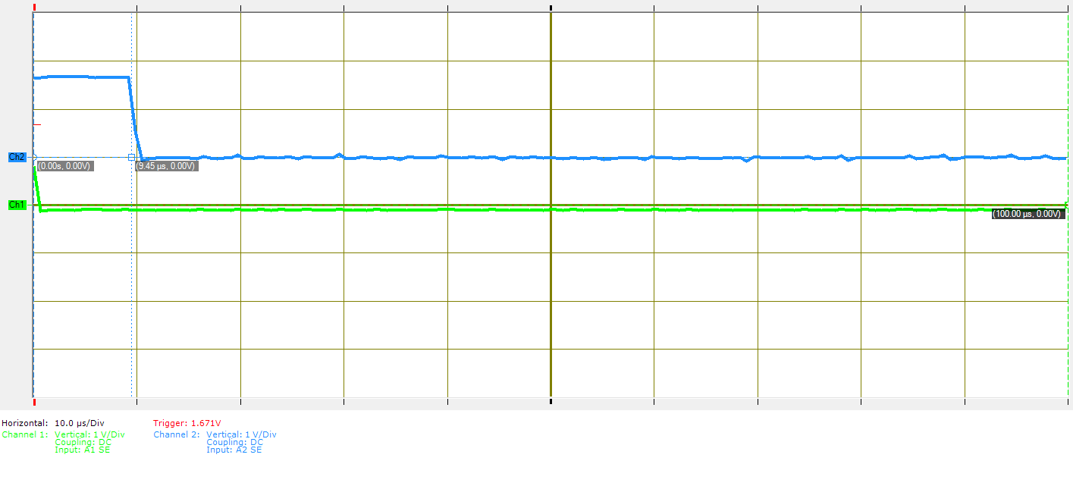
Exercise: What is the time delay between the two falling edges?
Notes:
15q3 (3-1)

Slide 36
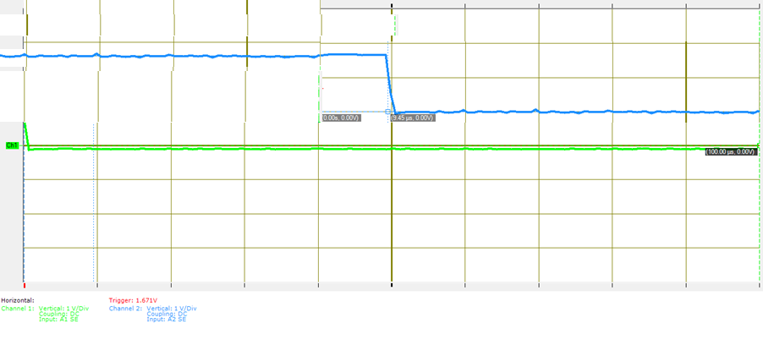
Exercise: What is the time delay between the two falling edges?
5 ms / Div

Slide 37
Exercise: What is the rise-time of this signal?
1 Volt/div
1 ms/div
0

Slide 38
Data-Rates
[Witty saying needed…]

Slide 39
TODO: Get all the noisy-analog-channel data-rates

Slide 40
SI multipliers
P = 1,000,0000,000,000,000
T = 1,000,000,000,000
G = 1,000,000,000
M = 1,000,000
K = 1,000
() = 1
m = 1/1,000
us = 1/1,000,000
ns = 1/1,000,000,000 (us = μs)

Slide 41
Binary multipliers
Pi = 1024⁵
Ti = 1024⁴
Gi = 1024³
Mi = 1024²
Ki = 1,024
() = 1

Slide 42
Ex
How many SI Kb is 4 Gibibytes (GiB)?
  Note: That’s SI kilobits, not kilobytes!

Slide 43
Ex:
Suppose you are designing a real-time system, and the “remote display” design team says they can handle a data rate of 100MB/s according to their current design.
What should you ask?

Slide 44
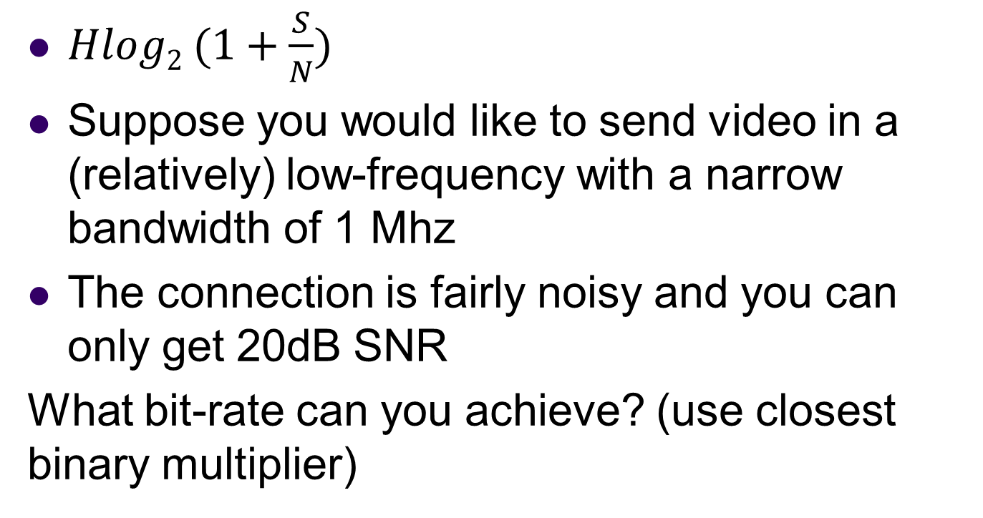
Quiz practice:
Analog to digital bandwidth
$Hlog2 (1+\frac{S}{N})$
Suppose you would like to send video in a (relatively) low-frequency with a narrow bandwidth of 1 Mhz
The connection is fairly noisy and you can only get 20dB SNR
What bit-rate can you achieve? (use closest binary multiplier)
Notes:
http://www.arrl.org/files/file/Regulatory/Recommended_Practices_Version_6_5.pdf
Earlier draft:
Modern Digital TV uses the same channels as analog TV, but dynamically maps them.
But each channel is now re-used by allocating virtual “sub-channels” within the main channel that use less of the bandwidth.
This is done digitally
[And as a result, the channel width is about the same]

Slide 45
Buffering
With 1 KB buffer, there will be ____ samples per buffer.
With a 40KHz sampling rate, the buffer must be filled every ____ milliseconds (audio deadline)
With 40KHz sampling, the maximum frequency sine-wave that can be encoded is…
[HINT: To compute: buffer size / sample size = samples per buffer
Similarly, samples per buffer / sample rate = time to empty buffer]

Slide 46
Ex
TODO: Various unit analyses (e.g. audio rates, video rates, Nyquist theorem)

Slide 47
Scheduling
When will I ever get all this done?

Slide 48
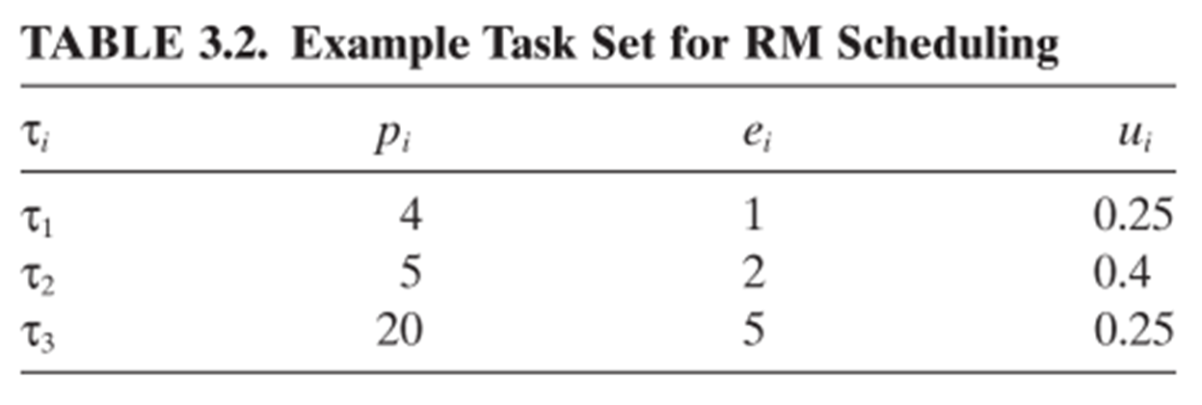
Rate-Monotonic Example
Notes:
See example soln. in text.

Slide 49
Other RMA and Scheduling questions
Does this meet the theoretical 69% bound?
Is it guaranteed to succeed?
Is it guaranteed to fail?
What simplifying assumptions do we make in RMA scheduling?
Round-robin vs. Cyclic Code Scheduling

Slide 50
Multithreading
Two hands, twice the productivity…

Slide 51
I was asked this question in an interview today…. (continued)
"When we create a thread with pthread_create() (POSIX Threads), the thread starts on its own. Why do we need to explicitly call start() in Java. What is the reason that Java doesnt start the thread when we create an instance of it."
I was blank and interviewer was short of time and eventually he couldnt explain the reason to me.
http://stackoverflow.com/questions/5269535/java-threads-vs-pthreads

Slide 52
Ex: Edit to include notify/wait to interleave these threads.
Consider this code-snippet
Queue q = …
…
synchronized(q) {
while(true) {
img = getImage();
q.offer(img);
}
}
// on another thread
synchronized(q) {
while(true) {
img = q.poll();
showImage();
}
}

Slide 53
Ex: Edit to include notify/wait to interleave these threads.
Consider this code-snippet
Queue q = …
…
synchronized(q) {
img = getImage();
while(true) {
q.offer(img);
}
}
// on another thread
synchronized(q) {
while(true) {
img = q.poll();
}
showImage();
}

Slide 54
Coding example.
Exercise:
Both the Java and Qt solutions will behave poorly if I start multiple threads.
Predict how each solution will behave if I:
  Click start
  Click start
  // what happens? (For Java? For Qt?)
  Click stop
  // what happens? (For Java? For Qt?)

Slide 55
More on signals/sockets in Qt
Why is it necessary to include a fifth argument when connecting the “stop” button to the “interrupt” socket on the prime worker thread?

Slide 56
Sequential Consistency
What are the two major things that a compiler does that invalidate the sequential consistency memory model?
Why does it do these things?
Notes:
(8-3), extra slide

Slide 57
Definitions
Explain what a data race as defined in the Java Language Specification, in your own words, but with enough rigor to get the essentials
Explain what sequential consistency is in your own words
Explain why it is important for some operations to be atomic.
Define volatile, as used in Java, in your own words.

Slide 58
Threading and JCF (Java Collections Framework)
Explain the advantage of the ConcurrentSkipListMap over a TreeMap that has been synchronized with
Collections.synchronizedMap(Map<K,V> m)

Slide 59
“Happening Before Does Not Imply Happens-Before”
void publishMessage() {
answer = 42;
isReady = 1;
}
void consumeMessage() {
if (isReady)
sout("%d\n", answer);
}
http://preshing.com/20130702/the-happens-before-relation/
Exercise:
How might this code execute to print 0 instead of 42?
(You may use reordering and/or caching in your solution)
Notes:
“Happening Before Does Not Imply Happens-Before”
http://preshing.com/20130702/the-happens-before-relation/
Just because one operation actually happens before another at runtime does not create a happens-before relationship.
(4) is allowed to print something other than 42!

Slide 60
Ex.
Prove the following code is(n’t) free of data races:
public void a() {
System.out.println(“x”);
System.out.println(“y”);
}
public void b() {
System.out.println(“x”);
System.out.println(“y”);
}
Notes:
15Q3 (9-1)

Slide 61
Ex.
Prove the following code is(n’t) free of data races:
public void a() {
x = 5;
System.out.println(“x”);
}
public void a() {
x = 5;
System.out.println(“x”);
}
Notes:
;

Slide 62
Ex.
Prove the following code is(n’t) free of data races:
public void a() {
synchronized {
x = 5;
System.out.println(“x”);
}
}
Notes:
;

Slide 63
Ex.
Write whether this code contains any data races. Explain your answer. Assume loggers is not volatile.
if(theLogger==null){
synchronized (EventLogger.class){
if(theLogger == null){
theLogger = new EventLogger(path);
}
}
}
Notes:
;

Slide 64
Ex.
Write whether this code contains any data races. Explain your answer. Assume loggers is volatile.
if(theLogger==null){
synchronized (EventLogger.class){
if(theLogger == null){
theLogger = new EventLogger(path);
}
}
}
Notes:
;

Slide 65
Exercise
Loggers is a map.
If this map is not designed to be used from multiple threads, and we run this program, it isn’t safe. Explain what might go wrong. (only text on slide needed)
if(loggers.get(path)==null){
synchronized (loggers){
if(loggers.get(path) == null){
EventLogger n = new EventLogger(path);
}
}
}
Notes:
Loggers is a map.
If loggers is a map not designed to be used from multiple threads, and we run this program, it isn’t safe. Explain what might go wrong.
Loggers is a map.
If loggers is a map not designed to be used from multiple threads, and we run this program, it isn’t safe. Explain what might go wrong.
Instructor: Then explain why if we use Collections.synchronizedMap this might go wrong.
(Collections. … creates a proxy/decorator that locks for every access.)
Also mention that with this “bad” map, the most correct solutions I saw were those that did not attempt to double-lock.

Slide 66
Ex.
Write whether this code contains any data races. Explain your answer. Assume loggers is not thread safe.
if(loggers.get(path)==null){
synchronized (loggers){
if(loggers.get(path) == null){
Logger logger = new EventLogger(path);
loggers.put(path, logger);
}
}
}
Notes:
;

Slide 67
Ex.
Write whether this code contains any data races. Explain your answer. Assume loggers is thread safe.
if(loggers.get(path)==null){
synchronized (loggers){
if(loggers.get(path) == null){
Logger logger = new EventLogger(path);
loggers.put(path, logger);
}
}
}
Notes:
15Q3 (9-1)

Slide 68
TODO:
VERY SIMPLE C/C++ example
Or example based on Lab 8 code…

Slide 69
TODO: Material covered by Dr. Schilling
But that’s not all, there’s more!

Slide 70
References
EBB: Derek Malloy, Exploring Beaglebone, Wiley, 2015
RTS: Laplante and Ovaska, Real-Time Systems Design and Analysis by, Fourth Edition, Wiley, 2012

