Slide 1
SE3910
Week 3, Class 3
Today
  Networking in Linux/C
Lab
  Eclipse cross-compiling
  Measuring latency of
    100% CPU busy-wait polling
    Sleeping busy-wait polling
    Interrupt-driven response
    Network transmission

Slide 2
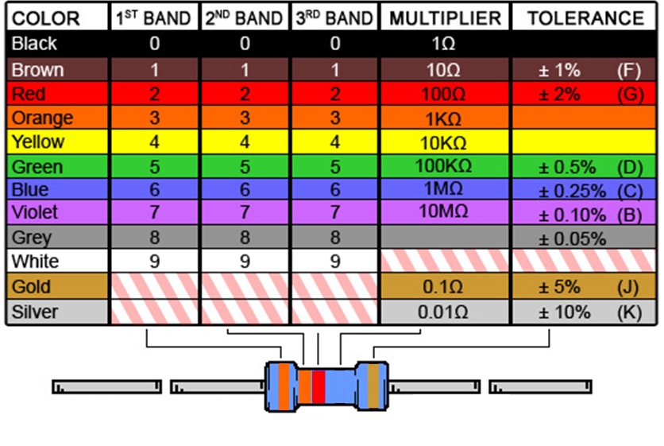
Ex: What is the resistance of this resistor?
Notes:
And what is the tolerance?

Slide 3
Ex: GPIO safety
Considering the resistor on the previous slide, is it large enough to not damage a GPIO pin configured as output, if the resistor ties the output to 3.3V?
Sourcing limit: 4mA
Sinking limit: 8mA
Voltage: 3.3 V

Slide 4
Real-time and Embedded (Review)
Real-Time
  responding as rapidly as required by the user or the process being controlled.
  - Random House Dictionary (Abbrev.)
Embedded System
  A combination of hardware & software to perform a specific function
  -Dr. Schilling’s slides
  Often real-time
Notes:
Real-Time System Examples:
Temperature control of a chemical reactor
Space mission control system
Nuclear power generator system
Many safety-critical systems
Click-drag in a GUI
Hospital reports delivered within minutes
Examples of Systems Containing Embedded Systems
Appliances: microwaves, VCRs, dishwashers, refrigerators, furnaces, clocks
Medical devices: hearing aids, pacemakers, …
Car systems: antilock brakes, engine timing and monitoring, seat/mirror positioner, air handling, lighting/environment
Mobile phones, PDA’s, Music players, remote controls
Diagram one of these devices, label the Real-time system and the Embedded Real-time system

Slide 5
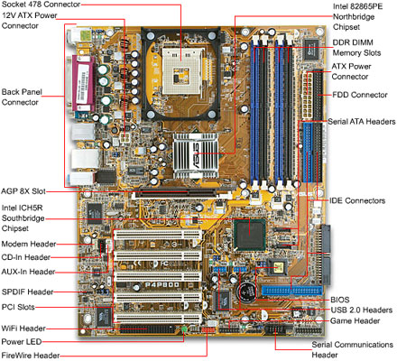
PC
Contains separate
    Microprocessor(s)
    Memory
    Peripheral (I/O) device HW
      serial port
        parallel port
        USB port
        Bluetooth port
        IR port
        AGP port
        WiFi port,…

Slide 6
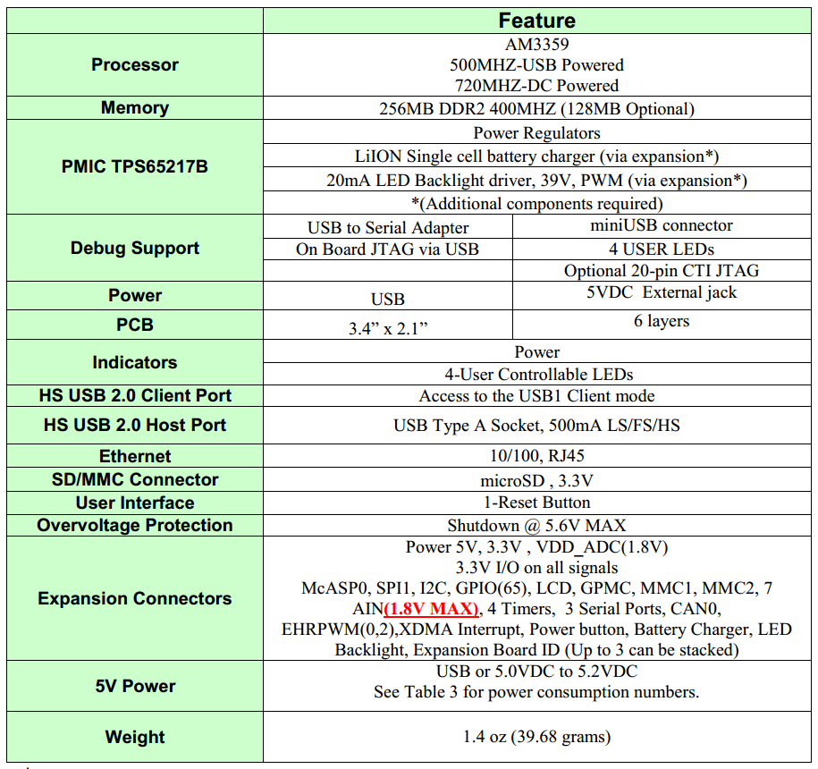
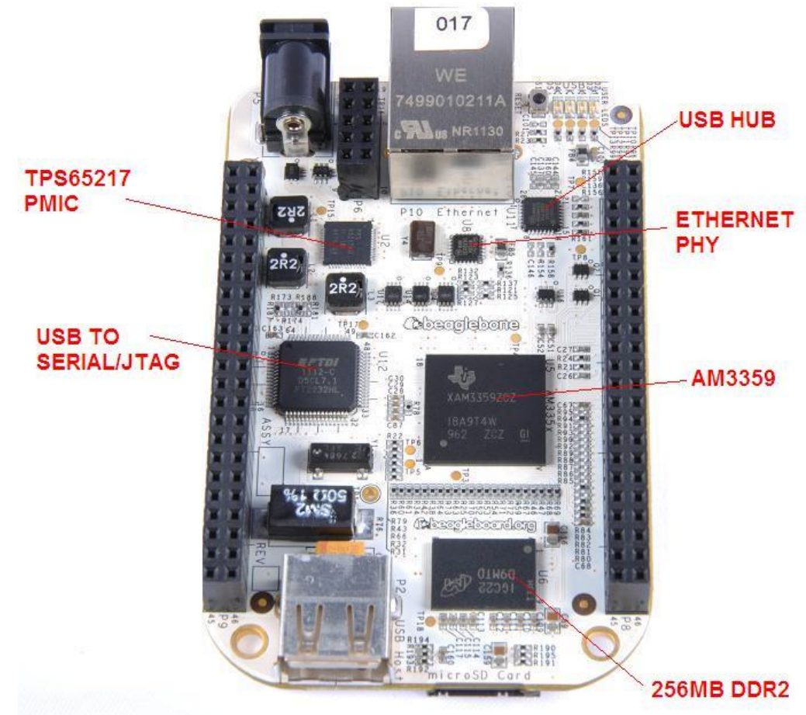
Beaglebone

Slide 7
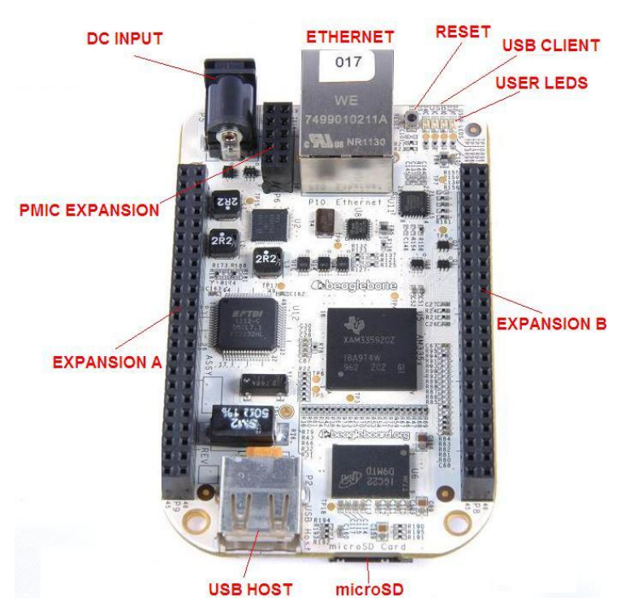
Expansion

Slide 8
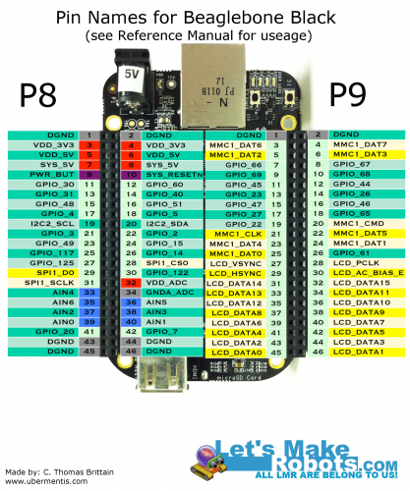
                Our Favorites
http://letsmakerobots.com/node/37063?page=3

Slide 9
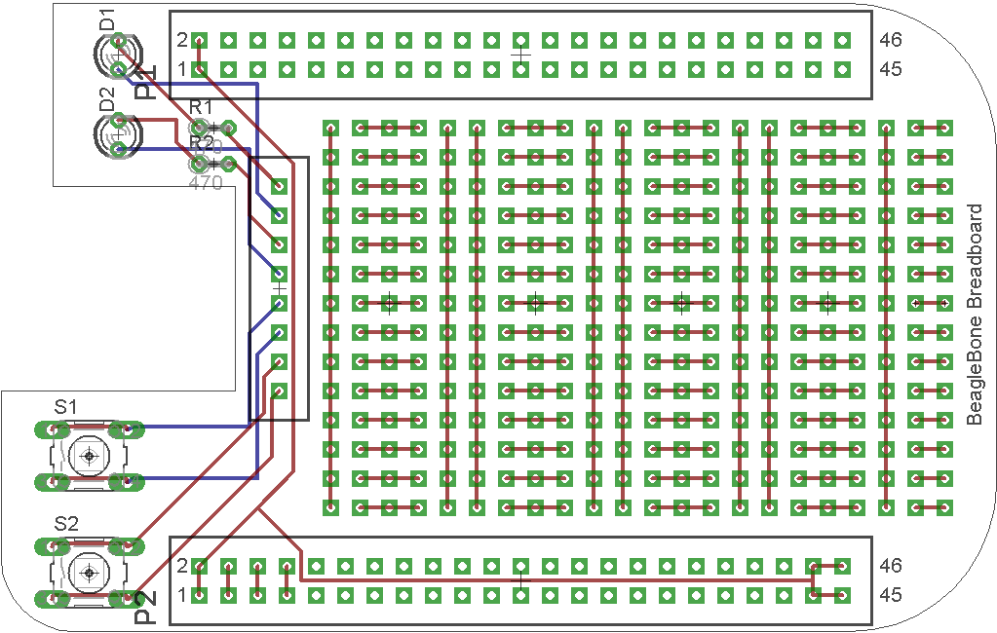
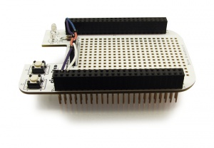
A Cape

Slide 10
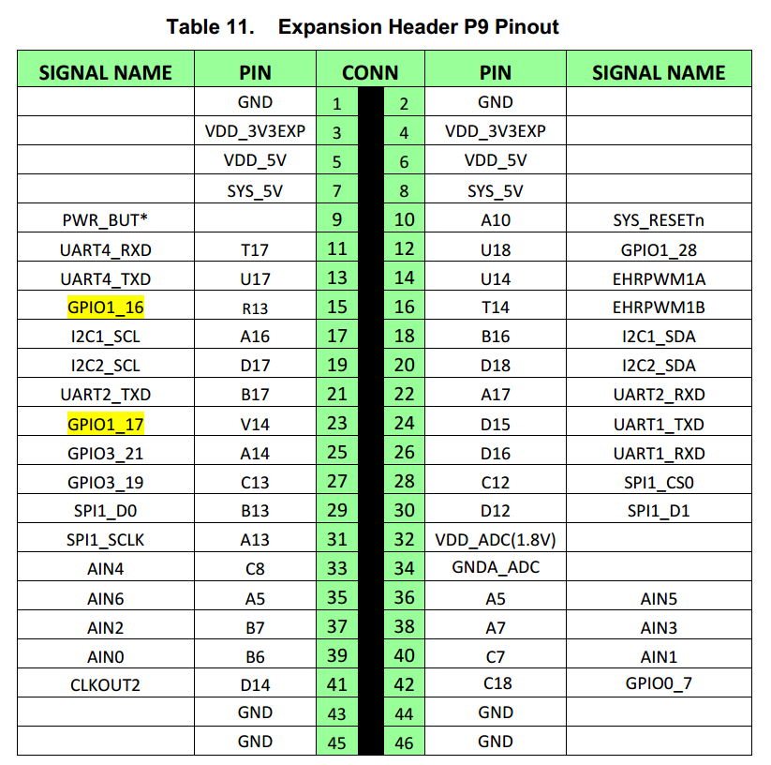
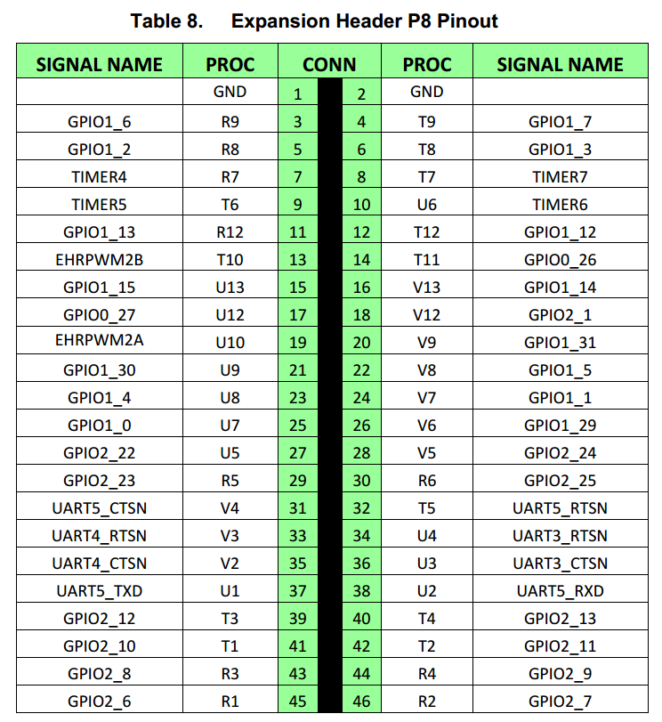

Slide 11
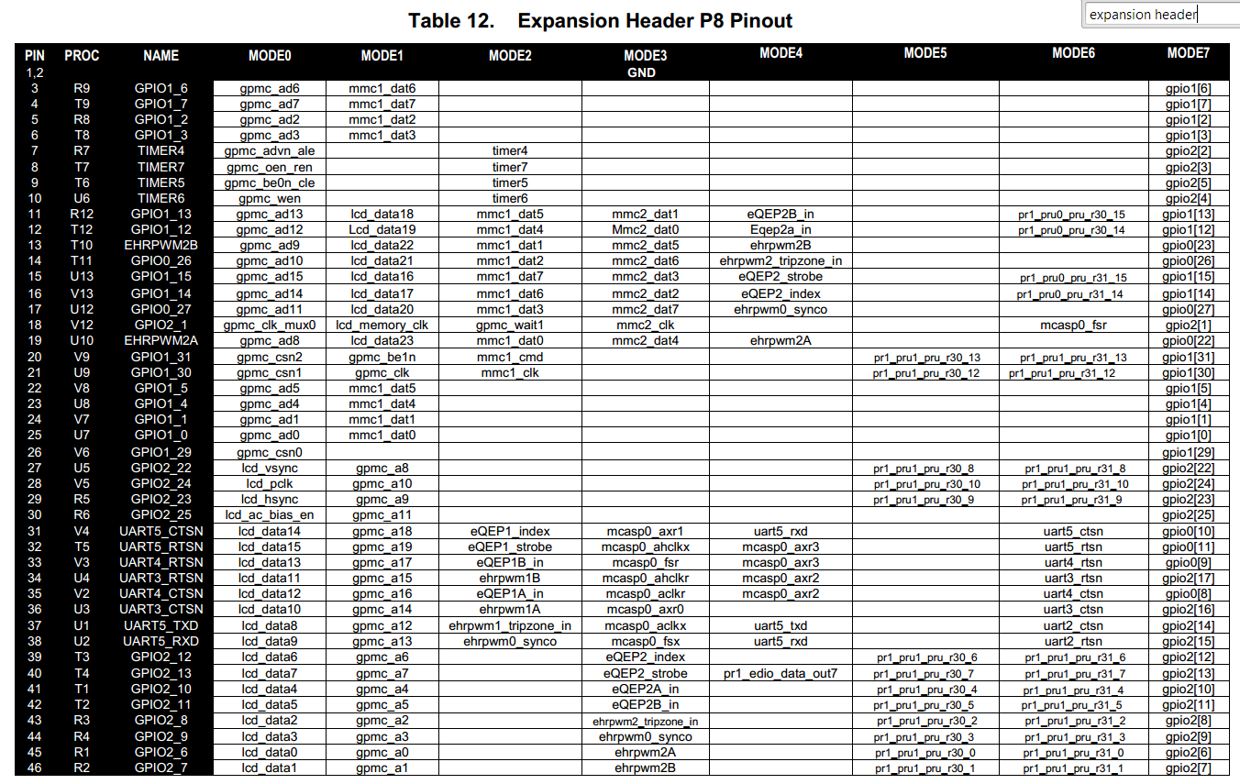
Finding GPIO Port
Notes:
𝐸𝑥𝑝𝑜𝑟𝑡 𝑃𝑖𝑛 𝑁𝑢𝑚𝑏𝑒𝑟=𝐺𝑃𝐼𝑂𝐶𝑜𝑛𝑡𝑟𝑜𝑙𝑙𝑒𝑟𝑁𝑢𝑚𝑏𝑒𝑟 ∗32+𝐺𝑃𝐼𝑂𝑃𝑖𝑛

Slide 12
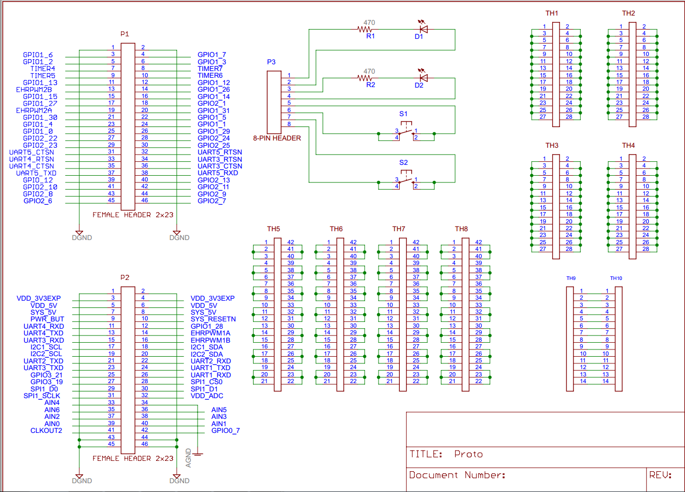
The breadboard cape

Slide 13
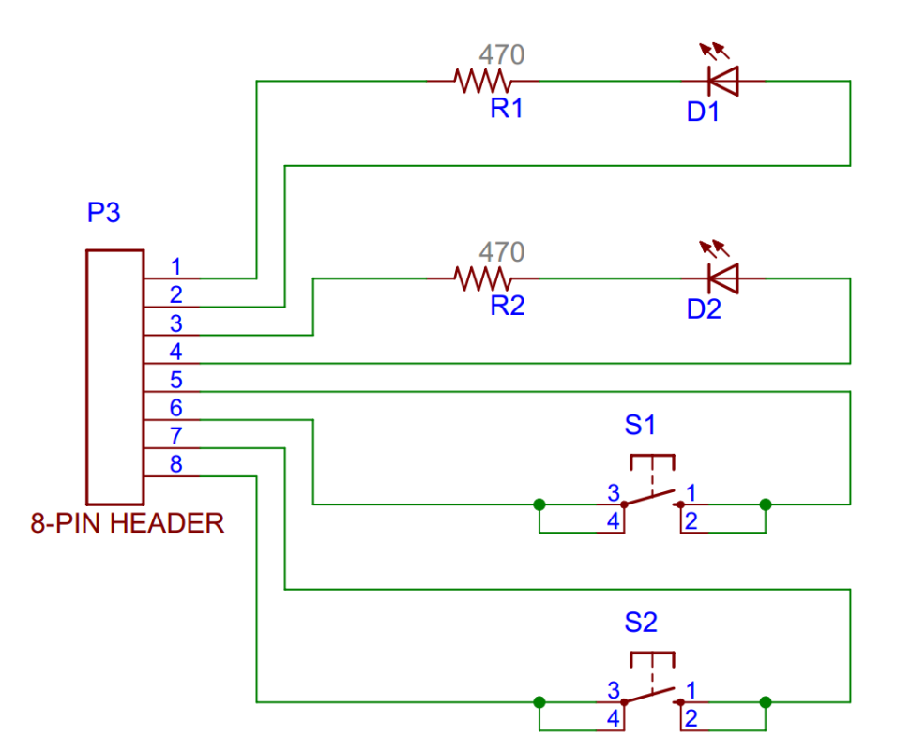
ITM | QTY | REF | PART | DESCRIPTION | DISTR | PART #
1 | 1 |  | PCB | 2-LAYER 3.4" x 2.15"
2 | 2 | P1, P2 | 2x23 HDR FE | DUAL - STRAIGHT SOCKET STRIP .025" SQ. PINS | MLE | SSHQ-123-D-08-F-LF
3 | 1 | P3 | 8 PIN HDR FE | CONN HEADER FEMALE 8 POS 0.1" GOLD | DK | PPPC081LFBN-RC
4 | 2 | S1, S2 | BUTTONS | SWITCH TACT SPST-NO .05A 24V | DK | B3F-1000
5 | 2 | D1, D2 | LEDS | LED GREEN 3MM 568NM 20mA 2.12V | DK | WP7104SGC
6 | 2 | R1, R2 | RESISTOR | RES 470 OHM 1/4W 5% CF MINI | DK | CFM14JT470R
7 | 1 | BR1 | BREADBOARD | WHT ADHSV SLDRLSS BRDBRD 170 TIE PT 1.8" x 1.37" | PLU | 1490
8 | 1 |  | JMPR WIRE KIT | 10 x 14 LNGTH .1" .2" .3" .4" .5" .6" .7" .8" .9" 1" 2" 3" 4" 5" | SQR

Slide 14
Some Technical Goals
How does one control the speed of a motor?
How does one change the brightness of a light-bulb?

Slide 15


Pulse-Width-Modulation
… in traffic

Slide 16
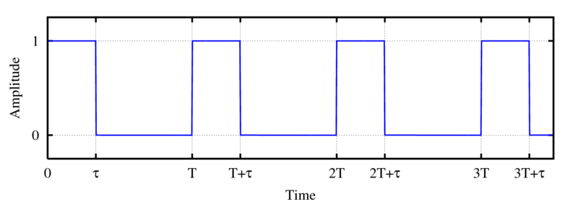
Pulse-width modulation terminology
Determine the duty cycle (D)
Multiply the duty cycle by the peak voltage (V_{p})

Slide 17
In-class exercise
How can you control the brightness of an LED, using tools we have discussed so far?
How would you accomplish this if you went into lab right now?

Slide 18
Advantages of Pulse-Width Modulation
Can’t control brightness of LED (easily)
Can use same hardware
More power efficient
Motors: Avoid stalling
Easier to replicate
Meet minimum voltage to turn on light

Slide 19
Muddiest Point
Wait for the slides, or follow this link to answer both questions at once:
http://bit.ly/1Mow5a3

Slide 20
Muddiest Point
Wait for the slides, or follow this link to answer both questions at once:
http://bit.ly/1Mow5a3

Slide 21

http://bit.ly/1Mow5a3
Notes:
Today, the professor made the course material clear and understandable?
Poll Title: Today, the professor made the course material clear and understandable
https://www.polleverywhere.com/multiple_choice_polls/Tgsho9KFq8cPvBg

Slide 22
http://bit.ly/1Mow5a3
Notes:
What was the muddiest point?
Poll Title: What was the muddiest point?
https://www.polleverywhere.com/free_text_polls/5ecaTmFuFeJ65hY

Slide 23
References
EB: Derek Malloy, Exploring Beaglebone, Wiley, 2015

