Slide 1
SE3910
Week 5, Class 1
Today
  LED safety
  A bit on Units
  Physical Data Rates
  Audio Data Rates
Tomorrow
  Good Friday

Slide 2
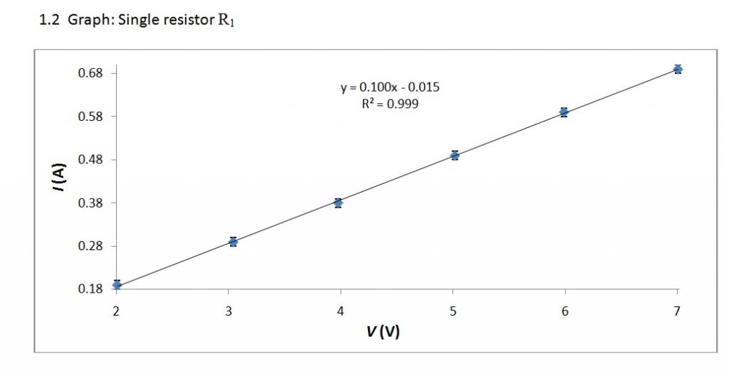
Resistor Limits
A resistor follows Ohm’s law; V=IR
http://physics.stackexchange.com/questions/55534/physical-interpretation-of-y-intercept-in-a-current-vs-voltage-graph

Slide 3
How do resistors fail?
They burn up, literally
For many resistors, the maximum steady-state generation of heat they can handle is ¼ watt
Can calculate with P = IV = V²/R = I²R (subbing in V=IR)
Ex: Find the minimum ¼ W resistance that is safe with a (non-Beaglebone) 3.3 V source?

Slide 4
How do diodes fail?
Same way as resistors – they burn up
So total temperature is the limiting factor
How to determine max V or I?
If a voltage is applied across an LED current will flow through the LED
The higher the voltage, the more current will flow
But this does NOT follow Ohm’s Law; V≠IR

Slide 5
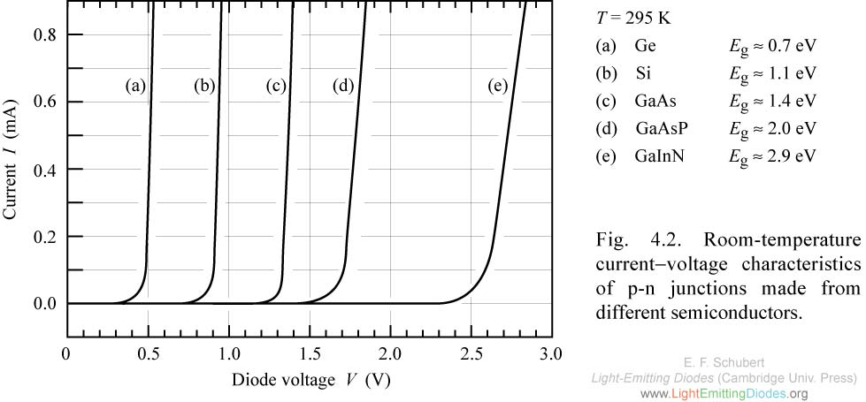
LED current-voltage curves
http://www.ecse.rpi.edu/~schubert/Light-Emitting-Diodes-dot-org/chap04/chap04.htm

Slide 6
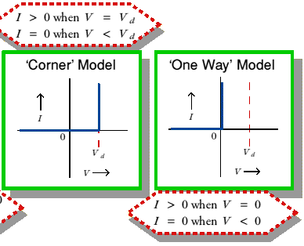
Our “mental model(s)” for diodes
https://www.st-andrews.ac.uk/~www_pa/Scots_Guide/info/comp/passive/diode/chars/chars.htm

Slide 7
LED current and voltage limits
So if we apply a voltage higher than the transition V_{d} to the LED (c), the current will be…
If we force a current in the 0.5 mA range through the LED (c), the voltage will be …
Ex: Decide will more likely damage the component? 1 mA or 2V? Explain.

Slide 8
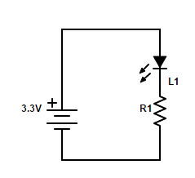
Selecting an LED resistance value
Suppose L1 is a diode with V_{d} = 1.8 V
Ex: Write a formula relating the current through L1 to R1.
Ex: Solve for R1 if we want the (max) current to be 10 mA.

Slide 9
Ex:
Suppose you are designing a real-time system, and the “remote display” design team says they can handle a data rate of 100MB/s according to their current design.
What should you ask?

Slide 10
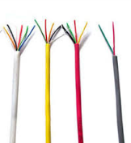
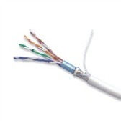

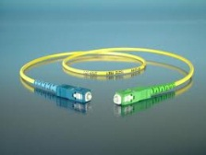
Physical cable data rates
Sources: Dr. Schilling’s Slides and
http://en.wikipedia.org/wiki/Fiber-optic_communication
Wiring Type | Bandwidth
CAT 3 | 16MHz
CAT 5 | 100 MHz
Coaxial Cable (50 Ohm) | 1-2 GHz
Fiber Optic Fiber (Single fiber) | 100 Tbit/s
Notes:
Compare result with this
We got this far – working examples either again or for the first time and discussing new material.

Slide 11
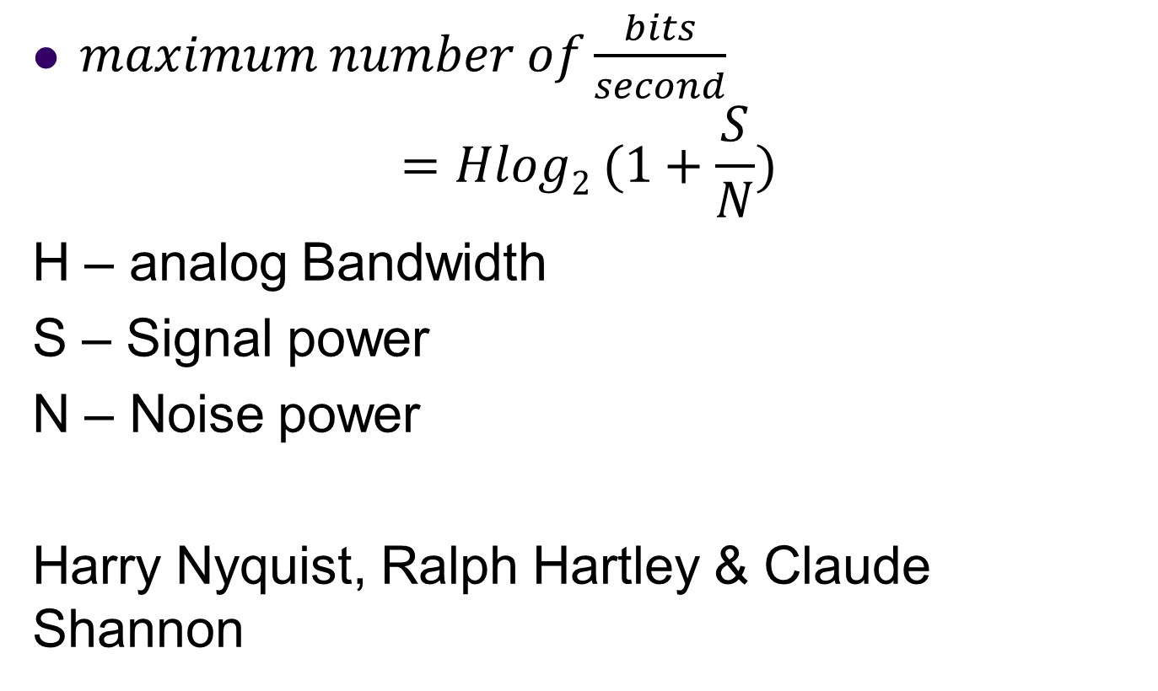
Maximum bandwidth of a physical channel
$maximum number of\frac{bits}{second}$
$$=Hlog2 (1+\frac{S}{N})$$
H – analog Bandwidth
S – Signal power
N – Noise power
Harry Nyquist, Ralph Hartley & Claude Shannon

Slide 12
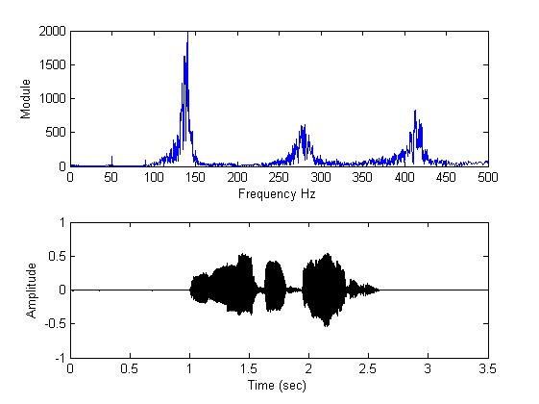
What is analog bandwidth?
Time
Freq.
http://www.mathworks.com/matlabcentral/fileexchange/22214-voice-audio-processing
Notes:
Can do this not only with audio, but also with radio waves
Indeed, both are squared:
http://en.wikipedia.org/wiki/Parseval's_theorem

Slide 13
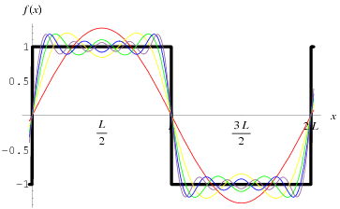
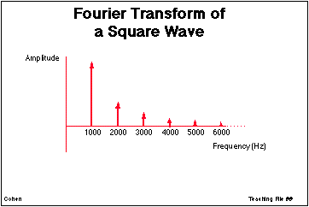
Signals as sums of sine-waves
http://ccn.ucla.edu/BMCweb/SharedCode/slides/SlideFiles.html
http://mathworld.wolfram.com/FourierSeriesSquareWave.html

Slide 14
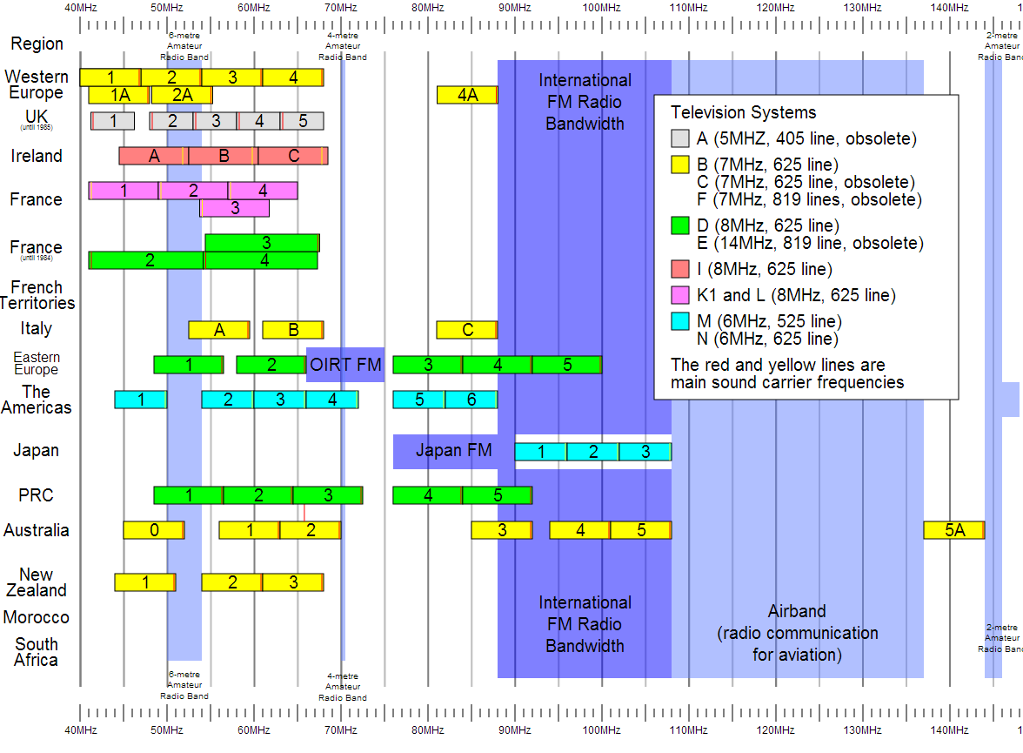
Notes:
For Digital TV:
http://transition.fcc.gov/mb/engineering/dtvmaps/
Full US allocations:
http://upload.wikimedia.org/wikipedia/commons/4/45/United_States_Frequency_Allocations_Chart_2003_-_The_Radio_Spectrum.jpg
VHF Usage (World wide)
http://upload.wikimedia.org/wikipedia/en/c/cc/VHF_Usage.svg

Slide 15
Units: dB
What is a decibel?
A tenth of a bel
What is a bel?
The log₁₀ of some ratio.
e.g. signal power / noise power
X dB = 10 log₁₀ (Y)
X – in units of dB
Y – simple ratio (unitless)

Slide 16
dB examples
dB
50 dB | 100,000
30 dB | 1,000
0 dB | 1
-30 dB | 0.001
-50 dB | 0.000 010

Slide 17
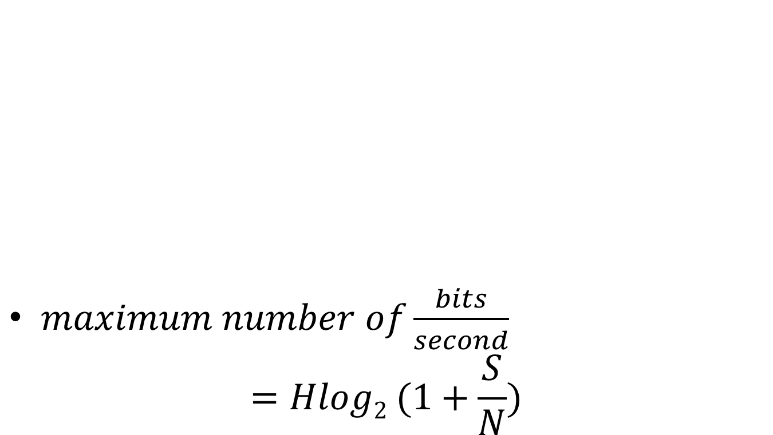
Channel capacity
$maximum number of\frac{bits}{second}$
$$=Hlog2 (1+\frac{S}{N})$$

Slide 18
In-class exercise
The old analog TV channels had a bandwidth of 6MHz
Supposing a SNR of 50 dB, what is the maximum possible bit-rate?
Notes:
For Spring 2015 (15q3):
Work through one, then give an in-class exercise for the following.

Slide 19
In-class Activity: What is the data rate of classic NTSC television (as digital stream)?
Store color with special scheme so only two bytes required per pixel, on average
720x480
30/1.001 fps
Follow up:
If compressed to 25MiB/s (or 25MB/s) what is the compression ratio?
Notes:
[Draw out example on board]

Slide 20
The Stroboscopic Effect
Have you ever noticed something that is in motion seem to stop?

Slide 21
The Stroboscopic Effect
(Aliasing)
http://upload.wikimedia.org/wikipedia/commons/7/77/Propeller_strobe.ogv
http://upload.wikimedia.org/wikipedia/commons/e/ef/The_wagon-wheel_effect.ogv

Slide 22
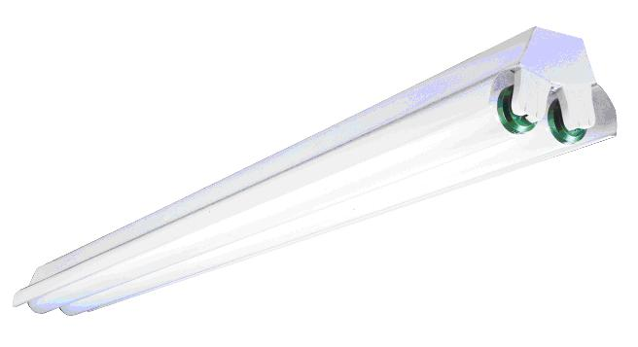

Safety
See, e.g. http://www.seasshops.ucla.edu/services/student-faculty-shop/machine-shop-rules

Slide 23
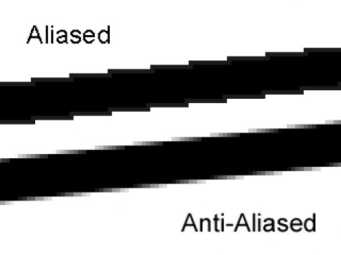
Aliasing
http://photo.stackexchange.com/questions/24512/what-is-aliasing-and-anti-aliasing

Slide 24
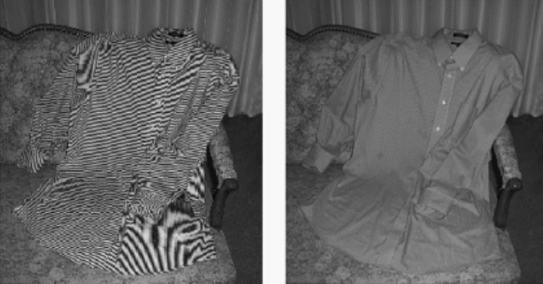
More aliasing
Single-Sensor Imaging: Methods and Applications for Digital Cameras, by Rastislav Lukac
http://www.openphotographyforums.com/forums/showthread.php?t=14988

Slide 25
Human eye
Recall
  As little as 13ms
Notice interruption
  As short as 16ms
Single-ms duration looks as long as
  100-400ms
10ms green followed by 10ms red
  May appear as single yellow stimulus

Slide 26
Ex:
Why might you want to sample at a higher frame-rate than the 30fps?
Be as professional as possible
  Avoid flame wars
  Have technical depth to back it
  Avoid sounding technical just to be cool

Slide 27
Ex:
What are two ways we can avoid the stroboscopic effect in a video game simulation of a rotating wheel?

Slide 28
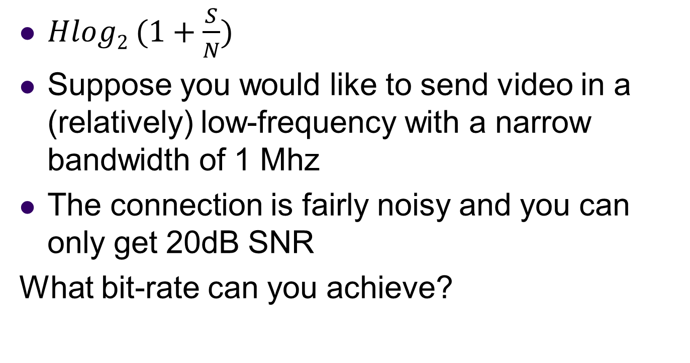
In-class Activity:
Analog to digital bandwidth
$Hlog2 (1+\frac{S}{N})$
Suppose you would like to send video in a (relatively) low-frequency with a narrow bandwidth of 1 Mhz
The connection is fairly noisy and you can only get 20dB SNR
What bit-rate can you achieve?
Notes:
http://www.arrl.org/files/file/Regulatory/Recommended_Practices_Version_6_5.pdf
Earlier draft:
Modern Digital TV uses the same channels as analog TV, but dynamically maps them.
But each channel is now re-used by allocating virtual “sub-channels” within the main channel that use less of the bandwidth.
This is done digitally
[And as a result, the channel width is about the same]

Slide 29
In-class activity
Suppose I have a band centered at 100 Mhz which is 1Mhz wide.
What are the limits on this range?
What is the wavelength of the center 1 Mhz signal
speed of light = 299 792 458 m / s
speed in Cat-5 is 70% of this
wavelength = time of period * velocity
Notes:
http://www.eham.net/ehamforum/smf/index.php?topic=56160.0

Slide 30
Fiber-optic Transmission
In fiber-optic transmission, signals are sent by transmitting various colors (or invisible) light down a fiber-optic channel
The colors are separated at the other end
Multiple fibers can be used
Supposing that the same bandwidth rule applies, what bandwidth can be carried by the visible spectrum? (700-400nm)
Use SNR of 4000
Hint: Convert wavelength to period/frequency
Notes:
http://physics.stackexchange.com/questions/56240/maximum-theoretical-bandwidth-of-fibre-optics
So, let's begin by exploring the best way to use our power. If we devote it to M symbols per second, each of our measurements comprise the detection of N=PMhν0 photons, thus our signal to noise ratio is SNR=NN√=PMhν0−−−−−√. By the Shannon-Hartley form of the Noisy channel coding theorem(see also here), we can therefore code our channel to get log2(1+PMhν0−−−−−√) bits of information per symbol, i.e. Mlog2(1+PMhν0−−−−−√) bits per second through our optical fibre. This is a monotonically rising function of M, so a limit on P by itself does not limit the capacity.
However, by a converse of the Nyquist-Shannon sampling theorem we can send a maximum of Bsymbols down the channel per second. This then is our greatest possible symbol rate. Hence, our overall expression for the fibre capacity in bits is:
C=Blog2(1+PBhν0−−−−−√) bits per second

Slide 31
Muddiest Point
Wait for the slides, or follow this link to answer both questions at once:
http://bit.ly/1Mow5a3

Slide 32
Muddiest Point
Wait for the slides, or follow this link to answer both questions at once:
http://bit.ly/1Mow5a3

Slide 33

http://bit.ly/1Mow5a3
Notes:
Today, the professor made the course material clear and understandable?
Poll Title: Today, the professor made the course material clear and understandable
https://www.polleverywhere.com/multiple_choice_polls/Tgsho9KFq8cPvBg

Slide 34
http://bit.ly/1Mow5a3
Notes:
What was the muddiest point?
Poll Title: What was the muddiest point?
https://www.polleverywhere.com/free_text_polls/5ecaTmFuFeJ65hY

Slide 35
References
EB: Derek Malloy, Exploring Beaglebone, Wiley, 2015

