Slide 1
SE3910
Week 6, Class 3
Today
  Signals
  Nyquist Theorem (revisited)
  Audio Sampling
  Latency and Bandwidth
  Scheduling Theory

Slide 2
Side Note
EBB stands for “Exploring BeagleBone” not “embedded BeagleBone” (as I have used it)

Slide 3
Hardware Signals
Software signals
  Events
  Messages from one part of the program to another
  Method calls
Hardware signals
  function conveying information about the behavior or attributes of some phenomenon – ISP (p. 1)
  Physical phenomenon – varies in time, and possibly in space

Slide 4
Examples of Hardware Signals
Audio
  Air pressure variation with time
  Voltage variation with time
Video
  Light variation with space and time
  Pixel intensity variation with time
Network
  Voltage variation with time
    Either in wire, or wireless, or even fiber optics
Notes:
Multi-media!

Slide 5
[INSERT SLIDES FROM VIDEO DATA RATES HERE (4-2)]
[INSERT SLIDES FROM AUDIO CHANNELS HERE (6-1)]
[INSERT SLIDES FROM PHYSICAL CHANNELS HERE (5-1, 5-3)]

Slide 6
Encoding audio signals digitally
How much data do we need to encode an audio signal?
[Matlab demo]
f_{sample} > 2f_{max audio frequency}

Slide 7
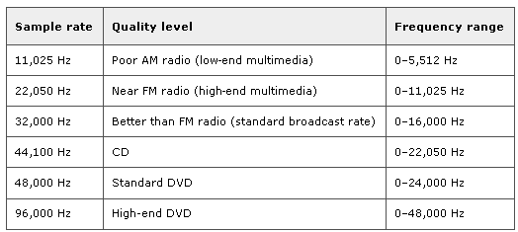
Sampling Theorem (again Nyquist)
f_{s} = 2f_{m} (f_{m} is maximum frequency of signal)
Notes:
Did not get to this.

Slide 8
Buffering
With 1 KB buffer, there will be ____ samples per buffer.

Slide 9
Physical transmission:
Latency vs. Bandwidth
Latency – delay to go over line
Bandwidth – rate of data
Can have high latency, high bandwidth (e.g. 1TB thumb-drive sneaker-net)
Can have low latency, low bandwidth (e.g. morse code through dedicated line)
[See MATLAB example]

Slide 10
Noise, Latency, and Bandwidth
If we add noise to the line
  If the “noise” is other users sending packets
    Must resend whole packet – increases latency
    Transport-level
  If the “noise” is “white noise”
    Must use more redundancy – e.g. use more time per bit
    Decreases bandwidth, but latency is the same
    Link-level

Slide 11
Scheduling Theory
What is a schedule?

Slide 12
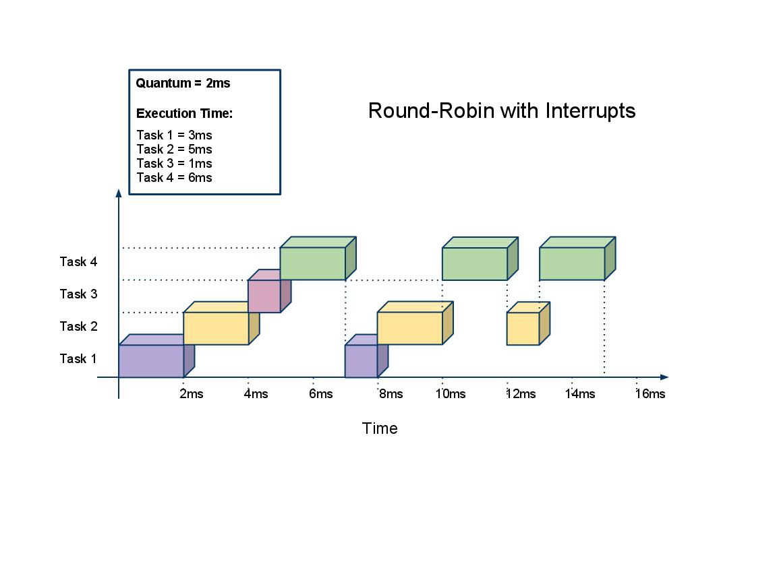
Round-Robin Scheduling

Slide 13
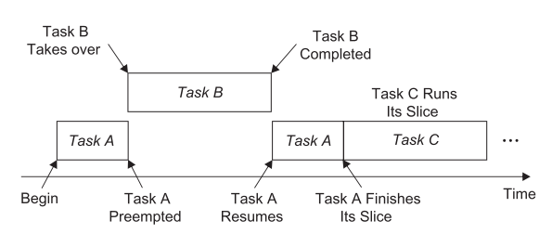
Round-Robin Scheduling with pre-emption

Slide 14
Cyclic Code Scheduling
Scheduling decisions are made periodically rather than arbitrarily
  Major cycle (hyperperiod)
    The minimum time required to execute tasks allocated to the CPU
    Equal to the least common multiple of the task periods
  Frames
    The locations where scheduling decisions are made
    No premption within frames
Notes:
p.100-101
Illustrate these definitions.

Slide 15
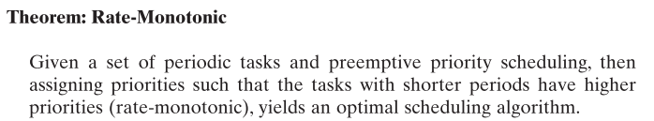
Optimal Cyclic Code Scheduling
– Rate Monotonic Scheduling
Notes:
Write out by hand
- use creative spacing to emphasize structure

Slide 16
Muddiest Point
Wait for the slides, or follow this link to answer both questions at once:
http://bit.ly/1Mow5a3

Slide 17
Muddiest Point
Wait for the slides, or follow this link to answer both questions at once:
http://bit.ly/1Mow5a3

Slide 18

http://bit.ly/1Mow5a3
Notes:
Today, the professor made the course material clear and understandable?
Poll Title: Today, the professor made the course material clear and understandable
https://www.polleverywhere.com/multiple_choice_polls/Tgsho9KFq8cPvBg

Slide 19
http://bit.ly/1Mow5a3
Notes:
What was the muddiest point?
Poll Title: What was the muddiest point?
https://www.polleverywhere.com/free_text_polls/5ecaTmFuFeJ65hY

Slide 20
References
EBB: Derek Malloy, Exploring Beaglebone, Wiley, 2015
RTS: Laplante and Ovaska, Real-Time Systems Design and Analysis by, Fourth Edition, Wiley, 2012
  ISP: Roland Priemer (1991). Introductory Signal Processing. World Scientific. p. 1. ISBN 9971509199.

