Slide 1
SE3910 Week 7, Class 2
Today
Final Project “Preview”
Real-time concurrency
Multithreading Options
pthreads
qthreads
GPIO.h & GPIO.cpp
Quiz tomorrow & Tuesday in lab

Slide 2
Quizzes
Tomorrow (7-3)
Various unit analyses (e.g. audio rates, video rates, Nyquist theorem)
Scheduling
Round-robin vs. Cyclic Code Scheduling
Rate Monotonic Analysis
Compile vs. Link errors
In-lab (8-Lab)
Ask me on Monday!

Slide 3
Linking errors
Any error in ld (the linker) (That’s LD, lowercase)
Undefined reference
cannot find -lasound (NEW!)
(For now),
All the rest are compiler errors!

Slide 4
Final Project “Preview” (1)
BeagleBone Webcams
Two units communicating over the network
Each unit has:
Video “presence” (camera & playback)
Audio “presence” (microphone jack & playback)
Requirements:
“Reasonable” latency for video & audio transmission
Determination of which deadlines are hard, medium, or soft – and what qualitative cost to miss is.

Slide 5
Final Project “Preview” (2)
Requirements (cont.)
Perhaps synchronization of Video and Audio
Design of the data-rates and audio rates to maximize user satisfaction while meeting deadlines
Fairly-open-ended design of the entire system
Working prototype

Slide 6
Concurrency
Simultaneous execution of computation (Wiki: Concurrency (computer science))
Includes
Multiple computers
E.g., multiple beaglebones on either end of the wire
Multiple cores
E.g., using the PRU in addition to the ARM (someday)
Multiple processes
E.g., one program splitting into two running instances
Multiple threads
E.g., one program running multiple threads

Slide 7
Concurrency in the final project
You MAY NOT want to have a single, single-threaded application, to meet your goals
You SURELY do not want your system to be challenging to write and hard to debug
Today’s presentation is meant to help with the project

Slide 8
Options for multithreading
pthreads
POSIX (Linux/Unix standard) threads
Can use in C/C++
qthreads
Qt Threads
Object-Oriented
Uses pthreads under the hood, when on POSIX [1]
Derek Malloy’s GPIO class
Uses pthreads under the hood, but is single-threaded
[1] http://stackoverflow.com/questions/4140189/qthreads-vs-pthreads

Slide 9
I was asked this question in an interview today….
"When we create a thread with pthread_create() (POSIX Threads), the thread starts on its own. Why do we need to explicitly call start() in Java. What is the reason that Java doesnt start the thread when we create an instance of it."
I was blank and interviewer was short of time and eventually he couldnt explain the reason to me.
http://stackoverflow.com/questions/5269535/java-threads-vs-pthreads

Slide 10
Threading – pthreads
Java | Pthreads
java.lang.Thread | #include <pthread.h>
No external jar needed | link with -pthread
Thread t = new Thread(r) t.start(); | pthread_create(t,r,sr,a)
interface Runnable { void run(); } | Parameter: void* (*sr) (void *)
t.join(); | pthread_join(*t, &p)
Object o; | pthread_mutex_init(m,null)
synchronized(o) { … } … /* Garbage coll. */ | pthread_mutex_lock(…) … pthread_mutex_destroy(…)

Slide 11
Function Pointers (From Taylor’s)
We can declare a function pointer by:
uint8_t (*min)(uint8_t, uint8_t);
We can assign a function pointer to point to an actual function by:
uint8_t minimum(uint8_t num1, uint8_t num2) {
return num1 < num2 ? num1 : num2;
}
min = &minimum;
We can use it to call minimum using either of the following ways:
uint8_t answer = min(3, 8);
uint8_t answer = (*min)(3, 8);

Slide 12
Threading – pthreads
Java | pthreads
Object o; o.notify(); | phread_cond_t c = PTHREAD_COND_INITIALIZER; pthread_cond_broadcast(c);
o.wait(); | pthread_cond_wait(c,m);
o.notify(); | phtread_cond_broadcast(c);
Caveat: “POSIX threads can wait at condition variables of a greater generality than available in Java, but the corresponding queues may be leaky.”
http://wimhesselink.nl/pub/whh241b.pdf

Slide 13
Threading -- pthreads
For my PhD dissertation, I used pthreads, and locked/unlocked resources to communicate between threads. Not the fastest, but it worked.

Slide 14
Threading – qthreads
Java | qthreads
java.lang.Thread | (TODO)
No external jar needed
Thread t = new Thread(r) t.start();
interface Runnable { void run(); }
t.join();
Object o;
synchronized(o) { … } … /* Garbage coll. */

Slide 15
Looks useful if you are into Qt slots/signals == events
“A QThread should be used much like a regular thread instance: prepare an object (QObject) class with all your desired functionality in it. Then create a new QThread instance, push the QObject onto it using moveToThread(QThread*) of the QObject instance and call start() on the QThread instance. That’s all.”
https://mayaposch.wordpress.com/2011/11/01/how-to-really-truly-use-qthreads-the-full-explanation/
I have not used this approach.

Slide 16
Possibly Fun
Very simple C++ wrapper for pthreads
http://www.cs.utexas.edu/users/lavender/courses/cs345/lectures/CS345-Lecture-09.pdf
notify/wait – example comparison with Java and pthreads
http://wimhesselink.nl/pub/whh241b.pdf
Compares create for Java, pthreads, and Win32 threads
http://cs.millersville.edu/~csweb/lib/userfiles/9ThreadsII.pdf

Slide 17
Certainly fun (Dr. Taylor’s Reviews)
http://msoe.us/taylor/tutorial/ce2810/functionpointers
Function Pointers
http://msoe.us/taylor/tutorial/ce2810/csimilar
C/C++/Java
http://msoe.us/taylor/tutorial/ce2810/ooc
Object-Oriented C

Slide 18
Other references
http://granite.sru.edu/~whit/cpsc464/Notes/figs/02-14.jpg
Simple pthread chart
From http://granite.sru.edu/~whit/cpsc464/Notes/ch2.html
https://pic.dhe.ibm.com/infocenter/iseries/v7r1m0/index.jsp?topic=%2Fapis%2Fusers_75.htm
IBM example of using pthread_cond_init

Slide 19
Standards
http://pubs.opengroup.org/onlinepubs/7908799/xsh/pthread.h.html
pthead.h
http://pubs.opengroup.org/onlinepubs/7908799/xsh/systypes.h.html
systypes.h – for xxxx_t

Slide 20
Muddiest Point
Wait for the slides, or follow this link to answer both questions at once:
http://bit.ly/1Mow5a3

Slide 21
http://bit.ly/1Mow5a3
Notes:
Today, the professor made the course material clear and understandable?
Poll Title: Today, the professor made the course material clear and understandable https://www.polleverywhere.com/multiple_choice_polls/Tgsho9KFq8cPvBg

Slide 22
http://bit.ly/1Mow5a3
Notes:
What was the muddiest point?
Poll Title: What was the muddiest point? https://www.polleverywhere.com/free_text_polls/5ecaTmFuFeJ65hY

Slide 23
References
EBB: Derek Malloy, Exploring Beaglebone, Wiley, 2015
RTS: Laplante and Ovaska, Real-Time Systems Design and Analysis by, Fourth Edition, Wiley, 2012

Slide 24
Someday soon
Late next week?
Real-Time Operating Systems
What is a RTOS? How does it relate to the rest?
OS roles
Interrupts and the OS
Definitions, Flowchart, Timing diagram
Detailed steps
Scheduling
Task states & pre-runtime vs runtime

Slide 25
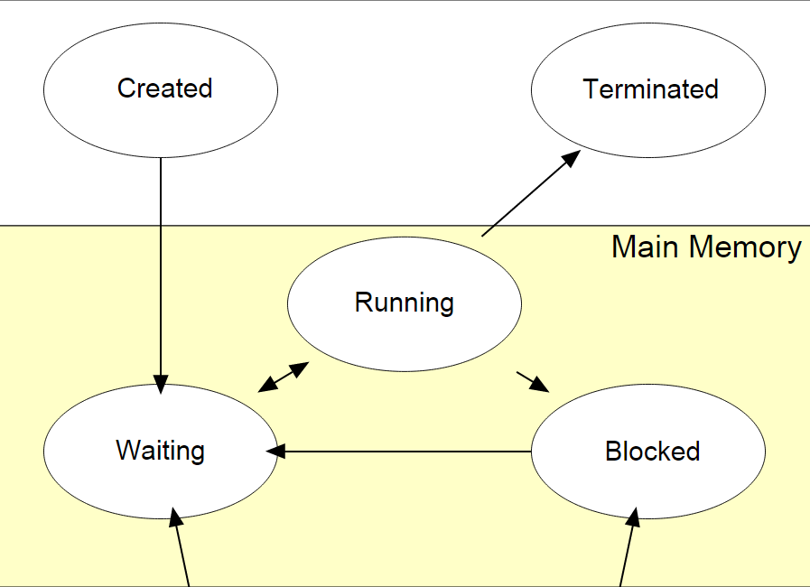
Task States
Wiki:Process (computing)
See also Laplante and Ovaske 4E p. 97

