Slide 1
SE3910
Week 8, Class 3
Today
  Take Quiz
  Rate Monotonic Analysis
  More on Multithreading
    Happens-Before in Java

Slide 2
More on the Rate Monotonic Analysis
Why is it called Rate Monotonic?
When is RMA guaranteed to work?

Slide 3
Why is it called Rate Monotonic?
What do you think of when you hear the word monotonic?

Slide 4
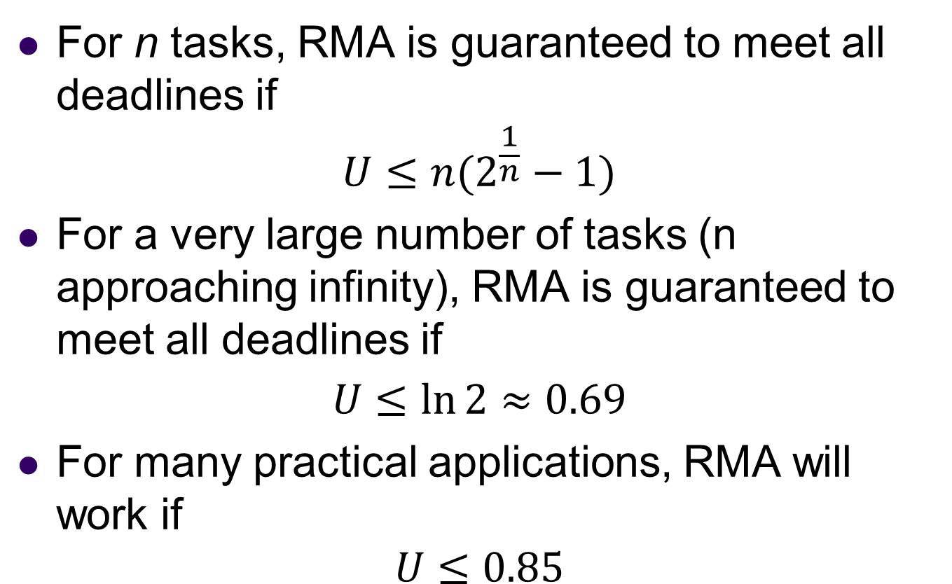
When is Rate Monotonic Guaranteed to work?
For n tasks, RMA is guaranteed to meet all deadlines if
$$U≤n(2^{\frac{1}{n}}−1)$$
For a very large number of tasks (n approaching infinity), RMA is guaranteed to meet all deadlines if
$$U≤\ln{2}≈0.69$$
For many practical applications, RMA will work if
$$U≤0.85$$

Slide 5
Muddiest Point
Wait for the slides, or follow this link to answer both questions at once:
http://bit.ly/1Mow5a3

Slide 6

http://bit.ly/1Mow5a3
Notes:
Today, the professor made the course material clear and understandable?
Poll Title: Today, the professor made the course material clear and understandable
https://www.polleverywhere.com/multiple_choice_polls/Tgsho9KFq8cPvBg

Slide 7
http://bit.ly/1Mow5a3
Notes:
What was the muddiest point?
Poll Title: What was the muddiest point?
https://www.polleverywhere.com/free_text_polls/5ecaTmFuFeJ65hY

Slide 8
References
EBB: Derek Malloy, Exploring Beaglebone, Wiley, 2015
RTS: Laplante and Ovaska, Real-Time Systems Design and Analysis by, Fourth Edition, Wiley, 2012

Slide 9
Someday soon
Late next week?
  Real-Time Operating Systems
    What is a RTOS? How does it relate to the rest?
    OS roles
  Interrupts and the OS
    Definitions, Flowchart, Timing diagram
    Detailed steps
  Scheduling
    Task states & pre-runtime vs runtime

Slide 10
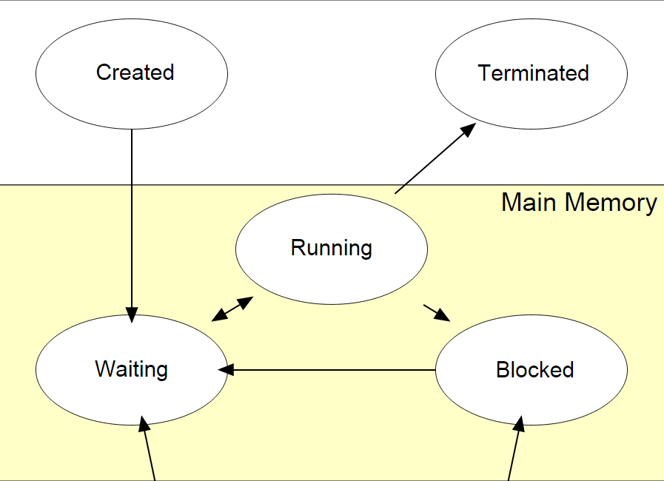
Task States
Wiki:Process (computing)
See also Laplante and Ovaske 4E p. 97

