Slide 1
SE3910
Week 9, Class 1
Today
  Quiz not yet graded
  Final report requirements posted
  More on Multithreading
    Happens-Before in Java

Slide 2
We need a “Memory Model” (updated)
“The Java programming language memory model works by examining each read in an execution trace and checking that the write observed by that read is valid according to certain rules.”
http://docs.oracle.com/javase/specs/jls/se7/html/jls-17.html#jls-17.4

Slide 3
Happens-Before (review)
“If one action happens-before another, then the first is visible to and ordered before the second.”
“Happens-Before Does Not Imply Happening Before”
“Happening Before Does Not Imply Happens-Before”
http://docs.oracle.com/javase/specs/jls/se7/html/jls-17.html#jls-17.4.1
http://preshing.com/20130702/the-happens-before-relation/
Notes:
(this ordering is not necessarily in time, as seen in the examples at the beginning of this program --- see following slides)
My interp: “visible to” means “observed by” in the original definition of “Memory Model”

Slide 4
“Happening Before Does Not Imply Happens-Before”
void publishMessage() {
answer = 42;
isReady = true;
}
void consumeMessage() {
if (isReady)
sout(answer);
}
http://preshing.com/20130702/the-happens-before-relation/
Exercise:
How might this code execute to print 0 instead of 42?
(You may use reordering and/or caching in your solution)
Notes:
“Happening Before Does Not Imply Happens-Before”
http://preshing.com/20130702/the-happens-before-relation/
Just because one operation actually happens before another at runtime does not create a happens-before relationship.
(4) is allowed to print something other than 42!

Slide 5
Some happens-before relationships
Every action in a thread
Exit synch. section
Write to volatile field
Any action
http://docs.oracle.com/javase/8/docs/api/java/util/concurrent/package-summary.html#MemoryVisibility
actions later in program order in same thread
Enter synch. section locked on same object (later in time)
Read of volatile field (later in time)
Any action which happens before an action which … happens before this action (chaining)
Notes:
http://docs.oracle.com/javase/8/docs/api/java/util/concurrent/package-summary.html#MemoryVisibility

Slide 6
Some definitions
“Two accesses to (reads of or writes to) the same variable are said to be conflicting if at least one of the accesses is a write.” (§17.4.1)
“When a program contains two conflicting accesses that are not ordered by a happens-before relationship, it is said to contain a data race.” (§17.4.5)

Slide 7
Data-race free programs
If a program has no data races, then we can treat that program as if it behaved according to our simple “switch-back-and-forth-between-threads” model
This is nice, but there can still be problems
  E.g. single-locked singleton

Slide 8
Slow program… (review)
synchronized(MySingleton.class) {
if(theInstance == null) {
theInstance == new MySingleton(…);
}
}
This program WILL work correctly. Just has a lock that we want to avoid.

Slide 9
Data-race free program with problems… (review)
if(theInstance == null) {
synchronized(MySingleton.class) {
theInstance == new MySingleton(…);
}
}
There is a data rate here, but not one according to the Java Language Spec definition of a data race.
The spec. does discuss this sort of problem (§17.4.3)

Slide 10
The double-locked Singleton (Review)
if(theInstance == null) {
synchronized(MySingleton.class) {
if(theInstance == null){
theInstance = new MySingleton();
}
}
}
return theInstance;
Notes:
Explained “Exercise”: How this can fail if theInstance is not synchronized

Slide 11
The faster double-locked Singleton (new!!!)
MySingleton local = theInstance;
if(local == null) {
synchronized(MySingleton.class) {
local = theInstance;
if(local == null) {
local = theInstance = new MySingleton();
}
}
}
return local;
Notes:
https://en.wikipedia.org/wiki/Double-checked_locking#Usage_in_Java
Explained “Exercise”: How this can fail if theInstance is not synchronized
Can this fail if not synchronized?
Give example of failure/problem if the outer local==null is not there at all.
Give example of failure if inner lock is not there.

Slide 12
Ex.
Prove the following code is(n’t) free of data races:
public void a() {
System.out.println(“x”);
System.out.println(“y”);
}
public void b() {
System.out.println(“x”);
System.out.println(“y”);
}
Notes:
;

Slide 13
Ex.
Prove the following code is(n’t) free of data races:
public void a() {
x = 5;
System.out.println(“x”);
}
public void a() {
x = 5;
System.out.println(“x”);
}
Notes:
;

Slide 14
Ex.
Prove the following code is(n’t) free of data races:
public void a() {
synchronized {
x = 5;
System.out.println(“x”);
}
}
Notes:
;

Slide 15
Ex.
Write whether this code contains any data races. Explain your answer. Assume loggers is not volatile.
if(theLogger==null){
synchronized (EventLogger.class){
if(theLogger == null){
theLogger = new EventLogger(path);
}
}
}
Notes:
;

Slide 16
Ex.
Write whether this code contains any data races. Explain your answer. Assume loggers is volatile.
if(theLogger==null){
synchronized (EventLogger.class){
if(theLogger == null){
theLogger = new EventLogger(path);
}
}
}
Notes:
;

Slide 17
Ex.
Write whether this code contains any data races. Explain your answer. Assume loggers is not thread safe.
if(loggers.get(path)==null){
synchronized (loggers){
if(loggers.get(path) == null){
Logger logger = new EventLogger(path);
loggers.put(path, logger);
}
}
}
Notes:
;

Slide 18
Ex.
Write whether this code contains any data races. Explain your answer. Assume loggers is thread safe.
if(loggers.get(path)==null){
synchronized (loggers){
if(loggers.get(path) == null){
Logger logger = new EventLogger(path);
loggers.put(path, logger);
}
}
}
Notes:
;

Slide 19
Volatile caveat
Although writes to references are protected by volatile, writes to objects are not.
  If you want a volatile object, you have to declare all its fields volatile (not recommended)
  Even then…
    You can’t do this for objects in the standard library
    Your class may still have parts that need to be atomic but are not
If you are calling a method that is not designed to be used without synchronization, you should synchronize around it.
Notes:
And worse yet…

Slide 20
Exercise: Determine if this implementation of the double-locked Singleton is correct. Explain. (See next slide)
if(loggers.get(path)==null){
synchronized (loggers){
if(loggers.get(path) == null){
EventLogger n = new EventLogger(path);
}
}
}
Notes:
Loggers is a map.
If loggers is a map not designed to be used from multiple threads, and we run this program, it isn’t safe. Explain what might go wrong.

Slide 21
Exercise
Loggers is a map.
If this map is not designed to be used from multiple threads, and we run this program, it isn’t safe. Explain what might go wrong.
if(loggers.get(path)==null){
synchronized (loggers){
if(loggers.get(path) == null){
EventLogger n = new EventLogger(path);
}
}
}
Notes:
Loggers is a map.
If loggers is a map not designed to be used from multiple threads, and we run this program, it isn’t safe. Explain what might go wrong.
Loggers is a map.
If loggers is a map not designed to be used from multiple threads, and we run this program, it isn’t safe. Explain what might go wrong.
Instructor: Then explain why if we use Collections.synchronizedMap this might go wrong.
(Collections. … creates a proxy/decorator that locks for every access.)
Also mention that with this “bad” map, the most correct solutions I saw were those that did not attempt to double-lock.

Slide 22
An alternative: java.util.concurrent
  Lock-free multi-threaded data structures:
ConcurrentHashMap
  Like HashMap, only “concurrent”
ConcurrentSkipListMap
  Like TreeMap, only “concurrent”
  Discussed in Dean & Dean
    SE1011 book
    recommended by a student for studying data structures
Notes:
Instead of Collections.synchronizedMap (or something like that_
use http://docs.oracle.com/javase/8/docs/api/java/util/concurrent/ConcurrentSkipListMap.html
or http://docs.oracle.com/javase/8/docs/api/java/util/concurrent/ConcurrentHashMap.html

Slide 23
Atomic
A set of operations that happen all at once; they cannot be interrupted
Example: Should be atomic
if(theInstance == null) {
theInstance = new MySingleton();
}

Slide 24
Muddiest Point
Wait for the slides, or follow this link to answer both questions at once:
http://bit.ly/1Mow5a3

Slide 25

http://bit.ly/1Mow5a3
Notes:
Today, the professor made the course material clear and understandable?
Poll Title: Today, the professor made the course material clear and understandable
https://www.polleverywhere.com/multiple_choice_polls/Tgsho9KFq8cPvBg

Slide 26
http://bit.ly/1Mow5a3
Notes:
What was the muddiest point?
Poll Title: What was the muddiest point?
https://www.polleverywhere.com/free_text_polls/5ecaTmFuFeJ65hY

Slide 27
References
EBB: Derek Malloy, Exploring Beaglebone, Wiley, 2015
RTS: Laplante and Ovaska, Real-Time Systems Design and Analysis by, Fourth Edition, Wiley, 2012

Slide 28
Someday soon
Late next week?
  Real-Time Operating Systems
    What is a RTOS? How does it relate to the rest?
    OS roles
  Interrupts and the OS
    Definitions, Flowchart, Timing diagram
    Detailed steps
  Scheduling
    Task states & pre-runtime vs runtime

Slide 29
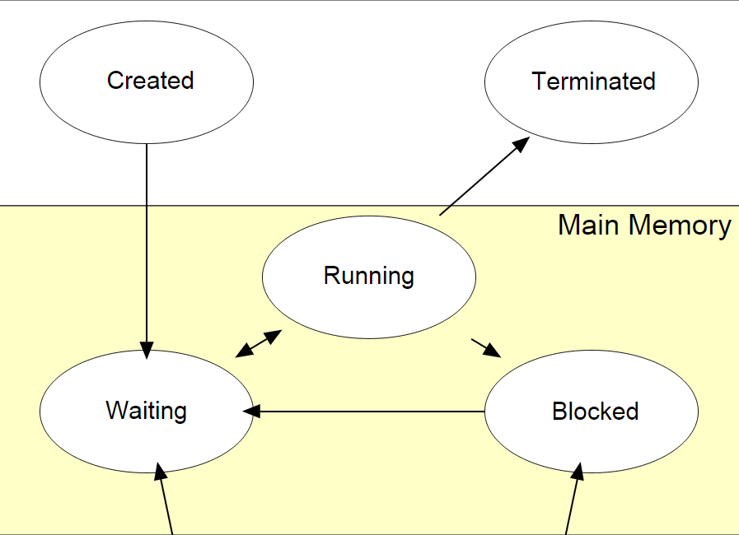
Task States
Wiki:Process (computing)
See also Laplante and Ovaske 4E p. 97

