Slide 1
SE-3910
Real-time Systems
Week 10, Class 2
  Real-Time Systems
    Apollo 11
    Toyota 2005 Camry L4
  Discussion
Today's Office Hours end at 3:30pm
Friday: PLEASE bring laptops!
  Class Climate
  Review for Final Exam
Notes:
SE3910
Class 5-1
Yoder
PPT notes
Spring 2014
Print 1-5,11,13-21
Instructor: Print notes
Tentative Class Objectives:
Explain why writing a file causes a pin to “light”
Explain why reading a file reads a 3.3/0V value from a pin
Create programs using file I/O
Create new capabilities for the GPIO library
Create new kernel modules for the BeagleBone?
- Because it’s cool
- To give deeper hardware/software understanding
- To give familiarity with the whole beagle-bone process
Explore the Beaglebone OS source code
Explain key design decisions made by Beaglebone / Linux OS writers
Contrast these decisions with Classic Linux and Windows decisions
For HW:
Explain the concept of rise time and fall time.
Make sketch or figure: Using the oscilloscope, measure the time difference between two signals.
Classify events as either being synchronous or asynchronous, periodic, aperiodic, or sporadic
Explain the difference between an embedded and non-embedded system
Explain the difference between a real-time system and a non-real-time system
Identify the key components of the Beaglebone platform
Explain why the Beaglebone changes operating frequency under different power conditions
Identify the key hardware interfaces of the beaglebone
Explain the concept of a cape (daughterboard)
Calculate the software GPIO pin number from an expansion port header definition
Understand how to read a basic schematic
Explain the concept of a dropping resistor
Explain the concept of a pull up and a pull down resistor
Short the beaglebone’s output to ground
Connect the input directly to 5V
Connect the input through a resistor to 5V
Discuss peak voltage again
Potential Topics
Piazza
Link to Schilling’s PDF Slides
Future Quick-quizzes:
Labeling voltage, current etc.
Why frequency scale? What is the advantage of turning down frequency?
HW:
How to set frequency to minimize power consumption given full-speed CPU load?
(for after scheduling later)Suppose a program blocks X time, and runs Y time while waiting for data, per period. What is the CPU load?
Future potential objectives:
Discuss two kinds of interrupt systems:
Idle main
“background” main
etc.
Identify possible values for hyperperiod and frames in cyclic scheduling
Compare and constrast round-robin and cyclic scheduling

Slide 2
Apollo 11 Landing (1)

Slide 3
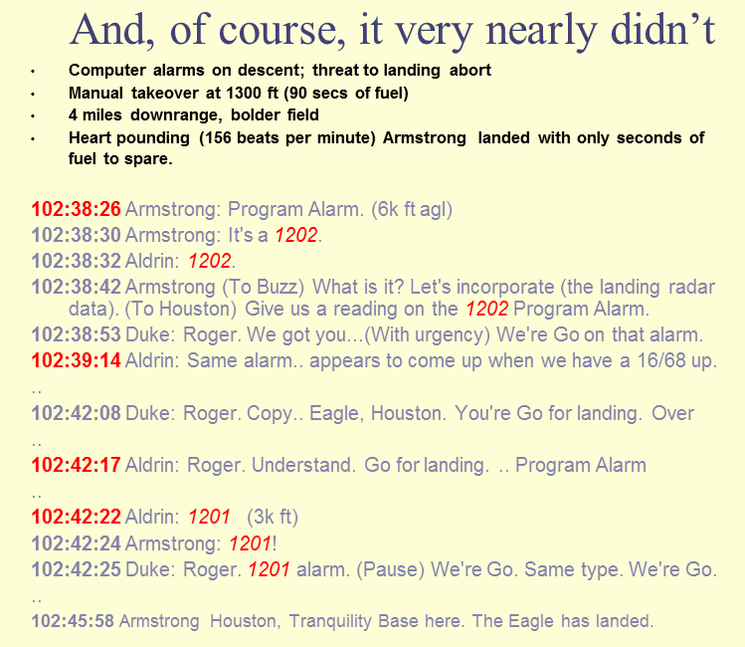
Apollo 11 Landing (2)

Slide 4
After landing…
M.I.T. Instrumentation Laboratory ("the Lab")
  Built the Apollo Guidance and Navigation System;
10 seconds after “the eagle has landed”,
  NASA rang the lab
  "What were those alarms?”
  “We're launching in 24 hours and we're not going with alarms.”
  “We must have an operational computer!”

Slide 5
Apollo 11 Memory
LEM/CM computer’s had two types of memory:
  fixed memory
    programs, constants and landmarks
    36,864*15 bit words= 67.5 KiB (!!)
  erasable memory,
    variables/ registers used in calculations
    2,048 15-bit terms = 3.75 KiB (!!)
    coincident-current ferrite cores woven into a rope with copper wires and sealed in plastic.
Notes:
http://rfcafe.com/miscellany/cool-pics/cool-pic-archive-19.htm
Rope memory used on Apollo 11 mission
"Woven by hand by dedicated employees (mostly women) at Ratheon"
"It is innately rad[iation] hardened."

Slide 6
Apollo 11 OS
Real-time multi-tasking operating system.
  Always processes the job with the highest priority before other, lower priority jobs
Two Apollo control programs :
  Waitlist handled <= 9 quick tasks (4ms or less)
  Executive handled longer tasks (up to 7 tasks)
Each task had erasable memory
  Memory was shared (up to seven ways!)
  Interrupt (time-) driven tasks had
    Dedicated memory (core set)
  Priority-ordered “jobs”
    Each job got 12 memory locations (15 bits/location, 7 of these “core sets” total)
    If more needed, request more space – 44 erasable words (VAC; vector accumulator) (15 bits/location again, 5 of these)

Slide 7
Errors 1201 and 1202
1201 error: Out of the VAC areas (extra space)
1202 error: Out of cores
On descent: searching for rendezvous radar data
  Because the rendezvous radar switch was set to “Auto” when it should have been set to “Manual”
  This radar was meant for the return to dock with the orbiter
Radar processing tasks filled the processor, both cores and VAC areas.

Slide 8
Why Apollo 11 was not fatal
  Computer had been programmed to recognize this task as being of secondary importance
  Ignored it, performed other tasks instead
  Rebooted the system, restoring current state
    Except did not restore the radar jobs
  Not exactly a watchdog, but similar
  Tested extensively
  Resolved to not have errors (next slide)

Slide 9
Apollo 11 Alarms 1201 and 1202
Final simulation done prior to the launch,
  Dave Scott and Jim Irwin in the LM simulator.
  landing simulation was aborted - unnecessarily
  because of a 1201 program alarm
Kranz sent Bales off to work up rules for each type of alarm. Later that evening, Bales rings Kranz saying
  “We should not have aborted (due to that guidance system error)”

Slide 10
Massive testing at MIT…
The bug: “cycle stealing”
Overload of queue
  computer not getting to certain computations,
What was slowing things up?
  I/O system keeps looking for data.
  The Rendezvous Radar Switch was in the AUTO position and the computer was doing I/O looking for radar data.
Error in the crew procedures
  “Place rendezvous radar switch” to “AUTO” during descent WRONG!
Why not found during simulation?
  The switch was not connected to a real computer (procedures validation performed on functional simulation)
Last message before lunar take-off
  Glenn Lunney,(Flight Controller), calmly told the astronauts…
  ”Please put the Rendezvous Radar Switch in the Manual position".

Slide 11
re: Apollo 1
“Spaceflight will never tolerate carelessness, incapacity, and neglect. Somewhere, somehow, we screwed up. It could have been in design, build, or test. Whatever it was, we should have caught it. We were too gung ho about the schedule and we locked out all of the problems we saw each day in our work. Every element of the program was in trouble and so were we. The simulators were not working, Mission Control was behind in virtually every area, and the flight and test procedures changed daily. Nothing we did had any shelf life. Not one of us stood up and said, ‘!$#@, stop!’ ” – Gene Kranz, Flight Director, three days after the accident
Notes:
https://www.extremetech.com/extreme/243548-remembering-apollo-disaster-50-years-later
Jan 27, 1967
Grissom, White, and Chaffee

Slide 12
Limiting Memory Utilization
Avoid recursion
  Uses up a lot of stack space
Avoid memory fragmentation
  Avoid allocating and deallocating memory unnecessarily
Carefully manage the scope of variables
  Helps to control stack utilization
Optimize memory usage with registers
  Compiler setup and options
Estimate your memory usage before starting a project
  Helps to gauge are you using things efficiently

Slide 13
Toyota 2005 Camry L4
Unintended Acceleration
2007 A single vehicle crash occurs which injures the driver and kills the passenger in Oklahoma
2011 – NASA issues a report on unintended acceleration in Toyota vehicles
January 2012 – Multiple engineers from the Barr group are able to analyze the Toyota software
July 2012 billion dollar economic loss settlement

Slide 14
Toyota 2005 Camry L4
Unintended Acceleration
October 2013 testimony from Michael Barr
October 2013
  Oklahoma jury found that Toyota owed each victim $1.5 million in compensatory damages and also found that Toyota acted with “reckless disregard”
On December 13, 2013, Toyota settled another West Virginia case
In March 2014,
  the U.S. Department of Justice announced a $1.2 billion settlement in a criminal case against Toyota. As part of that settlement, Toyota admitted to past lying to NHTSA, Congress, and the public about unintended acceleration and also to putting its brand before public safety.
April 1, 2014,
  Michael Barr gave a keynote speech at the EE Live conference, which touched on the Toyota litigation
  http://www.barrgroup.com/killer-apps/.
  Material for this lecture comes from here.

Slide 15
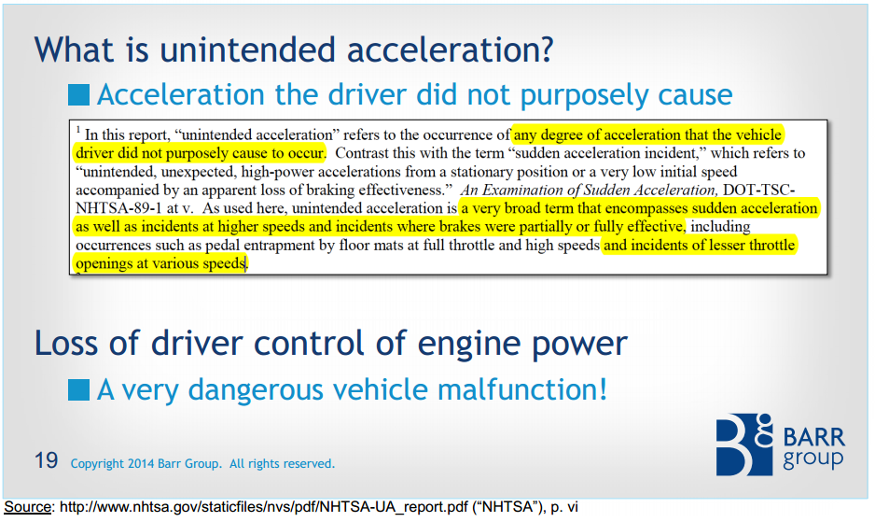
Unintended Acceleration

Slide 16
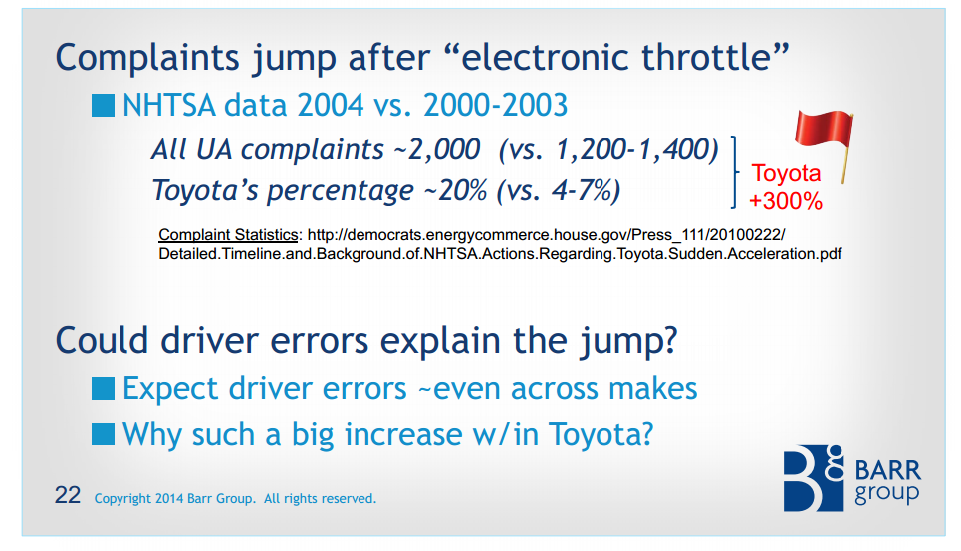
Could it just be driver error?

Slide 17
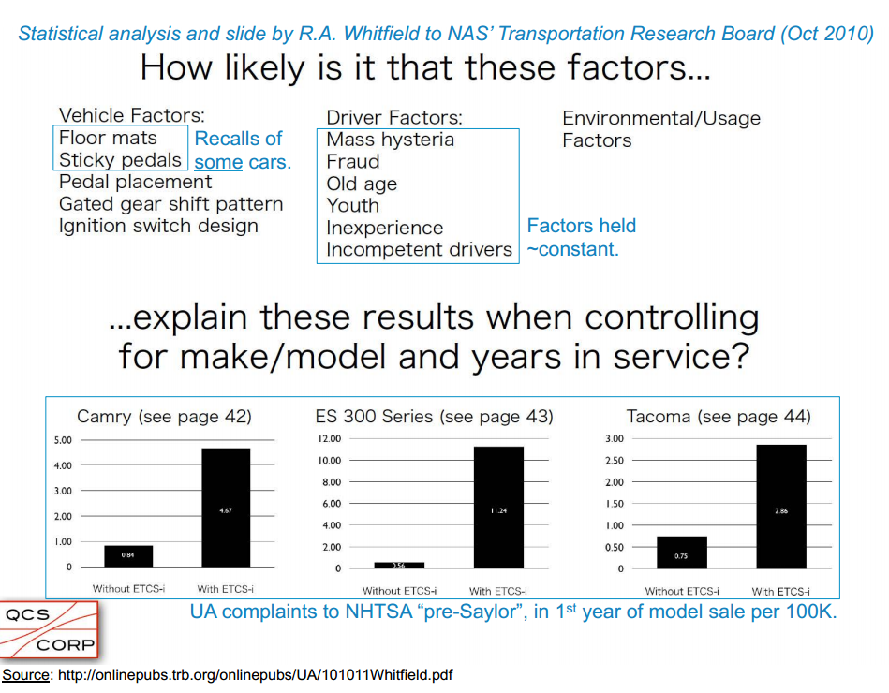
Not really..
Notes:
And so NASA is brought in…

Slide 18
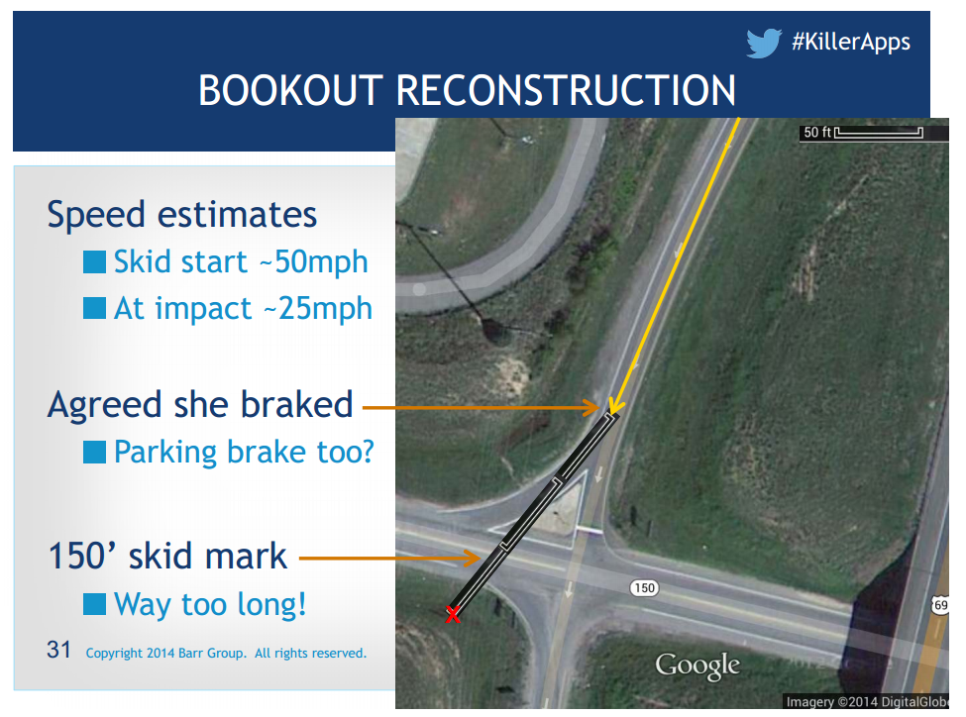

Slide 19
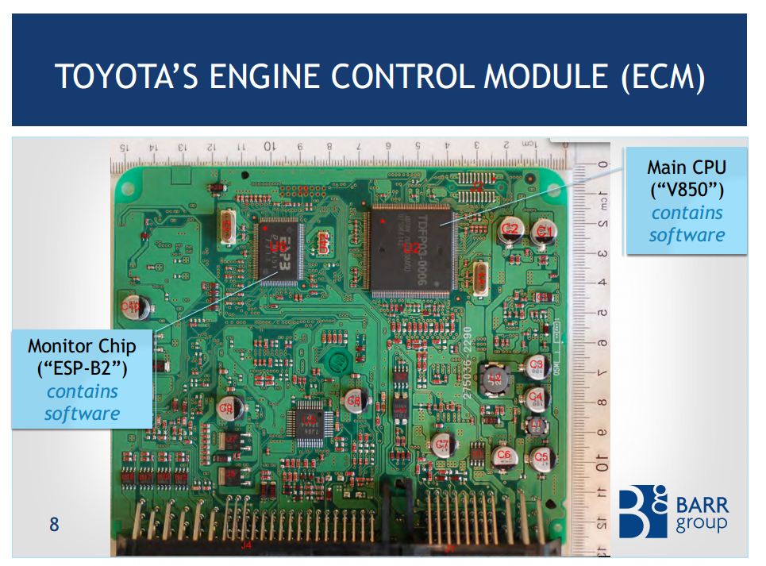

Slide 20
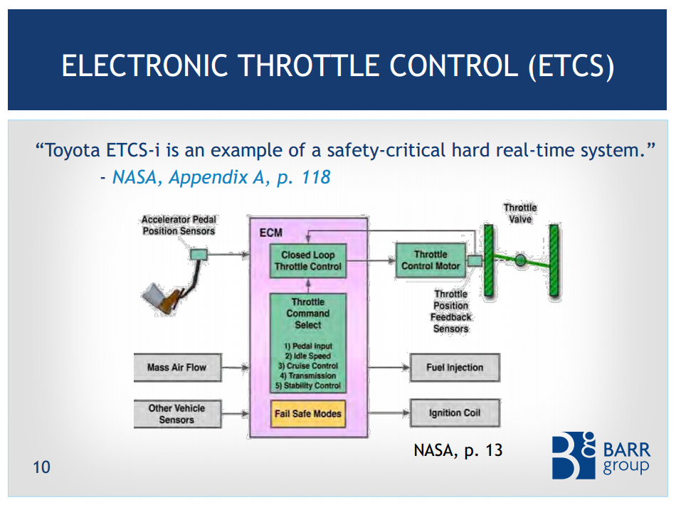

Slide 21
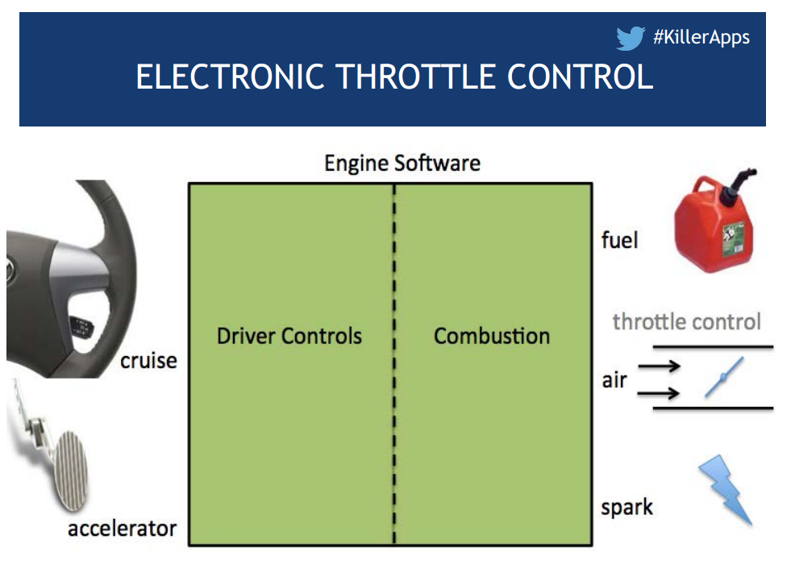

Slide 22
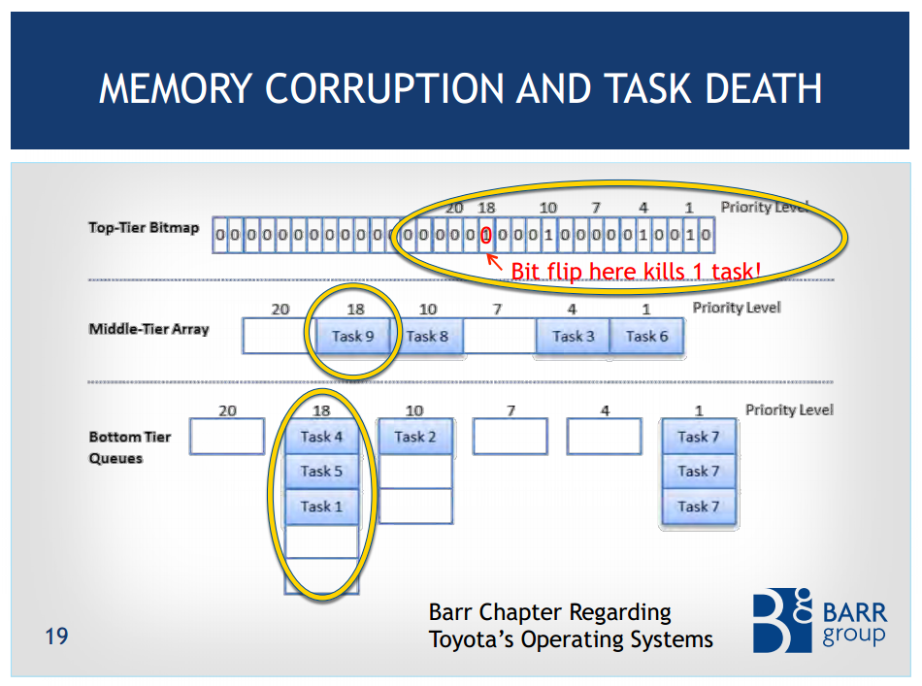

Slide 23
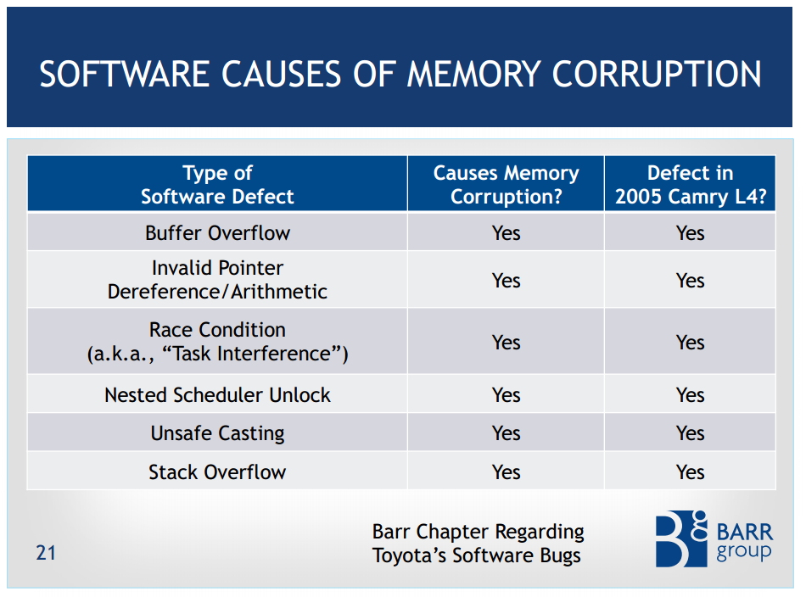

Slide 24
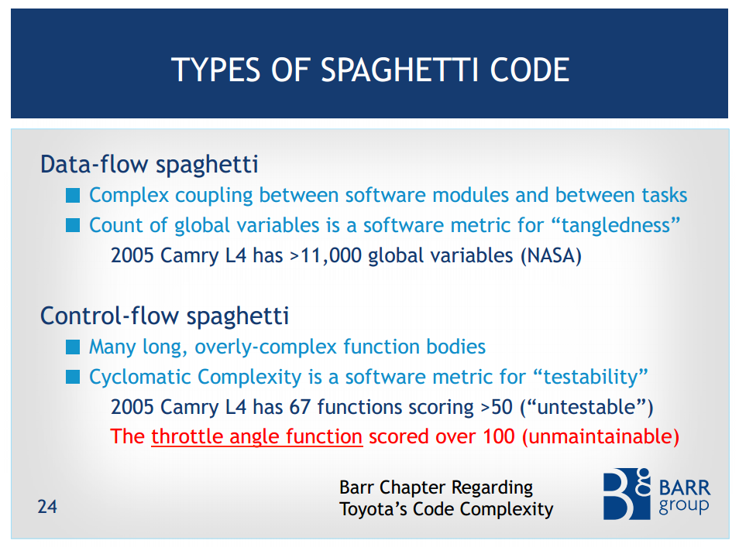

Slide 25
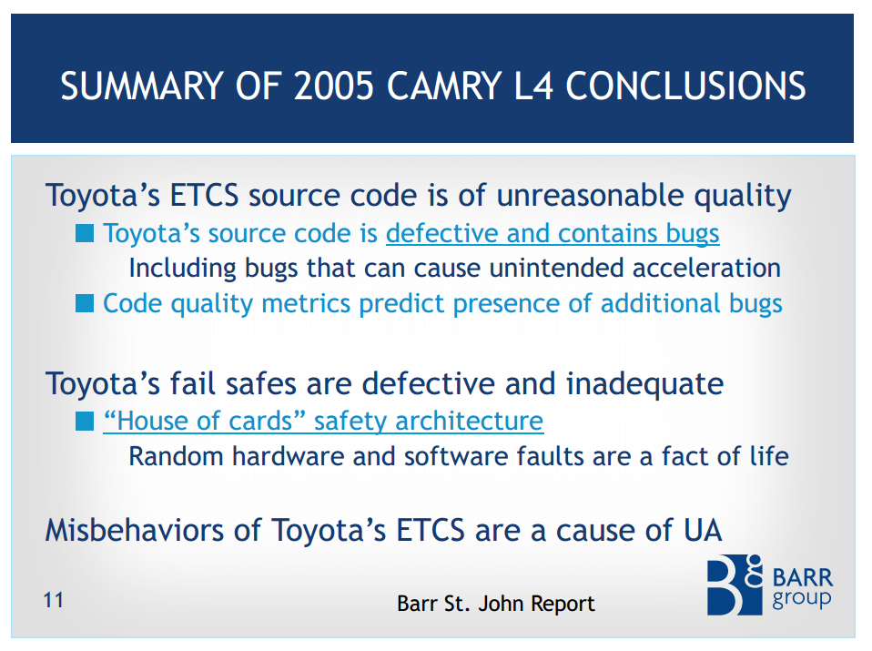

Slide 26
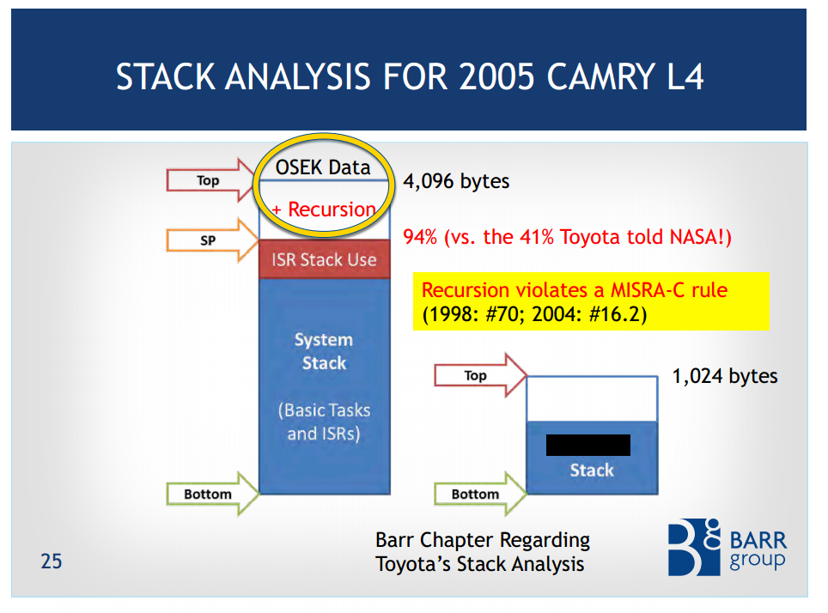
Stack Analysis..

Slide 27
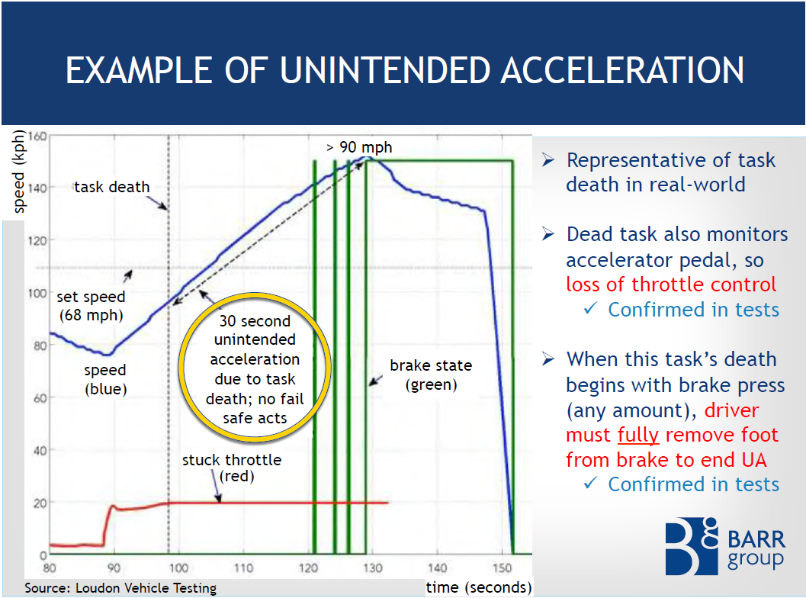

Slide 28
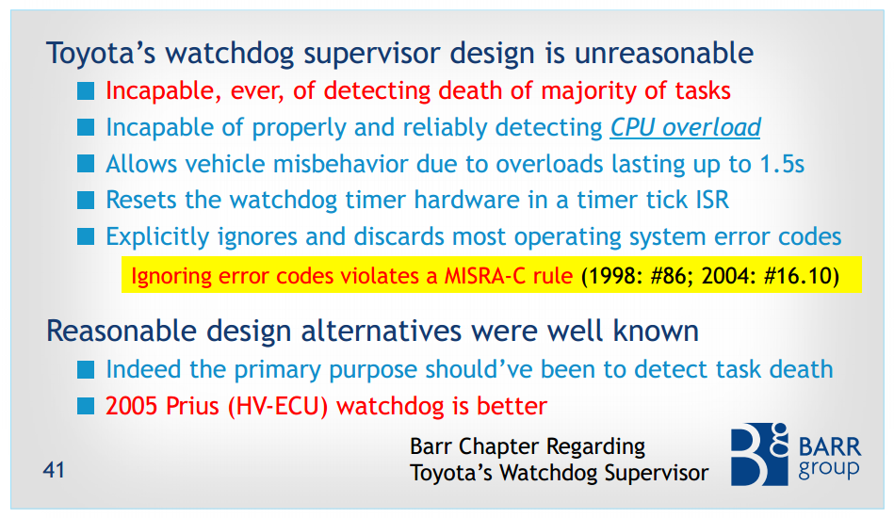
Why didn’t the watchdog catch it?

Slide 29
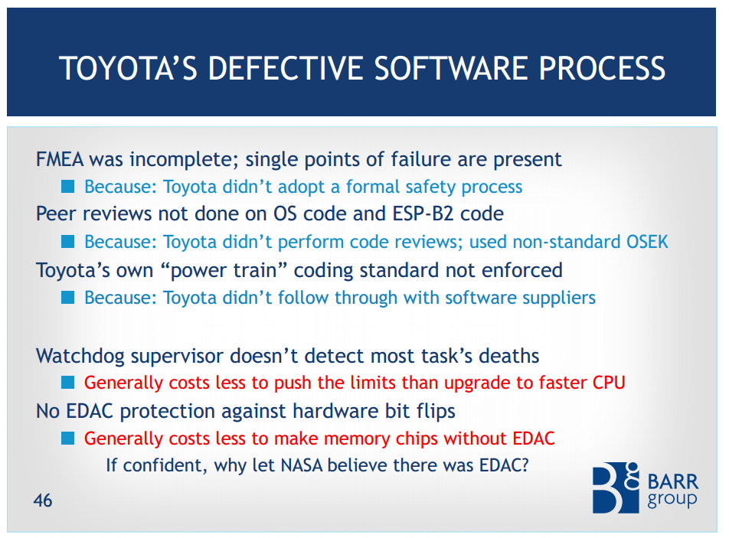
Notes:
Why didn’t TOYOTA catch it?

Slide 30
One footprint is lonely…
Notes:
Some student comments (some tongue-in-cheek) from 16q3
What would you do if you were a new manager at Toyota (just transferred about 6 mo before issue became known), having transferred from GM?
Resign & retire; flee, but not in a Toyota
Find a scape-goat (e.g. Junior Developer)
Note the issue in the back-log
Notify the public. "We are aware of the issue and working to correct it"
Enable the backdoor shutoff to disable all Toyotas of that model from starting (instant "recall")
What if you are Gene Kranz on the Apollo 11 mission?
Ignore it, if we know it won't cause any issues
Tell astronauts it's OK beforehand (so they know they won't die)
What if you are Gene Kranz on Apollo 1?
Ask astronauts to sign a waiver
Ask for more money & time
Say Russians are causing trouble…
Continue on (I added this one)

