Slide 1
Polling vs. Interrupts
Notes:
Interrupts: “Cut it out! I’ll tell you when we’re there!”

Slide 2
SE3910 Week 2, Class 2
Circuits Exercises
Real-time Systems – Chapter One of Laplane Ovaske. Chapter One of Hybrid Text.
Polling and Interrupts
Notes:
Full agenda:
Return Exam
Questions about lab due tomorrow in class?
Threads: Locking on null object
Threads: invokeLater
Threads: The squares example
Decorator Class Diagram
More on Java IO
Class diagrams
Design Principles
in the patterns we’ve seen so far
Compare with alternatives
Decorator vs. array approach suggested in class
Non-decorator array – decorator can be added on without modifying the original hierarchy
Decorator has “before-after” and possibly other combinatorial control that would be hard-coded in array
[Show “screenshot” of discussion from class? Or just re-type?]
Strategy vs. Decorator class diagrams side-by-side
Structural difference (inheritance optional in Strategy pattern?)
Decorator vs. “Strategy” array
Perhaps next:
Coding Starbuzz coffee (?)
Add real patterns
ArrayList – null-checking
Java I/O: Students do coding examples
http://stackoverflow.com/questions/9358821/should-i-extend-arraylist-to-add-attributes-that-isnt-null

Slide 3
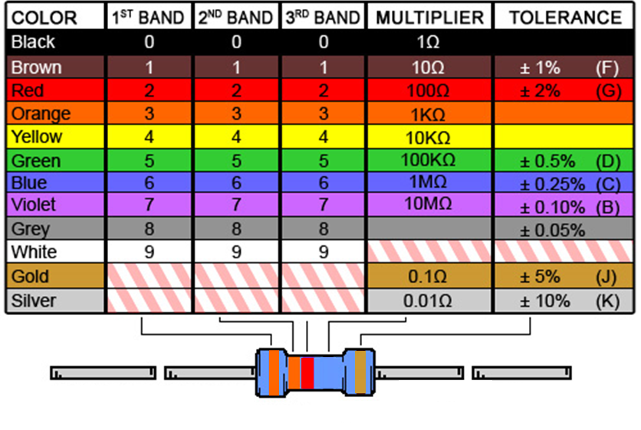
Ex: What is the resistance of this resistor?
Notes:
And what is the tolerance?

Slide 4
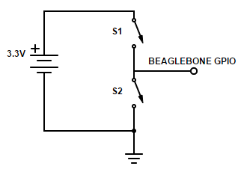
Exercise: Find all of:
Voltage from GPIO to ground if
S1 is closed
S2 is closed
Both are open
Current from source if both are closed

Slide 5
Microcontroller vs. Microprocessor
Microprocessor
a single chip holding a single (large) CPU
what most PC’s have
Microcontroller
A single chip holding a CPU, memory, peripherals
What’s on the Beaglebone Black

Slide 6
System on a Chip vs. MicroController
Microntroller – see previous
System on a Chip
broader
will include microcontroller
may include more (e.g. analog components)
a bit of a buzzword – every manufacturer has their own meaning
For example, CE1901/CE1911 students use a SoC consisting of a microprocessor and an FPGA

Slide 7
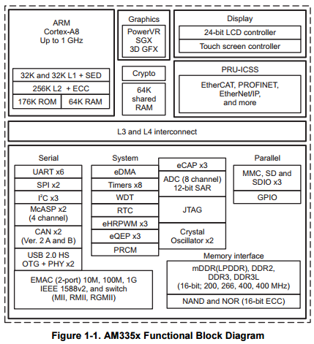
The AM 335x (The Beaglebone’s CPU chip)
http://www.ti.com/lit/ds/symlink/am3358.pdf
Notes:
http://www.ti.com/lit/ds/symlink/am3358.pdf

Slide 8
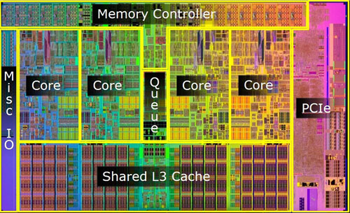
An i5 (Intel chip in laptop)
http://aphnetworks.com/reviews/intel_core_i5_750/2
Notes:
What’s the difference? i5 really NEEDS external memory to work, the AM335x’s could, in theory operate without external memory
(And my first attempts to find something like the above found the “chipset” instead.)
This page:
http://www.bjorn3d.com/2010/01/intel-i5-661-3-33ghz-dual-core-cpu/
says that the i7 chip includes graphics (i.e. GPU). Wow!

Slide 9
Five Misconceptions (paraphrased from Laplante and Ovaske)
Real-time systems are fast
All you need is
a real-time OS
a rate-monotonic scheduler
lots of scheduling theory
We’ve figured out how to make real-time systems
Notes:
Draw graph illustrating Rate-monotonic
See hand notes

Slide 10
Timing Terminology
Event
A jump in the program counter
Synchronous
Predicatable. Scheduled. In sync with other events
Asynchronous
Unpredictable. Unscheduled. External requests
Aperiodic – No fixed period, asynchronous
Sporadic – Extremely infrequent and aperiodic
Punctual – Neither early nor late
Notes:
Draw pictures of time sequence for synchronous and asynchronous events.
Do Comparison table

Slide 11
What is an event?
for example, in SE 1021

Slide 12
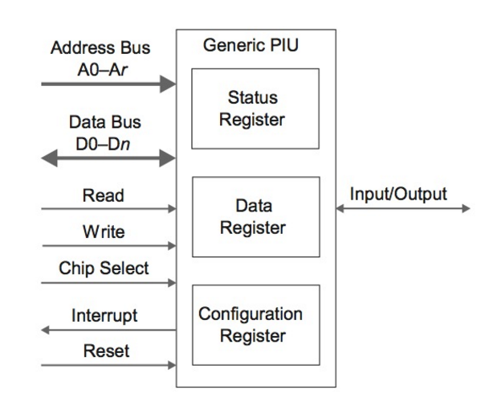
I/O hardware
External pin
Inside the device
Notes:
Custom text, p. 57
Laplante and Ovaske 4E, p. 52
Polling hardware is easy
Interrupts require some additional hardware

Slide 13
Interrupt Definitions
Interrupt
An event in hardware that triggers the processor to jump from its current program counter to a specific point in the code.
Interrupt Service Routine (ISR)
The function that is called or the particular assembly code that is executed when the interrupt happens is called the Interrupt Service Routine (ISR).
Interrupt flag (IFG)
this is the bit that is set that triggers the interrupt, leaving the interrupt resets this flag to the normal state.
Interrupt Enable
Control bit that tells the processor that a particular interrupt should or should not be ignored.
Interrupt Vector Table
A table in memory which maps ISRs to interrupts.

Slide 14
ISR Handling (1)
[Discussed at high level – Interrupt like any other event, only triggered by hardware]

Slide 15
ISR Handling (2)
Notes:
Fig 2.14 p. 54 Laplante and Ovaske 4E
PIU – Peripheral interface unit

