Slide 1
SE3910
Week 4, Class 1
Today
This week Wednesday
  QUIZ at start of clas
  Office Hours held in Grohmann auditorium
Week 5, Wednesday
  Half-Exam 1
Notes:
Full agenda:
Return Exam
Questions about lab due tomorrow in class?
Threads: Locking on null object
Threads: invokeLater
Threads: The squares example
Decorator Class Diagram
More on Java IO
Class diagrams
Design Principles
in the patterns we’ve seen so far
Compare with alternatives
Decorator vs. array approach suggested in class
Non-decorator array – decorator can be added on without modifying the original hierarchy
Decorator has “before-after” and possibly other combinatorial control that would be hard-coded in array
[Show “screenshot” of discussion from class? Or just re-type?]
Strategy vs. Decorator class diagrams side-by-side
Structural difference (inheritance optional in Strategy pattern?)
Decorator vs. “Strategy” array
Perhaps next:
Coding Starbuzz coffee (?)
Add real patterns
ArrayList – null-checking
Java I/O: Students do coding examples
http://stackoverflow.com/questions/9358821/should-i-extend-arraylist-to-add-attributes-that-isnt-null

Slide 2
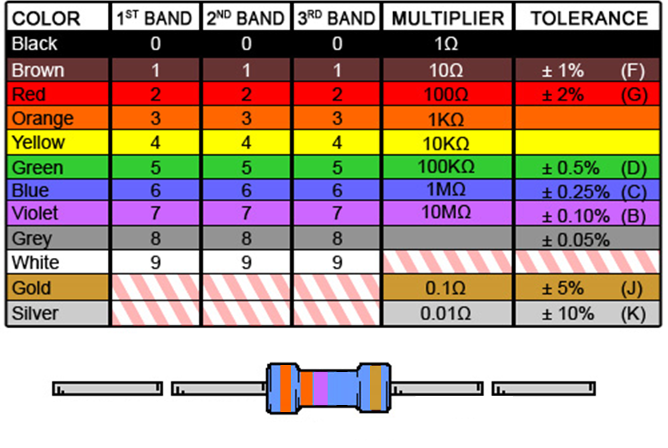
Ex: What is the resistance of this resistor?
ORANGE ORANGE VIOLET GOLD
Notes:
And what is the tolerance?

Slide 3
GPIO safety
Sourcing limit: 4mA
  Limit if current is coming OUT OF Beaglebone
Sinking limit: 8mA
  Limit if current is flowing INTO Beaglebone
Digital Voltage: 3.3 V
Analog input max voltage: 1.8 V

Slide 4
Threading
Java | Pthreads
java.lang.Thread | #include <pthread.h>
No external jar needed | link with -pthread
Thread t = new Thread(r) t.start(); | pthread_create(t,r,sr,a)
interface Runnable { void run(); } | Parameter: void* (*sr) (void *)
t.join(); | pthread_join(*t, &p)
Object o; | pthread_mutex_init(m,null)
synchronized(o) { … } … /* Garbage coll. */ | pthread_mutex_lock(…) … pthread_mutex_unlock(…) pthread_mutex_destroy(…)

Slide 5
Threading – pthreads (corrected)
Java | Pthreads
Object o; o.notify(); | phread_cond_t c = PTHREAD_COND_INITIALIZER; pthread_cond_signal(c);
o.wait(); | pthread_cond_wait(c,m);
o.notify(); | phtread_cond_signal(c);
o.notifyAll(); | phtread_cond_broadcast(c);
See Java coding example NotifyWaitExample
Caveat: “POSIX threads can wait at condition variables of a greater generality than available in Java, but the corresponding queues may be leaky.”
http://wimhesselink.nl/pub/whh241b.pdf
Notes:
View links in class.

Slide 6
I was asked this question in an interview today….
"When we create a thread with pthread_create() (POSIX Threads), the thread starts on its own. Why do we need to explicitly call start() in Java. What is the reason that Java doesnt start the thread when we create an instance of it.
"I was blank and interviewer was short of time and eventually he couldnt explain the reason to me."
http://stackoverflow.com/questions/5269535/java-threads-vs-pthreads

Slide 7
From Taylor’s
We can declare a function pointer by:
  uint8_t (*min)(uint8_t, uint8_t);
We can assign a function pointer to point to an actual function by:
  uint8_t minimum(uint8_t num1, uint8_t num2) {
  return num1 < num2 ? num1 : num2;
  }
  min = &minimum;
We can use it to call minimum using either of the following ways:
  uint8_t answer = min(3, 8);
  uint8_t answer = (*min)(3, 8);

Slide 8
Possibly Fun (updated)
Very simple C++ wrapper for pthreads
  http://www.cs.utexas.edu/users/lavender/courses/cs345/lectures/CS345-Lecture-09.pdf
notify/wait – example comparison with Java and pthreads
  http://wimhesselink.nl/pub/whh241b.pdf
Compares create for Java, pthreads, and Win32 threads
  https://web.archive.org/web/20100615063903/http://cs.millersville.edu/~csweb/lib/userfiles/9ThreadsII.pdf

Slide 9
Certainly fun (Dr. Taylor’s Reviews)
http://msoe.us/taylor/tutorial/ce2810/functionpointers
  Function Pointers
http://msoe.us/taylor/tutorial/ce2810/csimilar
  C/C++/Java
http://msoe.us/taylor/tutorial/ce2810/ooc
  Object-Oriented C

Slide 10
Other references
http://granite.sru.edu/~whit/cpsc464/Notes/figs/02-14.jpg
  Simple pthread chart
    From http://granite.sru.edu/~whit/cpsc464/Notes/ch2.html
https://pic.dhe.ibm.com/infocenter/iseries/v7r1m0/index.jsp?topic=%2Fapis%2Fusers_75.htm
  IBM example of using pthread_cond_init

Slide 11
Standards
http://pubs.opengroup.org/onlinepubs/7908799/xsh/pthread.h.html
  pthead.h
http://pubs.opengroup.org/onlinepubs/7908799/xsh/systypes.h.html
  systypes.h – for xxxx_t

Slide 12
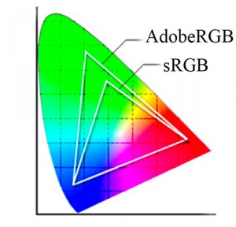
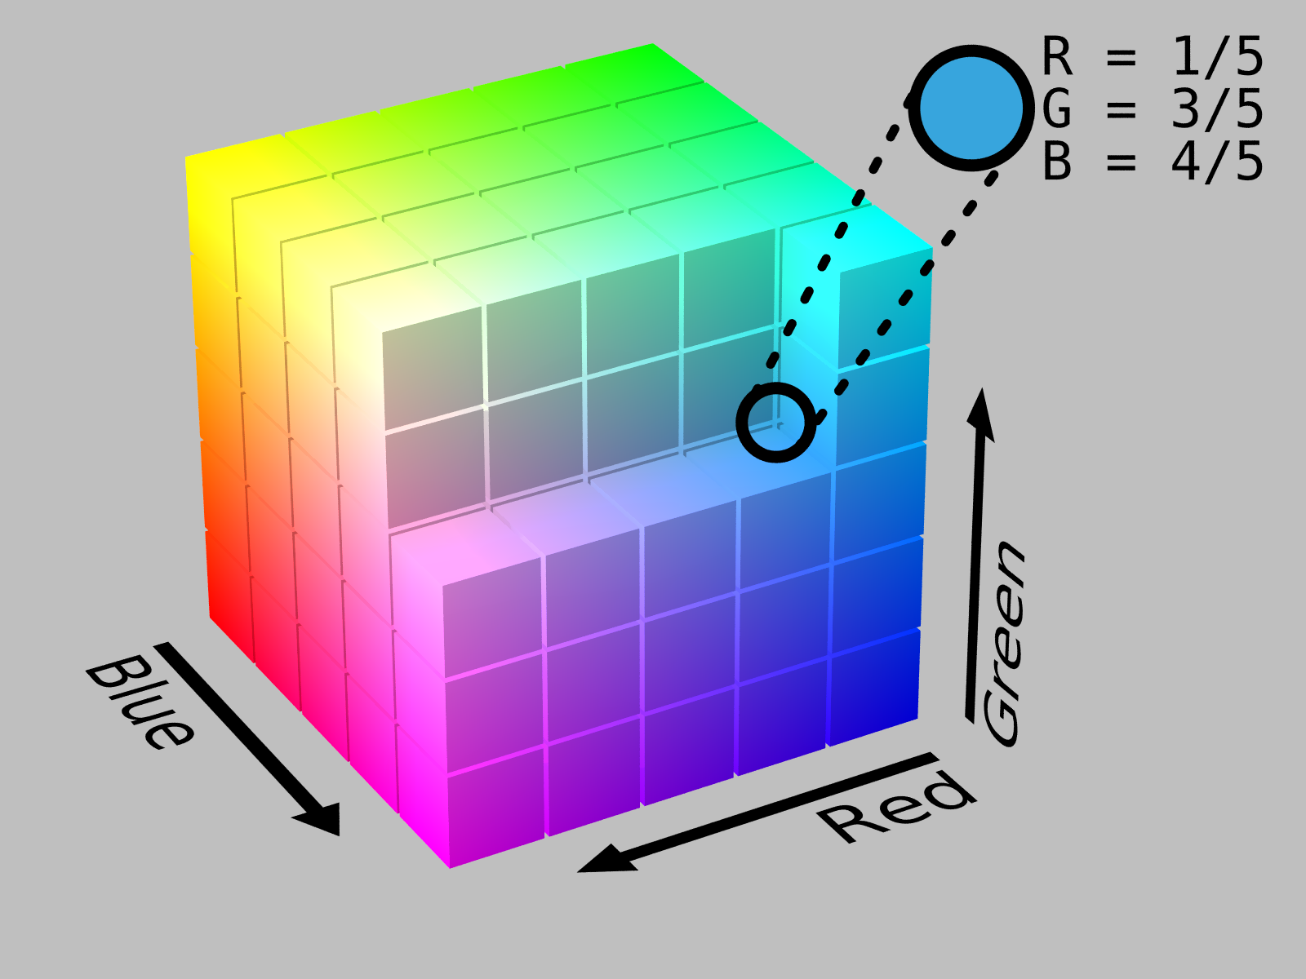
Storing Color
Only three colors needed
  Red
  Green
  Blue
Only 256 values
(0-255) for each color
Ex: How many bits?
http://en.wikipedia.org/wiki/RGB_color_space
http://thelightroomlab.com/2010/11/understanding-digital-camera-color-space-choices/

Slide 13
Storing an image

Slide 14
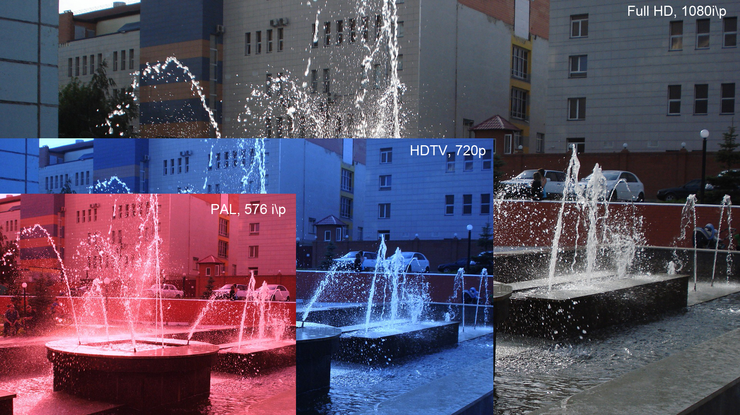
Full HD/1080p
Notes:
Explain that 1080p means the image has a resolution of 1920 by 1080
Image is sent at 60 frame per second
Each pixel has at least 24 bit color associated with it
i – interaced
p – progressive
Full HD – 1920 X 1080
HDTV – 1280 x 720
PAL – 768 x 576

Slide 15
How large is an uncompressed image?
1080p
  1920 x 1080
  3 channels (RGB), each 8 bits
How many bytes for one image?

Slide 16
What is the uncompressed data-rate?
1080p
  1920 x 1080
  3 channels (RGB), each 8 bits
  60 fps
What is the data rate, in Xbits per second?

Slide 17
Very Useful for Today’s Lecture (Also discussed Mebi)
P = 1,000,0000,000,000,000
T = 1,000,000,000,000
G = 1,000,000,000
M = 1,000,000
K = 1,000
() = 1
m = 1/1,000
us = 1/1,000,000
ns = 1/1,000,000,000 (us = μs)

Slide 18
Very Useful for Today’s Lecture (Also discussed Mebi)
Pi = 1024⁵
Ti = 1024⁴
Gi = 1024³
Mi = 1024²
Ki = 1,024
() = 1

Slide 19
Stopped here Spring 2016

Slide 20
H.262 Compression
H.262 compression has a target maximum data rate of 25 Mb/s. Supposing this means Mebibits/s (or Megabits/s), what is the desire compression ratio?
compression ratio = compressed /
uncompressed

Slide 21
Transmitting data
Physical Layer
  You didn’t talk too much about this in Network Protocols
  Can occur through many mediums
    Twisted Pair
    Coaxial Cable
    Fiber Optics
    Wireless

Slide 22
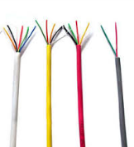
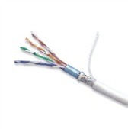

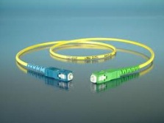
Physical cable data rates
Sources: Dr. Schilling’s Slides and
http://en.wikipedia.org/wiki/Fiber-optic_communication
Wiring Type | Bandwidth
CAT 3 | 16MHz
CAT 5 | 100 MHz
Coaxial Cable (50 Ohm) | 1-2 GHz
Fiber Optic Fiber (Single fiber) | 100 Tbit/s
Notes:
Compare result with this
We got this far – working examples either again or for the first time and discussing new material.

Slide 23
The Stroboscopic Effect
Have you ever noticed something that is in motion seem to stop?

Slide 24
The Stroboscopic Effect
(Aliasing)
http://upload.wikimedia.org/wikipedia/commons/7/77/Propeller_strobe.ogv
http://upload.wikimedia.org/wikipedia/commons/e/ef/The_wagon-wheel_effect.ogv

Slide 25
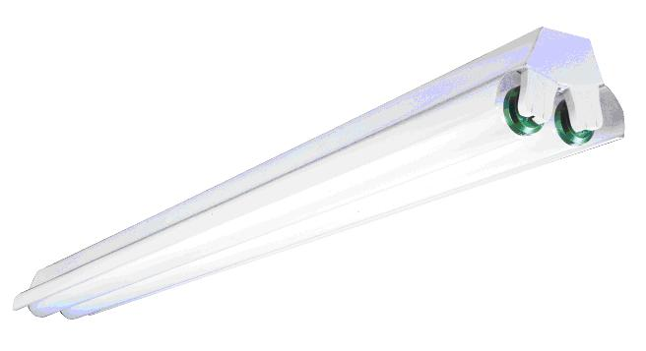
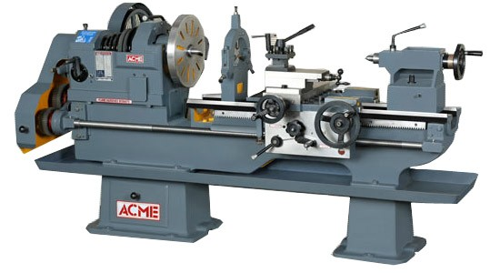
Safety
See, e.g. http://www.seasshops.ucla.edu/services/student-faculty-shop/machine-shop-rules

Slide 26
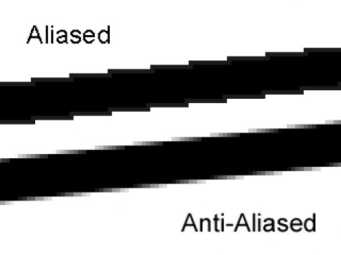
Aliasing
http://photo.stackexchange.com/questions/24512/what-is-aliasing-and-anti-aliasing

Slide 27
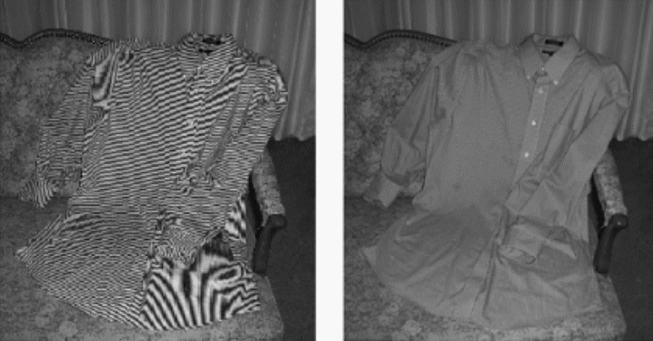
More aliasing
Single-Sensor Imaging: Methods and Applications for Digital Cameras, by Rastislav Lukac
http://www.openphotographyforums.com/forums/showthread.php?t=14988

Slide 28
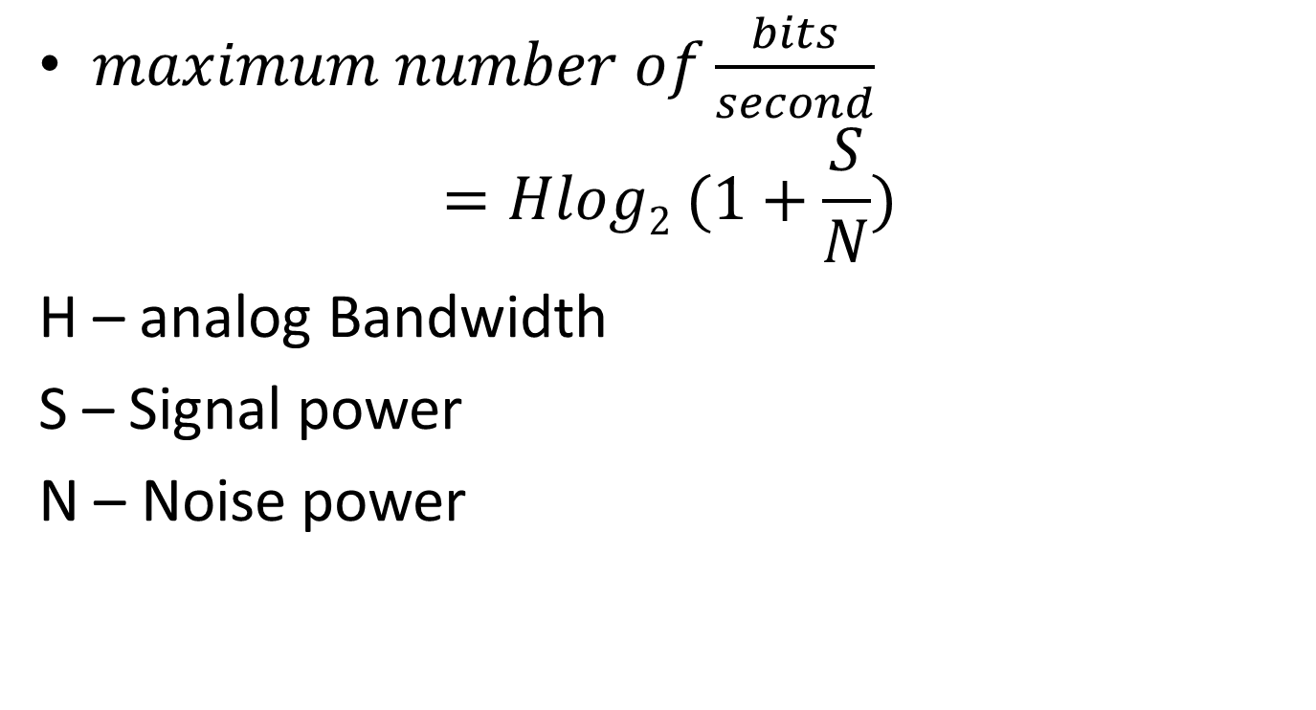
Claude Shannon
$maximum number of\frac{bits}{second}$
$$=Hlog2 (1+\frac{S}{N})$$
H – analog Bandwidth
S – Signal power
N – Noise power

Slide 29
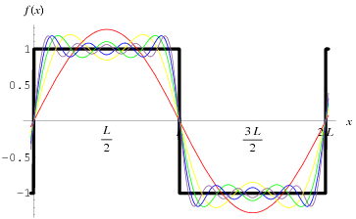
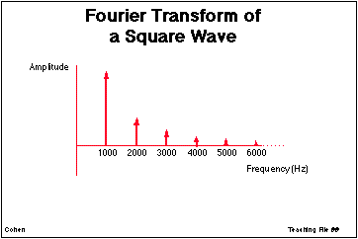
Signals as sums of sine-waves
http://ccn.ucla.edu/BMCweb/SharedCode/slides/SlideFiles.html
http://mathworld.wolfram.com/FourierSeriesSquareWave.html

Slide 30
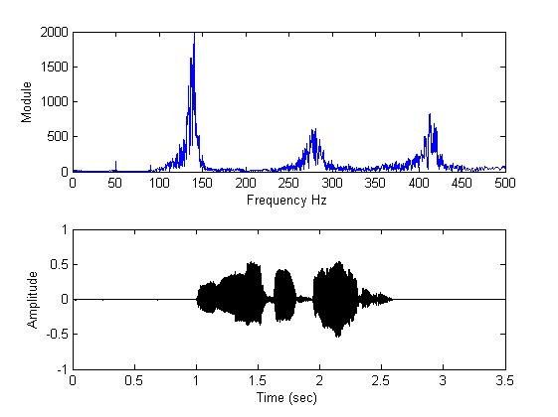
What is analog bandwidth?
Time
Freq.
http://www.mathworks.com/matlabcentral/fileexchange/22214-voice-audio-processing
Notes:
Can do this not only with audio, but also with radio waves
Indeed, both are squared:
http://en.wikipedia.org/wiki/Parseval's_theorem

Slide 31
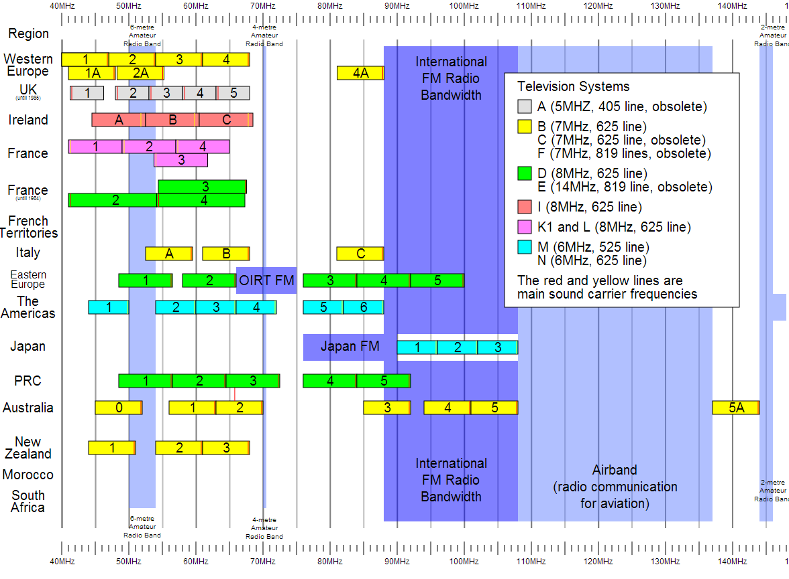
Notes:
For Digital TV:
http://transition.fcc.gov/mb/engineering/dtvmaps/
Full US allocations:
http://upload.wikimedia.org/wikipedia/commons/4/45/United_States_Frequency_Allocations_Chart_2003_-_The_Radio_Spectrum.jpg
VHF Usage (World wide)
http://upload.wikimedia.org/wikipedia/en/c/cc/VHF_Usage.svg

Slide 32
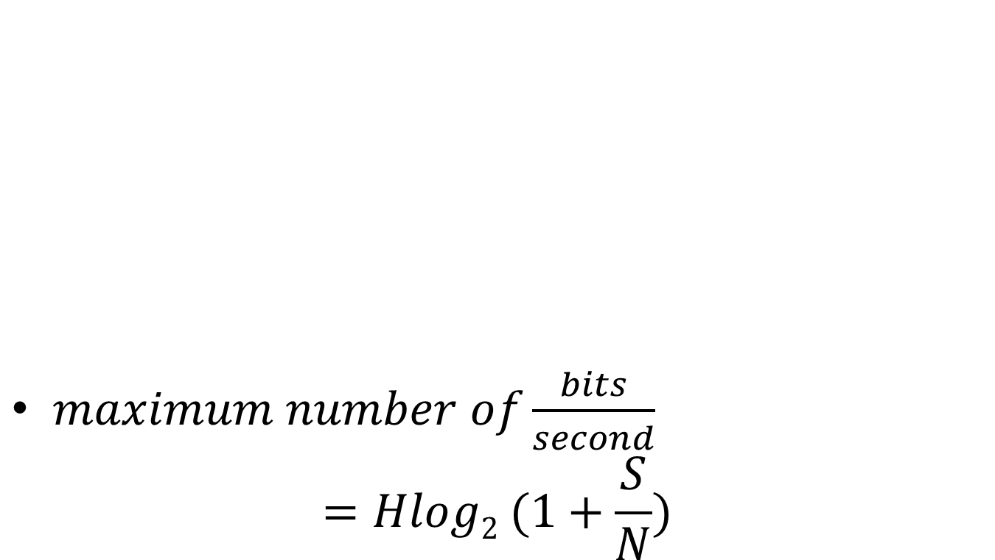
Channel capacity
$maximum number of\frac{bits}{second}$
$$=Hlog2 (1+\frac{S}{N})$$

Slide 33
In-class exercise
The old analog TV channels had a bandwidth of 6MHz
Supposing a SNR of 50 dB, what is the maximum possible bit-rate?
Notes:
For Spring 2015 (15q3):
Work through one, then give an in-class exercise for the following.

Slide 34
In-class Activity: What is the data rate of classic NTSC television (as digital stream)?
Store color with special scheme so only two bytes required per pixel, on average
720x480
30/1.001 fps
Follow up:
If compressed to 25MiB/s (or 25MB/s) what is the compression ratio?
Notes:
[Draw out example on board]

Slide 35
Human eye
Recall
  As little as 13ms
Notice interruption
  As short as 16ms
Single-ms duration looks as long as
  100-400ms
10ms green followed by 10ms red
  May appear as single yellow stimulus

Slide 36
Ex:
Why might you want to sample at a higher frame-rate than the 30fps?
Be as professional as possible
  Avoid flame wars
  Have technical depth to back it
  Avoid sounding technical just to be cool

Slide 37
Ex:
What are two ways we can avoid the stroboscopic effect in a video game simulation of a rotating wheel?

Slide 38
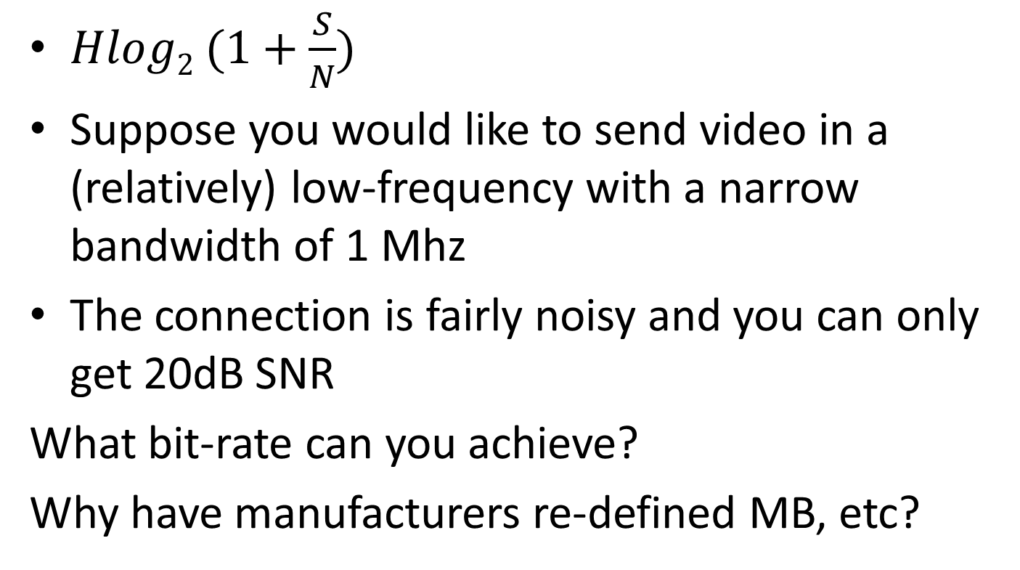
In-class Activity:
Analog to digital bandwidth
$Hlog2 (1+\frac{S}{N})$
Suppose you would like to send video in a (relatively) low-frequency with a narrow bandwidth of 1 Mhz
The connection is fairly noisy and you can only get 20dB SNR
What bit-rate can you achieve?
Why have manufacturers re-defined MB, etc?
Notes:
http://www.arrl.org/files/file/Regulatory/Recommended_Practices_Version_6_5.pdf
Earlier draft:
Modern Digital TV uses the same channels as analog TV, but dynamically maps them.
But each channel is now re-used by allocating virtual “sub-channels” within the main channel that use less of the bandwidth.
This is done digitally
[And as a result, the channel width is about the same]

Slide 39
In-class activity
Suppose I have a band centered at 100 Mhz which is 1Mhz wide.
What are the limits on this range?
What is the wavelength of the center 1 Mhz signal
speed of light = 299 792 458 m / s
speed in Cat-5 is 70% of this
wavelength = time of period * velocity
Notes:
http://www.eham.net/ehamforum/smf/index.php?topic=56160.0

Slide 40
Fiber-optic Transmission
In fiber-optic transmission, signals are sent by transmitting various colors (or invisible) light down a fiber-optic channel
The colors are separated at the other end
Multiple fibers can be used
Supposing that the same bandwidth rule applies, what bandwidth can be carried by the visible spectrum? (700-400nm)
Use SNR of 4000
Hint: Convert wavelength to period/frequency
Notes:
http://physics.stackexchange.com/questions/56240/maximum-theoretical-bandwidth-of-fibre-optics
So, let's begin by exploring the best way to use our power. If we devote it to M symbols per second, each of our measurements comprise the detection of N=PMhν0 photons, thus our signal to noise ratio is SNR=NN√=PMhν0−−−−−√. By the Shannon-Hartley form of the Noisy channel coding theorem(see also here), we can therefore code our channel to get log2(1+PMhν0−−−−−√) bits of information per symbol, i.e. Mlog2(1+PMhν0−−−−−√) bits per second through our optical fibre. This is a monotonically rising function of M, so a limit on P by itself does not limit the capacity.
However, by a converse of the Nyquist-Shannon sampling theorem we can send a maximum of Bsymbols down the channel per second. This then is our greatest possible symbol rate. Hence, our overall expression for the fibre capacity in bits is:
C=Blog2(1+PBhν0−−−−−√) bits per second

Slide 41
References
EB: Derek Malloy, Exploring Beaglebone, Wiley, 2015

