Slide 1
SE3910
Week 4, Class 1
Today
  Quiz at start of class: Rate calculations and simple tricky circuits
Notes on Lab
This week Wednesday
  OH after class cancelled
Week 5, Wednesday
  Half-Exam 1
    Bring calculator!!!
    You may make a note-sheet for yourself
Notes:
Full agenda:
Return Exam
Questions about lab due tomorrow in class?
Threads: Locking on null object
Threads: invokeLater
Threads: The squares example
Decorator Class Diagram
More on Java IO
Class diagrams
Design Principles
in the patterns we’ve seen so far
Compare with alternatives
Decorator vs. array approach suggested in class
Non-decorator array – decorator can be added on without modifying the original hierarchy
Decorator has “before-after” and possibly other combinatorial control that would be hard-coded in array
[Show “screenshot” of discussion from class? Or just re-type?]
Strategy vs. Decorator class diagrams side-by-side
Structural difference (inheritance optional in Strategy pattern?)
Decorator vs. “Strategy” array
Perhaps next:
Coding Starbuzz coffee (?)
Add real patterns
ArrayList – null-checking
Java I/O: Students do coding examples
http://stackoverflow.com/questions/9358821/should-i-extend-arraylist-to-add-attributes-that-isnt-null

Slide 2
Some notes before the quiz
What is an appropriate multiplier?
What is an SI multiplier?
What is a binary multiplier?
How do you abbreviate bit and Byte?

Slide 3
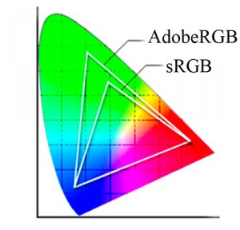
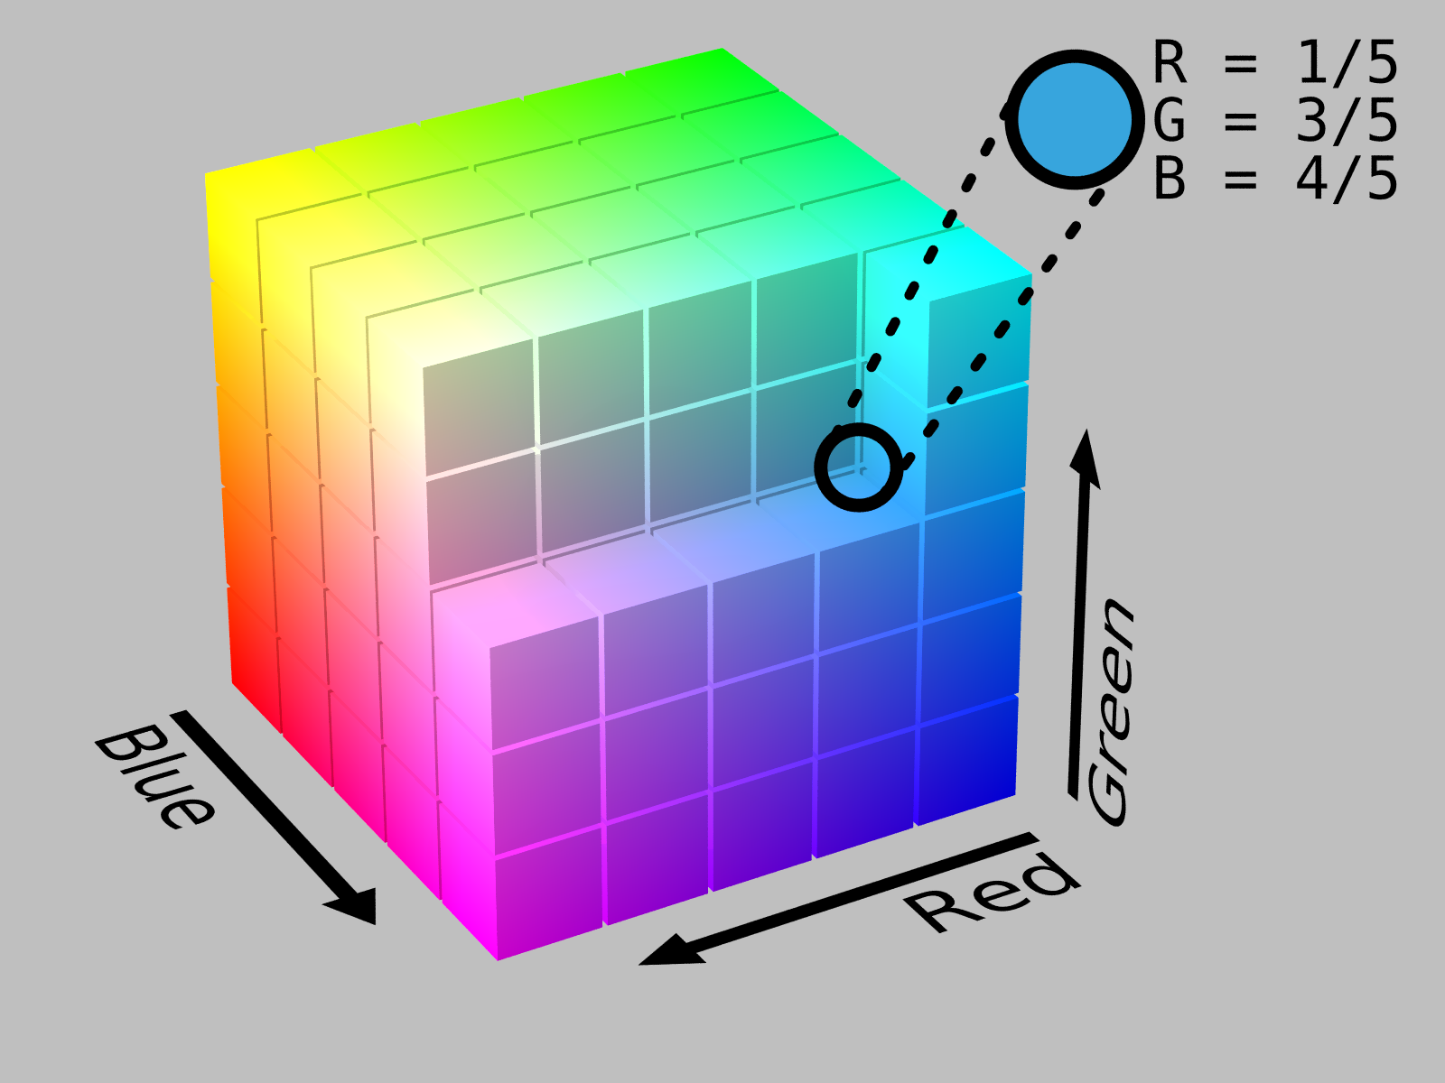
Storing Color
Only three colors needed
  Red
  Green
  Blue
Only 256 values
(0-255) for each color
Ex: How many bits?
http://en.wikipedia.org/wiki/RGB_color_space
http://thelightroomlab.com/2010/11/understanding-digital-camera-color-space-choices/

Slide 4
Storing an image

Slide 5
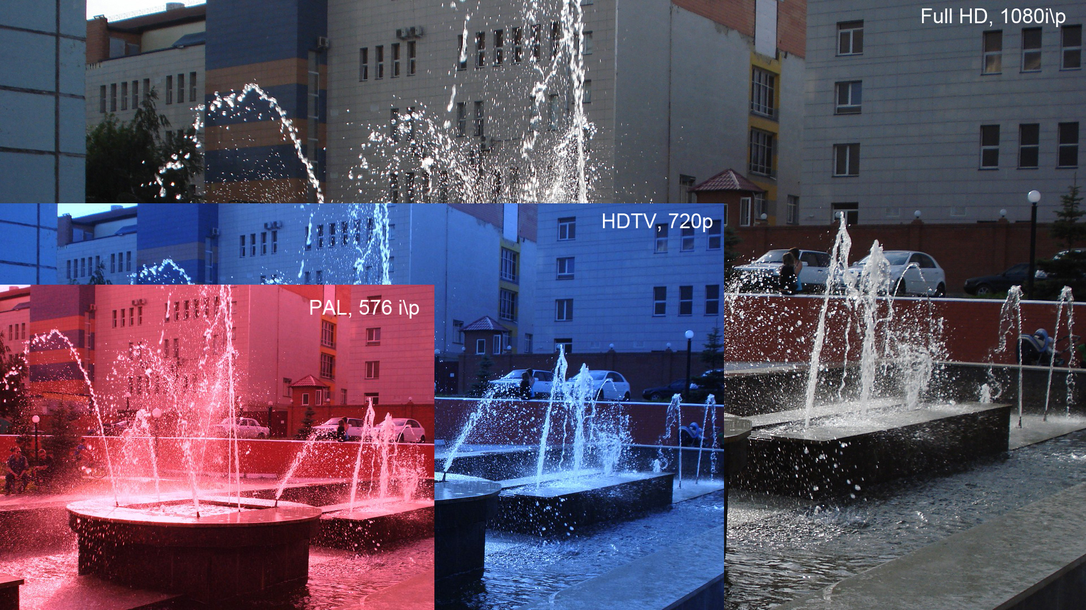
Full HD/1080p
Notes:
Explain that 1080p means the image has a resolution of 1920 by 1080
Image is sent at 60 frame per second
Each pixel has at least 24 bit color associated with it
i – interaced
p – progressive

Slide 6
How large is an uncompressed image?
1080p
  1920 x 1080
  3 channels (RGB), each 8 bits
How many bytes for one image?

Slide 7
What is the uncompressed data-rate?
1080p
  1920 x 1080
  3 channels (RGB), each 8 bits
  60 fps
What is the data rate, in Xbits per second?

Slide 8
SI Multipliers
P (SI) = 1,000,0000,000,000,000
T (SI) = 1,000,000,000,000
G (SI) = 1,000,000,000
M (SI) = 1,000,000
K (SI) = 1,000
() = 1
m = 1/1,000
us = 1/1,000,000
ns = 1/1,000,000,000 (us = μs)

Slide 9
Binary Multipliers
Pebi = Pi = 1024⁵
Tebi = Ti = 1024⁴
Gibi = Gi = 1024³
Mebi = Mi = 1024²
Kibi = Ki = 1,024
() = 1

Slide 10
Abbreviating
B = Byte = 8 bits
b = bit = 0.125 Bytes
b/s = bit/second
MB (SI) = Mega Byte (SI) = 1,000,000 Bytes
Mb (SI) = Mega bit (SI) = 1,048,576 bits
Tib/s = Tebi bit / second = 1.10 T bit/s (SI)
PiB = Peta Byte = 1.13 PB (SI)
Always specify either SI or binary

Slide 11
Some notes before the quiz
What is an appropriate multiplier?
What is an SI multiplier?
What is a binary multiplier?

Slide 12
Notes on Lab
Please do as much prelab as you can
  I prefer for all students to finish and submit the lab in lab, if possible
You can start on Lab 5:
  Install on the Beaglebone:
    the gpicview image viewer program and the OpenCV development libraries
    Compile boneCV.cpp on the BeagleBone
    Install the header files for compiling on the virtual machine BB.

Slide 13
Subnets
For two nodes to communicate on a network, they must be on the same IP subnet
For example, in lab, the switches set up a 192.168.1.X subnet.
The subnet mask has 1's for the subnet part, and zeros for the individual node's part, e.g. 255.255.255.0
So for the address 192.168.1.100, the subnet part is 192.168.1. and the individual computer's part is .100

Slide 14
Choosing an IP address
All computers can choose their own addresses, as long as they choose an address in the same subnet
The switch will act as a DCHP server, and assign IP addresses to any node acting as a DHCP client
Your windows laptop, the VM, and the BeagleBone Black can all use either of these approaches

Slide 15
Bridging networks
In bridging mode, the host helps the virtual machine appear to the outside world through one of its adapters.
If the VM talks, the host will send packets with the VM's IP. If the host itself talks, it will send packets with its own IP
To connect your VM to the internet, connect it to an interface connected to the internet
To connect your BB to the internet, plug it into a wired network connection

Slide 16
Places on campus with Wired internet connections
Some parts of CC third floor (the Mage corner)
Perhaps some rooms ground CC
Some SDL cubicles
Dorms – except for SMTP
Apartment? (off-campus)
Science building S365

Slide 17
H.262 Compression
Suppose a Full HD signal -- 1080p
  1920 x 1080
  3 channels (RGB), each 8 bits
  60 fps
H.262 compression has a target maximum data rate of 25 Mb/s. Supposing this means Mebibits/s, what is the desire compression ratio?
compression ratio = uncompressed /
compressed

Slide 18
Stopped here 16q3

Slide 19
Transmitting data
Physical Layer
  You didn’t talk too much about this in Network Protocols
  Can occur through many mediums
    Twisted Pair
    Coaxial Cable
    Fiber Optics
    Wireless

Slide 20
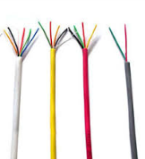
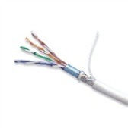

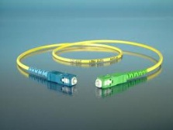
Physical cable data rates
Wiring Type | Analog Bandwidth
CAT 3 | 16MHz
CAT 5 | 100 MHz
Coaxial Cable (50 Ohm) | 1-2 GHz
Fiber Optic Fiber (Single fiber) | 100 Tbit/s
Sources: Dr. Schilling’s Slides and
http://en.wikipedia.org/wiki/Fiber-optic_communication
Notes:
Compare result with this
We got this far – working examples either again or for the first time and discussing new material.

Slide 21
The Stroboscopic Effect
Have you ever noticed something that is in motion seem to stop?

Slide 22
The Stroboscopic Effect
(Aliasing)
http://upload.wikimedia.org/wikipedia/commons/7/77/Propeller_strobe.ogv
http://upload.wikimedia.org/wikipedia/commons/e/ef/The_wagon-wheel_effect.ogv

Slide 23
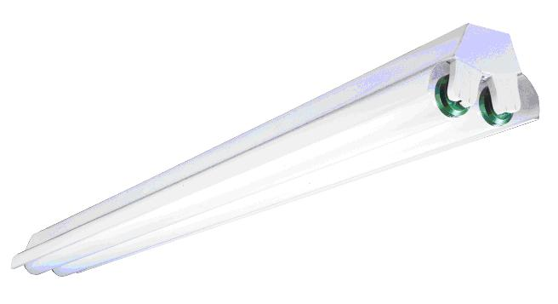
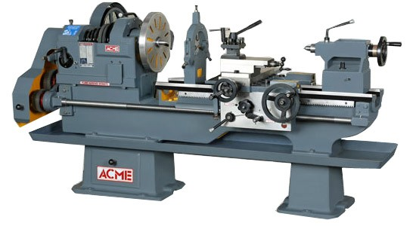
Safety
See, e.g. http://www.seasshops.ucla.edu/services/student-faculty-shop/machine-shop-rules

Slide 24
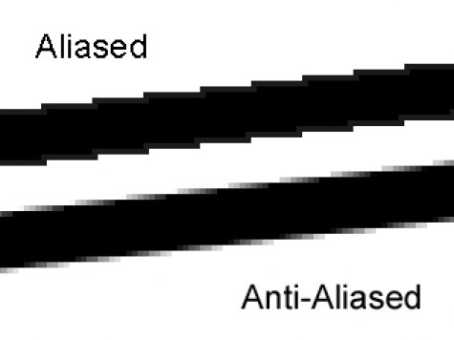
Aliasing
http://photo.stackexchange.com/questions/24512/what-is-aliasing-and-anti-aliasing

Slide 25
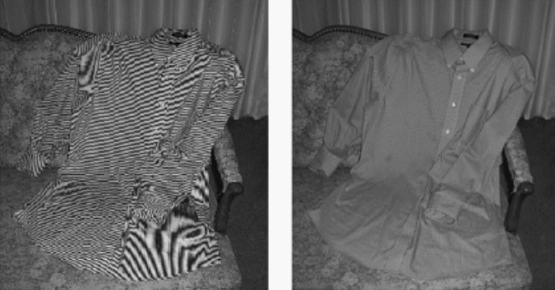
More aliasing
Single-Sensor Imaging: Methods and Applications for Digital Cameras, by Rastislav Lukac
http://www.openphotographyforums.com/forums/showthread.php?t=14988

Slide 26
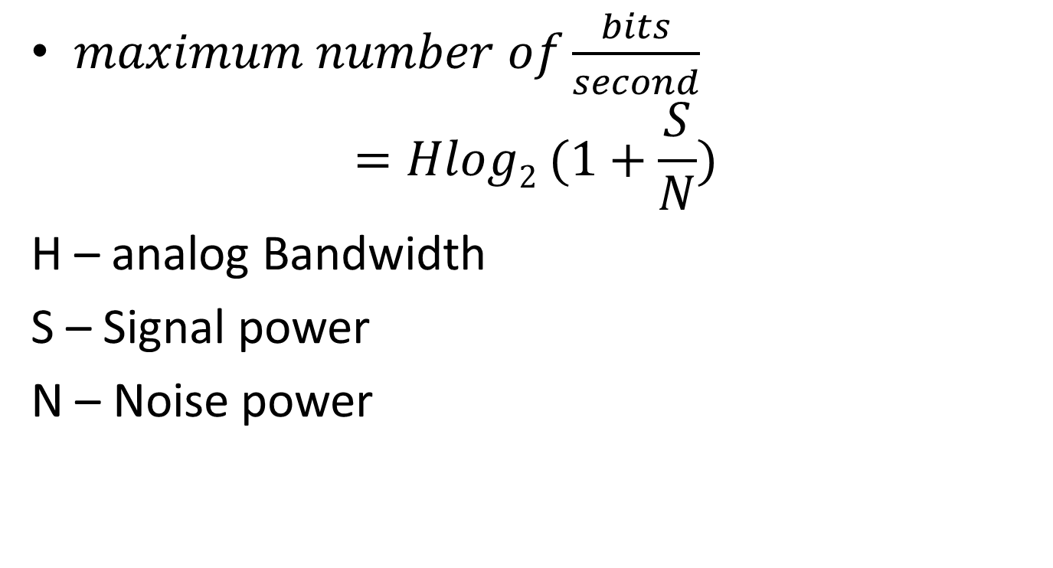
Claude Shannon
$maximum number of\frac{bits}{second}$
$$=Hlog2 (1+\frac{S}{N})$$
H – analog Bandwidth
S – Signal power
N – Noise power

Slide 27
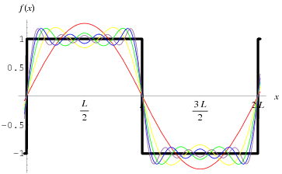
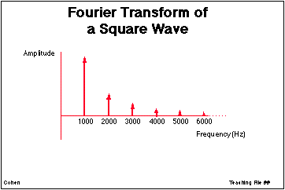
Signals as sums of sine-waves
http://ccn.ucla.edu/BMCweb/SharedCode/slides/SlideFiles.html
http://mathworld.wolfram.com/FourierSeriesSquareWave.html

Slide 28
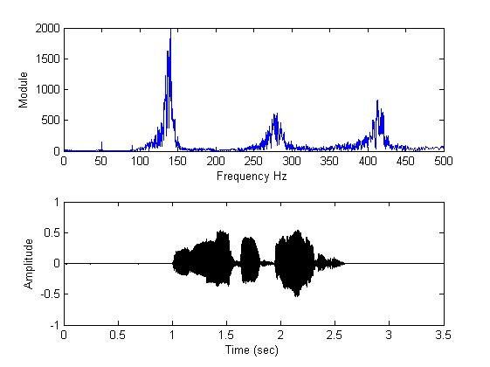
What is analog bandwidth?
Time
Freq.
http://www.mathworks.com/matlabcentral/fileexchange/22214-voice-audio-processing
Notes:
Can do this not only with audio, but also with radio waves
Indeed, both are squared:
http://en.wikipedia.org/wiki/Parseval's_theorem

Slide 29
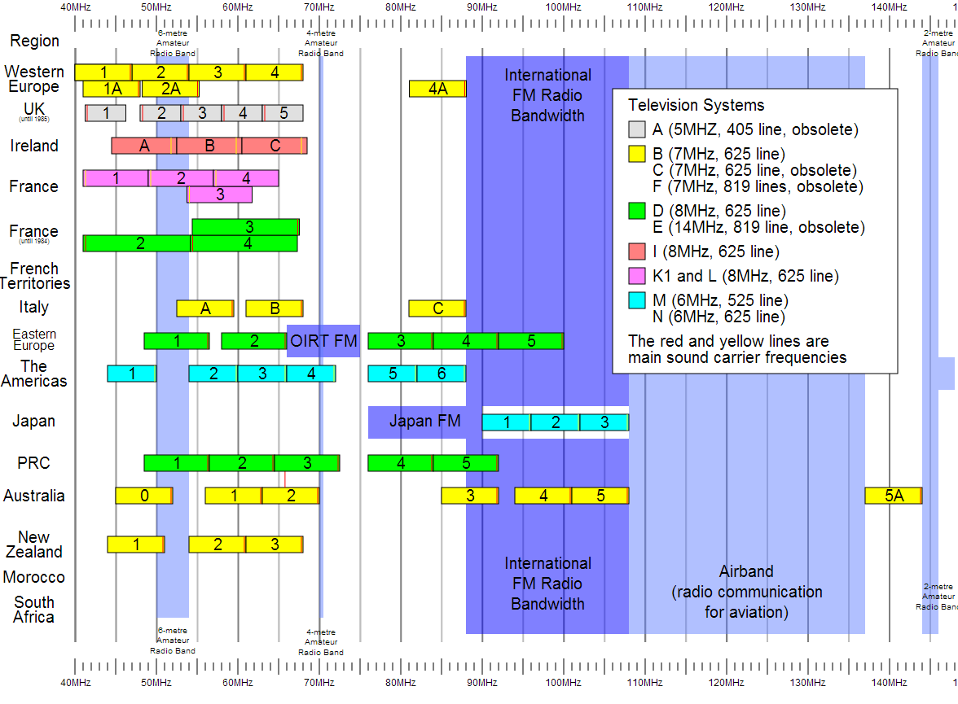
Notes:
For Digital TV:
http://transition.fcc.gov/mb/engineering/dtvmaps/
Full US allocations:
http://upload.wikimedia.org/wikipedia/commons/4/45/United_States_Frequency_Allocations_Chart_2003_-_The_Radio_Spectrum.jpg
VHF Usage (World wide)
http://upload.wikimedia.org/wikipedia/en/c/cc/VHF_Usage.svg

Slide 30
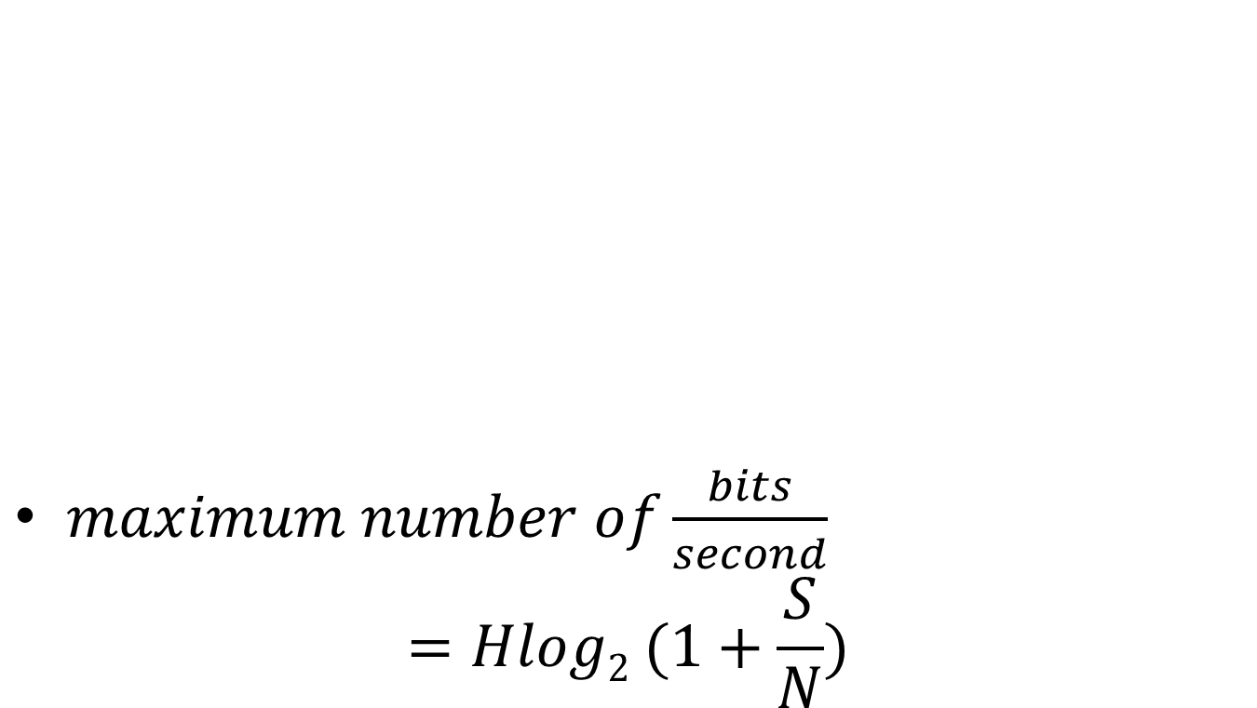
Channel capacity
$maximum number of\frac{bits}{second}$
$$=Hlog2 (1+\frac{S}{N})$$

Slide 31
In-class exercise
The old analog TV channels had a bandwidth of 6MHz
Supposing a SNR of 50 dB, what is the maximum possible bit-rate?
Notes:
For Spring 2015 (15q3):
Work through one, then give an in-class exercise for the following.

Slide 32
In-class Activity: What is the data rate of classic NTSC television (as digital stream)?
Store color with special scheme so only two bytes required per pixel, on average
720x480
30/1.001 fps
Follow up:
If compressed to 25MiB/s (or 25MB/s) what is the compression ratio?
Notes:
[Draw out example on board]

Slide 33
Human eye
Recall
  As little as 13ms
Notice interruption
  As short as 16ms
Single-ms duration looks as long as
  100-400ms
10ms green followed by 10ms red
  May appear as single yellow stimulus

Slide 34
Ex:
Why might you want to sample at a higher frame-rate than the 30fps?
Be as professional as possible
  Avoid flame wars
  Have technical depth to back it
  Avoid sounding technical just to be cool

Slide 35
Ex:
What are two ways we can avoid the stroboscopic effect in a video game simulation of a rotating wheel?

Slide 36
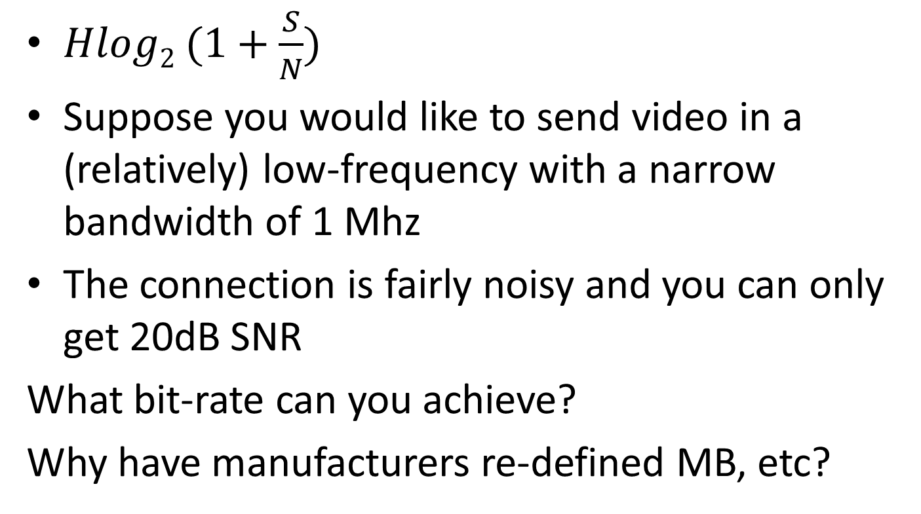
In-class Activity:
Analog to digital bandwidth
$Hlog2 (1+\frac{S}{N})$
Suppose you would like to send video in a (relatively) low-frequency with a narrow bandwidth of 1 Mhz
The connection is fairly noisy and you can only get 20dB SNR
What bit-rate can you achieve?
Why have manufacturers re-defined MB, etc?
Notes:
http://www.arrl.org/files/file/Regulatory/Recommended_Practices_Version_6_5.pdf
Earlier draft:
Modern Digital TV uses the same channels as analog TV, but dynamically maps them.
But each channel is now re-used by allocating virtual “sub-channels” within the main channel that use less of the bandwidth.
This is done digitally
[And as a result, the channel width is about the same]

Slide 37
In-class activity
Suppose I have a band centered at 100 Mhz which is 1Mhz wide.
What are the limits on this range?
What is the wavelength of the center 1 Mhz signal
speed of light = 299 792 458 m / s
speed in Cat-5 is 70% of this
wavelength = time of period * velocity
Notes:
http://www.eham.net/ehamforum/smf/index.php?topic=56160.0

Slide 38
Fiber-optic Transmission
In fiber-optic transmission, signals are sent by transmitting various colors (or invisible) light down a fiber-optic channel
The colors are separated at the other end
Multiple fibers can be used
Supposing that the same bandwidth rule applies, what bandwidth can be carried by the visible spectrum? (700-400nm)
Use SNR of 4000
Hint: Convert wavelength to period/frequency
Notes:
http://physics.stackexchange.com/questions/56240/maximum-theoretical-bandwidth-of-fibre-optics
So, let's begin by exploring the best way to use our power. If we devote it to M symbols per second, each of our measurements comprise the detection of N=PMhν0 photons, thus our signal to noise ratio is SNR=NN√=PMhν0−−−−−√. By the Shannon-Hartley form of the Noisy channel coding theorem(see also here), we can therefore code our channel to get log2(1+PMhν0−−−−−√) bits of information per symbol, i.e. Mlog2(1+PMhν0−−−−−√) bits per second through our optical fibre. This is a monotonically rising function of M, so a limit on P by itself does not limit the capacity.
However, by a converse of the Nyquist-Shannon sampling theorem we can send a maximum of Bsymbols down the channel per second. This then is our greatest possible symbol rate. Hence, our overall expression for the fibre capacity in bits is:
C=Blog2(1+PBhν0−−−−−√) bits per second

Slide 39
References
EB: Derek Malloy, Exploring Beaglebone, Wiley, 2015

