Slide 1
MOS Transistors CMOS Inverter and Logic Families

Slide 2
Levels-of-Design Pyramid
Systems
MSI Circuits
(Adders, Multiplexers)
Gates
Transistors

Slide 3
NMOS (N-Channel Metal Oxide Semiconductor) transistor
gate
source
drain
metal
metal
oxide insulator
metal
n-type
n-type
e
e
e
h
h
h
e
e
e
p-type
h
h
h
h
metal

Slide 4
“Doping” silicon for semi-conductance
Silicon by itself does not conduct well; it just makes a lattice (Group IV on periodic table)
Make silicon a better conductor by adding Group III or Group V elements:
process called doping
Add Group III elements like gallium or indium to get p-type material
Note that the Ga atom has only 3 valence electrons with which to bond; missing bond is called a hole
Si
Si
Si
Si
Si
Ga
Si
hole
Si
Si
Si
Si
Si
Si
Si
Si
Add Group V elements like arsenic or phosphorus to get n-type material
Note that the As atom has 5 valence electrons; it has an unbonded electron
Si
e
As
Si
Si
Si
Si
Si

Slide 5
NMOS transistor with no applied voltages
gate
source
drain
metal
metal
oxide insulator
metal
n-type
h
h
h
_
n-type
e
e
e
_
h
e
e
e
+
+
+
h
+
+
+
_
_
_
_
h
h
h
h
p-type
h
h
metal
When the transistor is left alone, some electrons from the n-type wells diffuse into the p-type material to fill holes.
This creates negative ions in the p-type material and positive ions are left behind in the n-type material.

Slide 6
NMOS transistor with small gate voltage
V_{GS} > 0
gate
+
-
source
drain
metal
metal
oxide insulator
metal
n-type
_
_
_
_
n-type
_
h
h
h
+
+
+
+
+
+
_
_
_
_
p-type
h
h
metal
When a small, positive V_{GS} is applied, holes “move away” from the gate.
Electrons from complete atoms elsewhere in the p-type material move to fill holes near the gate instead.

Slide 7
NMOS transistor “activated” with gate voltage
V_{GS} > V_{TH(n)}
gate
+
-
source
drain
metal
metal
oxide insulator
metal
n-type
e
e
_
e
_
e
_
e
_
n-type
+
+
+
_
+
+
+
_
_
_
_
p-type
h
h
h
h
h
h
h
h
h
h
metal
When V_{GS} is larger than a threshold voltage V_{TH(n)}, the attraction to the gate is so great that free electrons collect there.
The applied V_{GS} creates an induced n-type channel under the gate (an area with free electrons).

Slide 8
NMOS transistor with drain current
+
-
V_{GS} > V_{TH(n)}
V_{DS} > 0
gate
+
-
source
drain
metal
metal
oxide insulator
metal
n-type
e
e
_
e
_
e
_
e
_
n-type
+
+
+
_
+
+
+
_
_
_
_
p-type
h
h
h
h
h
h
h
h
h
h
metal
When a positive V_{DS} is applied, the free electrons flow from the source to the drain. (Positive current flows from drain to source).
The amount of current depends on V_{DS}, as well as the number of electrons in the channel, channel dimensions, and material.

Slide 9
NMOS transistor acts as a switch
When gate voltage is 0 V
No channel is formed
current does not flow easily
“open switch”
When gate voltage is above threshold voltage
electrons are drawn into channel
current can flow through channel with little resistance
“closed switch”
MOS transistors can be used as a voltage-controlled switch
This is the basis of computing with 1’s (open) and 0’s (closed)

Slide 10
NMOS circuit symbol
G
+
V_{GS}
_
I_{G}
I_{G} is (approx) 0 A
There is no one equation like Ohm’s law for transistors since they have 3 terminals
We will model as open circuit when “open”, small resistance when “closed”
I_{D}
S
- V_{DS} +
D

Slide 11
PMOS (P-Channel Metal Oxide Semiconductor) Transistor
gate
source
drain
metal
metal
oxide insulator
metal
p-type
p-type
n-type
metal
Same as NMOS, only p-type and n-type switched
(a negative gate voltage forms the channel and lets current flow)

Slide 12
PMOS transistor circuit symbol
G
I_{G}
+
V_{GS}
_
I_{D}
S
- V_{DS} +
D
Symbol has “dot” at gate. NMOS does not.
I_{D}, V_{GS}, V_{DS}, and V_{TH(p)} are all negative.
These values are positive for NMOS.
Channel formed (“closed” switch) when V_{GS} < V_{TH(p)}. Opposite for NMOS.

Slide 13
CMOS Inverter
V_{DD} (Logic 1, usually 5 V)
S
D
V_{OUT}
D
V_{IN}
S

Slide 14
CMOS Inverter
5 V
S
100 Ω
0 V because no current flows
D
V_{OUT}
= 5 V
D
V_{IN} ≈ 0 V
S
PMOS is “pull-up device”

Slide 15
CMOS Inverter
5 V
S
D
V_{OUT}
= 0 V
D
V_{IN} ≈ 5 V
100 Ω
0 V because no current flows
S
NMOS is “pull-down device”

Slide 16
Voltage Transfer Characteristic
V_{OUT}
V_{IL}: Highest input voltage recognizable as logic 0
5 V
V_{IH}: Lowest input voltage recognizable as logic 1
Slope = -1
V_{OH}
V_{OL}: Maximum logic 0 output voltage
V_{OH}: Minimum logic 1 output voltage
Slope = -1
V_{OL}
V_{IN}
V_{IL}
V_{IH}
5V

Slide 17
Logic Families
The specific voltages required to turn the transistors on and off varies, depending on the size of the transistors and the materials used.
The voltage requirements for a specific gate can be found on its datasheet, or approximated by considering its logic family, or underlying technology.
Logic Family | V_{DD} | V_{IL} | V_{IH} | V_{OL} | V_{OH}
TTL | 5V (4.75V-5.25V) | 0.8 V | 2.0 V | 0.4 V | 2.4 V
CMOS | 5V (4.5V-6V) | 1.35 V | 3.15 V | 0.33 V | 3.84 V
LVTTL | 3.3V (3V-3.6V) | 0.8 V | 2.0 V | 0.4 V | 2.4 V
LVCMOS | 3.3V | 0.9 V | 1.8 V | 0.36 V | 2.7 V
Table 1.4 on page 25 of textbook

Slide 18
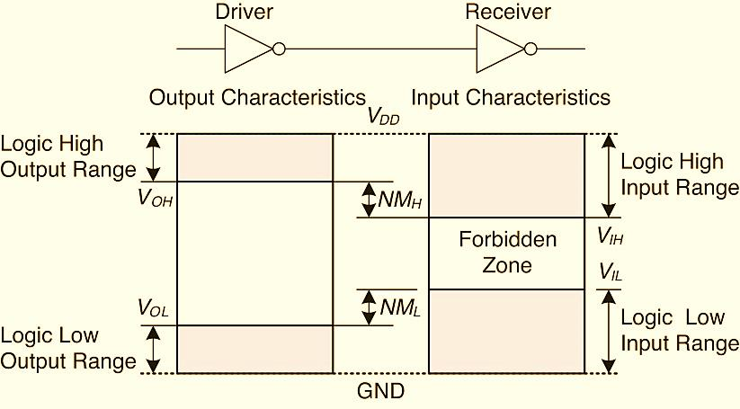
Compatibility
Figure 1.23 on page 23 of textbook, "Digital Design and Computer Architecture, ARM edition" by Harris and Harris.
http://booksite.elsevier.com/9780128000564/figures.php

Slide 19
Compatibility Considerations
Driver can’t break receiver’s gate with a high voltage
We require:
V_{OH} driver >> V_{DD} receiver
(unless the gate is built with special compatibility)
Driver can’t output into receiver’s Forbidden Zone
We require:
V_{OH} driver > V_{IH} receiver
and
V_{OL} driver < V_{IL} receiver
with some room for noise!

Slide 20
Noise Margin
If V_{OH} driver is very close to V_{IH} receiver, then some noise fluctuations on the output could take it into the Forbidden Zone. The same is true if V_{OL} driver is close to V_{IL} receiver.
The noise margin NM_{H} is defined as the difference between V_{OH} driver and V_{IH} receiver:
NM_{H} = V_{OH} driver - V_{IH} receiver
The noise margin NM_{L} is defined as the difference between V_{OL} driver and V_{IL} receiver:
NM_{L} = V_{IL} receiver - V_{OL} driver

