Slide 1
Advanced git: rebasing and friends
Josiah Yoder, MSOE
First Version: Spring 2020
CC-BY 4.0 – but note, includes fair-use images which may restrict redistribution. See slide notes

Slide 2
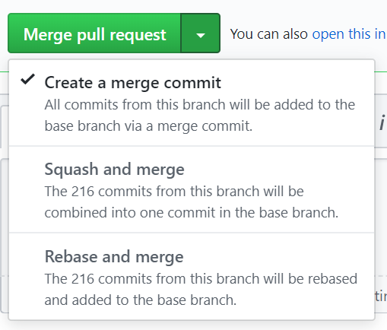
In a Github pull request:
What do these options mean?
Merge commit
Squash and merge
Rebase and merge

Slide 3
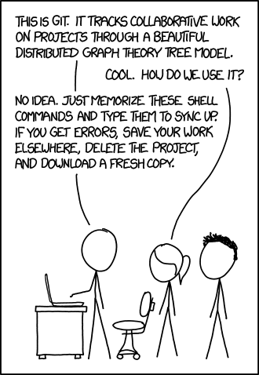
Now let’s focus here
We’ve been focusing our attention here all quarter

Slide 4
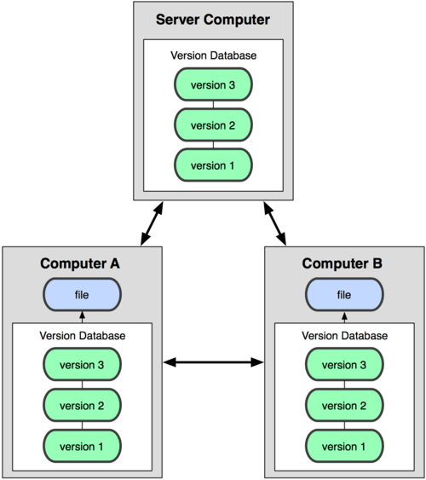
Our current mental model
The central server stores the version history (the remote repository)
Each development machine also stores version history (the local repository)
Notes:
From se2030-w4d1 Version Control.for21q1.pptx slide 29

Slide 5
Let’s look at just one of these repositories
A repository contains:
A working directory (“file” on left, also called “working tree”) – Your “real” files on your computer
Commit history (“versions” on left – The commits stored in your .git directory
Notes:
This is my own (simplified) mental model.

Slide 6
Now let’s look at a single commit
A commit contains:
A list of all the files in the commit
A previous commit
Notes:
This is my own (simplified) mental model.

Slide 7
Git stores WHOLE FILES, not differences
“second commit” stores a reference to a tree, which stores references to the individual files
Notes:
I suspect this figure originates somewhere else, but don’t have time to trace down the real source right now.
https://www.freecodecamp.org/news/pushing-a-list-of-files-to-the-github-with-javascript-b724c8c09b66/
TODO: Remove hashes

Slide 8
Neverthelss, we think of a commit as a “patch” to the files that change
We think of “second commit” as being an edit to test.txt. We diff “version 2” and “version 1” when thinking about that edit.
Notes:
I suspect this figure originates somewhere else, but don’t have time to trace down the real source right now.
https://www.freecodecamp.org/news/pushing-a-list-of-files-to-the-github-with-javascript-b724c8c09b66/
TODO: Remove hashes

Slide 9
Example diff
public static void main(String[] ignored) {
Scanner in = new Scanner(System.in);
- String name = f(in);
- String x = requestName(in);
++ String name = requestName(in);
- System.out.println("Your name is "+x);
+ System.out.println("Your name is "+name);
}
- private static String f(Scanner in){
+ private static String requestName(Scanner in){
System.out.println("Please enter your name");
return in.nextLine();
}
A diff is a comparison between two versions of a file
Notes:
This is my own work

Slide 10
Every object in the git database is hashed
Every commit, directory, and file in the git database is hashed
Notes:
I suspect this figure originates somewhere else, but don’t have time to trace down the real source right now.
https://www.freecodecamp.org/news/pushing-a-list-of-files-to-the-github-with-javascript-b724c8c09b66/

Slide 11
Neverthelss, we think of a commit as a “patch” to the files that change
If a file doesn’t change, we can reuse the hash
(But even changing a single line will duplicate the whole file! Please don’t let this keep you from making one-line commits!)
1f7a7a
1f7a7a
Notes:
And therefore reuse the file!
I suspect this figure originates somewhere else, but don’t have time to trace down the real source right now.
https://www.freecodecamp.org/news/pushing-a-list-of-files-to-the-github-with-javascript-b724c8c09b66/
Nice comparison of SVN vs Git here:
https://wiki.pama.it/display/FAQ/GIT+-+Version+control#GIT-Versioncontrol-howsvnworks
But likely also not the original source because the author also rips off another famous image floating around the web without citing the source.

Slide 12
What do these options mean?
Merge commit
Squash and merge
Rebase and merge
This is the standard “pull request” that we have done all quarter.
The commit has two previous commits.
Notes:
Figure From an anonymous student team Spring 2020

Slide 13
Example diff
public static void main(String[] ignored) {
Scanner in = new Scanner(System.in);
- String name = f(in);
- String x = requestName(in);
++ String name = requestName(in);
- System.out.println("Your name is "+x);
+ System.out.println("Your name is "+name);
}
- private static String f(Scanner in){
+ private static String requestName(Scanner in){
System.out.println("Please enter your name");
return in.nextLine();
}
Note how there are two columns of previous differences in the diff

Slide 14
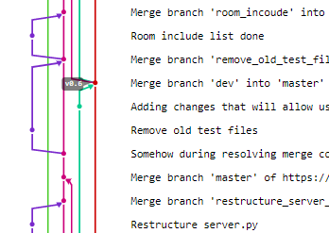
What do these options mean?
Merge commit
Squash and merge
Rebase and merge
Git creates a single commit with all changes for that release.
Note how there is no history record to the branches that created this merge.
Do this when you WISH you had done just one commit
Best for simple changes
Notes:
Figure From an anonymous SDL student team Spring 2020.
This anonymous team says they used a squash-and-merge approach. Git creates a single commit with all changes for that release.

Slide 15
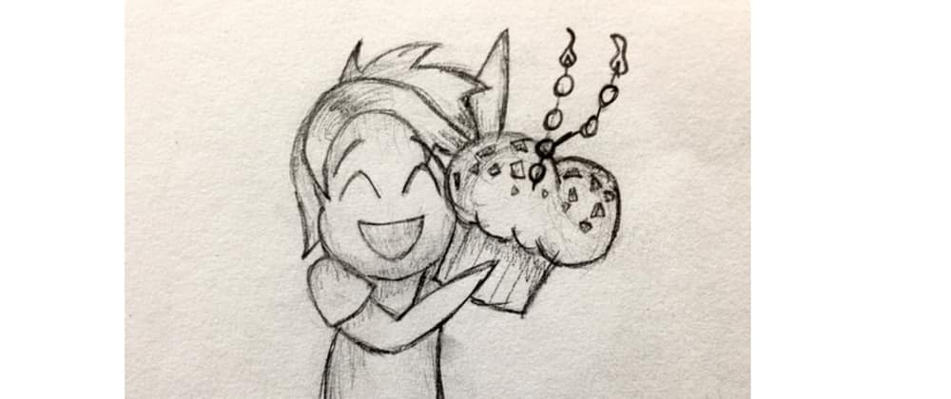
What do these options mean?
Merge commit
Squash and merge
Rebase and merge
This is the standard “pull request” that we have done all quarter.
The commit has two previous commits.
https://dev.to/
Notes:
https://dev.to/maxwell_dev/the-git-rebase-introduction-i-wish-id-had
This I believe IS the original source!

Slide 16
But we can’t actually move commits!
The reference to a commit is a hash of the commit
Changing anything in a commit changes its hash
31b5e4
cac0ca
fdf4fc
Notes:
I suspect this figure originates somewhere else, but don’t have time to trace down the real source right now.
https://www.freecodecamp.org/news/pushing-a-list-of-files-to-the-github-with-javascript-b724c8c09b66/

Slide 17
But we can’t actually move commits!
The reference to a commit is a hash of the commit
Changing anything in a commit changes its hash
And, of course, we are thinking of a commit as a diff again!
Edit one line
Edit same line, but starting from a different file!
File we actually edited
Updated version we wish we had edited
Notes:
I suspect this figure originates somewhere else, but don’t have time to trace down the real source right now.
https://www.freecodecamp.org/news/pushing-a-list-of-files-to-the-github-with-javascript-b724c8c09b66/

Slide 18
So how does rebasing work?
All commit are recreated
You specify what order you want to apply the commits (you can just use the original order if you want)
Each “diff” edit is applied in order
If can be applied automatically, great!
If manual merging is required, you need to go through the manual merging process
A new commit is created for each old commit in this way.

Slide 19
So when do we want to use these?
Pros
Cons
Merge commit
True history
Squash and merge
Simpler history
Useful when making a suggestion to someone else’s repo
Rebase and merge
Good for more complicated history
Merge commit
Real history sometimes unhelpful
Squash and merge
Obscures true history
Rebase and merge
Obscures true history
Can become a real mess

Slide 20
So when do we want to use these?
Pros
Cons
Merge commit
True history
Squash and merge
Simpler history
Useful when making a suggestion to someone else’s repo
Rebase and merge
Good for more complicated history
Merge commit
Real history sometimes unhelpful
Squash and merge
Obscures true history
Rebase and merge
Obscures true history
Can become a real mess

Slide 21
So when do we want to use these?
Pros
Cons
Merge commit
True history
Squash and merge
Simpler history
Useful when making a suggestion to someone else’s repo
Rebase and merge
Good for more complicated history
Merge commit
Real history sometimes unhelpful
Squash and merge
Obscures true history
Rebase and merge
Obscures true history
Can become a real mess

Slide 22
How to mark changes as complete?
Sometimes you fix something on one branch and you just want to FORCE MERGE it into another branch.
In Git, the way to do this is to actually merge the branch you want to completely replace into the branch that will replace it but keeping the files you want:
git checkout goodbranch
git merge -s ours branchtooverwrite
# Check history carefully with git log and git diff!!!
# Now merge goodbranch into branchtooverwrite with a standard pull request
This doesn't always work. In one situation where goodbranch is purely downstream from branchtooverwrite, it simply gives the message "Already up-to-date."

Slide 23
So when do we want to use these?
Pros
Cons
Merge commit
True history
merge -s ours
Shows intended history
Gives complete control over contents of commit
Is simple and intuitive
Can be combined with, e.g. squash-and-merge (I believe)
Merge commit
Real history sometimes unhelpful
merge -s ours
May complain if one commit is directly upstream of another

Slide 25
Parting note
When rebasing or squashing from the command line, the original branch is deleted
When rebasing or squashing/merging from github, the original branch appears to be preserved (try at your own risk)
If a rebase goes horribly wrong in the middle, it might be hard to recover.

Slide 26
Appendix: git diff with two parents
Before manual merge
After manual merge
++<<<<<<< HEAD
+ String name = f(in);
++=======
+ String x = requestName(in);
++>>>>>>> bb552c29ab5d0ab2bbc224601dadcf2f0967dbb4
- System.out.println("Your name is "+x);
+ System.out.println("Your name is "+name);
}
- private static String f(Scanner in){
+ private static String requestName(Scanner in){
System.out.println("Please enter your name");
return in.nextLine();
}
public static void main(String[] ignored) {
Scanner in = new Scanner(System.in);
- String name = f(in);
- String x = requestName(in);
++ String name = requestName(in);
- System.out.println("Your name is "+x);
+ System.out.println("Your name is "+name);
}
- private static String f(Scanner in){
+ private static String requestName(Scanner in){
System.out.println("Please enter your name");
return in.nextLine();
}
Notes:
This is my own work

Slide 27
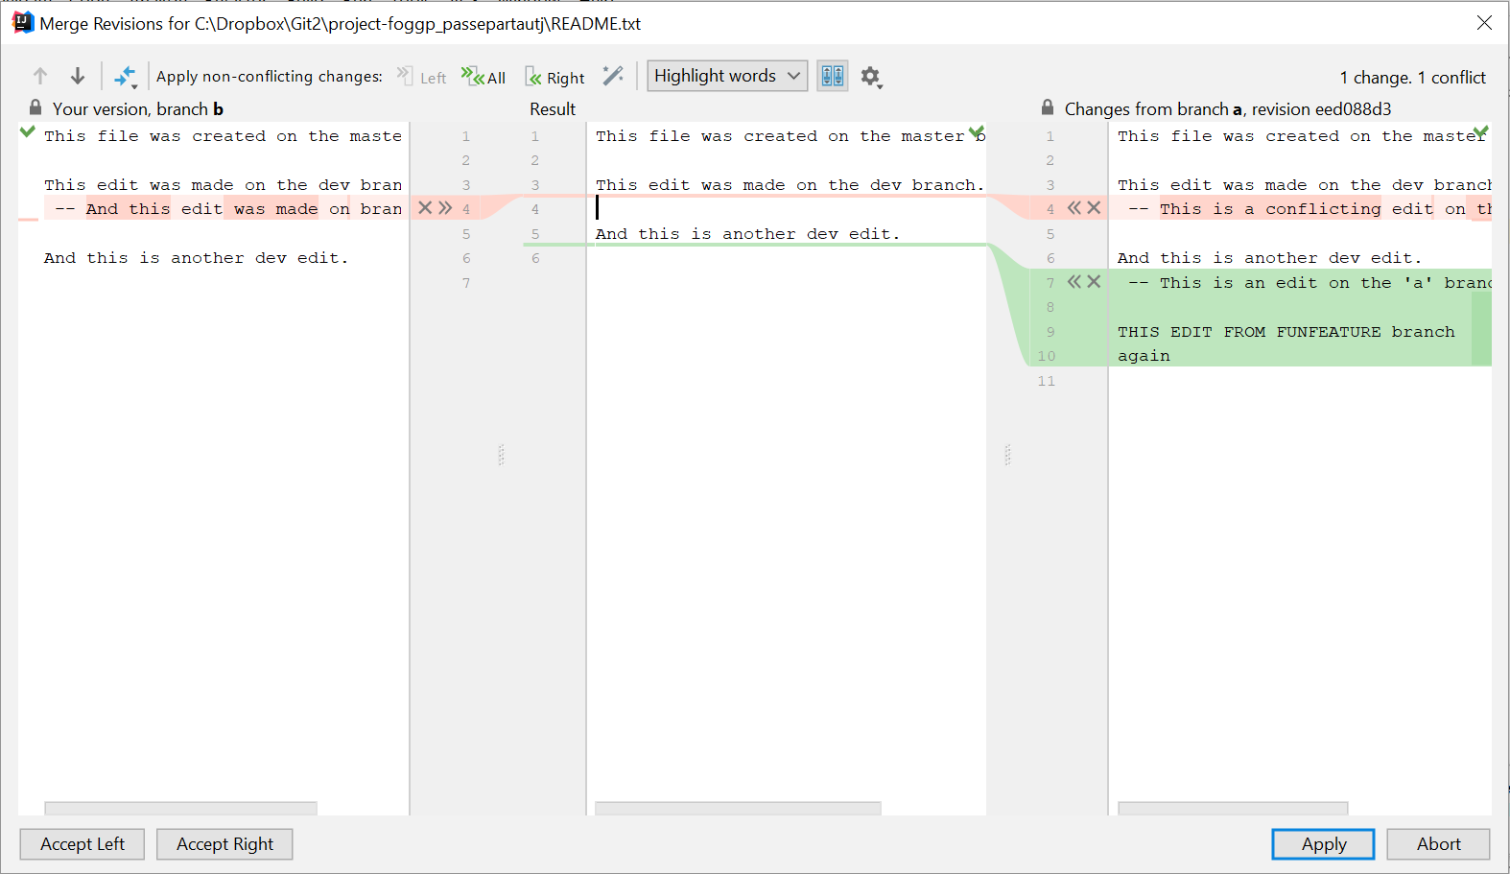
Note that git ALSO stores the parent
Assume the following history exists and the current branch is "master":
A---B---C topic
/
D---E---F---G master
Then "git merge topic“ will remember E, C, and G.
You can use git mergetool or IntelliJ to see all three versions while working on the merge conflict.
Notes:
Text modified from https://git-scm.com/docs/git-merge
Image is my own work.

Slide 28
Using IntelliJ’s built-in merge tool
Identify the file that has merge conflicts in IntelliJ. It should show up in red.
Right-click just about anywhere and select “Git->Resolve Conflicts…```.
This opens the Files Merged with Conflicts window. Double-click on the file whose conflicts you wish to resolve. You will see a window that looks like this:
Make your edits and apply!
Notes:
This is my own work.

Slide 29
A successful rebase
yoder@MSOE-5CG8190273 MINGW64 /c/Dropbox/Git2/2020-final-exam-question-1 (master)
$ git status
On branch master
Your branch and 'origin/master' have diverged,
and have 1 and 1 different commits each, respectively.
(use "git pull" to merge the remote branch into yours)
nothing to commit, working tree clean
yoder@MSOE-5CG8190273 MINGW64 /c/Dropbox/Git2/2020-final-exam-question-1 (master)
$ git rebase origin/master
First, rewinding head to replay your work on top of it...
Applying: Rename x to name
Using index info to reconstruct a base tree...
M source.java
Falling back to patching base and 3-way merge...
Auto-merging source.java
CONFLICT (content): Merge conflict in source.java
error: Failed to merge in the changes.
Patch failed at 0001 Rename x to name
Use 'git am --show-current-patch' to see the failed patch
Resolve all conflicts manually, mark them as resolved with
"git add/rm <conflicted_files>", then run "git rebase --continue".
You can instead skip this commit: run "git rebase --skip".
To abort and get back to the state before "git rebase", run "git rebase --abort".
yoder@MSOE-5CG8190273 MINGW64 /c/Dropbox/Git2/2020-final-exam-question-1 (master|REBASE 1/1)
$ git status
rebase in progress; onto bb552c2
You are currently rebasing branch 'master' on 'bb552c2'.
(fix conflicts and then run "git rebase --continue")
(use "git rebase --skip" to skip this patch)
(use "git rebase --abort" to check out the original branch)
Unmerged paths:
(use "git reset HEAD <file>..." to unstage)
(use "git add <file>..." to mark resolution)
both modified: source.java
no changes added to commit (use "git add" and/or "git commit -a")
yoder@MSOE-5CG8190273 MINGW64 /c/Dropbox/Git2/2020-final-exam-question-1 (master|REBASE 1/1)
$ vim source.java &
[1] 22288
yoder@MSOE-5CG8190273 MINGW64 /c/Dropbox/Git2/2020-final-exam-question-1 (master|REBASE 1/1)
$ git status
rebase in progress; onto bb552c2
You are currently rebasing branch 'master' on 'bb552c2'.
(fix conflicts and then run "git rebase --continue")
(use "git rebase --skip" to skip this patch)
(use "git rebase --abort" to check out the original branch)
Unmerged paths:
(use "git reset HEAD <file>..." to unstage)
(use "git add <file>..." to mark resolution)
both modified: source.java
no changes added to commit (use "git add" and/or "git commit -a")
[1]+ Done gvim source.java
yoder@MSOE-5CG8190273 MINGW64 /c/Dropbox/Git2/2020-final-exam-question-1 (master|REBASE 1/1)
$ git diff
diff --cc source.java
index 8271378,e6b8f95..0000000
--- a/source.java
+++ b/source.java
@@@ -1,11 -1,11 +1,11 @@@
public static void main(String[] ignored) {
Scanner in = new Scanner(System.in);
- String x = requestName(in);
- String name = f(in);
++ String name = requestName(in);
- System.out.println("Your name is "+x);
+ System.out.println("Your name is "+name);
}
-private static String f(Scanner in){
+private static String requestName(Scanner in){
System.out.println("Please enter your name");
return in.nextLine();
}
yoder@MSOE-5CG8190273 MINGW64 /c/Dropbox/Git2/2020-final-exam-question-1 (master|REBASE 1/1)
$ git add .
yoder@MSOE-5CG8190273 MINGW64 /c/Dropbox/Git2/2020-final-exam-question-1 (master|REBASE 1/1)
$ git status
rebase in progress; onto bb552c2
You are currently rebasing branch 'master' on 'bb552c2'.
(all conflicts fixed: run "git rebase --continue")
Changes to be committed:
(use "git reset HEAD <file>..." to unstage)
modified: source.java
yoder@MSOE-5CG8190273 MINGW64 /c/Dropbox/Git2/2020-final-exam-question-1 (master|REBASE 1/1)
$ git rebase --continue
Applying: Rename x to name
yoder@MSOE-5CG8190273 MINGW64 /c/Dropbox/Git2/2020-final-exam-question-1 (master)
$ git status
On branch master
Your branch is ahead of 'origin/master' by 1 commit.
(use "git push" to publish your local commits)
nothing to commit, working tree clean
yoder@MSOE-5CG8190273 MINGW64 /c/Dropbox/Git2/2020-final-exam-question-1 (master)
$ git log --all --graph --oneline
* f3791db (HEAD -> master) Rename x to name
* bb552c2 (origin/master, origin/HEAD) Rename f to requestName
* 1cbc081 Add blank line
* f597865 Revert "Renamed requestName"
* b96e1c2 Renamed requestName
* 46e94ba Source with poor naming
* cc8ce53 initial commit

